Slide 1
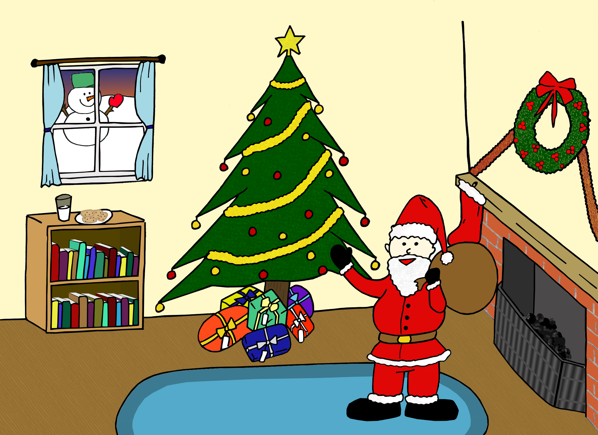
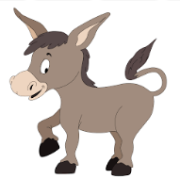
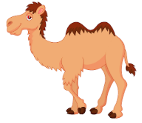
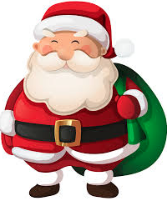

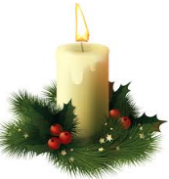

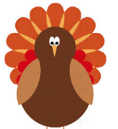
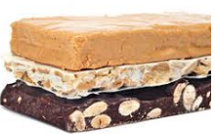


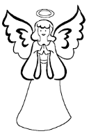
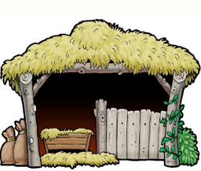
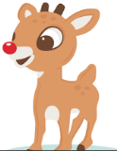
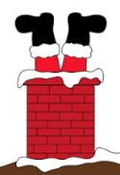
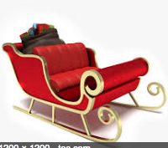
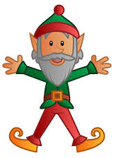
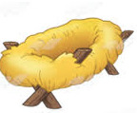




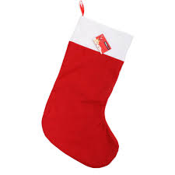
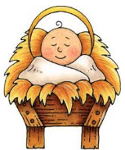
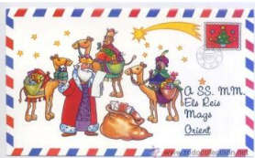

Write your prize here
Write your prize here
Write your prize here
Write your prize here
Write your prize here
Write your prize here
7
6
16
20
4
3
el burro
el camello
Papá Noel
el muñeco de nieve
la vela
la posada
Write your prize here
Write your prize here
Write your prize here
Write your prize here
Write your prize here
Write your prize here
19
11
1
22
23
18
el turrón
el establo
el pavo
las decoraciones
el regalo
el ángel
Write your prize here
Write your prize here
Write your prize here
Write your prize here
Write your prize here
Write your prize here
9
15
17
24
12
2
el reno
la chimenea
el trineo
el elfo
el pesebre
Write your prize here
Write your prize here
Write your prize here
Write your prize here
Write your prize here
d
14
21
13
10
5
8
la carta
el árbol de Navidad
la bola
la estrella
el calcetín
el bebé
tekhnologic

