Slide 1


The four stages of progress resource
Click here to start

Slide 2
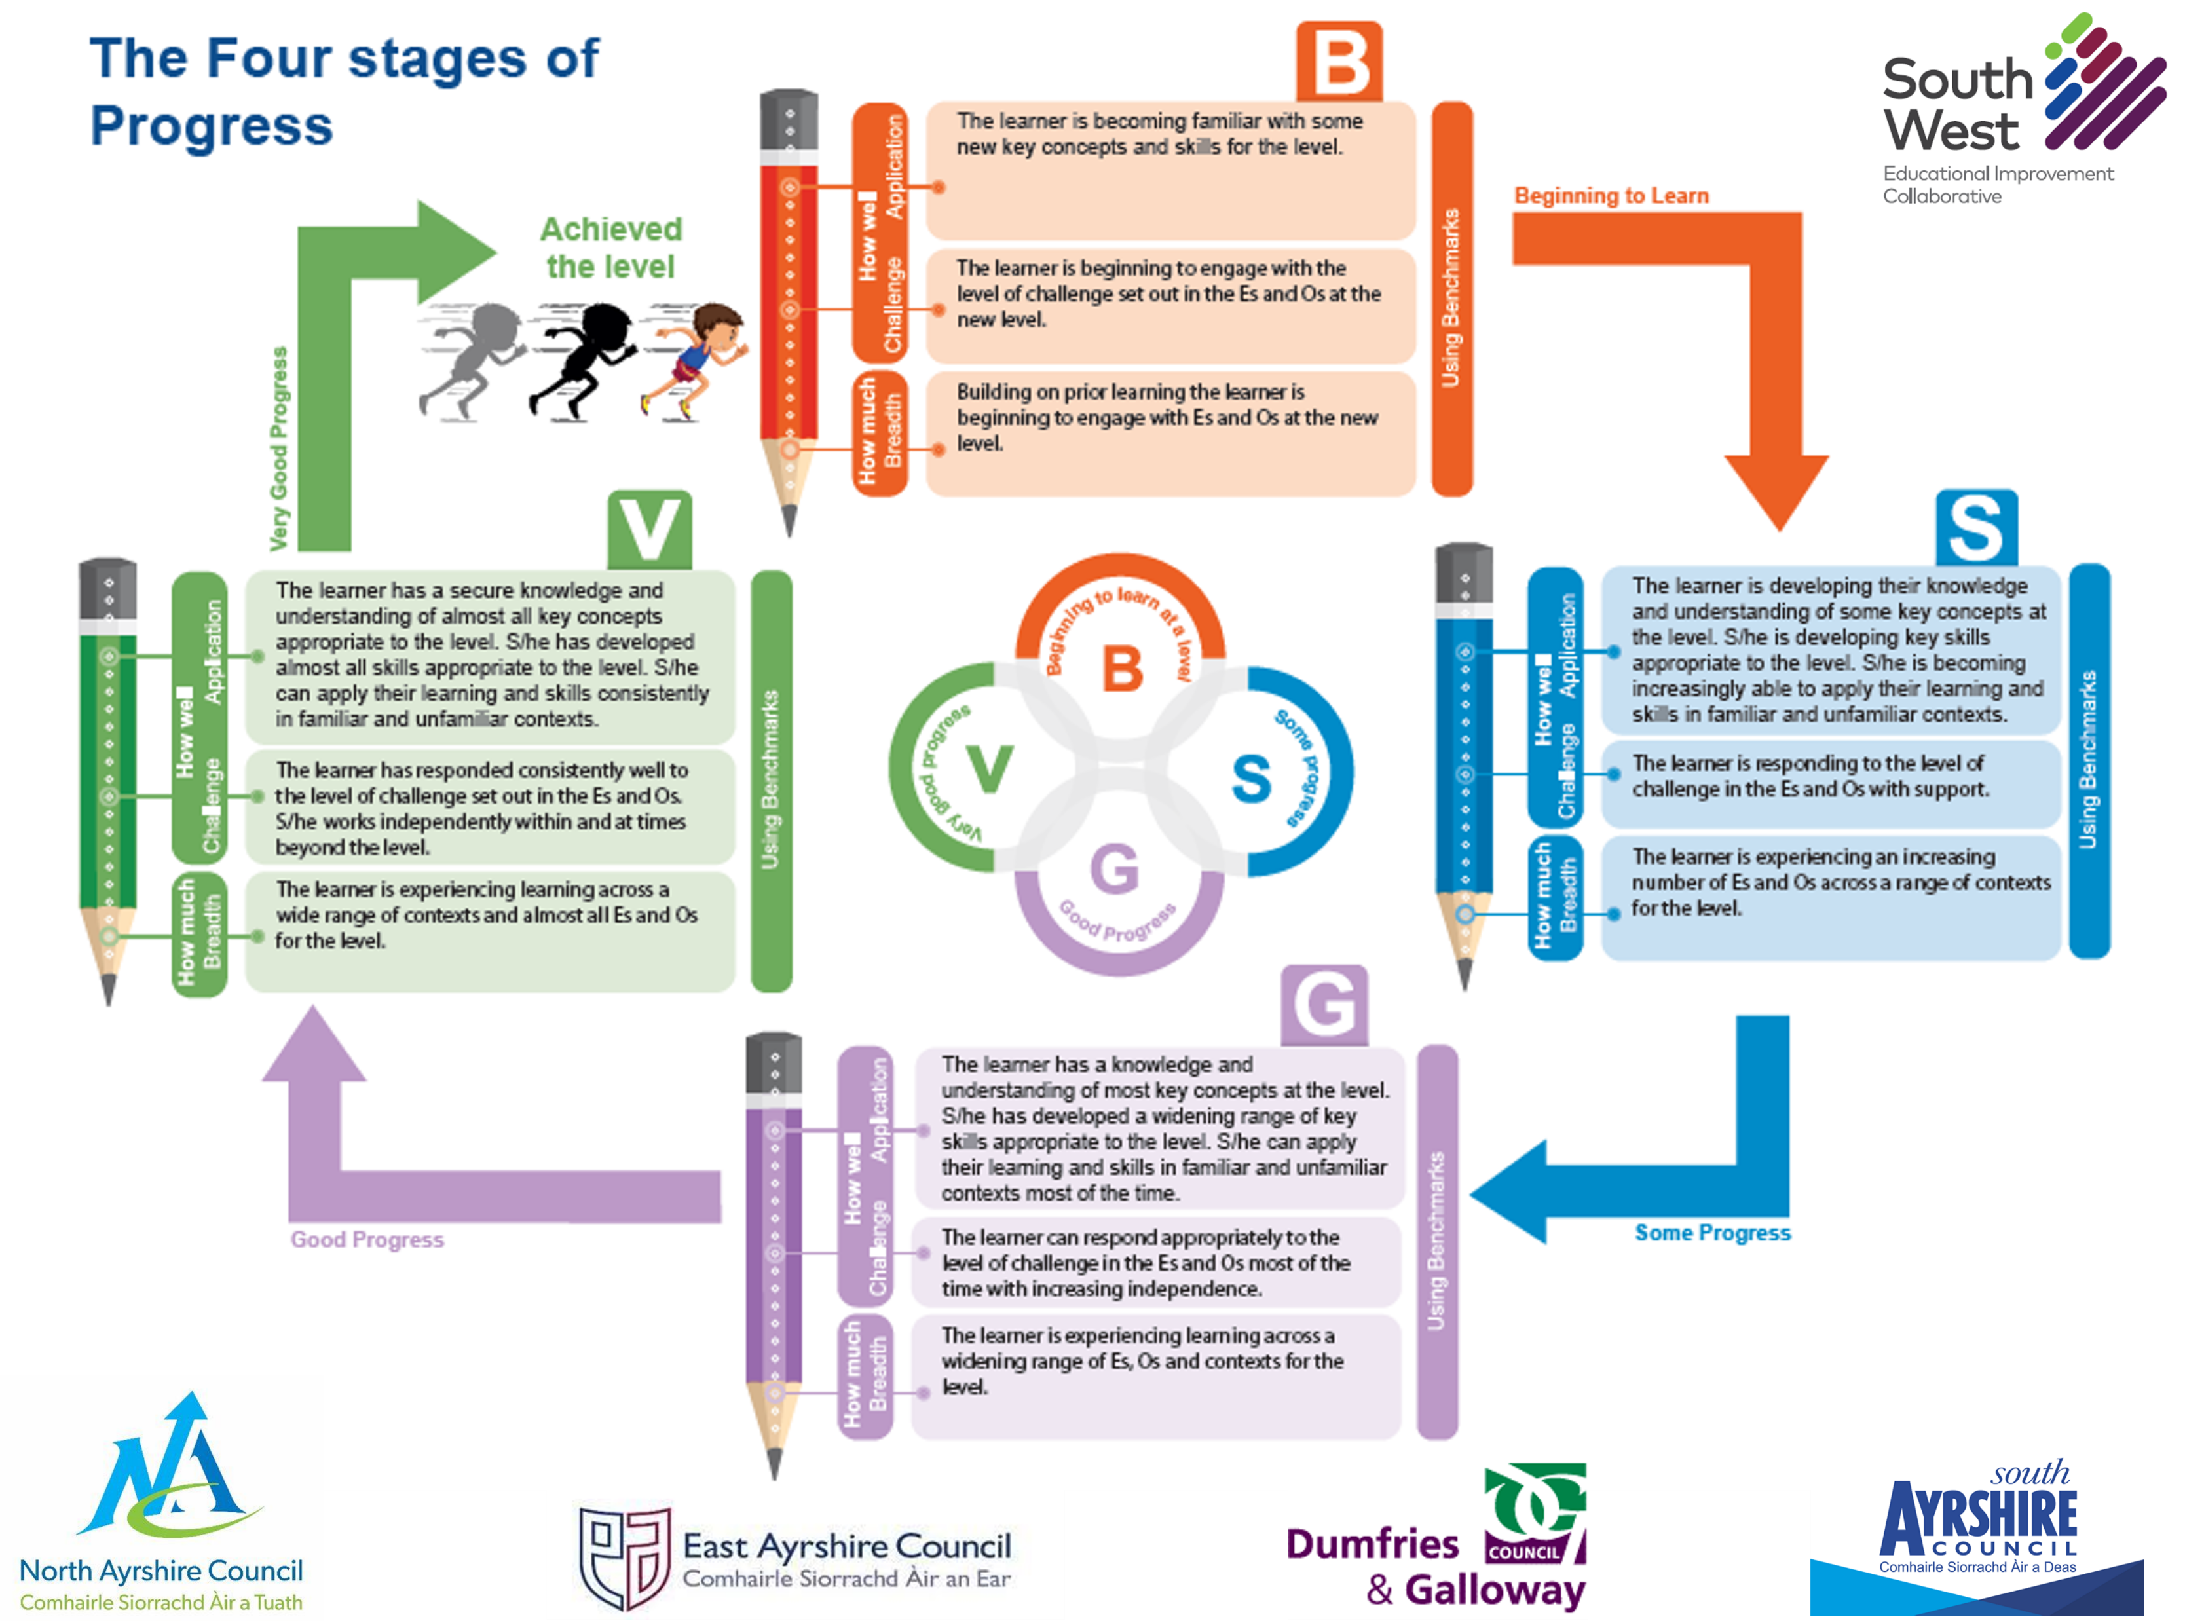






The four stages of progress
How to navigate this resource:
Navigate to previous page
Navigate to next page
Return to the menu
Watch video
Visit website
Page contains audio narration
Document
Page does not contain audio narration

Slide 3
The four stages of progress
Menu:
Aims of the resource
Stages: beginning to learn
Click on a title to navigate directly to that area of the resource or next to start
The story so far
Stages: some progress
Breadth
Stages: good progress
Challenge
Stages: very good progress
Application
Moderation Hub
The Stages

Slide 4

The four stages of progress
The aims of this resource are:
To support practitioners as they consider approaches to assessment in the BGE as part of their learning and teaching.
To recap on a learner’s journey through the levels and what this looks like.
To enhance practitioners confidence in making robust and accurate professional judgements.
To develop a shared understanding of the 4 stages of progress to ensure consistency across stages, departments, schools, clusters and authorities.
To create a resource that practitioners can add to with appropriate examples of their own learner's work

Slide 5
The four stages of progress
The story so far…
Prior to 2016, the terms Developing, Consolidating and Secure were used to assess a learner’s journey through a level.
Guidance was delivered to move from the use of this language leading to the creation of a bespoke framework which was adopted across the SWEIC to track, monitor and assess progress through a level.

Slide 6


The four stages of progress
The four stages of progress model aligns with Building the Curriculum 5 and the Benchmarks.
It makes clear the importance of taking into account how much (Breadth) and how well (Challenge and Application) a child or young person has learned when making assessment judgements​.
These will be explored in more detail as we move on.
Benchmarks
Building the Curriculum 5

Slide 7
The four stages of progress
Assessment is integral to learning and teaching and is an ongoing process based on the professional judgement of teachers informed by evidence. We need to consider:
When we assess
As part of ongoing learning and teaching
From time to time
At transitions
How we assess
Using a variety of approaches and range of evidence
Ensuring assessment is valid, reliable and proportionate

Slide 8
The four stages of progress
The benchmarks are designed to support the progress towards and achievement of a level. These along with the E’s and O’s (experiences and outcomes) are key resources which should be used to plan learning, teaching and assessment.
Approaches to assessment should help learners to show their progress through the levels and enable them to demonstrate their achievements in a range of ways which are appropriate for learning. For learners to demonstrate they have achieved a level they will have the opportunity to demonstrate confidence, proficiency and security across three key aspects of learning; Breadth, Challenge and Application.
Early Level
First Level
Second Level
Es & Os

Slide 9
The four stages of progress
Breadth
What do we mean by:
Breadth,
Challenge and Application?
Challenge
Application

Slide 10
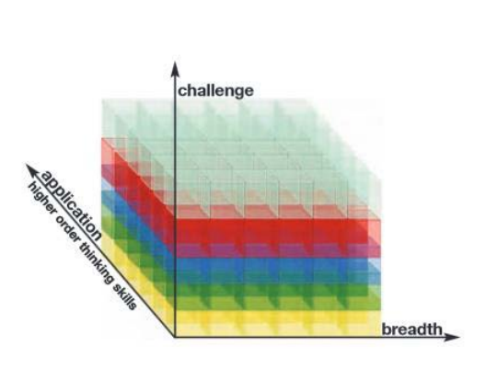
Breadth
Breadth refers to the number and range of experiences and outcomes encountered by learners. Learners need to be fully involved in planning how breadth, suitable to their needs, will be increased, and how they will show what they have learned. ​
Examples of where an increase in breadth can show that a learner is progressing include:​
a growing confidence and competence in skills for learning, life and work in familiar and routine contexts; ​
a broadening range of texts, performances or presentations; ​
an improving range and competence in skills and concepts; ​
a broadening use of more advanced language, formulae and equations; and ​
a broadening amount of detail in the descriptions and explanations they give.​
Notes:
Click on Breadth on slide 8 to take to this
Narration – Breadth of learning is about the coverage across a range of Experiences and Outcomes but also about the links between these

Slide 11
Challenge
Challenge refers to the attributes, capabilities and skills (including higher order thinking skills) which are embedded in learning. For example, many of the experiences and outcomes include skills such as analysing, evaluating and creating.​
Examples of where an increase in challenge can show that a learner is progressing include: ​
learning in more complex contexts; ​
using and/or presenting increasingly complex texts in terms of length, structure, ​vocabulary, ideas, and/or concepts; ​
responding to and producing increasingly complex pieces of work, information and concepts; ​
responding accurately and confidently to more complex contexts; ​
individuals becoming more adept at evaluating their own and other’s learning; and ​
demonstrating increasing responsibility and independence in learning.​
Notes:
Click on Challenge on slide 8 to take to this​
Narration – Challenge is about the differentiation of activities and expectations. It will reflect both the sophistication or demand of the task set. Here the learning or higher order thinking skills will be a key discriminator.

Slide 12
Application
Overlapping with both breadth and challenge, application refers to how knowledge and understanding, attributes, capabilities and skills (including higher order thinking skills) are used in new and unfamiliar contexts so that they become secure and transferable. Learners should be flexible and adaptable in the way they apply their learning.​
Examples of progress in application of learning include:​
using skills and knowledge in different situations; ​
using skills and knowledge in creative and innovative ways; ​
finding, selecting, sorting and linking information from a variety of sources; ​
using information for different purposes; ​
creating texts to persuade, argue, recording and presenting thinking in different ways; and
presenting, analysing and interpreting evidence to draw conclusions.
Notes:
Click on Challenge on slide 8 to take to this
Narration: Application is about the gradual progression from working and applying acquired knowledge and skills in ‘familiar’ contexts and for tasks with clear parameters to the ‘novel’ where the most appropriate range of knowledge and skills will need to be identified.

Slide 13
The four stages of progress
Notes:
Teachers can use these three aspects using a range of evidence, to decide when a learner has met agreed expectations and achieved a level, either in a part of a curriculum area such as reading, or in a whole curriculum area. The following diagram illustrates a three-dimensional view of assessment:

Slide 14


The four stages of progress
Demonstrating breadth, challenge and application within a level is NOT simply about “getting it right”.
Click on the video icon to watch a short clip.
Video 1
Notes:
Link to CLIP 1 Euan and Cameron 36 add 48 - YouTube

Slide 15
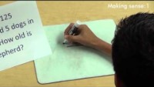
The four stages of progress
The video will play automatically after the narration, this may take a few seconds depending on your internet connection.

Slide 16
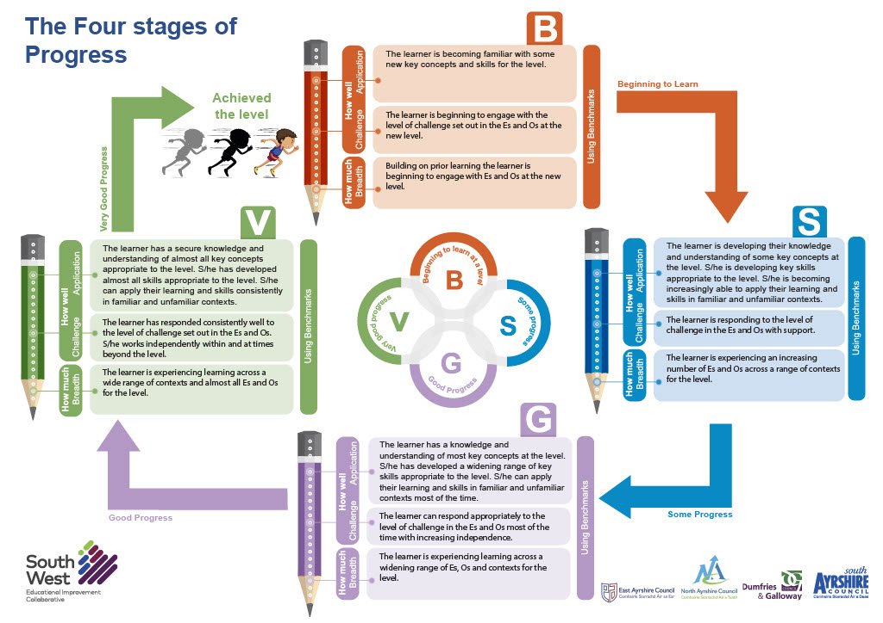
The four stages of progress
Let’s now look at the four stages in more detail.
Click on a stage to view in more detail

Slide 17

B
The learner is becoming familiar with some new key concepts and skills for the level.
Using Benchmarks
How well
Challenge Application
Beginning to Learn
The learner is beginning to engage with the level of challenge set out in the Es and Os at the new level.
Building on prior learning the learner is beginning to engage with Es and Os at the new level.
How much Breadth
Notes:
Link to highlighted E’s & O’s (Have put example on Slide 13)
Link to piece of work
Work annotated

Slide 18
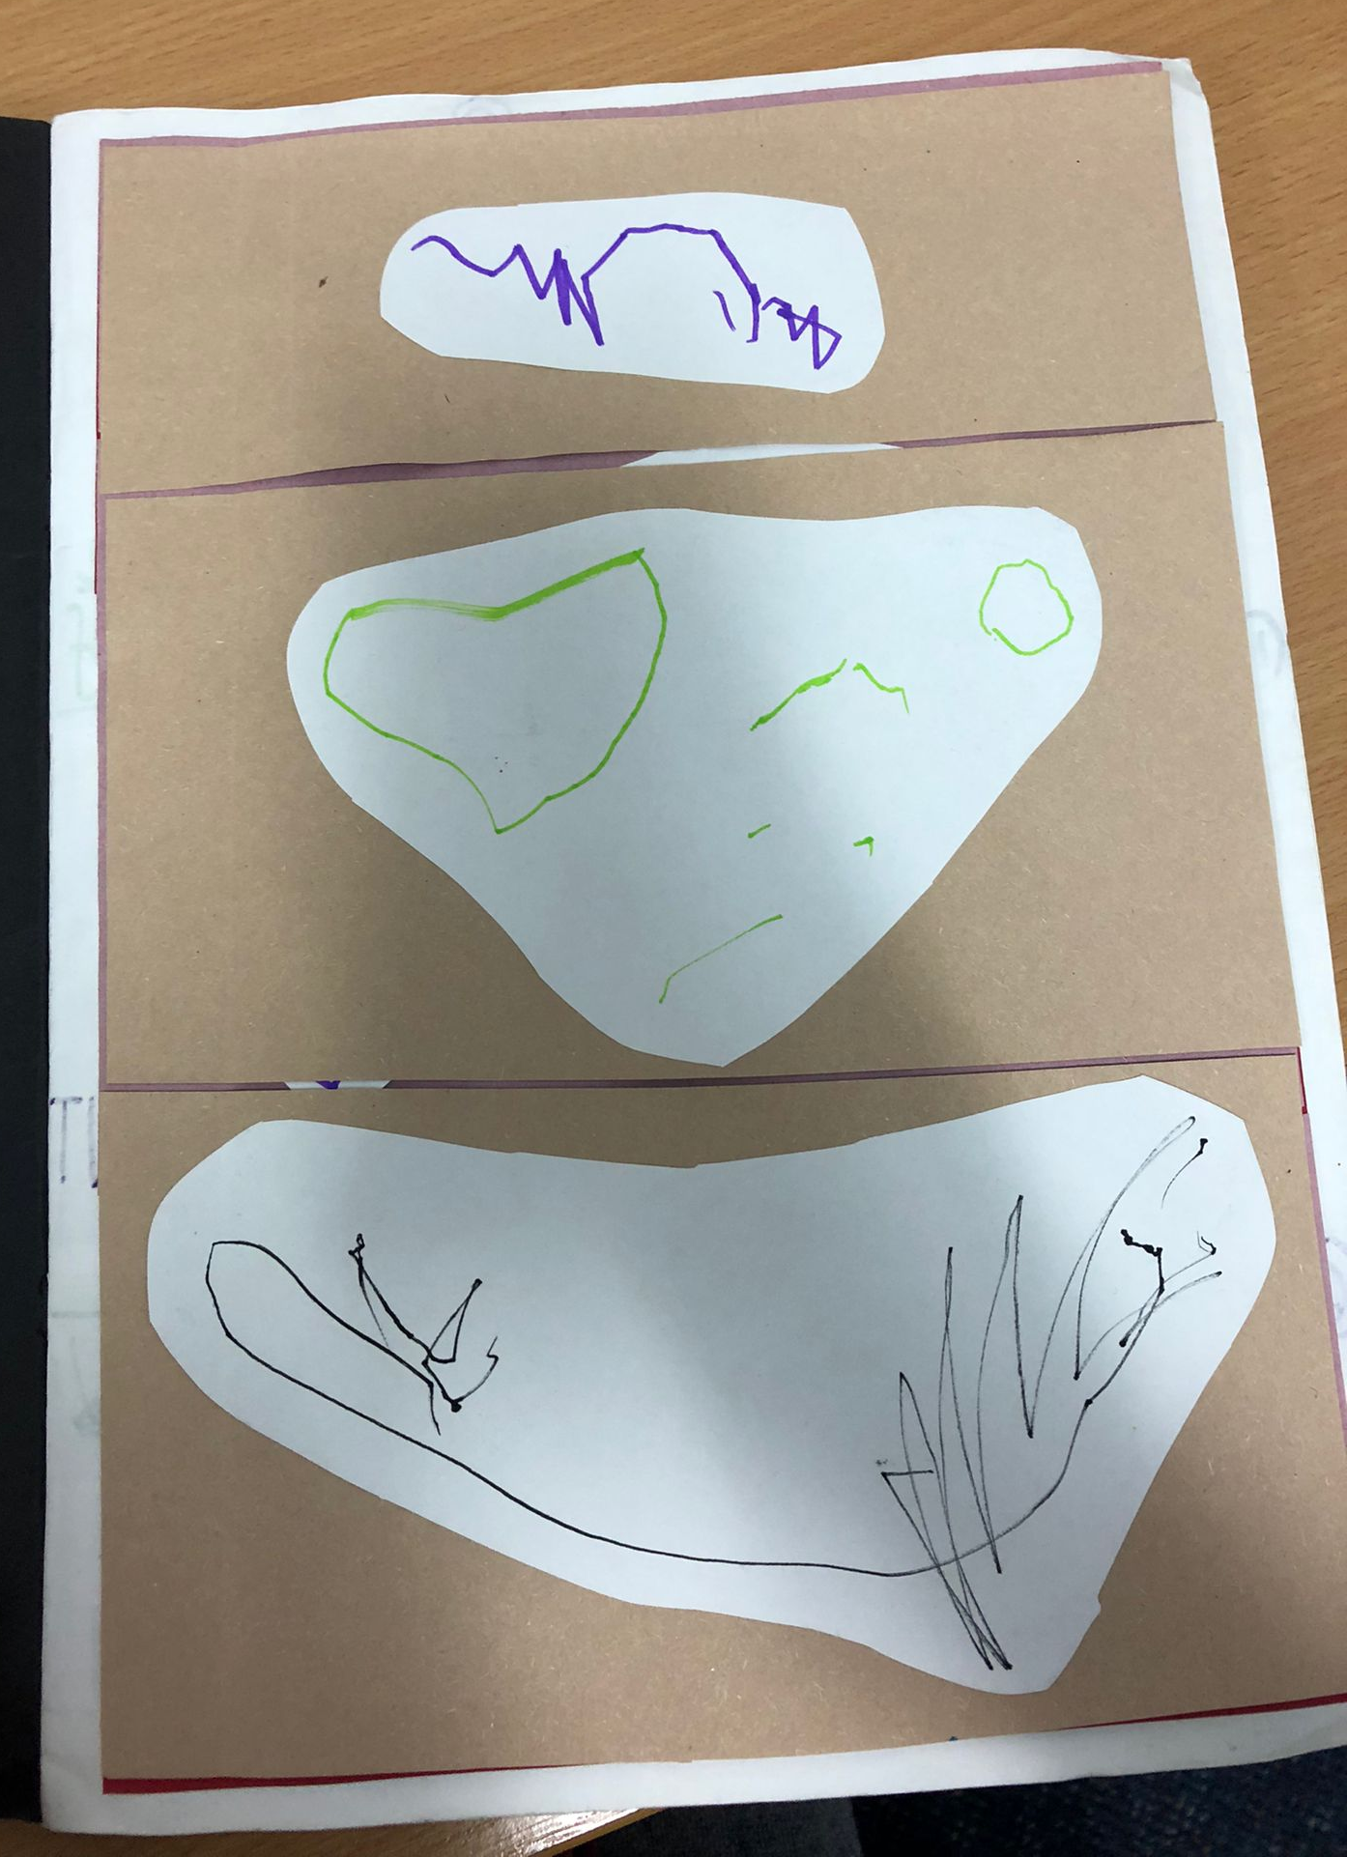
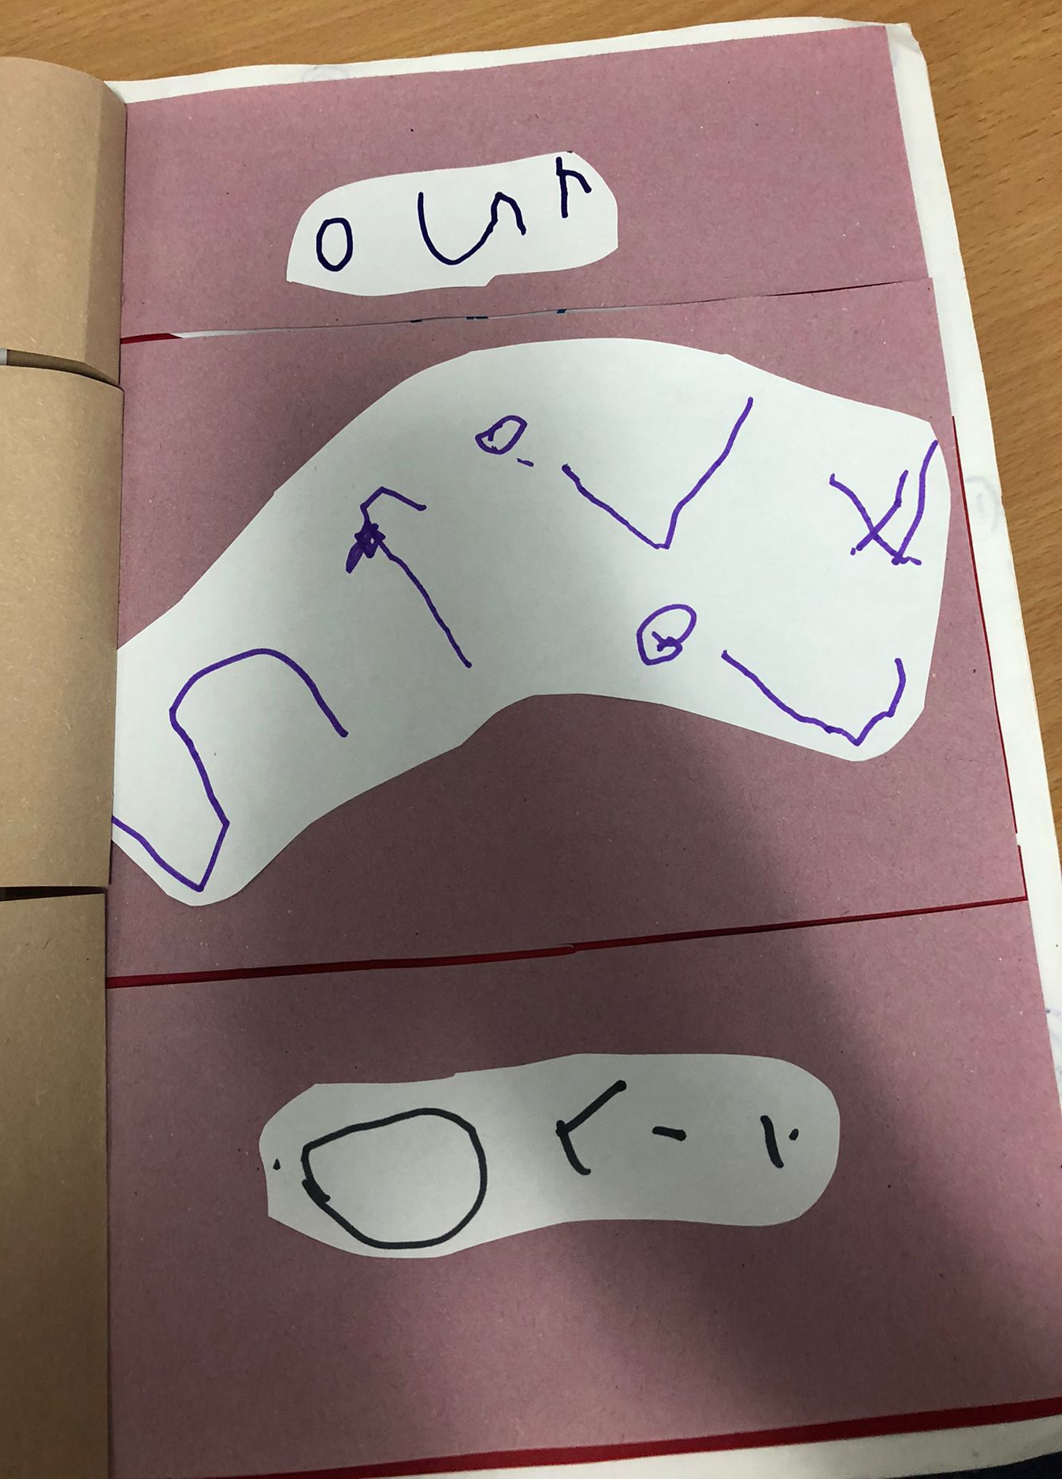
Benchmarks:
Invents own stories and characters to share with others in play, imaginative and real contexts.
Shares feelings, experiences, information, messages or ideas in pictures, print or digital texts.
Experiences and Outcomes:
I enjoy exploring events and characters in stories and other texts and I use what learn to invent my own, sharing these with others in imaginative ways. LIT 0-09b / LIT 0-31a

Slide 19
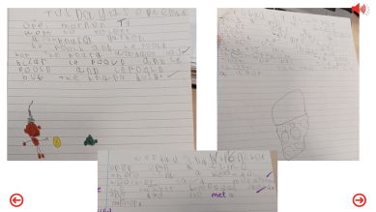

Benchmarks:
Uses knowledge of phonics and spelling strategies when spelling familiar and unfamiliar words.
Writes independently, punctuating most sentences accurately using a capital letter and full stop.
(Is starting to) link sentences using and or but.
Presents writing in a clear and legible using words and images as appropriate.
Creates own text, for example, stories with recognisable features of genre.
Creates interesting characters through their feelings, actions and physical descriptions.
Experiences and Outcomes:
I can spell the most commonly used words using my knowledge of letter patterns and spelling rules and use resources to help me spell tricky or unfamiliar words. LIT 1-21a
I can write independently, use appropriate punctuation and order and link my sentences in a way that makes sense. LIT 1-22a
I can present my writing in a way that will make it legible and attractive for my reader combining words images and other features. LIT1-24a
Having explored the elements which writers use in different genres I can use what I learn to create my own stories with interesting structures characters and or settings. ENG 1-31a
Click on the image to view the example.

Slide 20
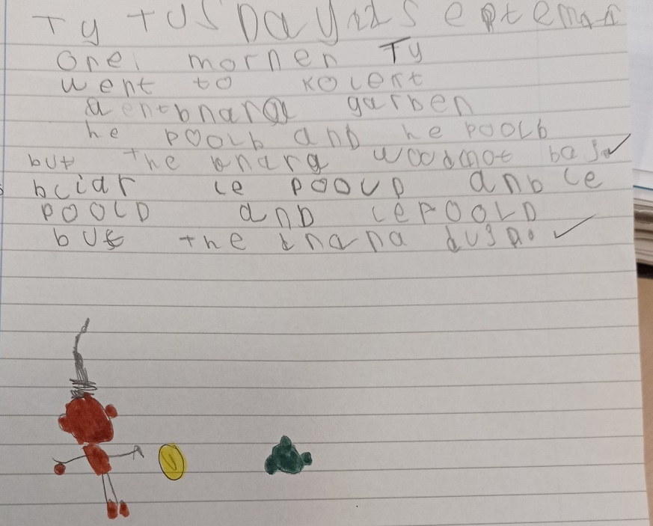
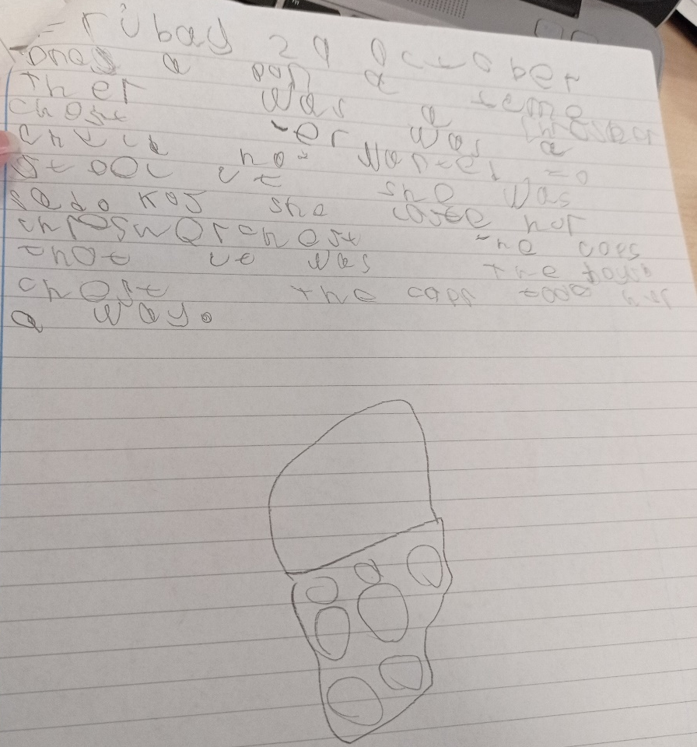
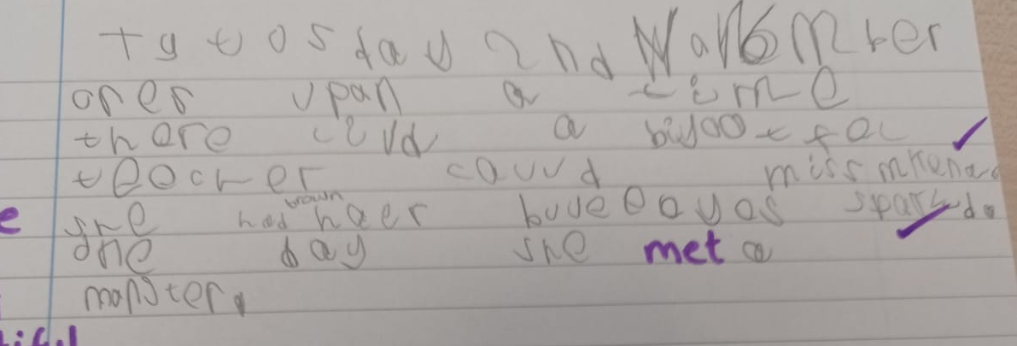
Notes:
Primary 4 pupil, working at ‘’beginning to learn’’ second level.

Slide 21
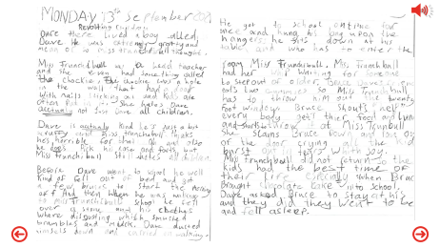

Benchmarks:
Uses paragraphs to separate thoughts and ideas.
Writes in a fluent and legible way.
Creates plots with clear structures, for example, suitable opening, turning point, climax and/or satisfactory ending.
Creates setting/context with some descriptive detail.
Creates interesting characters through, for example, their feelings and actions, physical description and/or dialogue.
Click on the image to view the example.
Experiences and Outcomes:
I can spell most of the words I need to communicate, using spelling rules, specialist vocabulary, self-correction techniques and a range of resources. LIT 2-21a
Throughout the writing process, I can check that my writing makes sense and meets its purpose. LIT 2-23a
I can divide my work into paragraphs in a way that makes sense to my reader. LIT 2-22a
I can spell most of the words I need to communicate, using spelling rules, specialist vocabulary, self-correction techniques and a range of resources. LIT 2-21a
Notes:
Primary 5 pupil, working at ‘’beginning to learn’’ second level.

Slide 22
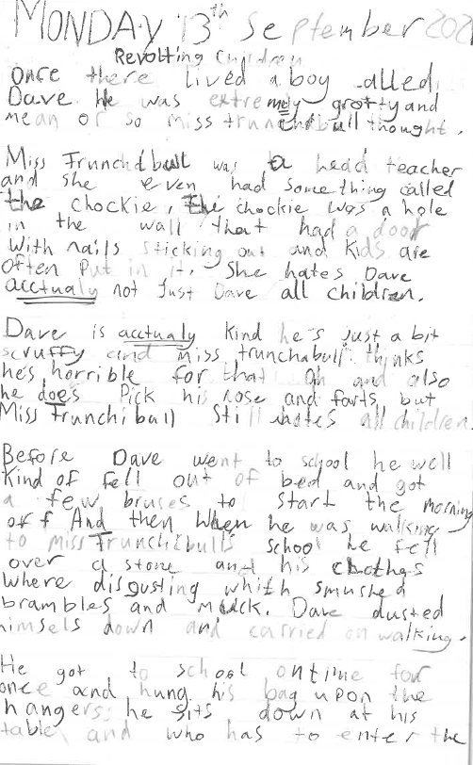
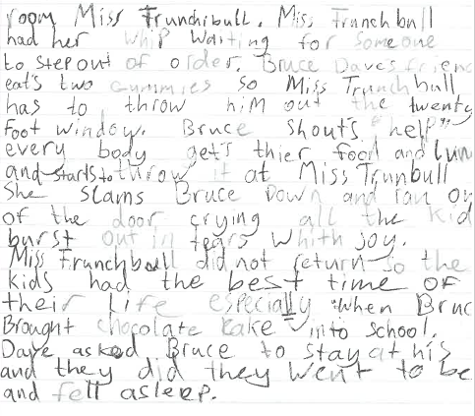
Notes:
Primary 5 pupil, working at ‘’beginning to learn’’ second level.

Slide 23
Click on a stage to view in more detail

Slide 24

S
The learner is developing their knowledge and understanding of some key concepts at the level. S/he is developing key skills appropriate to the level. S/he is becoming increasingly able to apply their learning and skills in familiar and unfamiliar contexts.
Using Benchmarks
How well
Challenge Application
The learner is responding to the level of challenge in the Es and Os with support.
The learner is experiencing an increasing number of Es and Os across a range of contexts for the level.
How much Breadth
Some Progress
Notes:
Link to highlighted E’s & O’s
Link to piece of work
Work annotated

Slide 25
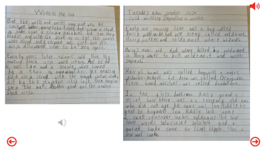

Benchmarks:
Spells most commonly used words correctly.
Uses knowledge of phonics and spelling strategies when spelling familiar and unfamiliar words.
Writes independently, punctuating most sentences accurately for example using a capital letter, full stop, question mark or exclamation mark.
Links sentences using common conjunctions for example; and, because, but, or so.
Starts sentences in a variety of ways to engage the reader.
Presents writing in a clear and legible way.
Creates own texts, for example, stories with recognisable features of genre.
Creates texts with evidence of structure
Experiences and Outcomes:
I can spell the most commonly used words using my knowledge of letter patterns and spelling rules and use resources to help me spell tricky or unfamiliar words. LIT 1-21a
I can write independently, use appropriate punctuation and order and link my sentences in a way that makes sense. LIT 1-22a
I can present my writing in a way that will make it legible and attractive for my reader combining words images and other features. LIT 1-24a
Having explored the elements which writers use in different genres I can use what I learn to create my own stories with interesting structures characters and or settings. ENG 1-31a
Click on the image to view the example.
Notes:
FIRST level SOME progress

Slide 26
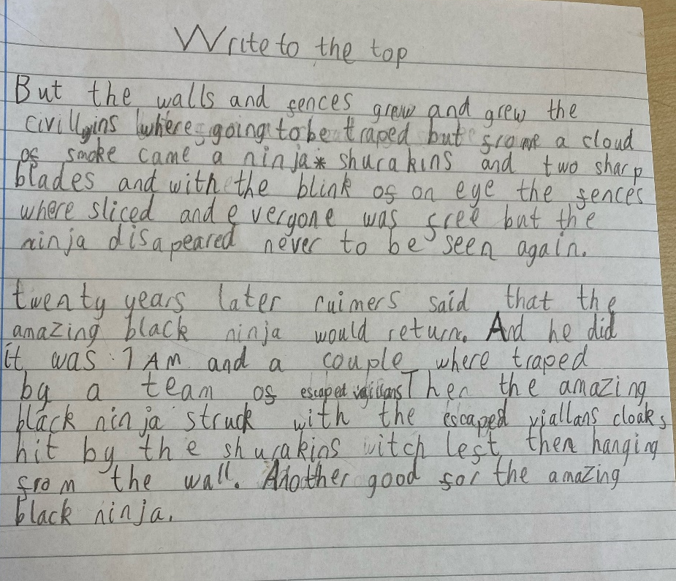
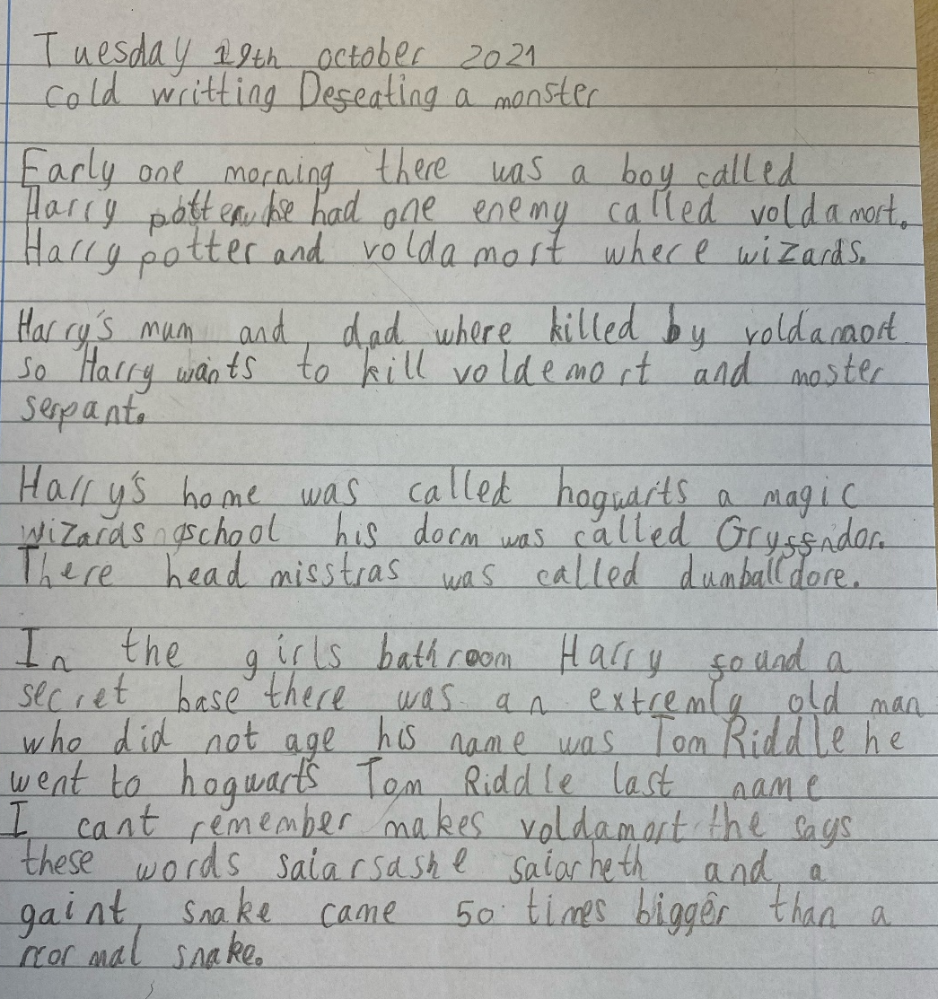

Slide 27
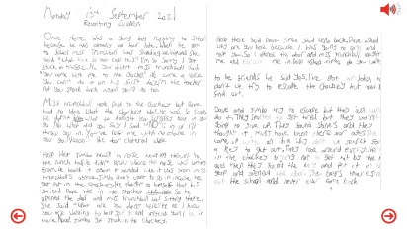
Benchmarks:
Uses paragraphs to separate thoughts and ideas.
Writes in a fluent and legible way.
Writes most sentences in a grammatically accurate way.
Creates plots with clear structures, for example, suitable opening, turning point, climax and/or satisfactory ending.
Click on the image to view the example.
Experiences and Outcomes:
I can spell most of the words I need to communicate, using spelling rules, specialist vocabulary, self-correction techniques and a range of resources. LIT 2-21a
Throughout the writing process, I can check that my writing makes sense and meets its purpose. LIT 2-23a
I can divide my work into paragraphs in a way that makes sense to my reader. LIT 2-22a
Next steps:
In both short and extended texts, I can use appropriate punctuation and vary my sentence structures.
LIT 2-22a
Notes:
Primary 6 pupil, working at second level, just moved to making ‘’some progress’’

Slide 28
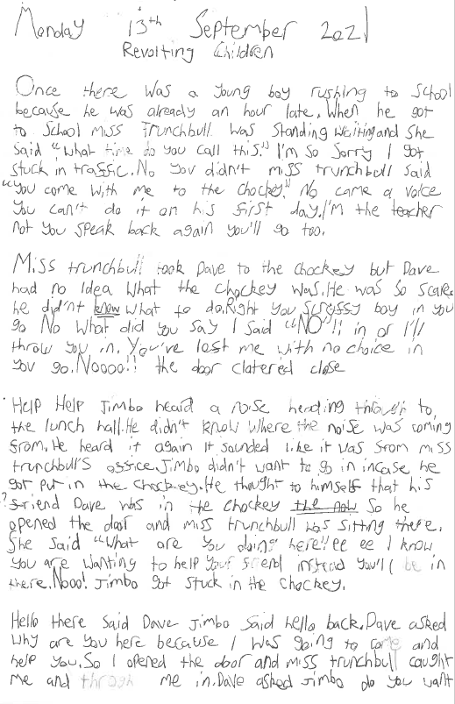
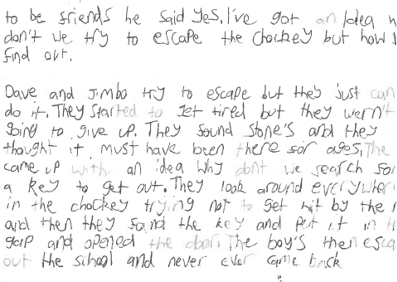
Notes:
Primary 6 pupil, working at second level, just moved to making ‘’some progress’’

Slide 29
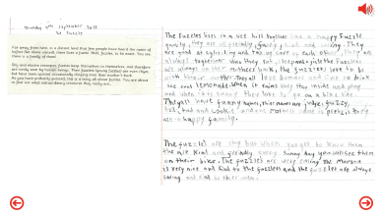

Benchmarks:
Uses paragraphs to separate thoughts and ideas.
Writes in a fluent and legible way.
Creates interesting characters through, for example, their feelings and actions, physical description and/or dialogue.
Click on the image to view the example.
Experiences and Outcomes:
I can spell most of the words I need to communicate, using spelling rules, specialist vocabulary, self-correction techniques and a range of resources. LIT 2-21a
Throughout the writing process, I can check that my writing makes sense and meets its purpose. LIT 2-23a
I can divide my work into paragraphs in a way that makes sense to my reader. LIT 2-22a
I can spell most of the words I need to communicate, using spelling rules, specialist vocabulary, self-correction techniques and a range of resources. LIT 2-21a
Next steps:
Experiences & Outcomes – In both short and extended texts, I can use appropriate punctuation and vary my sentence structures. LIT 2-22a
Benchmarks – Uses sentences of different lengths and types and varies sentence openings. Links sentences using a range of conjunctions. Creates plots with clear structures, for example, suitable opening, turning point, climax and/or satisfactory ending.
Notes:
Primary 7 pupil working at second level ‘’some progress’’.

Slide 30
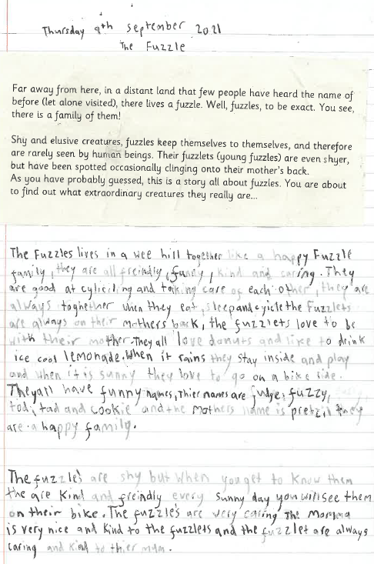
Notes:
Primary 7 pupil working at second level ‘’some progress’’.

Slide 31
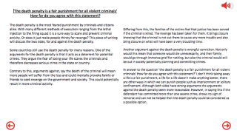

Benchmarks:
Can summarise notes or ideas from other texts in your own words.
Selects relevant ideas and information for the task.
Organises and writes ideas and information in a logical order.
Uses varied and appropriate vocabulary to make meaning clear and/or to attempt to enhance writing.
Uses signposts to make structure and/or argument clear, for example, topic sentences and/or linking phrases.
Includes an introduction that makes the purpose of the text clear and makes some attempt to engage the audience.
Ends with a conclusion that sums up the line of thought.
Uses language to influence or persuade the reader, for example, word choice, repetition, rhetorical questions and/or emotive language.
Experiences and Outcomes:
Using what I know about the features of different types of texts, I can find, select, sort, summarise, link and use information from different sources. LIT 3-14a
I recognise when it is appropriate to quote from sources and when I should put points into my own words. I can acknowledge my sources appropriately. LIT 3-25a
By considering the type of text I am creating, I can independently select ideas and relevant information for different purposes and organise essential information or ideas and any supporting detail in a logical order. I can use suitable vocabulary to communicate effectively with my audience. LIT 3-26a
I can persuade, argue, evaluate, explore issues or express an opinion using a clear line of thought, relevant supporting detail and/or evidence. LIT 3-29a
Click on the image to view the example.
Notes:
THIRD level SOME progress

Slide 32
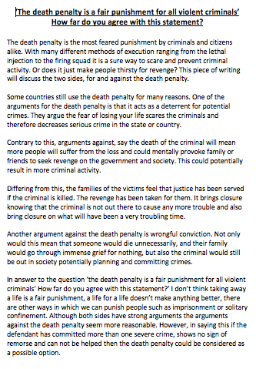
Notes:
THIRD level SOME progress

Slide 33
Click on a stage to view in more detail

Slide 34

G
The learner has a knowledge and understanding of most key concepts at the level. S/he has developed a widening range of key skills appropriate to the level. S/he can apply their learning and skills in familiar and unfamiliar contexts most of the time.
Using Benchmarks
How well
Challenge Application
The learner can respond appropriately to the level of challenge in the Es and Os most of the time with increasing independence.
Good Progress
The learner is experiencing learning across a widening range of Es, Os and contexts for the level.
How much Breadth
Notes:
Link to highlighted E’s & O’s
Link to piece of work
Work annotated

Slide 35
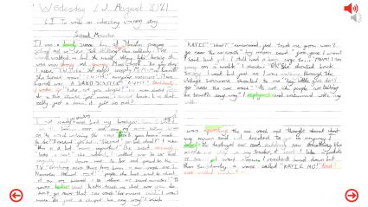

Benchmarks:
Uses paragraphs to separate thoughts and ideas.
Writes in a fluent and legible way.
Writes most sentences in a grammatically accurate way.
Creates plots with clear structures, for example, suitable opening, turning point, climax and/or satisfactory ending.
Applies a few features of the chosen genre.
Attempts to use figurative language (imagery) to engage the reader, for example, simile, metaphor, alliteration and onomatopoeia.
Click on the image to view the example.
Experiences and Outcomes:
I can spell most of the words I need to communicate, using spelling rules, specialist vocabulary, self-correction techniques and a range of resources. LIT 2-21a
Throughout the writing process, I can check that my writing makes sense and meets its purpose. LIT 2-23a
I can divide my work into paragraphs in a way that makes sense to my reader. LIT 2-22a
In both short and extended texts, I can use appropriate punctuation, vary my sentence structures and divide my work into paragraphs in a way that makes sense to my reader.
LIT 2-22a
Notes:
Primary 7 pupil, working at ‘’good progress’’ in second level.

Slide 36
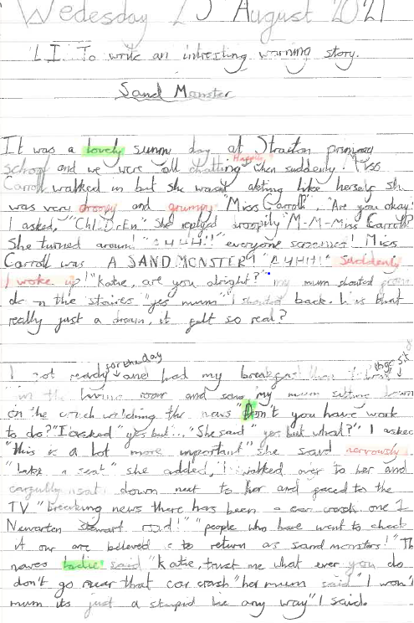
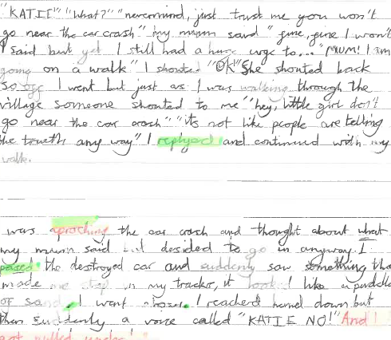
Notes:
Primary 7 pupil, working at ‘’good progress’’ in second level.

Slide 37
Click on a stage to view in more detail

Slide 38

Very Good Progress
V
The learner has a secure knowledge and understanding of almost all key concepts appropriate to the level. S/he has developed almost all skills appropriate to the level. S/he can apply their learning and skills consistently in familiar and unfamiliar contexts.
Using Benchmarks
How well
Challenge Application
The learner has responded consistently well to the level of challenge set out in the Es and Os. S/he works independently within and at times beyond the level.
The learner is experiencing learning across a wide range of contexts and almost all Es and Os for the level.
How much Breadth
Notes:
Link to highlighted E’s & O’s
Link to piece of work
Work annotated

Slide 39
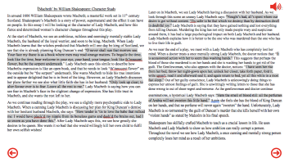

Benchmarks:
Finds, selects and sorts essential information for the purpose of the task
Is able to make inferences, using appropriate references to support assertions.
Translate information into own words to show understanding.
Use a dictionary and/or thesaurus to make sophisticate vocabulary choices.
Check work carefully to reduce the number of technical errors.
Ensure writing has a clear line of thought and is understood at first reading.
Experiences and Outcomes:
Using what I know about the features of different types of texts, I can find, select, sort, summarise, link and use information from different sources. LIT 4-14a
To show my understanding across different areas of learning, I can make inferences from key statements and state these accurately in my own words. LIT 4-16a
I can use a range of strategies and resources independently and ensure that my spelling, including specialist vocabulary, is accurate. LIT 4-21a
Throughout the writing process, I can review and edit my writing independently to ensure that it meets its purpose and communicates meaning clearly at first reading. LIT 4-23a
Click on the image to view the example.
Notes:
Fourth Level Very Good

Slide 40
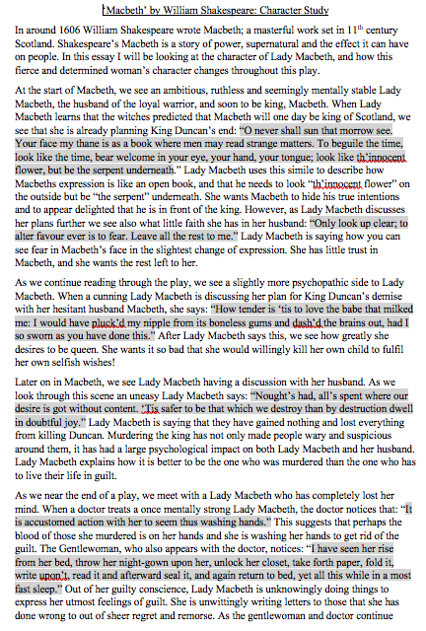
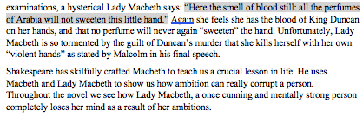
Notes:
Fourth Level Very Good

Slide 41
The four stages of progress
Planning next steps – moving forward:
Children and young people should be at the heart of planning learning, teaching and assessment. For example, learning intentions should be shared with children and young people and they should be involved in the co-creation of success criteria.
From your discussions with learners you will have a good idea of what they can do and which areas need reinforcement.
Next steps may be different for each child or young person depending on their prior learning.
A bespoke programme of work may be beneficial for a short period of time to reinforce different areas of learning for some children and young people.
Consider the validity of available evidence in terms of progress through and achievement of CfE levels.
Engage in professional dialogue with colleagues (stage/level partners) to moderate and plan collegiately at all stages of the learning, teaching and assessment (moderation) cycle. Education Scotland has produced guidance on setting up digital moderation that can be found on the Moderation Hub.
Moderation Hub

Slide 42
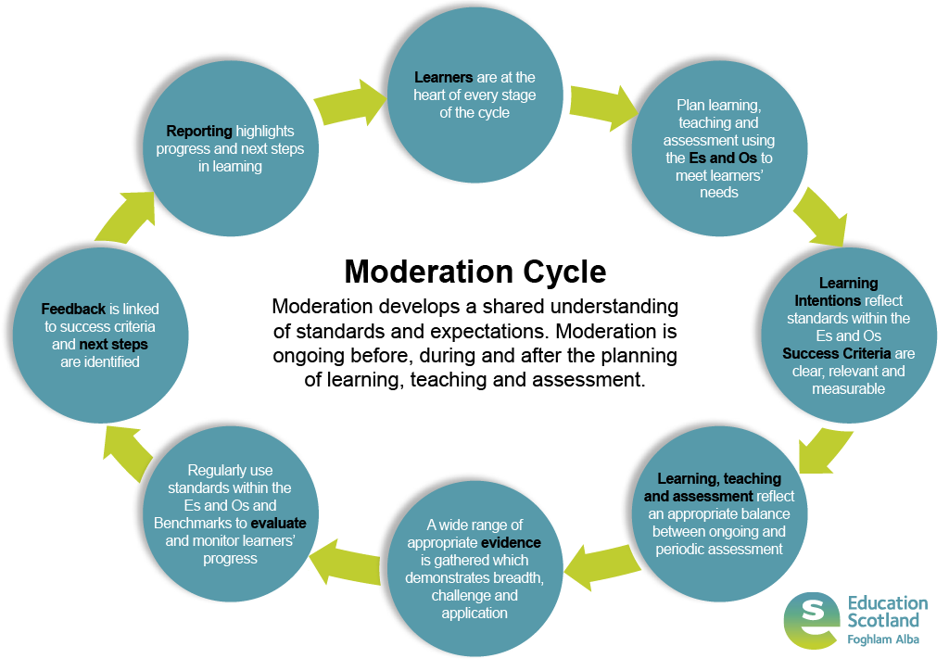
The four stages of progress
Notes:
Narration – Ongoing collaboration within our stages, departments, schools, clusters, authorities and RICs will ensure we as practitioners have a shared understanding of the standards pupils are expected to achieve in their learning. This is shown in The Moderation Cycle.

Slide 43
The four stages of progress
We hope you have found this resource useful. The examples of work included have come from practitioners across the SWEIC. If you have suitable examples of learners work which you would like to see included, we would encourage you to send these to your LA lead (Click on their name opposite to send an email).
This will allow the creation of a bank of resources to assist assessment and moderation work at every stage and sector across the SWEIC.
Thank you!
Dumfries and Galloway
Alastair Young
East Ayrshire
Robert McCallum or Gail Elder
North Ayrshire
Fiona Hopkins
South Ayrshire
Gavin Pitt
To report any technical issues with this resource, please email:
Laura Fugaccia

