Slide 1
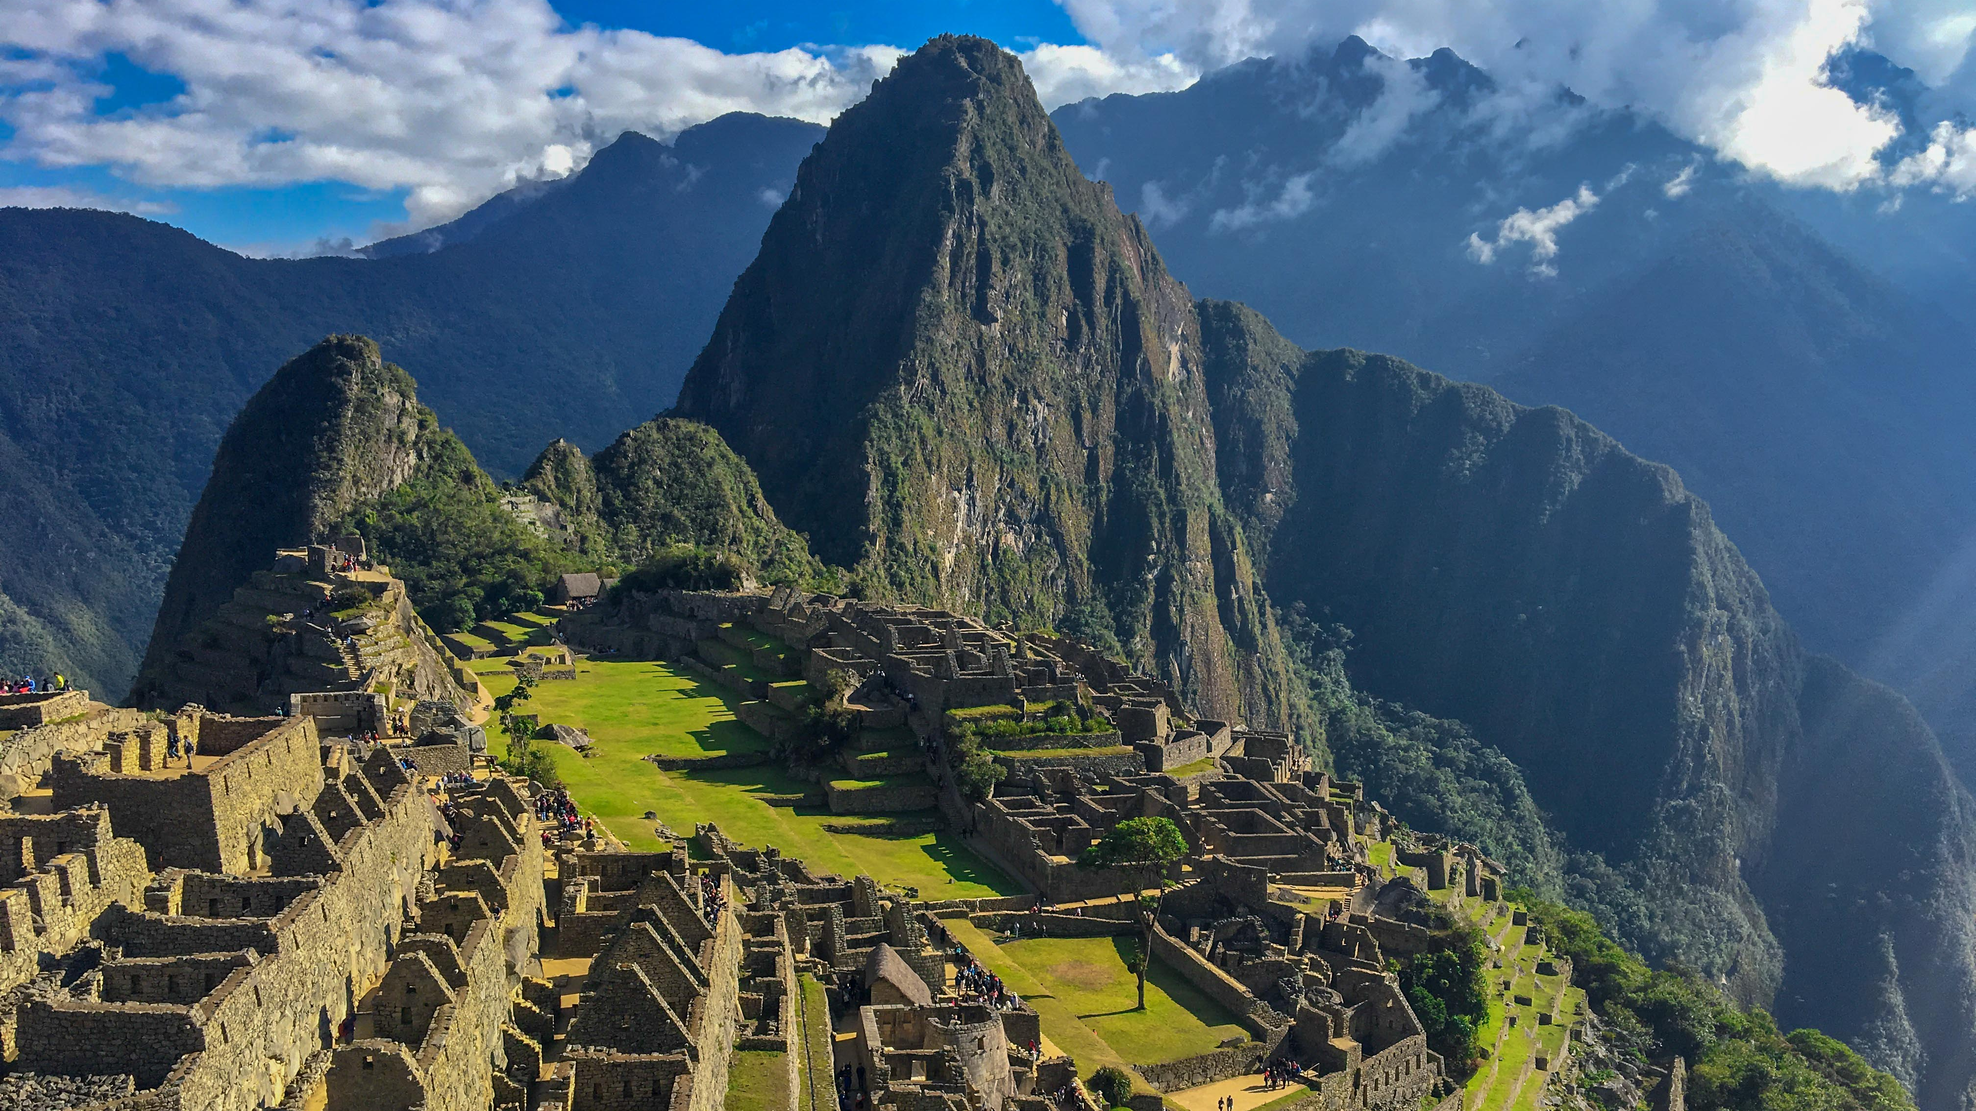


Sanquhar Academy’s
3-week Peru Sacred Valley Expedition in the Summer of 2028
Student assembly Friday 25th September
Come along to our Parents Presentation​
Tuesday 29th September at 6pm in the Learning Hub

