Slide 1
Sanquhar Academy Curriculum Architecture Parental Engagement Event
January 2022

Slide 2
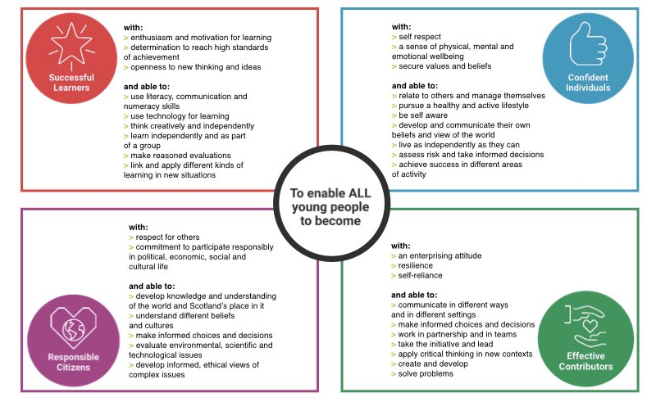

Slide 4
Challenges Considered
How do we deliver the full entitlements of Curriculum for Excellence at Sanquhar Academy?
How do we ensure the 4 capacities and the 4 contexts for learning are met?
How do we ensure our Curriculum Design meets the needs of all Sanquhar Academy’s learners?

Slide 5
Nuts and Bolts of the Timetable
School Day – will continue to start and finish at the same times, 8:50-15:20
Break and lunch will be at the same time each day
There are 6 periods in the day. Five at 1 Hour and One at 30 minutes.
30 minute periods: 3 Tutor and 2 curricular periods.
Period | Start Time | End Time | Number of Mins
Tutorial / P1 | 08:50 | 09:20 | 30
P2 | 09:20 | 10:20 | 60
Break | 10:20 | 10:35 | 15
P3 | 10:35 | 11:35 | 60
P4 | 11:35 | 12:35 | 60
Lunch | 12:35 | 13:20 | 45
P5 | 13:20 | 14:20 | 60
P6 | 14:20 | 15:20 | 60

Slide 6
Tutor Time – 3 Mornings per Week
Purpose/aims
Format
Content/Topics
Consultation, Feedback, Suggestions
Is there anything else you would like to see us use Tutor Time for?
Suggestions to date
Settle and Check in
Attendance monitoring – letters etc
Assemblies
Activities – UNCRC, Mentoring
Tracking and Monitoring
Wider achievement
Health and Wellbeing/ Nurture
Brain Development

Slide 7
Brain Development in Adolescence and Learner Pathways

Slide 8
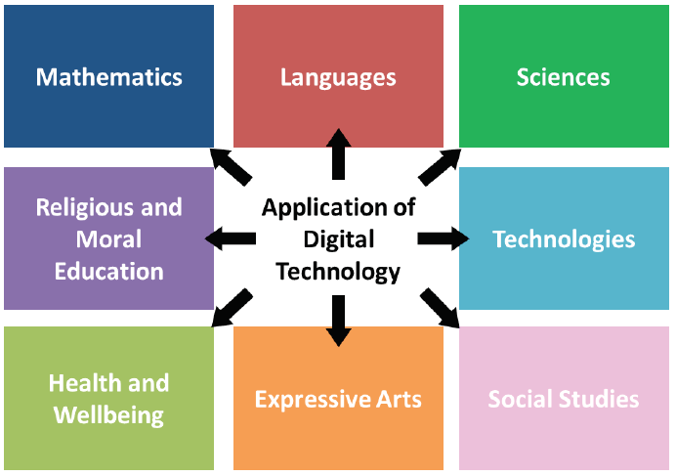
BGE = Broad General Education, S1-S3
S3 get the opportunity to start to specialise in curriculum areas and start to gain greater depth with their learning.
Learners will specialise in 5 areas alongside: English, Maths, PE, PSE and Tutor Time
S1 and S2 will continue to follow a broad wide curriculum to ensure they experience the outcomes to CfE Third/Fourth Level.

Slide 9
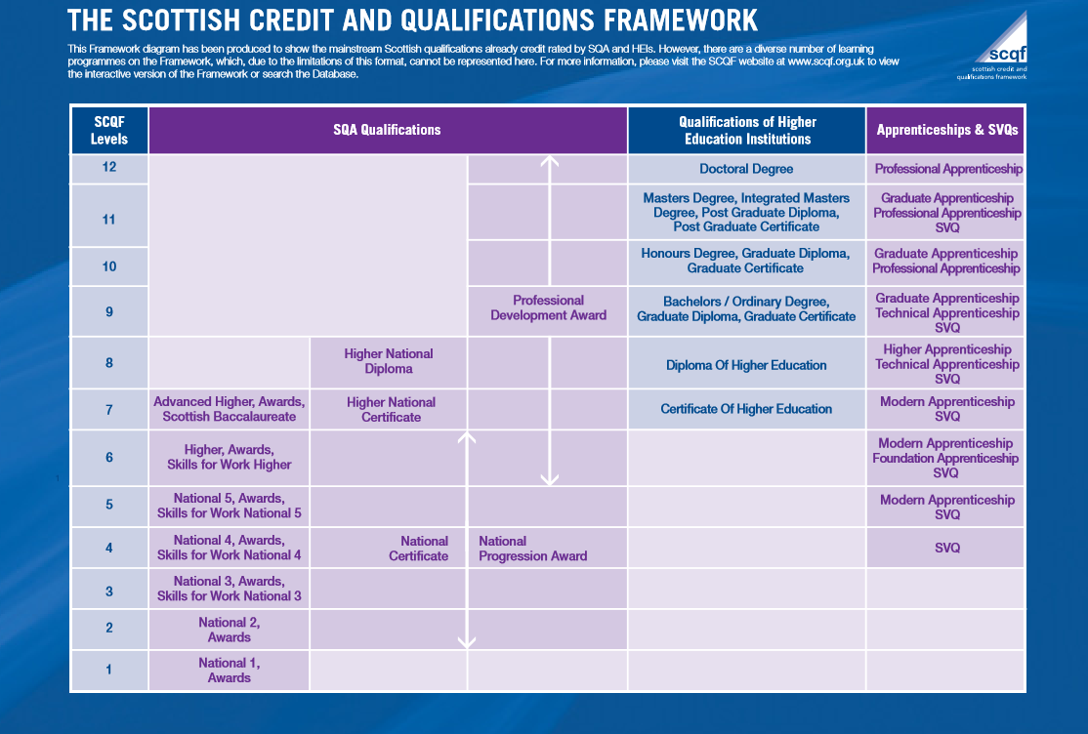
SP = Senior Phase, S4-S6

Slide 10
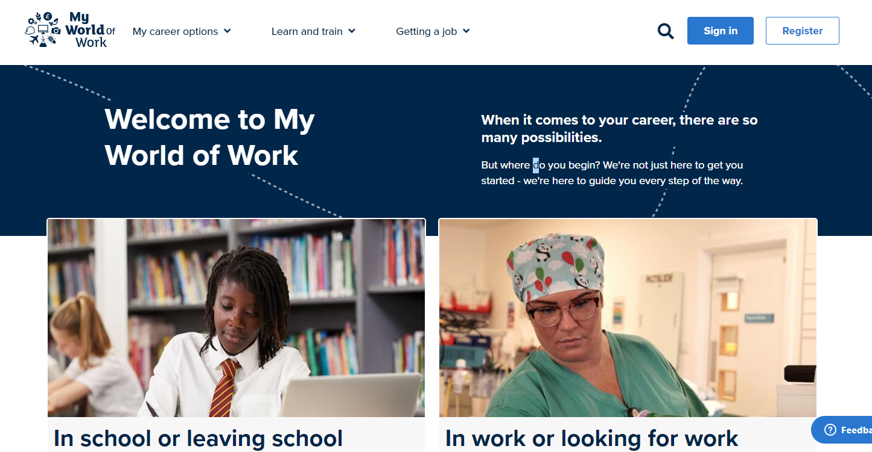
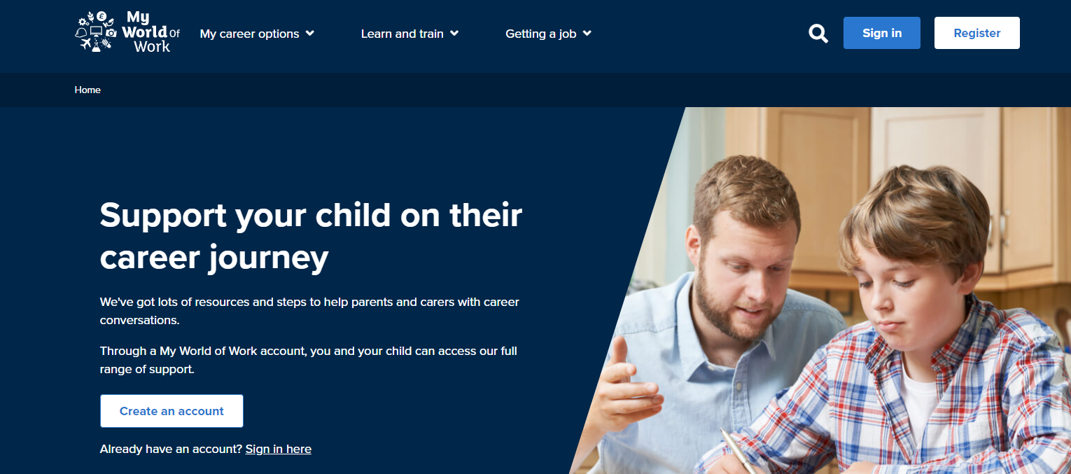
My World of Work
We use My World of Work and the SCQF Framework in PSE to support pupils to develop their individual Learner Pathway.
There is a section on My World of Work specifically for Parent/Carers.
https://www.myworldofwork.co.uk/parents-carers

Slide 11
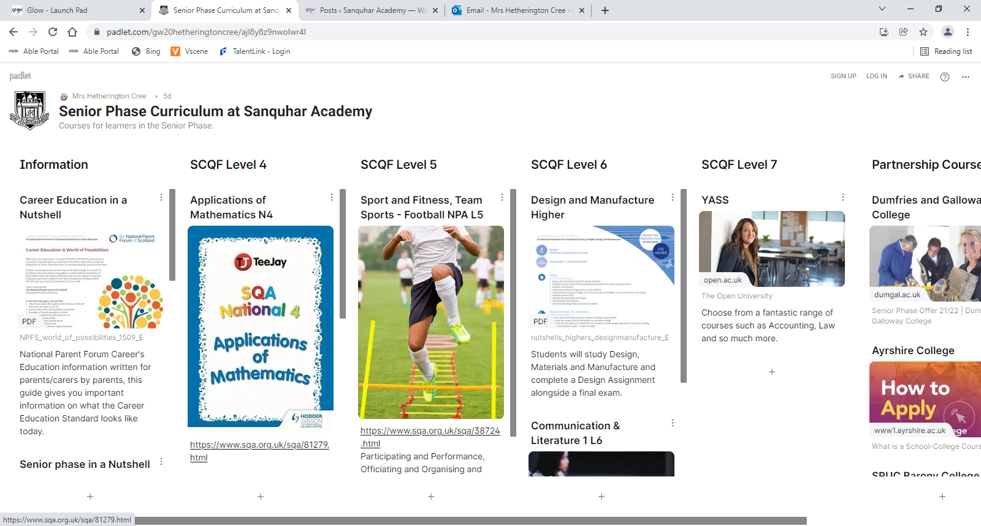
Curricular Offer in the Senior Phase

Slide 12
Partnership Working
Current Partners
1 pupil at D&G College
3 pupils at Ayrshire College
3 FA’s with D&G
4 Ayrshire College
1 Barony College
3 pupils GCU
7 @SW Connect
2 YASS
DoE – pupils looking to complete Bronze, Silver and start Gold
Mrs McLean is working with the South West Improvement Collaborative as the D&G Link on the School Lead Focus Group for the Senior Phase L7 provision.

Slide 13
Learner Pathway

Slide 14
SP = Senior Phase, S4-S6
Using the information from the Learner pathway we refine our curricular offer. The curriculum is structured to enable learners to study 6 courses in S4-S6 where learners work at their own level. By the time pupils leave at the end of S6 they will have had the chance to study 18 courses across subjects and levels based on their individual Learner Pathway.
Once the Learner Pathways for the whole school are analysed the column structure for the next session is created. After this point if learners wish to change courses or a course can’t be facilitated that session they need to re-opt within the column structure.
If numbers for a subject are small, courses may be structured to enable the teacher to deliver using a tutorial based pedagogy. Where learners are set tasks across the weeks and taught using a range of approaches. Ultimately this prepares learners for the next phase in their learner pathway or entering the World of Work.
For example 10 pupils wish to study N5 Art, 4 wish to do Higher Art. A class will be created to allow all learners to study their course of choice. The Learning and Teaching approaches are adapted to ensure that pupils are supported to work towards achieving their level within the class.

