Slide 1
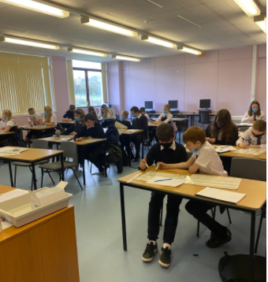
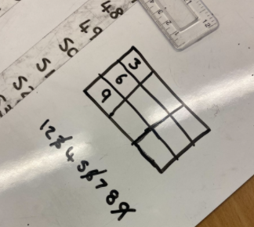
S2 Numeracy Quiz Monday 27th September
Competition Winners Lucy and Blake Shania and Lauren
S2 pupils participated in a specially designed quiz that featured questions from departments across the school therefore linking mathematics and numeracy with other subject areas.

Slide 2
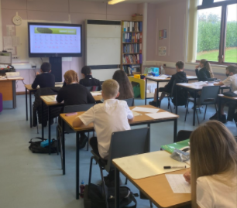
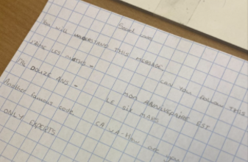
S1 French/Maths/Decoding Tuesday 28th September
S1 Were working on a task that was based on the Enigma Machine. This task linked coding, problem solving, mathematics and logic, history and French. Pupils enjoyed this task and presentation of work was excellent.
Competition Winners Lucy , Tony , Aiden

Slide 3
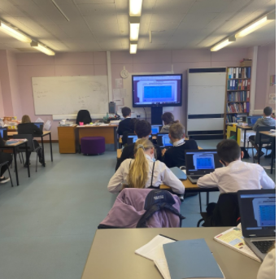
S2 Using Technology in Maths/Distance/Speed/Time Tuesday 28th September
Some of the S2 Were using the school laptops to work in pairs to solve time intervals and Distance, speed time problems. There were a lot of tricky problems.

Slide 4
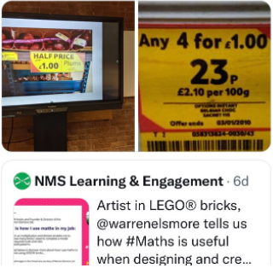
NAT 5 Application of Mathematics Wednesday 29th September
Seniors were discussing tweets from Lego artist and had a look at pricing deals and also looking at volume of shapes all linked to real world examples.

Slide 5
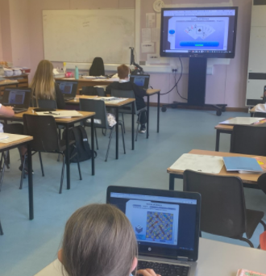
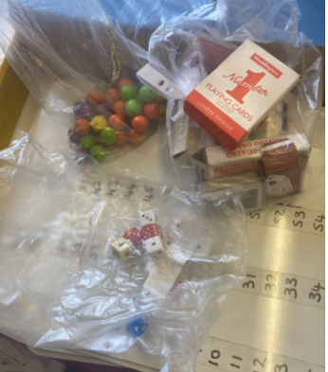
S1 Probability and Technology Thursday 30th September
S1 Numeracy class Were using concrete materials to solve probability and then using technology to play various games of chance. The card game was most enjoyable.

Slide 6
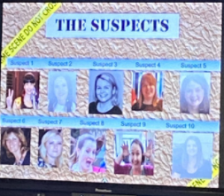
S1 CS1 Friday 1st October
S1 Were working on a criminal CS1 investigation to solve a crime using pieces of evidence requiring mathematics. Some of the class teacher suspects were looking very suspicious.
Competition Winners Lucy Daizy Linizi Gabrielle Grant Katelyn Connor Tamia Tony Aiden

Slide 7
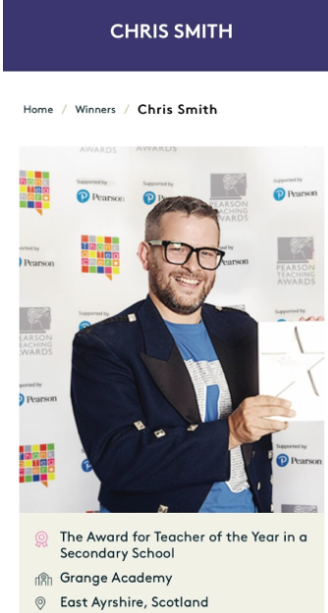
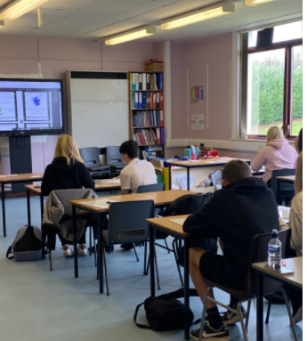
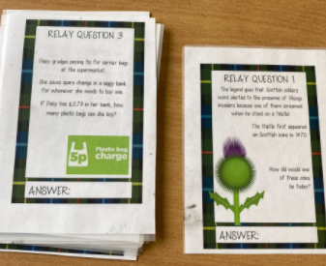
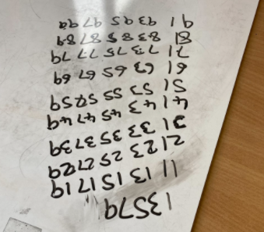
S3 Scottish Maths relay Race Friday 1st October
Most of S3 Were doing the Scottish mathematics Relay Race. Written by a winner of Scottish Teacher of the year, Making Maths week Count Scotland Promoter and friend of the Sanquhar Maths Department Chris Smith. The class were very competitive and the problem solving skills were outstanding.
Competition Winners Matthew Megan

Slide 8
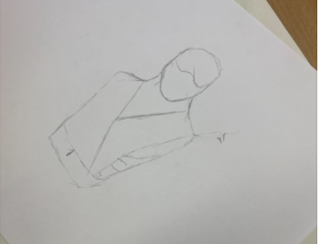
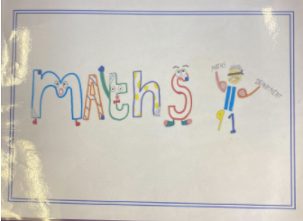
Creativity Tasks – Various classes were involved in designing pursuit curves and maths logos.

Slide 9
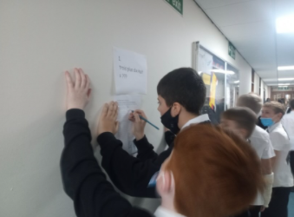
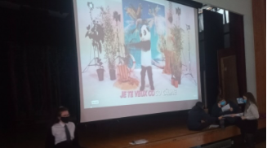
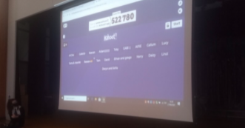
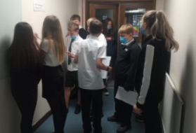
S1 French/Maths Task
Sanquhar Languages
Number games , active learning finding and solving, Kahoot, Bingo and even some French songs with numbers were some of the activities the languages faculty and S1 took part in at various times of the week.
Big Thank you to all the S3 pupils who displayed their leadership skills by helping the S1 pupils around the school with this task.

