Slide 1
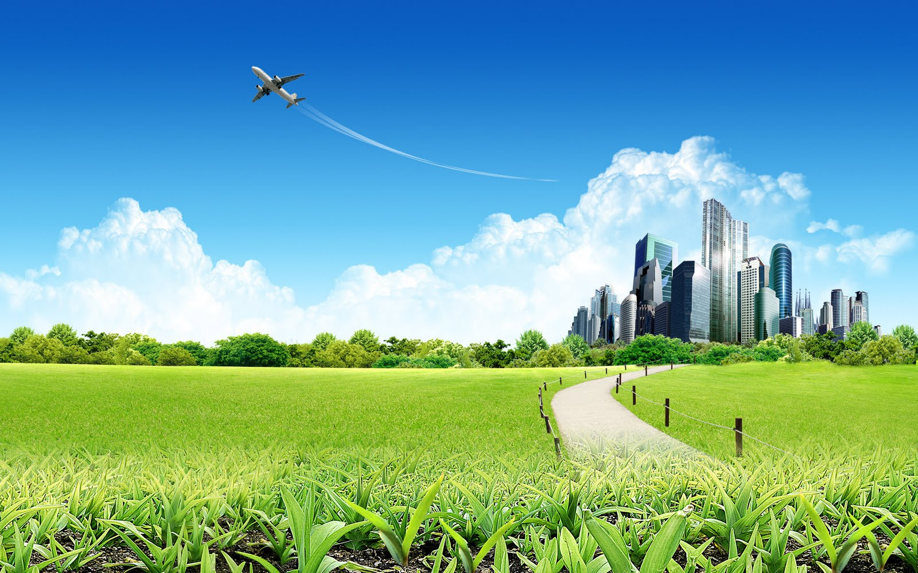
Life Cycles

Slide 2
What Are Life Cycles
A life cycle is when something:
Is Born
Becomes a child
Becomes a teenager
Becomes an adult
Dies
And It keeps on going round and round.

Slide 3
How Do They Work
Life cycles are the stages of an organism's life. Here's an example.
As you can see the chicken lays an egg. The chick hatches from the egg and then grows into a chicken which goes on to lay another egg. The life cycle is complete.
The life cycle repeats until the organism is extinct.

