Slide 1
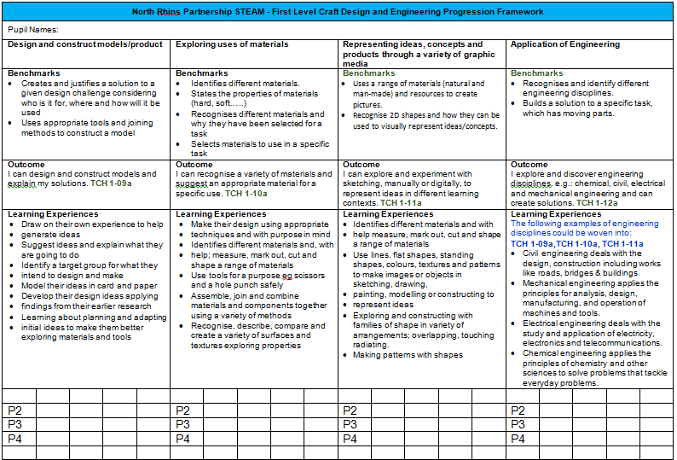
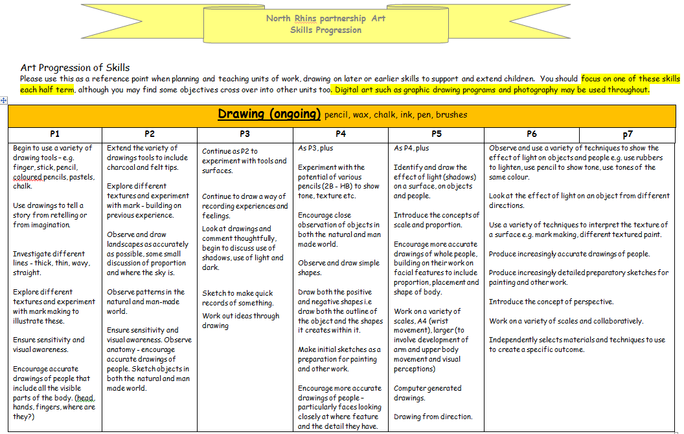
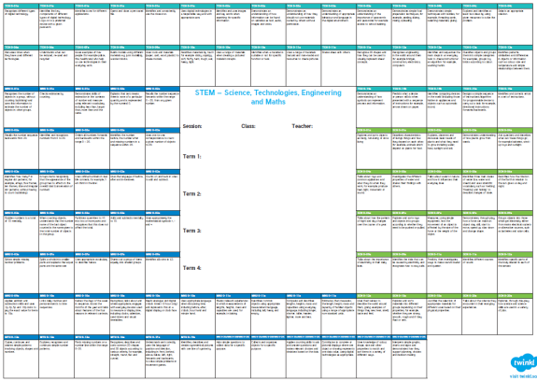
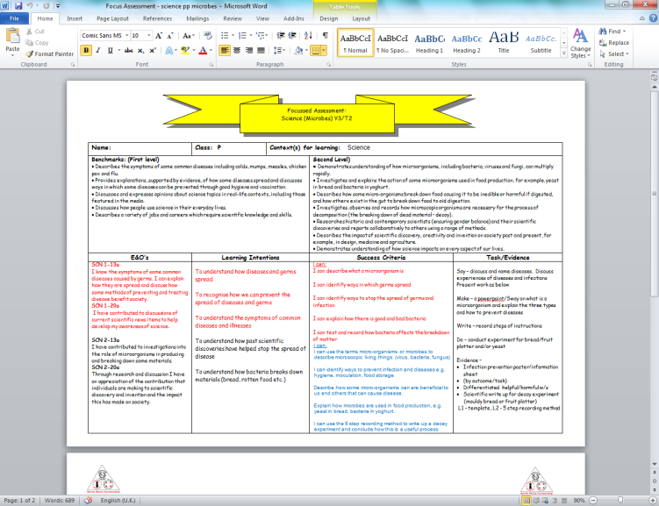
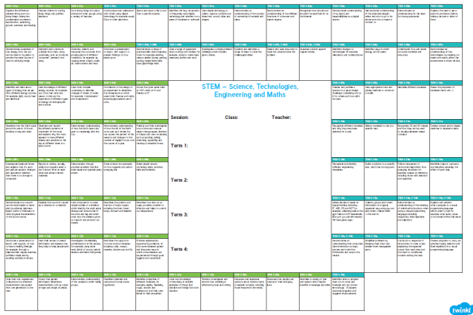
Documents hyperlinked to source. Not a full range of documents – samples given to illustrate school procedures across STEAM subjects.
Click on Each base corner point for ease of access:
STEAM Curricular Mapping
STEM Experiences and Outcomes Progression Tracking by level
STEM Benchmark Progression Tracking by level
CDT Progression Framework
Internet Safety Curriculum
Digital Skills Progression Framework/Tracker
Digital Skills Benchmark folio by level
Science Curricular Structure
Sample Science Skills Progression – enquiry
Sample Science progression – electricity
Core Maths Progression Framework/Tracker
Mental Maths Progression Framework/Tracker
Art Curricular Structure
Art Progression
Music Curricular Structure – Charanga
PE – Dance Curricular Structure
Sample CDT Focussed Assessment
Sample learning conversation target setting
Staff keep up to date through engagement with publications such as Full STEAM Ahead. Our trio features in this month’s issue for our family involvement.
Click - to see photos of our STEM/CDT work, activities, visits and open days!
Click here to check out our blog with STEM posts!
https://blogs.glowscotland.org.uk/dg/portpatrickprimary/
Movie – Click me!
Soundtrap
Click Me!
Topic Animation
Click Me!
Movie Click Me!
Notes:
Please click on images to access documents, images, videos, music, animations etc.
Photo slideshow available in salmon pink box – activities, work, open days, visits, transitions etc.
Currently correlating parental views (also a sample of industry comments awaited)
Digital Schools Award Accredited school in 5 element areas inclusive of curriculum

Slide 2
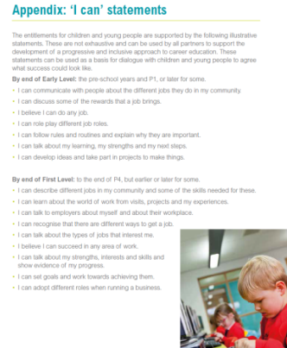
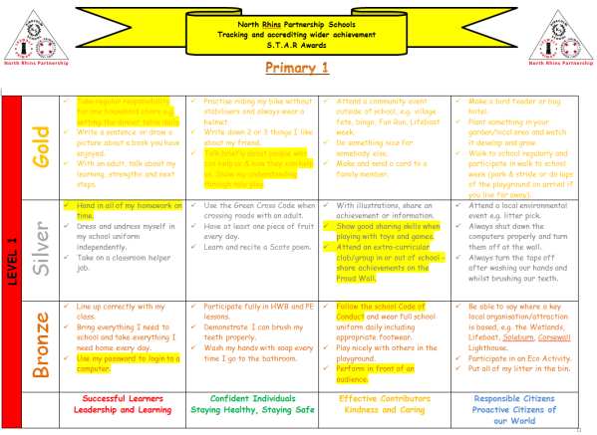
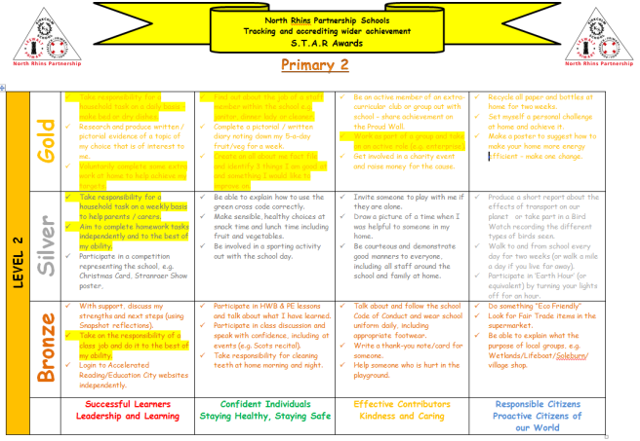
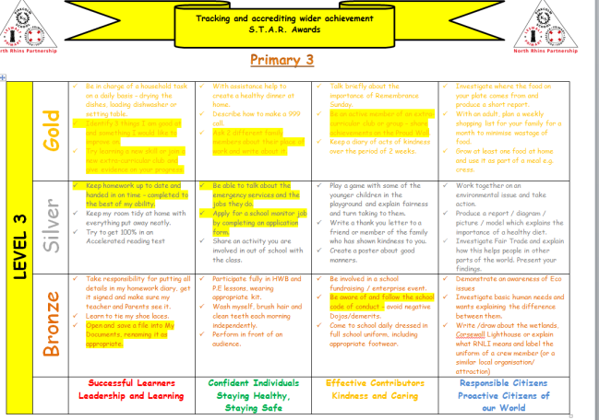
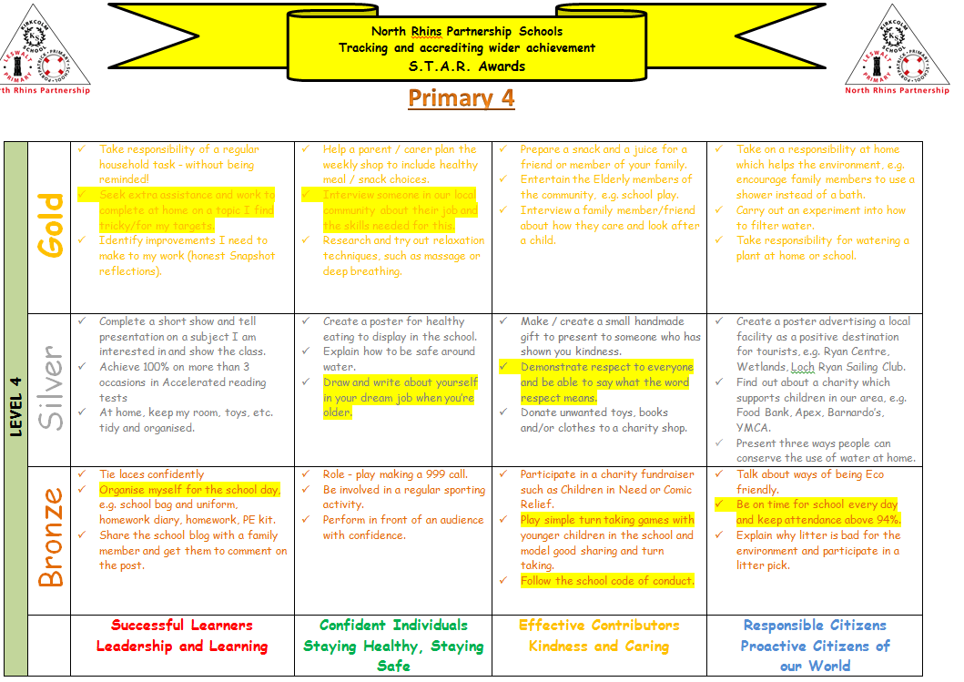
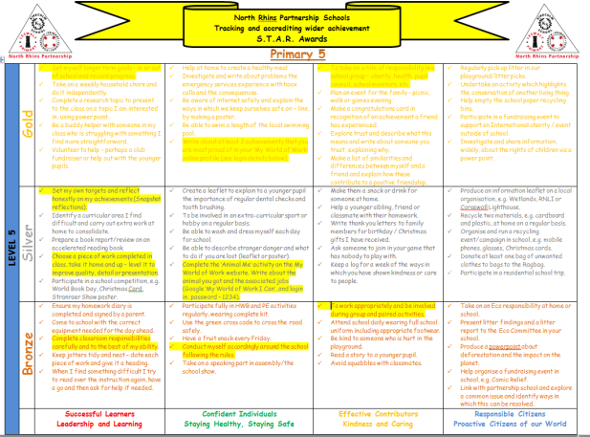
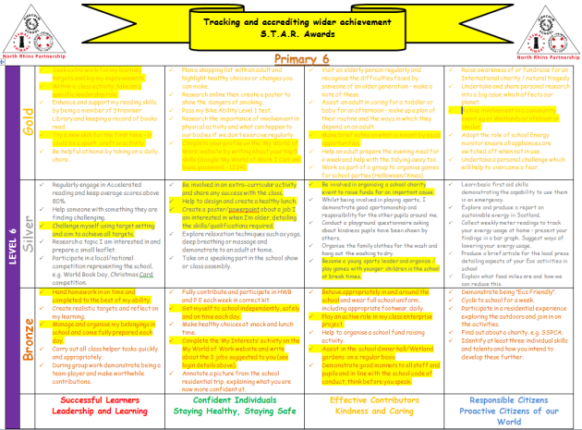
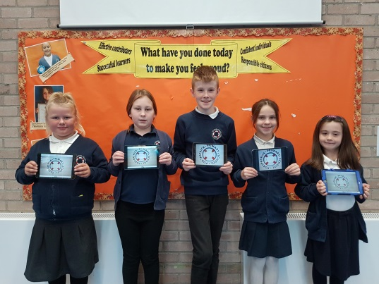
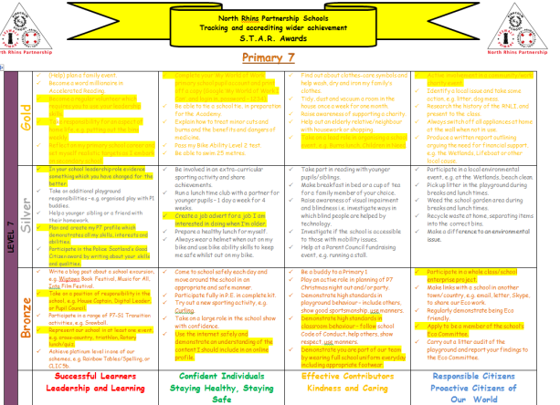
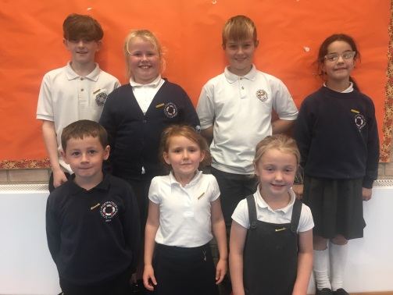
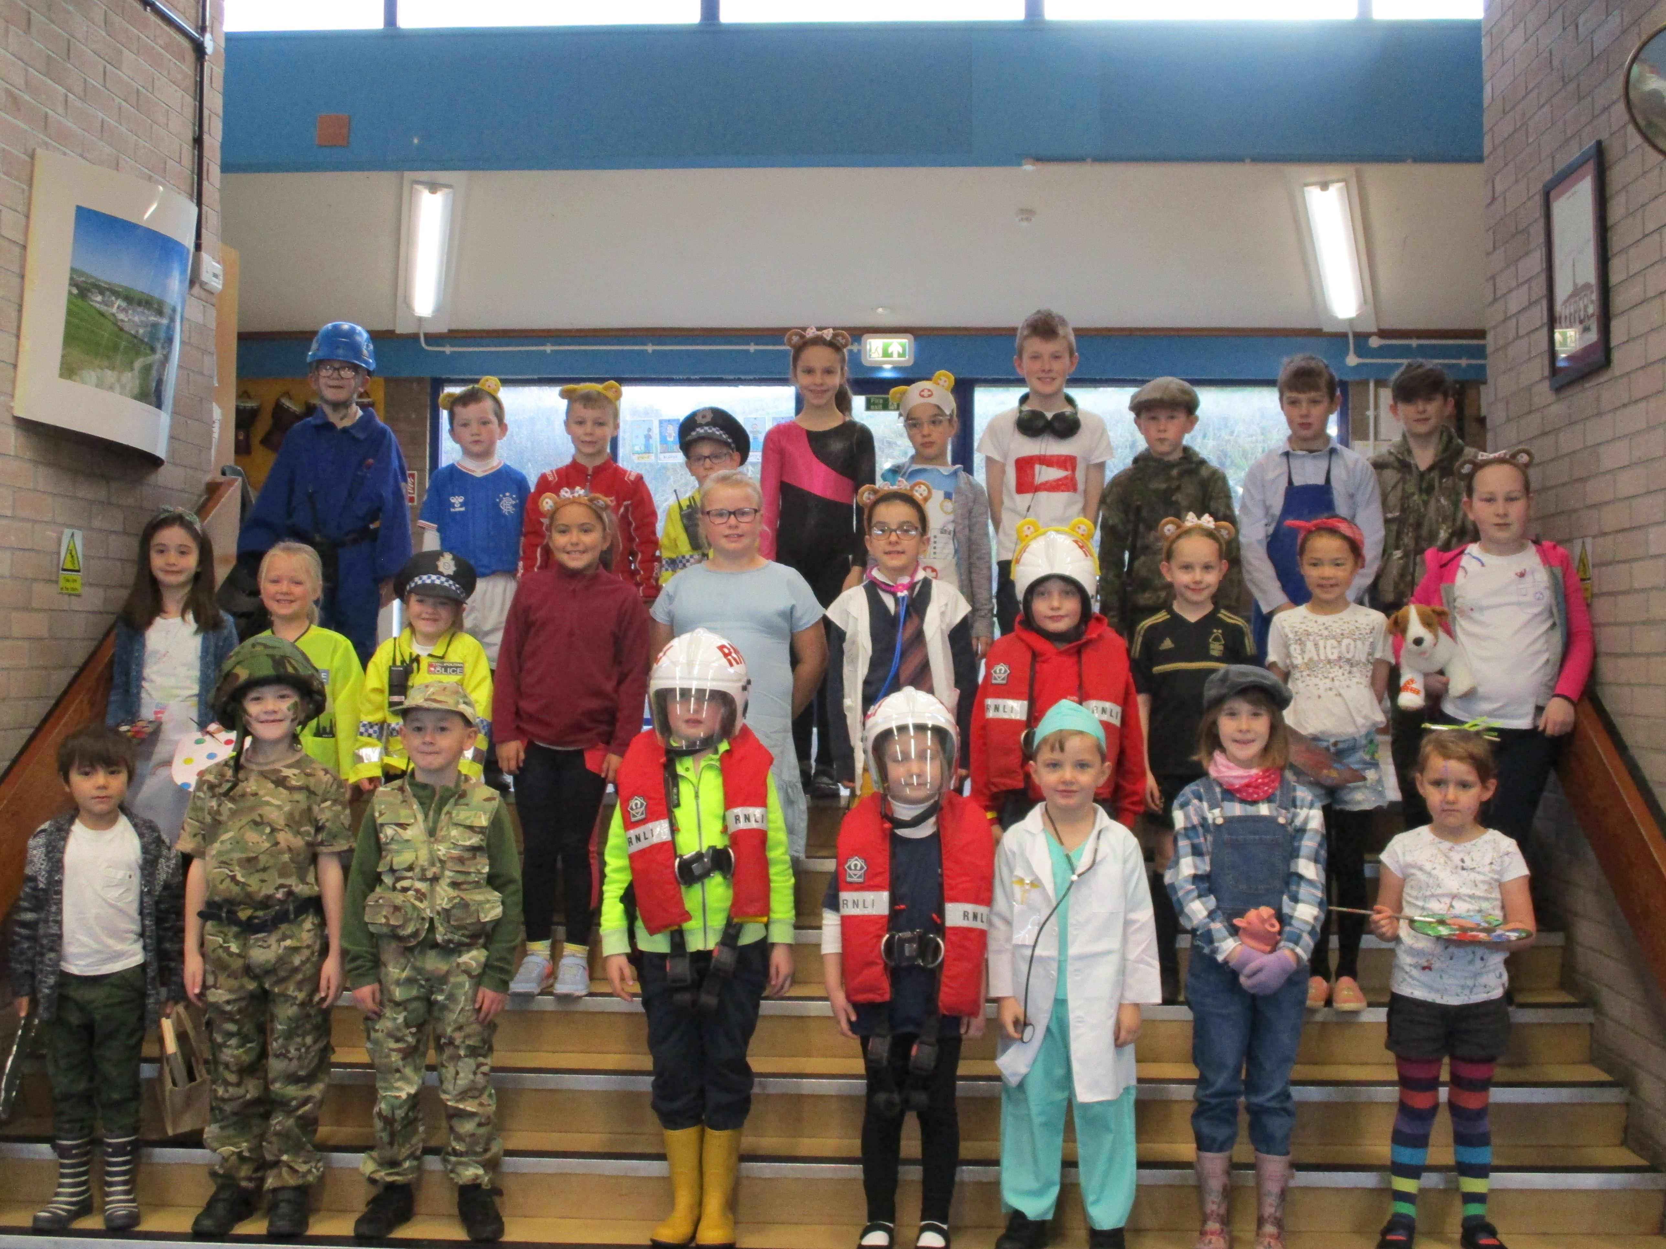
Click here to check out our blog with STEM posts!
Skills, Employability and Careers
https://blogs.glowscotland.org.uk/dg/portpatrickprimary/
Our pupils develop problem solving, creativity, enterprise, and collaboration etc. through open ended STEM activities involving play, tinkering and active learning. Click Me
Our STAR target portfolios embed skills for employability and work, across the 4 Capacities and also and link to the DYW ‘I can’ statements and progressive expectations.
We track pupil responsibilities and engagement in wider achievement too.
Our pupils learn about industry and job roles through: site visits, incoming visitors, Careers in the community assemblies and parents and family partners supporting our curricular learning e.g. nurses for HWB hygiene, Soundtrap engineers etc.
Click Me for sample evidence.
https://www.myworldofwork.co.uk/
We challenge stereotypes to improve life and career aspriations and promote DYW.
Click - Our pupils engage with My World of Work to learn about their skills, strengths and interests related to future careers.
Our pupils gain world of work relevant experience of responsibility, decision making and leadership through applying for, and joining our Eco Council, Pupil Council, House Captains and Digital Leaders.groups.
We have opportunities to explore what careers we want to have – Children in Need (Working Together theme) -
Click
P7
P6P5P4
P3P2P1
Digital Leaders
Pupil Council
Notes:
Digital Schools Award Accredited school in 5 element areas inclusive of curriculum

Slide 3
Click here to check out our blog with STEM posts!
Partners - Transitions – Attainment, Moderation
https://blogs.glowscotland.org.uk/dg/portpatrickprimary/
Current Activities
Our P7 pupils complete Academy transition forms that highlight their learning, skills and interests across the curriculum inclusive of STEM subjects and takes into account the four capacities. This is passed on to the third level prior to the transition.
Our new P1 pupils engage in phased activities as part of transition days prior to staring school. We have no feeder nursery; with children coming from different early level centres. We engage them in collaborative problem solving challenges to develop skills for STEM, working and life.
Partnership working
All stage partners plan and moderate work collegiately as a team. The staff get together each term to design planning. All curriculum documentation factors technology at the outset, making use of the STEM Curricular Mapping and Digital Technologies. Focussed assessments are agreed upon to allow moderation.
We are also working with ICE – Institute of Civil Engineers and the Principal Technician – Structures ( D & G council to have our trio participate in structural design and construction workshop challenges on the 26th of November across our trio partnership to enhance design, problems solving, creativity and materials skills..
We engage with local industry to discuss the skills and qualities they desire in future employees. We have had whole school discussions with the HR Manager of Lactalis McLelland. The children and staff questioned him on the range of careers available in the processing plant, and the skills and qualities they require for these roles. We have attended a site visit to see the roles being carried out, having the opportunity to speak to staff such as engineers, food technicians and product quality control etc. All of these roles use engineering, science, food technology, digital literacy and computing science. Our relationship with Lactalis continues. We use such experiences to open up children’s minds to future career possibilities and inform them of the relevance of the learning challenges we plan. Staff use such industry experiences to inform planning. Staff also regularly attend the D & G STEM conference with industry and key note speakers on STEM, Career pathways. This is fed back to the team at Development nights. This shares Ed Scotland’s STEM priorities drivers and pedagogy highlights career barriers and provides links to partners such as I.C.E., SERRC etc. which we then utilise.
Click - STEM Conference Summary
Progression is monitored using the STEM range of progression frameworks, trackers and curricular structures shown on this section’s 1st slide. This evidence is used to inform the design of STEM challenges, planning & target setting.
A range of evidence is used to assess individual progress in STEM - based on the Benchmarks for Assessment, say, make, write, do, and success criteria. The assessments are also used for moderation by staff across the trio. Individual progress and attainment for each child is tracked on the HT’s attainment overview spread sheet. All of this informs planning and target setting with pupils and parents.as part of pupil and parent attainment meetings that happen regularly throughout the year.. Focussed A1, Focussed A2, Focussed Overview
We collaboratively plan STEM and the curriculum and share resources.

Slide 4
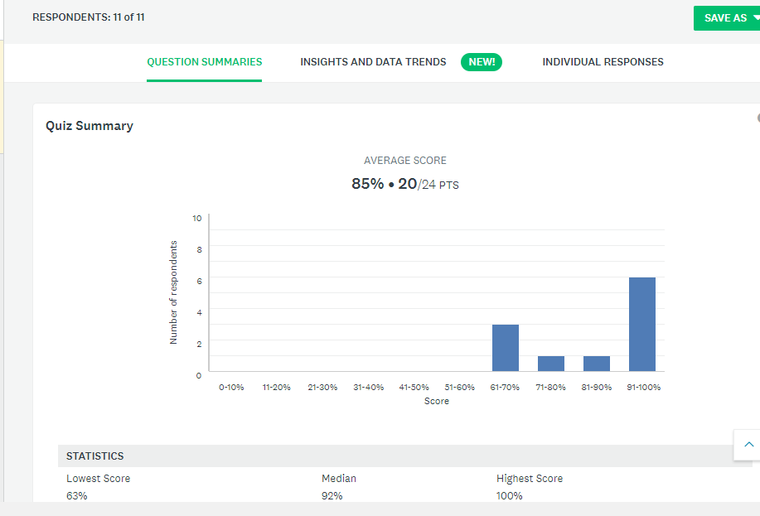
Click here to check out our blog with STEM posts!
Parental Partners Engagement and consultation
https://blogs.glowscotland.org.uk/dg/portpatrickprimary/
We consult our parents as partners and take their views on-board e.g. planning to introduce STEM open events outwith the school day to allow fuller family participation.
Q3 – Science learning experiences: Very Satisfied - Especially the one off afternoon events and those with the other schools in the trio
Q4 – Technology learning experiences:
They appear to have a well rounded experience and learn essential skills
I think for our wee school we do very well. Staff try to inform both children and parents about internet safety for example, and encourage the children in the use of technology.
X commented only the other day on how good the visitors to the school are. We are delighted to see the school making positive steps in terms of digital learning experiences
Q5 – Engineering learning experiences:
They seem to get a wide variety of experiences
I am only not saying 'very satisfied' because I always feel there is more we could do. However, visits cost money and as a small school we have a limited budget, so again, for a wee school, I think we do very well.
Q6 – Maths learning experiences: 92% Satisfied or Very Satisfied ( no comments)
Q7 – provision of opportunities to participate in STEM with your child:
The girls get really engaged in these types of activities
Open day activities generally rely on parents being available during the school day which discriminates against working parents, and this has always been an issue
My daughter loves sound trap ! It’s a great tool to get creative and very easy to use !
Q8 – Opportunities for your child to learn about STEM careers:
We should look at ways we can linkup with past pupils and STEM ambassadors – Already arranged
Q8 – Developing your child’s skills for life and work:
Probably. Certainly by equipping the children with digital skills and a good understanding of maths, and a taste of differing careers they are being led in the right direction.
Digital Leaders
Notes:
Please click on images to access documents, images, videos, music, animations etc.
Photo slideshow available in salmon pink box – activities, work, open days, visits, transitions etc.
Currently correlating parental views (also a sample of industry comments awaited)
Digital Schools Award Accredited school in 5 element areas inclusive of curriculum

Slide 5
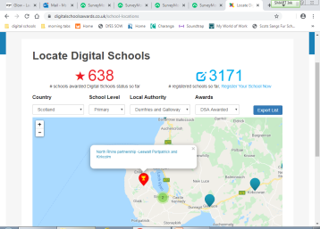
Click here to check out our blog with STEM posts!
Award & Project Participation
https://blogs.glowscotland.org.uk/dg/portpatrickprimary/
We are the first school in Wigtownshire to receive Digital Schools Award Accreditation.
We have been assessed and verified as meeting the required standards in 5 elements by generating a wide raging evidence portfolio and undergoing an audit inspection on site: Read our achievement report by clicking on the purple box. : )
Leadership and Vision
Use of technology to deliver the curriculum
School Culture
Professional Development
Resources and infrastructure
I'm a Mathematician!
We have applied to participate in the 'I'm a mathematician Christmas lectures presented by the Royal Institution. The Lectures will probe the limits of maths and its role in our modern world. Click
Additional note: Our children are set termly targets across the BGE inclusive of STEM areas. These are agreed in person with pupils, parents and teachers during learning conversations and reviewed throughout the term.
Click - We have achieved Digital school Award status
We were selected to participate in the evaluation of Dumfries and Galloway’s RAiSE programme. Pupils were consulted to gain their views and perceptions on science etc. Staff engaged with the consultative evaluation of the programme
https://education.gov.scot/improvement/learning-resources/Raise
Future activities & Next Steps
We have imminent visits from Third Level STEM Ambassadors planned for this term. The Ambassador Secondary pupils are coming to share their knowledge and skills in Science. This has been arranged through collaboration with the Principal Teacher of Science at Stranraer Academy.
We are engaging with the new STEM HUB being constructed at The John Niven Centre Tertiary college in Stranraer. This facility is linked to The Bridge Centre in Dumfries. Our Head Teacher is already liaising with the centre to arrange access upon completion.
Owing to our work on technology and STEM, our trio partnership has received an invitation to participate in a Soundtrap podcast story telling project linked to Moat Brae, Dumfries. this will take place in term 3.
Notes:
Please click on images to access documents, images, videos, music, animations etc.
Photo slideshow available in salmon pink box – activities, work, open days, visits, transitions etc.
Currently correlating parental views (also a sample of industry comments awaited)
Digital Schools Award Accredited school in 5 element areas inclusive of curriculum

