Slide 1
Results of students’ questionnaires about project “Music is a common language”

Slide 2
1. Class Band questionnaire for students

Slide 3
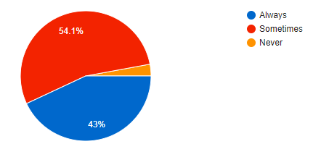
1.Do you like going to school?

Slide 4
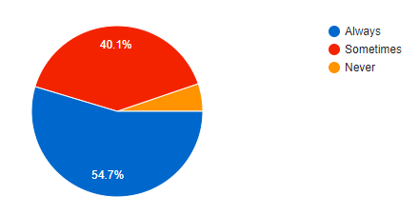
2.Do you like music lessons?

Slide 5
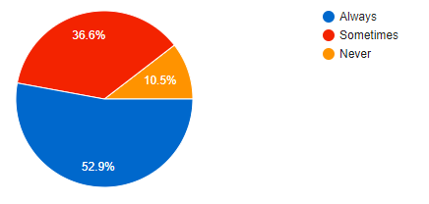
3.Do you like Class-Band activities?

Slide 6
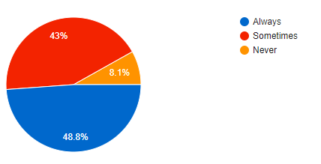
4.Do Class-Band activities make your music lessons interesting/exciting?

Slide 7
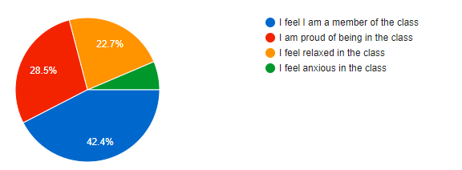
5.How do you feel during these activities?

Slide 8
2. Singing to Learn, Learning to Sing questionnaire for students

Slide 9
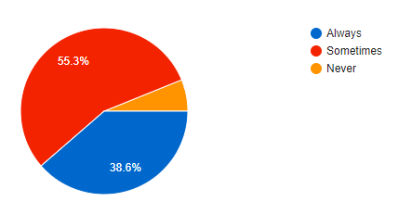
1.Do you like going to school?

Slide 10
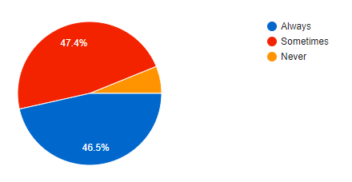
2.Do you like music lessons?

Slide 11
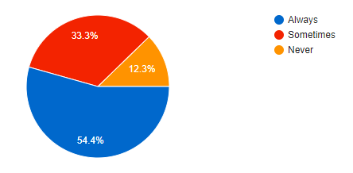
3.Do you like Charanga, Buzz&Blast, Feis Rois activities?

Slide 12
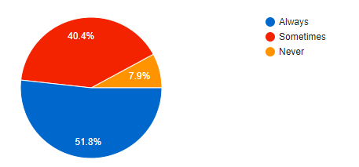
4.Do Charanga, Buzz&Blast, Feis Rois methods make your music lessons interesting/exciting?

Slide 13
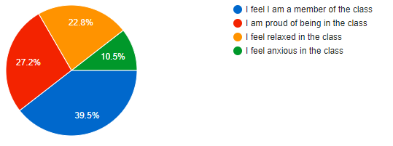
5.How do you feel during these activities?

Slide 14
3. C.Orff‘s questionnaire for students

Slide 15
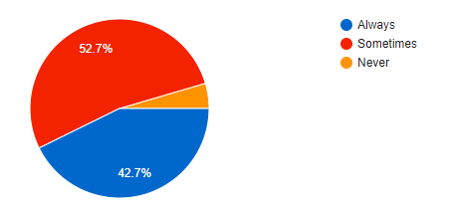
1.Do you like going to school?

Slide 16
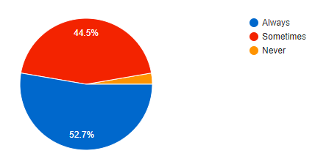
2.Do you like music lessons?

Slide 17
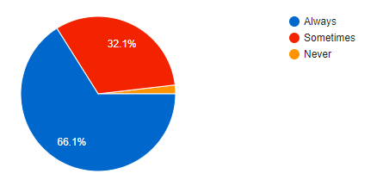
3.Do you like C.Orff's method activities?

Slide 18
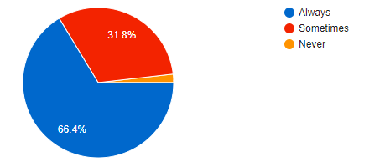
4.Does C.Orff's method make your music lessons interesting/exciting?

Slide 19
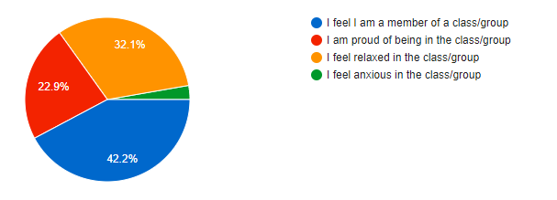
5.How do you feel during these activities?

