Slide 1
Evaluation questionnaire of the project “Music is a common language” for teachers

Slide 2
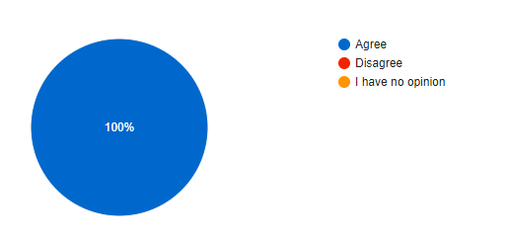
1. I positively evaluate my colleagues and my participation in the international project "Music is a common language“.

Slide 3
2.I notice that teachers, representatives of administration after the mobility visits are more motivated, willing to share good practices.

Slide 4
3.After each mobility colleagues share good practices by organizing presentations, meetings, conferences, workshops or sharing information on social media.

Slide 5
4.I use the experience taken from my colleagues, new music teaching methods and digital teaching platforms (Class band, Charanga, Buzz & Blast, Feis Rois, C.Orff) in my lessons.

Slide 6
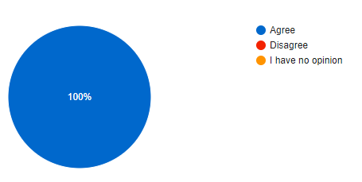
5.I notice that the application of digital music teaching platforms and methods make the educational process more interesting, attractive and better assimilated for my students.

Slide 7
6.During the last 2 years, when the project has been taking place, the school has increased the number of musical educational activities, creative projects, the teachers cooperate more with each other.

Slide 8
7.New music teaching methods and various activities applied in the educational process help students to acquire knowledge better, make learning more interesting, improve students' teamwork skills and learning motivation.

Slide 9
8.Tested and adapted new music teaching methods help to improve my class/group microclimate, emotional relaxation of students, the inclusion of children with special needs in the educational process, built their self-confidence and self-esteem.

Slide 10
9.Music teaching methods learned and applied during the project have improved lesson organization, lesson planning and time management.

Slide 11
10.The international experience gained during the project motivates me to be interested in innovations, to apply new music teaching methods, to participate in other project activities.

Slide 12
11.Participation in Erasmus+ project broadens my horizons, knowledge of other educational systems, nations, cultures, traditions, and foreign languages.

Slide 13
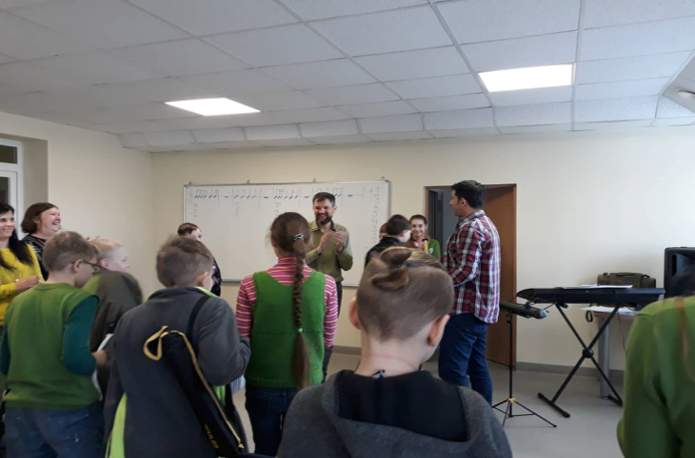
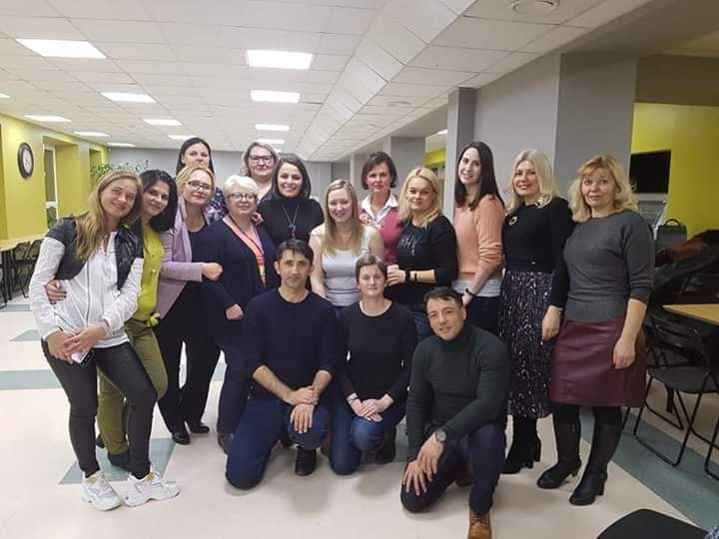
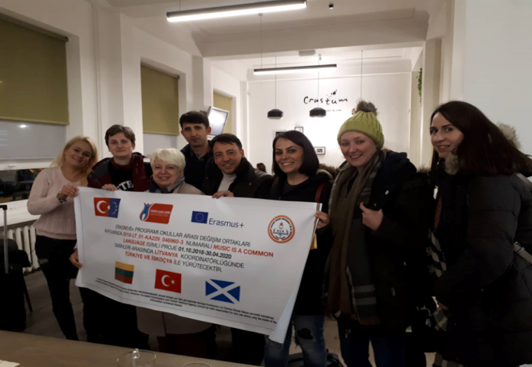
Class Band Questionnaire for teachers

Slide 14
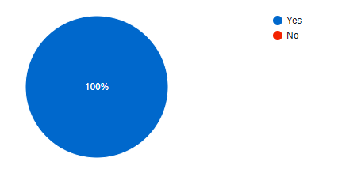
1.Is the Class-Band method attractive to the students of your class?

Slide 15
2.Is this method appropriate for tagged group students (Special needs, Roma/Syrian students)?

Slide 16
3.What especially they like/dislike?
1.Children like using instruments.
2.This method is suitable for all students. singing different types of music attracted the attention of students.
3.They like cozy, peaceful, relaxing atmosphere.
4.They like to be together with classmates and be important, they can choose an individual instrument.
5.Students with special needs like it because music helps them easier to immerse into learning process.
6.They can be like everyone.
7.Music is a universal "language" and every child from every nation can join and feel important part of the team.
8. They like the same things like other pupils and they feel equal.
9.To be a part of the class and to be important, to prove that they also are able to learn.
10.She likes being together with children and being an important part of the team.
11.To play the instruments.
12.To choose and playing the instruments.
13.They feel better after activities, more relaxed.
14.They feel equal with other students.
15. Roma students have an innate musicality and sense of rhythm, so they are very good at music in general and they feel confident.

Slide 17
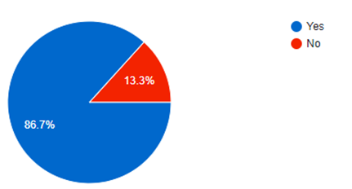
5.Is the Class-Band method elements applicable in your particular learning environment?

Slide 18
6.Are there any advantages/disadvantages of this method?
1.It learns students to concentrate, focus and be responsible for the class.
2.Yes, it makes my students more concentrated and focused, that leads to more serious learning.
3.We were able to take an idea and try to develop the principles.
4.Students learn to work together, to listen each other.
5.Yes. This method increases team working, focusing on the subject skills of my students.
6.Advantages : focused on all competencies. Disadvantages : sometimes students can become passive (sometimes interested , sometimes not)
7.Children learn how to play instruments,develop hearing and they start to understand music better.
8.Class Band method has many advantages: children learn to listen to each other, to be responsible for instruments, to collaborate working in the group. Learning an instrument demands concentration and discipline. The musical skills that young people develop through Class Band will help them in other musical activities outside school.
9.Yes, method makes my students tolerant, responsible and motivated.
10.It something new, inclusive, especially good for hyperactive children.
11.Great for musical minded teachers, not so good for musical novices.
12.Kids really like this method.
13.Advantage is that this method is motivating and encouraging.
14.Motivates students and their success increases.
15.It motivates students and improves students collaborating, creativity and team working skills.

Slide 19
7.Will you apply this music teaching method elements in the future?

Slide 20
8.Will you recommend Class-Band method to your colleaques?

Slide 21
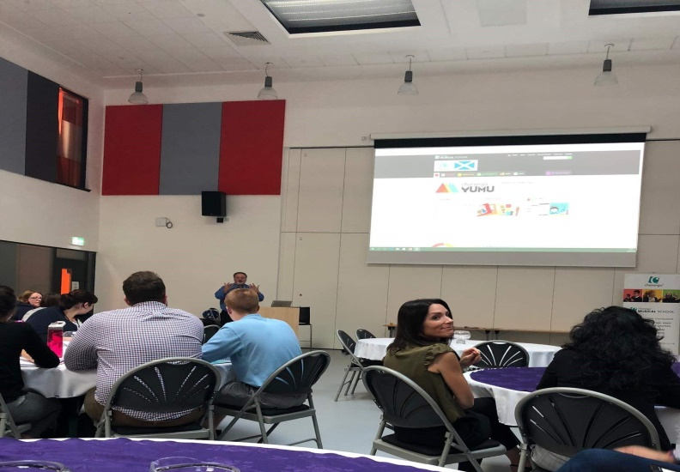
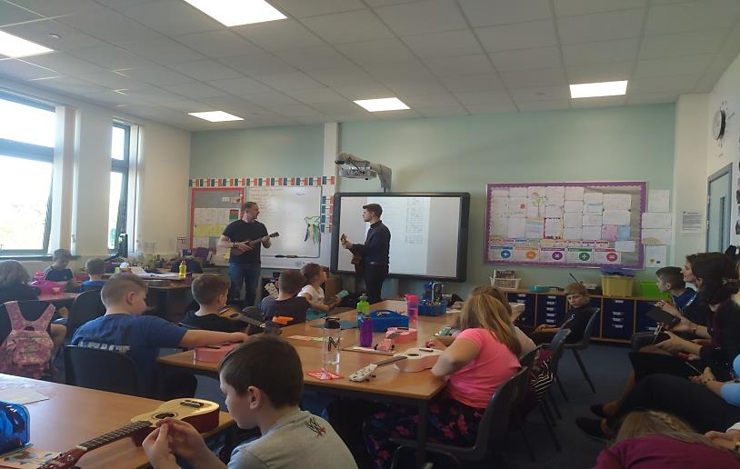
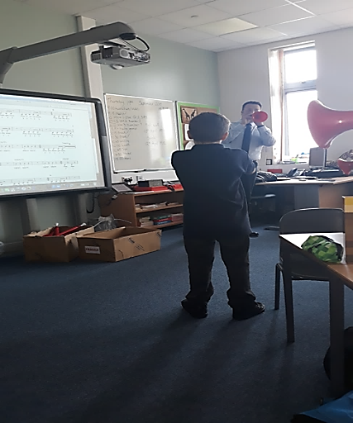
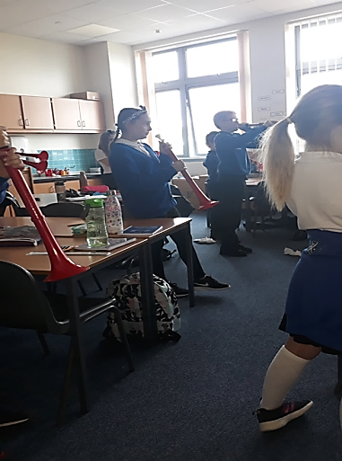
Singing to Learn, Learning to Sing questionnaire for teachers

Slide 22
1.Is the method mentioned above attractive to your students?

Slide 23
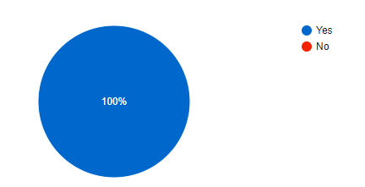
2.Is this method appropriate for tagged group students (Special needs, Roma/Syrian students)?

Slide 24
3.What especially they like/dislike?
1.They like new melodies, digital platform on a whiteboard screen, animation.
2.Mostly they like that they can move during activities.
3.They like to dance and move together with music, imitate and repeat sounds.
4.They like to move, dance and rhymth.
5.Children love to move, play and sing.
6.hey like to make music and learn together.
7.They are fond of music, rhythm exercises, they like to participate in public events.
8.Active listening to music; dance and sing with songs and videos; familiarity with the instruments; rythm activities; instrumental guesswork.
9.Singing, using of interactive board, variety of resources.
10.They like to touch musical instruments and try to play them.
11.Students like singing, exercises with dancing elements.
12.They like dancing to music, guess different music instruments, listen to sounds.

Slide 25
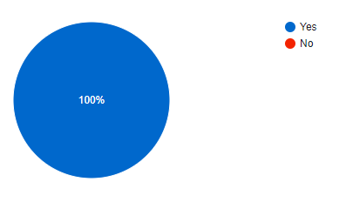
4.Is this methods motivating and encouraging students to learn?

Slide 26
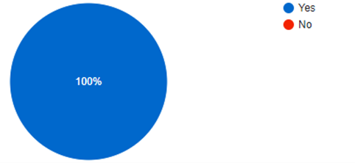
5.Is the method‘s elements applicable in your particular learning environment?

Slide 27
6.Are there any advantages/disadvantages of this method?
1.Yes, children learn to listen each other, to work in a team.
2.They are inclusive, interactive methods, which can engage and motivate students.
3.Yes, they are very motivating students, interactive and suitable for this age children.
4.They are attractive and motivating for students.
5.It would be great if a similar platform like Charanga were in Lithuania.
6.It is fun for students, they like it. Making music helps to develop individuality.
7.It fits perfectly with music program, teachers students to work in pairs, groups.
8.Advantages:everything is in one platform; easy to use; create your own lessons; many interesting topics.
9.Have to enrol and pay for subscription to site and be familiar with the resource online.
10.This approach met all expectations.
11.They are encouraging students‘ creativity and helping to absorb new knowledge, raising motivation and communication and collaborative skills.
12.Kids learn to hear different sounds, understand rythm, learn some dance movements.

Slide 28
7.Will you apply this music teaching method in the future?

Slide 29
8.Will you recommend this method to your colleaques?

Slide 30
C.Orrf‘s method questionnaire for teachers

Slide 31
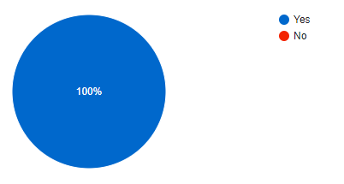
1.Is C.Orff‘s method attractive to your students?

Slide 32
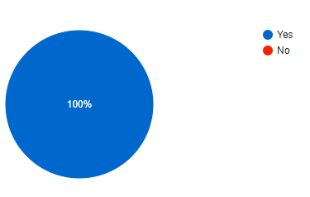
2.Is C.Orff's method appropriate for tagged group students (special needs, Roma/Syrian students)?

Slide 33
3.What especially they like/dislike?
1.Rythms with cups.
2.Choose different melodies, songs, share their likes/dislikes, to discuss what are characteristics of different cultures.
3.Adapt their movements to music.
4. They do not feel different, language barrier vanishes.
5. Be a part of the team, to be important, to create something together.
6. Experience music, rhythm, dance, language.
7. Move, dance and feel relaxed.
8. Beating rhythms, dancing and free atmosphere in tha class.
9 Dancing, moving and improvising.
10. Feel free and related to others.
12. Play, sing, move and rhythm and they are better at that than mainstream students.
13.To imitate, explore space, sounds and play the drums.
13.They are doing well in these activities.

Slide 34
4.Is this method motivating and encouraging students to learn?

Slide 35
5.Are C.Orff's method's elements applicable in your particular learning environment?

Slide 36
6.Are there any advantages/disadvantages of C.Orff method?
1.It‘s easy, funny and attractive.
2.Helps unite the class.
3.It has advantagesin motivating students.
4.The advantage of this system is the synthesis and artistry of the tools, activities. It is based on the most natural need of a child - move, improvise, use body movements, instruments, sing.
5.This method blends music, language and dance, develops children's motor skills, ability to focus and concentrate.
6.This method develops children's imagination, playfulness and experimentation.
7.Advantages only. Children feel relaxed, peaceful and tend to create.
8.It is motivating, students want to play, sing, beat and improvise.
9.This method improves children‘s creativity and imagination.
10.Children are encouraged to compose, express themselves.
11.This method allows to include SEN students into the learning process and that motivates them to attend school.
12.My SEN students experience a sense of success and that motivates them.
13.It allows to create sounds, rhythms using simple household objects.

Slide 37
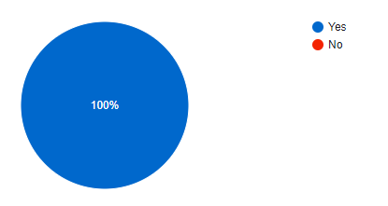
7.Will you apply this music teaching method in the future?

Slide 38
8.Will you recommend this method to your colleagues?

