Slide 1
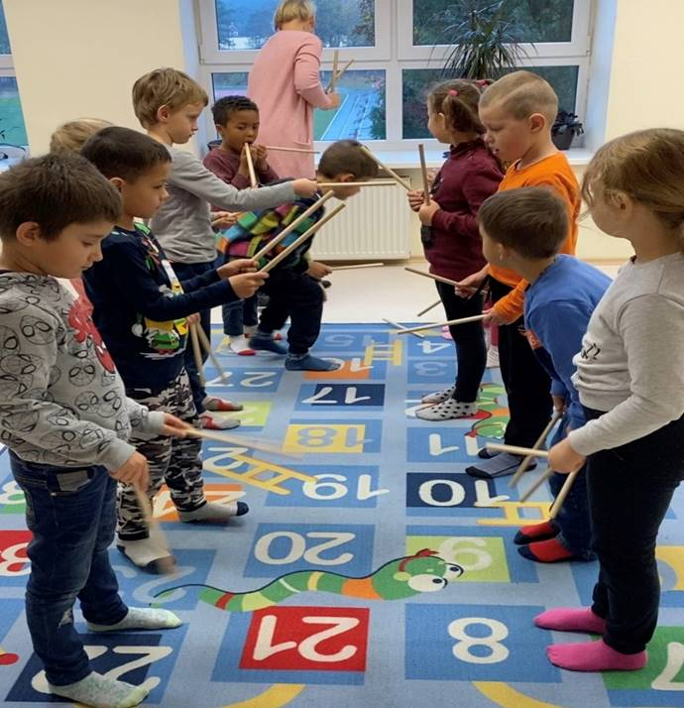
Evaluation of the project “Music is a common language” by students with special needs

Slide 2
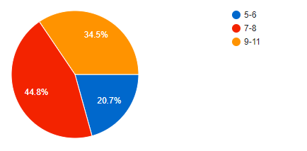
1.How old are you?

Slide 3
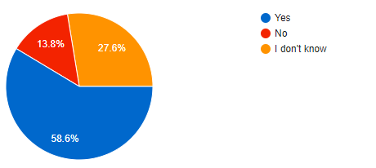
2.Do you like going to school?

Slide 4
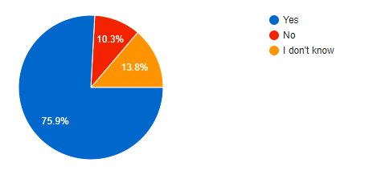
3.Do you like participating in project's "Music is a common language" activities?

Slide 5
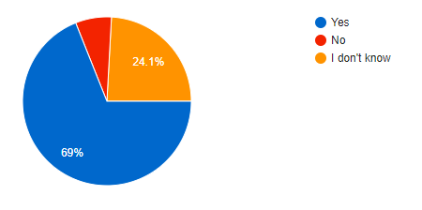
4.Do you like to play instruments, sing and dance during these activities?

Slide 6
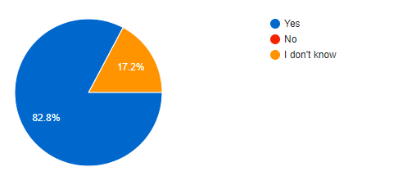
5.Do you like to participate in the project's activities with your classmates?

Slide 7
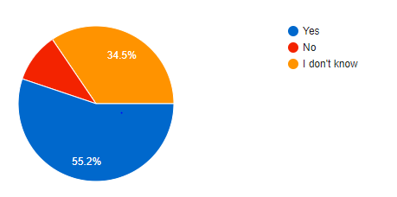
6.Has your behavior at school improved during the project?

Slide 8
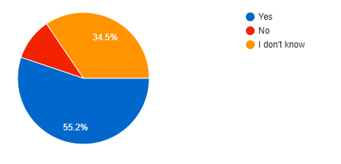
7.Do project's activities encourage you to learn?

Slide 9
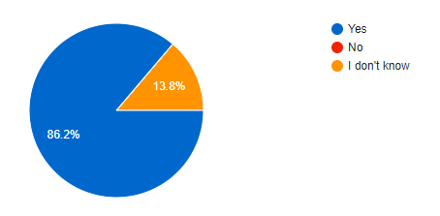
8.Do you feel relaxed during project's activities?

Slide 10
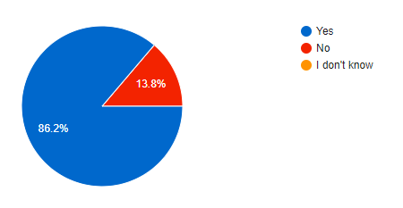
9.Do you make friends during project's activities?

Slide 11
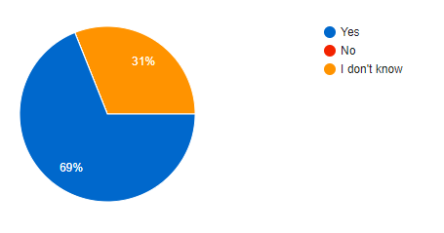
10.Do you feel needed in your class/group during these activites?

