Slide 1
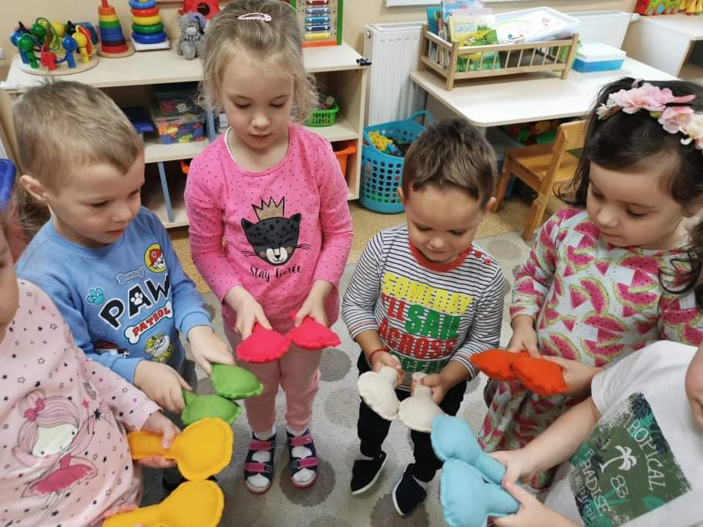
Evaluation survey of Erasmus+ project "Music is a common language" for parents

Slide 2
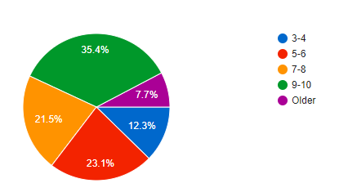
1.How old is your child?

Slide 3
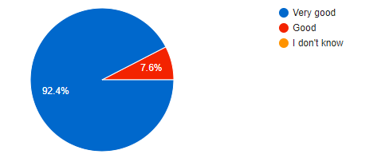
2.How do you evaluate your child's involvement in the project?

Slide 4
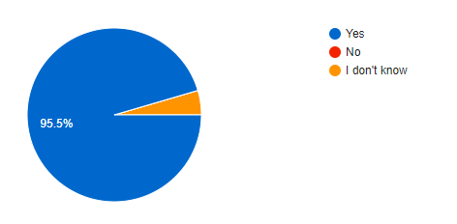
3.Do you think that different teaching methods and attractive activities make educational process more interesting and exciting for children?

Slide 5
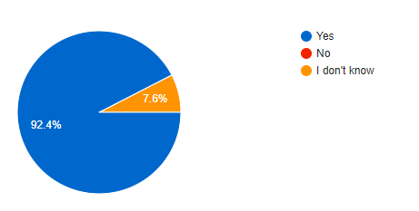
4.Do you think that this project gave the children with special needs opportunities to become more involved in the educational process?

Slide 6
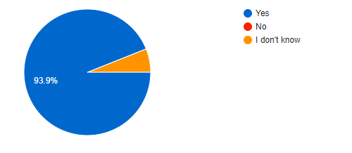
5.Do you think that your child's emotional background improved during the project?

Slide 7
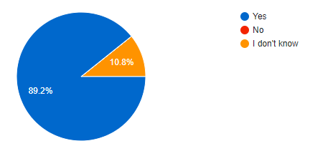
6.Do you think that your child's social behavior improved during the project?

Slide 8
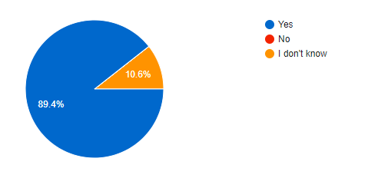
7.Do you think that applied music teaching methods and activities improved your child's creativity, confidence, self-esteem?

Slide 9
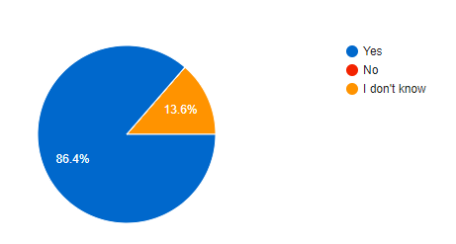
8.Do you think that applied new music teaching methods have improved your child’s physical well-being?

Slide 10
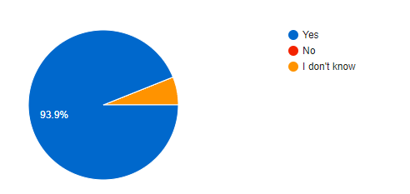
9.Do you think that teachers' participation in the project and professional development positively affect the quality of education in the school?

Slide 11
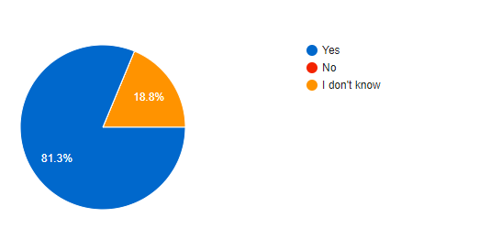
10.Do you think that participating in the project has made the school more attractive and popular?

