Slide 1
Students’ Well-being questionnaire results

Slide 2
The aim of the questionnaire
1.To identify how the application of new music teaching methods affect children's emotions, feelings, physical well-being and social behavior and to compare the results of the same polls at the beginning and the end of the project.

Slide 3
Juodšiliai „Šilas“ gymnasium

Slide 4
Juodšiliai „Šilas“ gymnasium

Slide 5
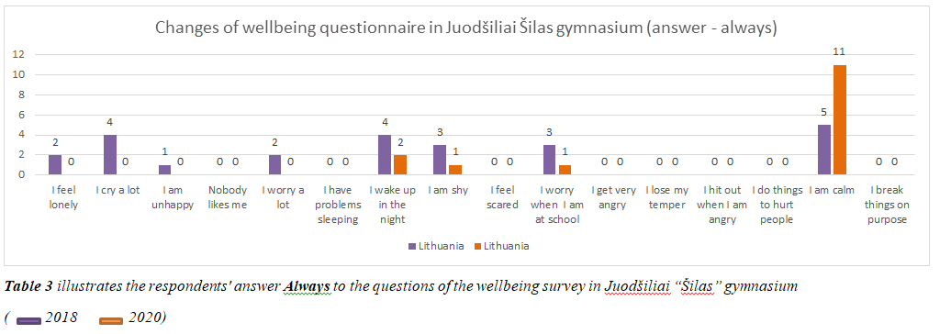
Juodšiliai „Šilas“ gymnasium

Slide 6
Lockerbie primary school

Slide 7
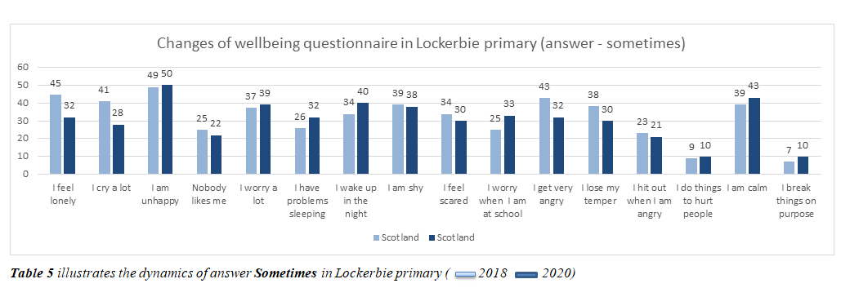
Lockerbie primary school

Slide 8
Lockerbie primary school

Slide 9
Vehbi Necip Savasan primary school

Slide 10
Vehbi Necip Savasan primary school

Slide 11
Vehbi Necip Savasan primary school

Slide 12
Conclusions
1.Listening to music, singing and making music impact children‘s emotions and feelings positively. Applied new music methods have a calming effect, reduce negative emotions, uplift the spirit of children from project target groups. After examining and analysing the responses to 9 statements that reflect children’s emotional state, it was revealed that the overall improvement of all emotional indicators in all three project partner schools is 87% (Lithuania-100%, Scotland-90%, Turkey-70%). Especially positively improved indicators (in all 3 schools) : I am shy 77% I cry a lot 42% I get very angry 41% I feel scared 37% I feel lonely 34% I am unhappy 28% I am calm 26% I worry a lot 11% I lose my temper 10%.

Slide 13
Conclusions
2. Incorporating new music teaching methods into the curriculum increased social bonds, allowed to improve social adjustment and positively changed children's attitudes to relationships with friends, teachers.That facilitates team work; increases self esteem; builds confidence. Responses to 5 statements that reflect social and behavioral indicators demonstrate the improvement by 33% in general in all 3 project schools. The most signifact change is notable in statements Nobody likes me 49% I break things on purpose 37% I do things to hurt people 37 %. Next 2 indicators also reflect positive tendency I worry a lot when I am at school 32% I hit when I am angry 10%.

Slide 14
Conclusions
3. Implemented new music teaching methods provided learning motivation and improved children's general physical ability. Through reduction of muscle tension and the improvement of coordination and movement, music is a beautiful way of assisting children's physical development. Analysis of the responses to 2 statements related to children's general physical well-being revealed that this indicator has improved by 9% in general in all 3 project schools. Although the improvement in this area is not very significant, it is still positive: I have problems sleeping 6% and I wake up in the night 11%.

Slide 15
Conclusions
4.Comparing the results of the survey of special needs students with the group of students in which they participated together with mainstream students, it can be stated that the well-being results of SEN students improved significantly more than in the group in which they participated together with the mainstream students. The overall improvement in all survey indicators was 92% in the groups with children with special needs (98% in Juodšiliai „Šilas“ Gymnasium, 86% in Vehbi Necip Savasan Primary School), while in the group with all students together it is 50% (Lockerbie primary school). Thus, the application of various music teaching / learning methods has a much more positive effect on the emotional, psychological and physical well-being of the target group of children, which facilitates and expands their opportunities to become more involved in the educational process.

