Slide 1
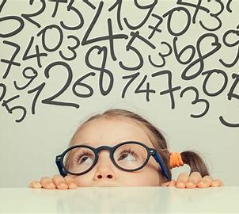
Dyscalculia and Math Anxiety
Training 20th May – Supporting Learners

Slide 2
Overview
Definition and Indicators of Dyscalculia
Process for Identification
Supporting learners with Dyscalculia and Maths Anxiety

Slide 3
Scottish Working Definition of Dyscalculia
Dyscalculia is a neurodevelopmental learning difference which can co-occur with a range of other specific learning needs.
Dyscalculia can be described as a specific difficulty in understanding number and number processes which persists despite the provision of appropriate learning opportunities. It is distinguishable from other challenges associated with numeracy and mathematics due to the:
Persistent inability to understand and or retrieve numerical facts from memory
Use of underdeveloped procedures and processes
Severity of difficulties with number sense.

Slide 4
What we know:
Less research has been done into dyscalculia than into dyslexia.
Around 4-6% of the population have dyscalculia whilst 4 -10% are dyslexic.
Learners whose parents have dyscalculia are ten times more likely to have it.
50% of learners with dyscalculia have siblings who also have it.
Notes:
As mentioned previously little research has been carried out in this field but some factors on this slide are known.
Though environmental factors can affect difficulty in mathematics and dyscalculia, research has proven that biological influences play a significant role too.
Learners whose parents have dyscalculia are ten times more likely to have it too compared with members of the general population. Similarly, 50% of learners who have dyscalculia have siblings who have it too.

Slide 5
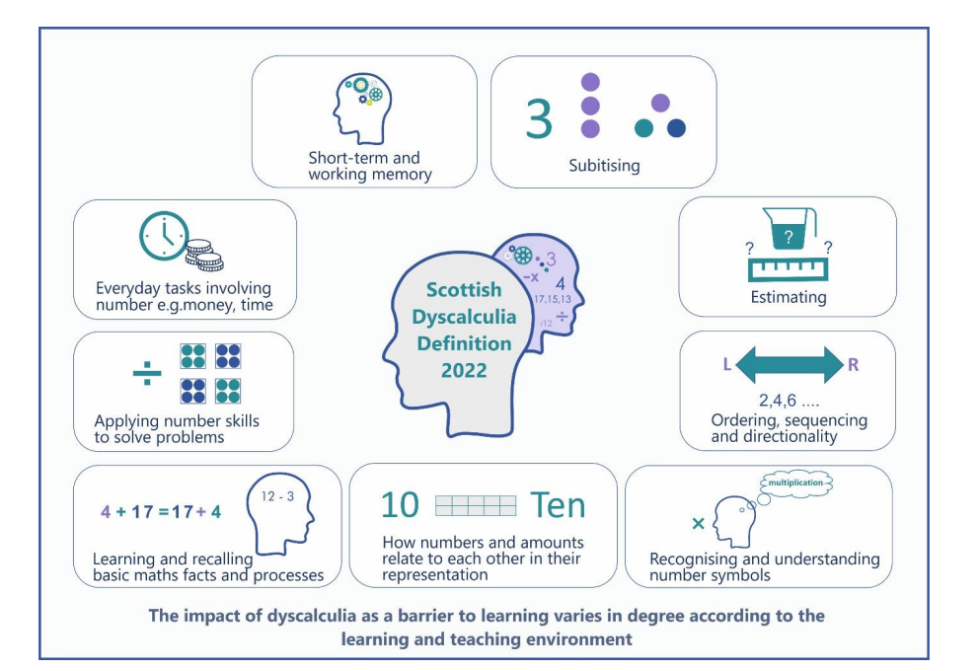

Slide 6
Indicators of Dyscalculia
An inability to subitise even very small quantities
Poor number sense
Inability to generalise
Magnitude processing difficulty
An inability to estimate whether a numerical answer is reasonable
Inability to notice patterns
Immature strategies- for example counting all instead of counting on
Directional confusion
Problems with all aspects of money
Marked delay in learning to tell the time
Notes:
Judy
Subitising comes from Latin= ‘Sudden’
It is the ability to give the amount of objects in a set without counting
Most people can subitise up to five or six objects
Dyscalculic people do not have this ability- they may not even be able to subitise a set of two items
Is this innate? Are we born with the ability to assess quantity?
Yes, being able to identify quantity is a survival instinct and is innate in us all- but people with dyscalculia may not have this ability
Number sense
The ability to determine the number of objects in a small collection, to count, and to perform simple addition and subtraction, without direct instruction.
Spoken language and number sense are survival skills but abstract maths is not.
Go through each of these indicators and discuss with the group;
Do they recognise these difficulties in any of their learners?
Why and how would these difficulties impact on their ability to learn maths
Main ones to highlight are- inability to subitise, persisitance in using immature strategies, inability to notice patterns, and inability to estimate.

Slide 7
Dyscalculia can affect:
short-term working memory
subitising (the ability to see and count numbers instantly)
estimating
ordering, sequencing and directionality
recognising and understanding number symbols
how numbers and amounts relate to each other and their representation
learning and recalling basic maths facts and processes
applying number skills to solve problems
everyday tasks involving numbers (for example: money or time)

Slide 8
Dyscalculia can be associated with difficulties with two fundamental numerical concepts
Dyscalculia
Number Sense
Subitising
Notes:
Learners with Dyscalculia encounter difficulty in developing number sense. Research has shown that the Dyscalculic learner has particular difficulties with subitising. It is not that they can't develop number sense it's just that more time is required with Dyscalculic learners to develop these concepts conceptually.

Slide 14
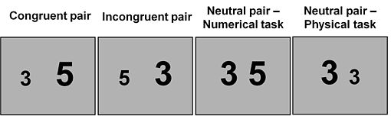
Numerical stroop

Slide 15
At all stages, dyscalculia is on a continuum varying from mild to severe, with a range of strengths and difficulties which are affected by the nature of the activity undertaken, the learning environment and any coping strategies and support in place. As a result, every individual with dyscalculia will differ in how they are affected and in the level of severity experienced.

Slide 16
Strategies to help
Concrete Pictorial Abstract
Using dot patterns
Cuisenaire Rods
Two coloured counters
Notes:
Judy

Slide 17

Learners with dyscalculia will benefit from:
  Appropriate early identification, support, planning and review.
  Tailored support - for example, actively encouraging the use of specific materials which may include concrete materials and visual representations.
  Effective, inclusive learning and teaching pedagogical approaches and environments.
Notes:
The Scottish definition is explicit in its recognition that early identification where possible is important and that planning for supporting learners should be an ongoing process that is reviewed regularly. It is important to help learners identify which supports work for them, and that their use is encouraged. It is also recognised that sound pedagogical approaches and the use of concrete materials and visual approaches at all stages will be of particular support to learners with dyscalculia.

Slide 18
Start from what pupils know
Planning of learning, teaching and assessment must begin from where the learner is at.
"The most important single factor influencing learning is what the learner already knows. Ascertain this and teach (them) accordingly."
(Ausubel, 1968)
Notes:
These statements look quite simple and innocent, but of course, they describe something quite profound. In numeracy and maths, every new piece of learning builds upon a wealth of knowledge and skills that have come before. Some of these are really fundamental such as visual perception, visual memory, motor skills and spacial awareness. Learners need to shown or come to understand how their learning links together and where new learning links in to the network of knowledge and understanding they already have.

Slide 19

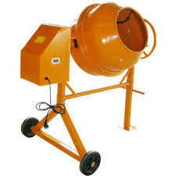
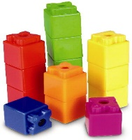

Iconic
Enactive
Symbolic
Concrete
Pictorial
Abstract

Slide 20
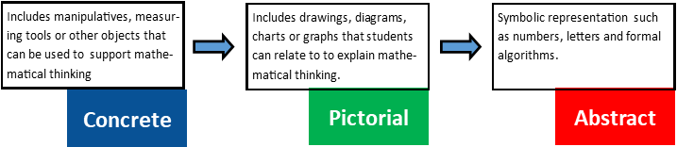



Concrete, pictorial, abstract (CPA)
CPA is an approach to teaching that develops a deep and sustainable understanding of maths. Developed by American psychologist, Jerome Bruner, whose premise was that children’s conceptual understanding develops from being actively engaged in three stages of learning: enactive, iconic and symbolic.
1 + 1 = 2
Notes:
Key to progression is building firm foundations rooted in understanding as opposed to memorising processes. Multiple representations of concepts, such as these for addition, can help learners develop a deeper understanding of mathematical concepts. Learners should develop understanding through the use of concrete materials and visual approaches, only moving on to abstract notation and purely written methods when the understanding is embedded.
This approach, which is called the Concrete, Pictorial, Abstract approach is becoming more and more widespread in Scottish schools. It isn’t new, and has a solid research base and evidence of success. It also isn’t linear. Whenever learners move on to something new, introducing the concept with concrete or visual representations is really worthwhile at whatever the stage – mid and upper primary, and into secondary. Groups of learners can also tackle more similar tasks when the differentiation comes in the way of what scaffolding is used. Learners can move towards abstract thinking when they have built up their understanding and confidence, and the aim is always still developing fluent abstraction where possible. Accurate efficiency is still the goal, as it enables learners to focus on applying their skills to solve problems.
In a really simple way, this progression is illustrated with one apple and one more, where learners might be counting apples at snack time. Learners might then move to using pictures of apples or dots or other marks to represent items. Then learners move on to using symbols to represent numbers, along with other mathematical notation.

Slide 21
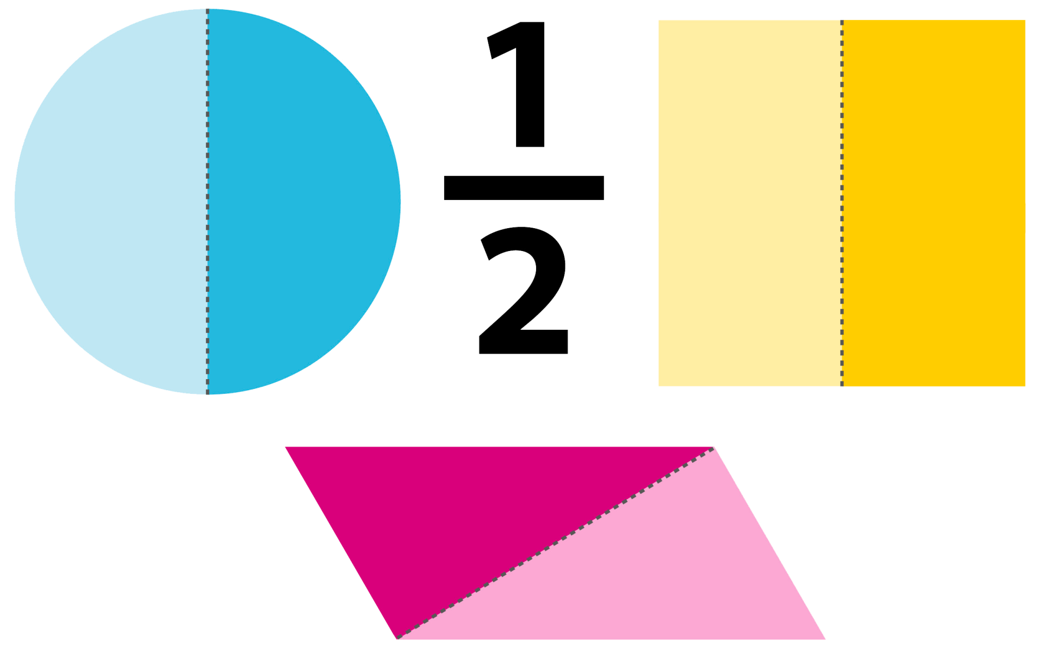
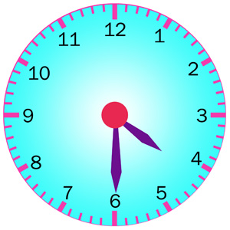
Making connections across concepts
Working with arrays for multiplication leads to work on division, area work, algebra, patterns.
When working with fractions, visual representations of halves and quarters lead to representations of half past and quarter past on a clock, symmetry and turning through angles.
Notes:
Key to developing mathematical thinking and conceptual understanding is to be explicit as to how elements of numeracy and maths are linked together. Here are just two examples…

Slide 22
Deep Learning
    "..consolidating understanding of mathematical concepts and procedures and making connections among ideas".
(J Hattie, 2016)
Notes:
John Hattie describes all of this as Deep learning, consolidating understanding of mathematical concepts and procedures and making connections among ideas. It is really useful to reflect on this – how do we give our learners opportunities for deep learning? Here are a few final ideas

Slide 23

Having lots of discussions
Representing, thinking, talking, agreeing and disagreeing.
Notes:
It’s great for learners to talk about their maths. Developing the mathematical behaviours of justifying their ideas and forming a reasoned argument. Sometimes there is more than one right answer. Sometimes we might be looking for an optimal answer. How do learners know they have a valid answer and how could they be sure their answer is the optimal one?

Slide 24
Repetition, over learning and access to appropriate accessible resources.
Number bonds
Times tables
Visualisations
Mathematical language
Notes:
You may hear from a range of sources that repetition and rote learning are frowned upon. Teachers have been told that drill-and-practice dulls students’ creativity (Heward, 2003) and that rote learning in math classes robs all students of the opportunity to develop their creative potential (Elliott, 1980) and will kill their motivation to learn (Heffernan, 2010).
When properly conducted, however, drill-and-practice is a consistently effective teaching method and should not be slighted as “low level,” and appears to be just as essential to complex and creative intellectual performance as they are, for example, to the performance of a virtuoso violinist (Brophy, 1986). A meta-analysis of 85 academic intervention studies with students with learning disabilities, carried out by Swanson and Sachse-Lee (2000), found that regardless of the practical or theoretical orientation of the study, the largest effect sizes were obtained by interventions that included systematic drill, repetition, practice, and review. What we’re saying here really is use it or lose it. Repeat little and often the deliberate practice of number bonds, times tables, visual representations and correct use of mathematical language so they become automatic and free up the brain so learners can unleash their creativity.

Slide 25
Using Dot Patterns
Dot patterns
Bridge the gap between concrete and abstract work
Will help develop a sense of number
Will help develop the concept of conservation of number
Can be linked to familiar patterns eg dice or dominoes
Notes:
Using dot patterns is a great way to develop an understanding of number and to help dysclaulic learners to compare quantities. It will also develop there ability to subitise greater quantities
Dot patterns sheet

Slide 26
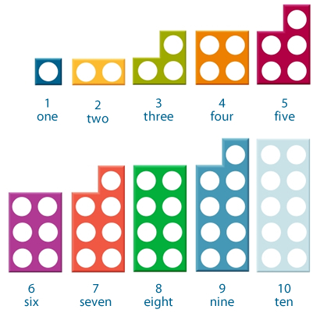
Numicon
Notes:
Commercially great to manipulate great odd and even
Stick to one pattern to begin with
Looking for a strong visual image of the pattern.
What could be limitations of this- or problems with this
( eg strong rep could mean inability to generalise- how would you over come this?)

Slide 27
Number Patterns Dorean Yeo
1 2 3

Slide 28
Number patterns
4 5 6

Slide 29
Number Patterns
7 8 9

Slide 30
Number Patterns
10
Notes:
These are the dot patterns that Dorian Yeo used- ( she was a very emanent dyscalculia researcher) Chinn uses a diffferent pattern. It does not really matter as long as you choose a pattern and stick to it. Once the child is familiar with the pattern then you can introduce different formations and use this to teach the conservation of number.

Slide 31
Chinn Patterns
Notes:
Based on 5 +
Help bridge through 5 +5=10 5+6=5+5+1=11

Slide 32
Chinn Patterns (5 and a bit)

Slide 33
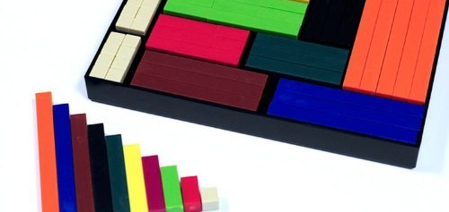
Notes:
Cuisenaire rods- reference Ronit Bird’s books on these
Dyscalculia Toolkit and Overcoming Difficulties with Number

Slide 34
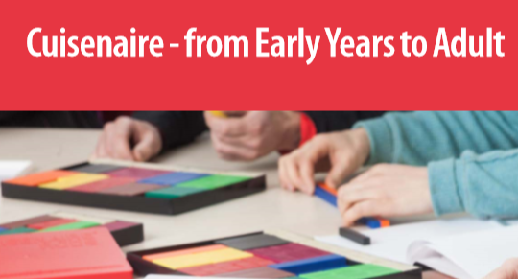
by Mike Ollerton, Simon Gregg and Helen Williams

Slide 35

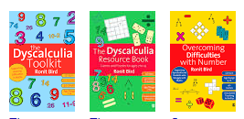
Ronit Bird

Slide 36


Slide 37
Why use them?
They are a continuous manipulative
Discrete or continuous manipulatives?
Continuous manipulatives avoid the counting trap
Sophisticated and versatile

Slide 38
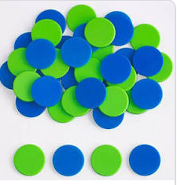
Two coloured counters

Slide 42
Visual Algebra
2x + y = 10

Slide 43
What is the Bar Model?
The bar model exposes the relationships within the structure of the mathematics.
It is used to find the unknown elements in the context of part/part/ whole relationships.
This supports the development of algebraic thinking.

Slide 44
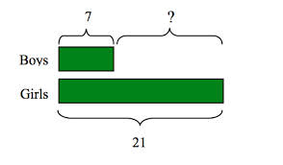
Bar Modelling

Slide 45
Types of Bar Model
Part/Part Whole model
Comparison Model
Before and After Model
This Photo by Unknown Author is licensed under CC BY-NC

Slide 46
Thomas and James Problem
Thomas has 4 times as much money as James. Together they have £200. How much money does James have?
Common Misconceptions
Do we need to divide 200 by 4 ?
Do we need to multiply 200 by 4?

Slide 47
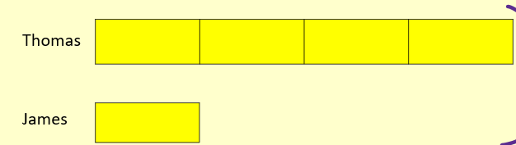

Slide 48
Thomas and James Problem
Thomas
£200
James

Slide 49
Why identify?
The identification of dyscalculia and the understanding of what it means can be extremely important to the learner’s wellbeing and their family and this should not be underestimated.

Slide 50
Needs Led Support
Receiving appropriate additional support is not dependent upon the formal identification of a specific need or label such as dyscalculia. However, this should not mean that schools and local authorities are not supportive of formally identifying additional support needs such as dyscalculia.

Slide 51
These difficulties often do not reflect an individual's cognitive abilities. They may not be typical of performance in other areas and cannot be attributed to other factors, for example gaps in learning, developmental, genetic and neurodevelopmental differences which include autism, dyslexia, FASD, ADHD, intellectual disabilities.
The impact of dyscalculia as a barrier to learning varies according to the learning and teaching environment.

Slide 52
Dyscalculia exists in all cultures and across the range of abilities and socio-economic backgrounds.
Learners with dyscalculia can continue to make progress in mathematics but may do so at a different pace.
Dyscalculia is likely to be a genetic, life-long, neurodevelopmental difference.
Unidentified, it could result in mathematics anxiety, low self-esteem, high stress, atypical behaviour and low achievement. This can have associated impacts on opportunities in adult life.

Slide 53
Dyscalculia Identification Pathway
Use a contextualised , dynamic and holistic assessment approach in the same way we do for dyslexia.
Involve learners and families in the process
Be mindful that parents, carer is and children over 12 years old have the legal right to request an assessment and this should be started within 10 weeks of the request.
Notes:
Forms link

Slide 54
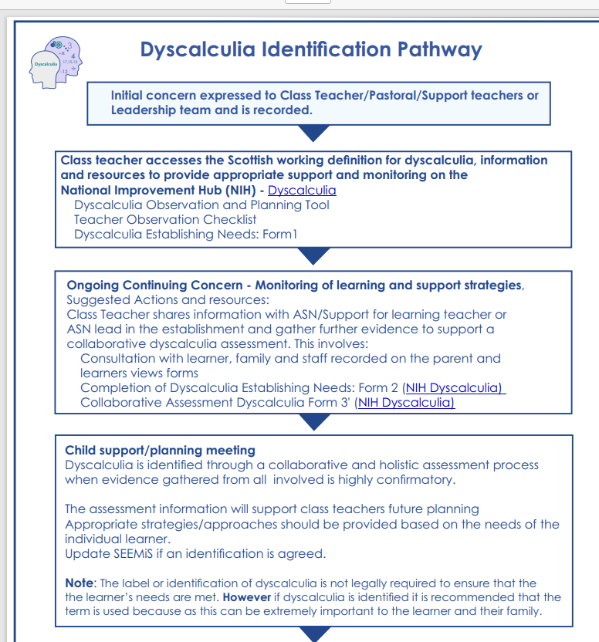

Slide 55
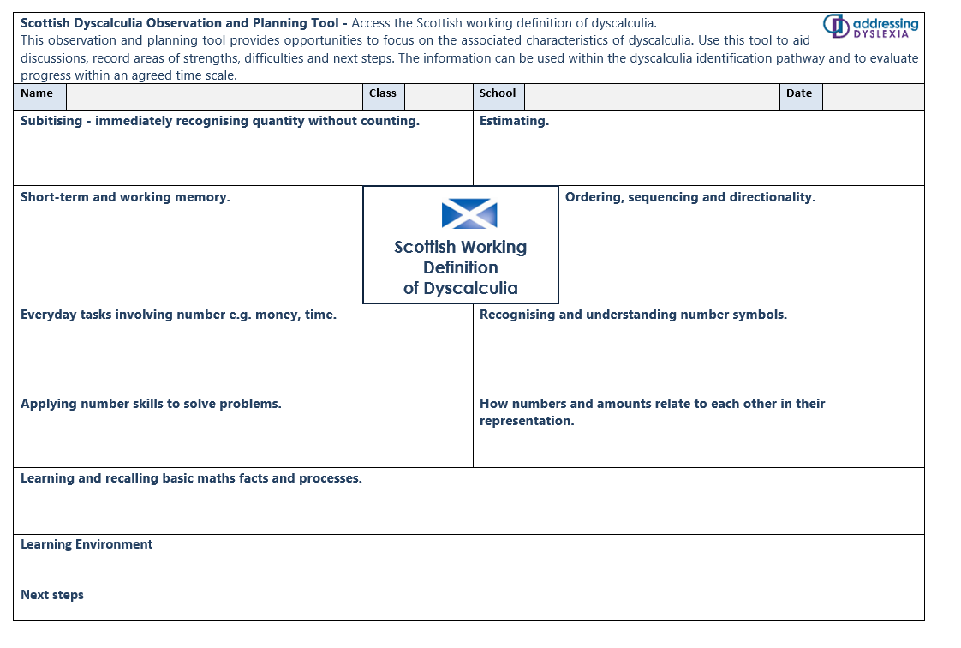

Slide 56
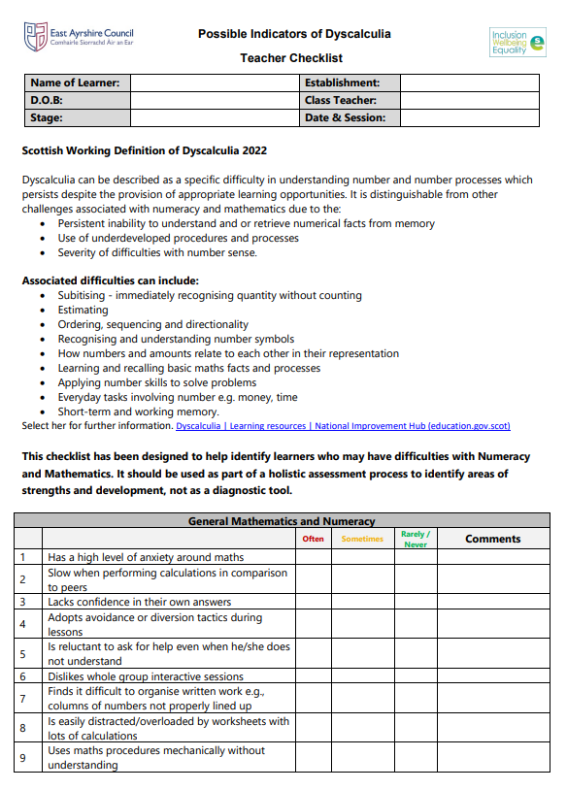


Slide 57
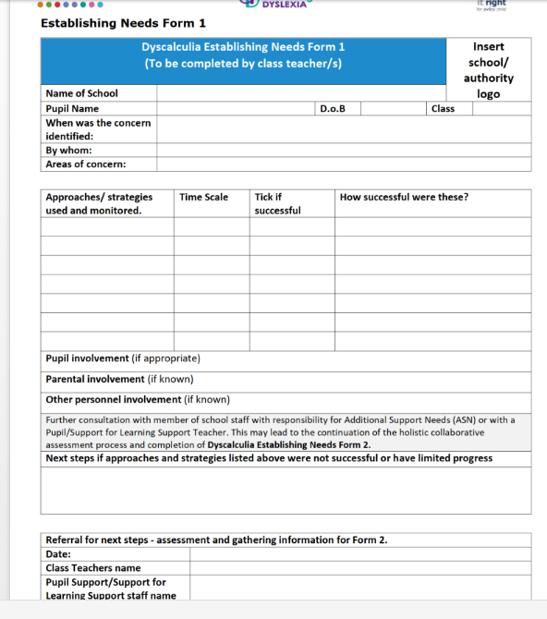

Slide 58
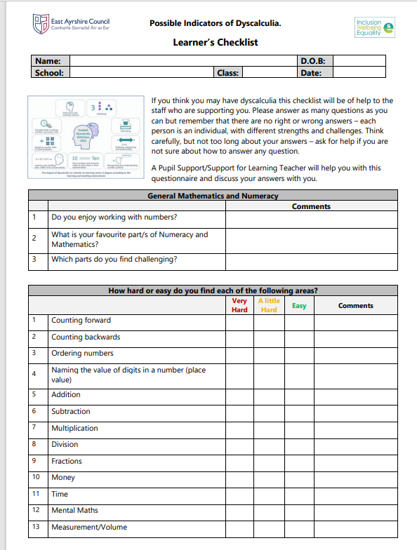
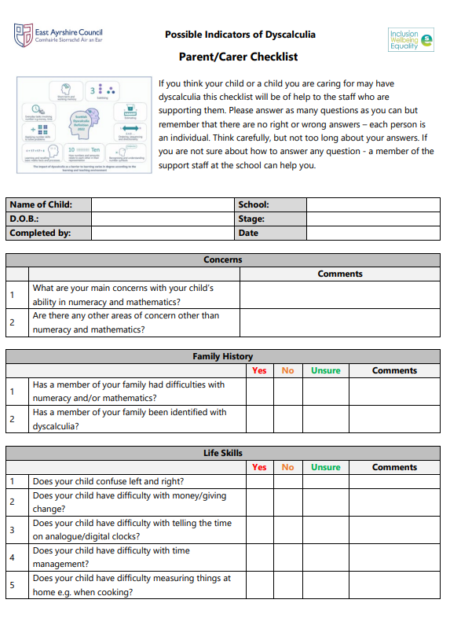

Slide 59
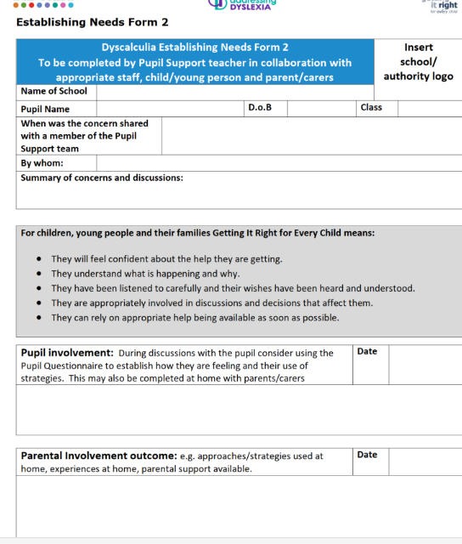

Slide 60
Identification of dyscalculia
Dynamo Maths
Dyscalculia Screener
DANS
More Trouble with Maths
IDL Numeracy
SNAP Maths

Slide 61
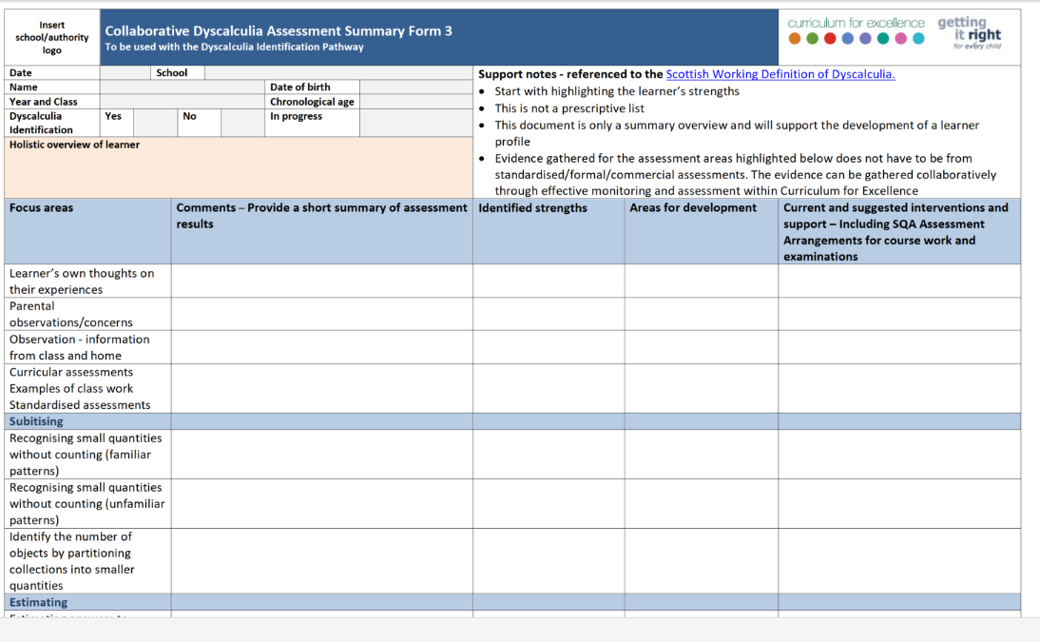

Slide 62

What is Maths Anxiety?
This Photo by Unknown Author is licensed under CC BY

Slide 63
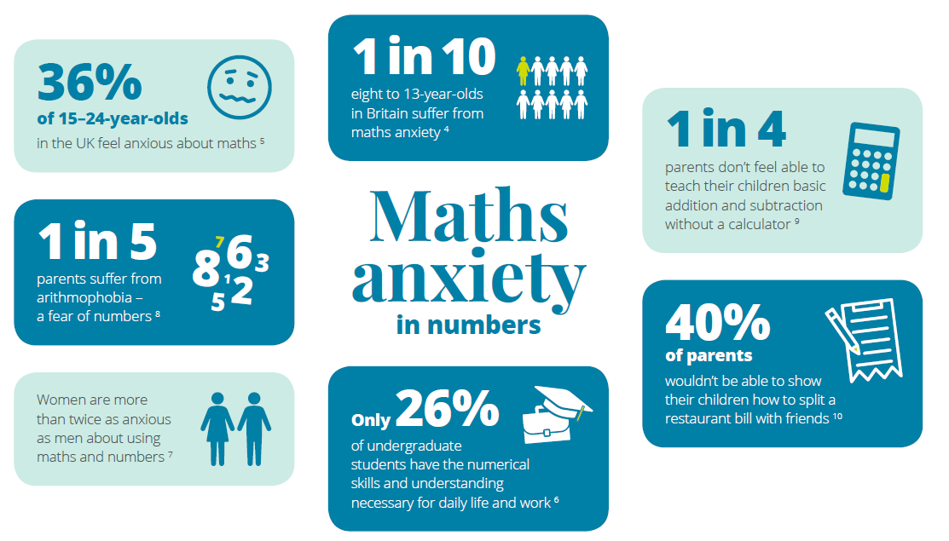
Pearson.com

Slide 64
Maths Anxiety- Definitions
Maths anxiety has been defined as
‘the panic, helplessness, paralysis, and mental disorganization that arises among some people when they are required to solve a mathematical problem.’
Tobias and Weissbrod (1980)
Notes:
Brain not wired for abstract maths

Slide 65
Maths Anxiety can be related to:
Life Experiences
attitudes of parents, teachers or other people in the learning environment
some specific incident in a student’s maths history which was frightening or embarrassing
poor self-concept caused by past history of failure
Notes:
Learner’s attitudes
Lack of belief in ability
Lack of faith in intuition
Negative beliefs
Giving up before really trying
‘Dropped stitch’ thinking
Depression
Fear of failure

Slide 66
Maths Anxiety can be related to:
Teaching Techniques
Anxiety can be caused by teaching techniques which emphasize:
  timed activities
  the right answer
  speed in getting the answer
  competition among students
  working in isolation
  memorization rather than understanding

Slide 67
Maths lessons
“Evidence suggests that math anxiety results more from the way the subject is presented than from the subject itself.”
J. Greenwood (1984)
Notes:
Few maths classes are structured in such a way as to relieve anxiety. There will always be time limits, right answers, and competition. Reducing maths anxiety will not make students ‘smarter’ in maths. However, it could allow a students to reach their full potential

Slide 68

Climbing a broken ladder

Slide 69
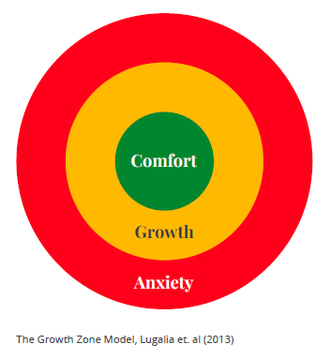
Growth Zone Model
The comfort zone
familiar tasks independently,
building self-confidence
practice and automaticity
The growth zone
new learning happens
safe to make mistakes, get stuck, require support
activities may be challenging and tiring
The anxiety zone
Beyond learner’s reach for now
threat rather than challenge,
stress increases, cognition decreases, and little or no learning

Slide 70


Reflections
How could you make use of the Scottish Definition of Dyscalculia in your setting?
What are the key messages you take away from this presentation?
How can this definition be shared more widely in your setting and what are the professional learning needs of your colleagues?
Notes:
Now we have looked at an overview of the challenges commonly faced by learners with Dyscalculia and some of the strategies that can be used to support them, here are some questions you may wish to use to reflect on your own practice.

