Slide 1
Neurodiversity in the workplace
Sharron Harper
Depute Principal Educational Psychologist
Dumfries and Galloway Council
13th December 2024

Slide 2
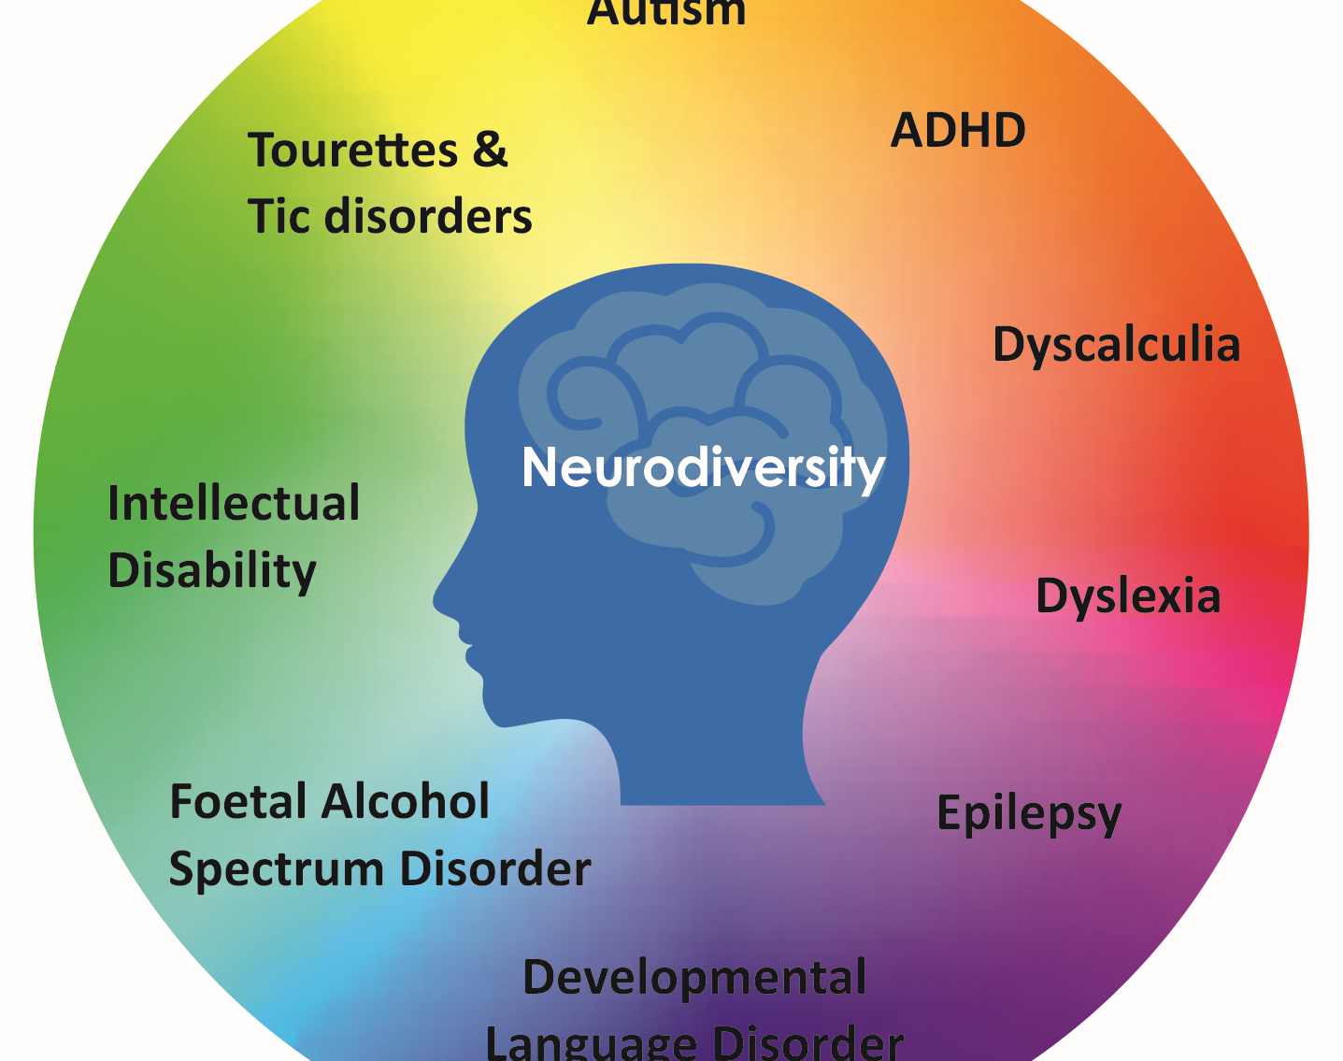
It is estimated that around 1 in 7 people (more than 15% of people in the UK) have neuro-developmental differences, including autism, which are observed when they learn and process information in a particular way.
Notes:
There is a range of diagnosed neurodevelopmental conditions, which commonly co-occur including autism, ADHD, intellectual disability, fetal alcohol spectrum disorder (FASD), developmental co-ordination disorder (DCD) (previous known as dyspraxia), developmental language disorder (DLD) and specific learning difficulties. Although not all adults are identified or diagnosed formally, we now understand that: • 10-15% of the population have one or more neurodevelopmental conditions and these usually co-occur • 2-3% of the population are autistic • 3-5% have ADHD • 6-17% have FASD • around 8% have DLD • 2-6% have DCD Although these are not mental health conditions, the consequence of being neurodivergent in our current society, is that co-occurring mental health conditions are common

Slide 3
What is Autism?
Autism is a lifelong neurodevelopmental difference affecting the way a person communicates and interacts with others, how information is processed and how the person makes sense of the world.
https://youtu.be/6lp09wSMPeM
Notes:
As with all people, each autistic person has their own unique profile of strengths, abilities and challenges. For this reason, it is important that approaches to support are responsive to the individual. There are however, some common threads underlying the autistic experience which it can be helpful to consider when planning for support. The Scottish Government Different Minds website was created in partnership with autistic people:

Slide 4
A wee word about terminology
Neurotypical: the most common pattern of skills and differences seen in over 80% of the population
Neurodivergent: a different profile of skills and differences seen in less than 20% of the population.
Neurodiverse: all of us together/the whole population. The many different ways our brains work and learn.
Neuro-affirming: embracing all types of brains/respecting that differences are not negative things that need to be “fixed”.
Neurodevelopmental Disorders: medical labels/diagnoses used when assessing neurodivergent people.
Identity-First Language – ‘autistic person’
Notes:
In the autism community, many self-advocates and their allies prefer terminology such as “Autistic,” “Autistic person,” or “Autistic individual” because we understand autism as an inherent part of an individual’s identity

Slide 5
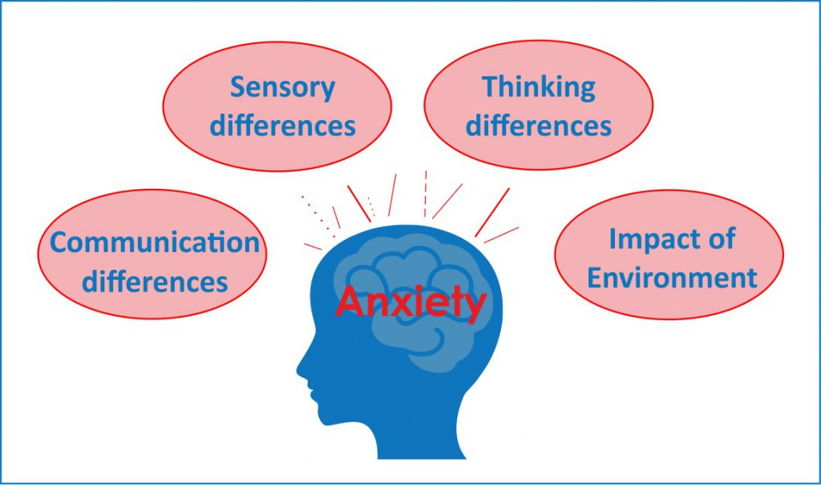
The autistic experience
Notes:
If these four aspects are not appropriately supported, an autistic person can experience anxiety and distress. For children and young people, there is a reciprocal relationship between the autistic learner and the environment – this includes the physical environment and the people around them. With appropriate understanding and adjustments,autistic people can flourish.
Autism is not a linear scale running from ‘high functioning’ to ‘low functioning’, which are unhelpful terms. Instead, autism varies in several different ways – sensory differences, levels of anxiety, social skills and executive functions all vary both from person to person and from time to time.

Slide 6
What differences might we notice #1?
Neurodevelopmental differences can affect people in a range of ways. This might include need for support with:
learning new tasks
being very active
paying attention to other people’s focus/being easily distracted
remembering things and being organised
understanding other people
talking and communicating with e.g. family, friends, colleagues or clients

Slide 7
What differences might we notice #2?
expressing feelings and emotions
controlling impulses and reactions
managing friendships and relationships with others
finding shared interests with others
strong preference for predictability/difficulty with unexpected things happening
daily habits and routines (e.g. sleep, eating, washing and dressing, organising your things, travelling to and from work, social activities)
places that are busy or where there are loud noises

Slide 8
How do neurodevelopmental differences affect people?
Although these differences will always be part of the neurodivergent person, they do not always have to be a problem. Environments and people can help – or they can make things worse. Some things that seem small to one person can be really hard for another person (e.g. being in a noisy, crowded place or coping with sensor beeps in a car).
Simple adaptations can make things easier (like adjusting light brightness or heating temperature).
Experiences and behaviours often change as people become adults. Some differences can become less of a problem and some continue. New challenges can arise because others expect more of adults.

Slide 9
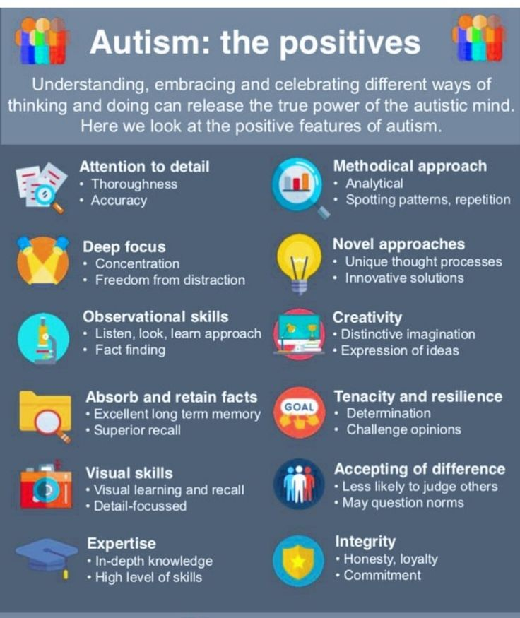
Focus on potential advantages in the workplace

Slide 10
The Neurotypical Majority
Our society is largely designed for the neurotypical majority, and living and working in this environment can require greater effort for neurodivergent people, with the outcome that individuals may be more likely to feel overwhelmed and overloaded or to experience meltdowns and shutdowns.

Slide 11
Employment Data
Recent data reports that 29% of autistic people are in employment (UK Office for National Statistics, 2021).
Current statistics may under-estimate the number of autistic and neurodivergent people in employment
Data about employment rates for neurodivergent people is hard to collect due to under-recognition or delays in diagnosis in adults
It is estimated that around half of autistic employees (self-identifying or diagnosed) do not share that they are neurodivergent.
Notes:
In one study, fewer than half of those who requested adjustments had them implemented. Autistic people we spoke to said: “We need a sea change in attitudes to neurodivergent people.” “My whole job history is typical of a late diagnosed autistic person. I’ve had so many jobs and careers. They lasted a maximum of 5 years… I felt like I wasn’t taken seriously. They didn’t take account of me being autistic.” “What helps me stay in the job? People who remember I’m autistic. In my experience that’s like 1% of people. In every scenario I have to remind people that this is a thing for me. When I do that, the change is made for a month, then it goes back…. Not having that ongoing support makes it challenging.”

Slide 12
Employment Barriers
Research findings:
Significant barriers to employment are experienced by autistic people-including stigma and discrimination-which can negatively impact mental health and job performance.
Employment is often precarious (short term, part-time, low paid) and individuals are under-employed or overqualified for the roles they have.
High likelihood of masking and non-disclosure (non-sharing) amongst those in employment.

Slide 13
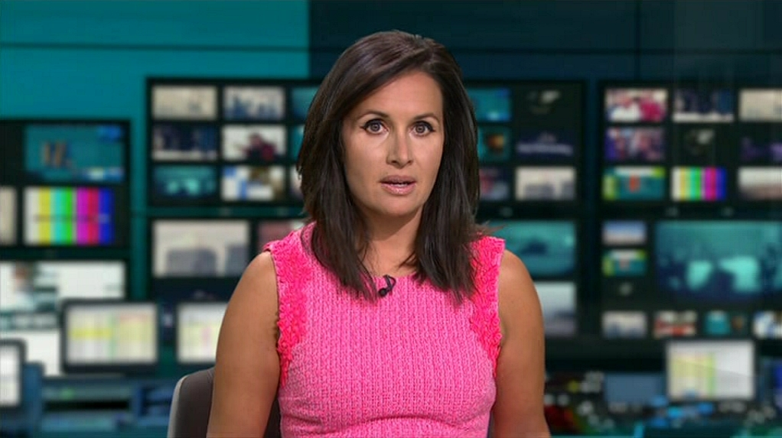
Notes:
Diagnosed autistic aged 50. Next slide has a link to an article from The Times about her understanding of how being autistic affected her at work. Mention women and girls.

Slide 14
Nina Hossain ITV Newsreader
https://www.thetimes.com/life-style/health-fitness/article/nina-hossain-my-autism-diagnosis-at-50-explained-so-much-lxfn55rvc
“My happy place is a live TV studio, where it’s totally unpredictable but I don’t have to mask anything,” she explains. “But in the office it’s different. I find small talk excruciating. So if you see me walking along a corridor with my head down, I’m not being scary or aloof — things I’ve been called at work. I just can’t pretend.
Her “worst-case scenario” is someone changing the Autocue script she’s written and only finding out when she reads it live on air. “The super-positive aspect of the way my brain works is that attention to detail and being a pedant, which is really good for journalism,” she says. “But something like that can just make my brain explode.”
Then there was the boss who noticed, eight years ago, that Hossain was suffering from cyclical autistic burnout, commonly caused by prolonged periods of exhaustion or high stress — although they didn’t realise that’s what it was at the time. “Looking back, it’s obvious,” she says. “He’d give me a task and I’d be fine for the first four weeks, but by week five or six the wheels would be coming off and I’d need a break from it to reset and not burn out.”
Hossain is bothered by misconceptions around autism and dismisses the idea that “everyone’s a little bit on the spectrum” “You can be neurotypical and find small talk hard or irritating noise hard,” she says. “But if it’s not pervasive and chipping away at your mental health, it doesn’t mean you’re a little bit autistic. It just means you can’t deal with small talk.”

Slide 15
Masking
Masking is a coping or self-preservation strategy used by many neurodivergent individuals, as a kind of stigma management strategy to avoid being judged negatively for being themselves, and to prevent discrimination and harassment. It involves covering up or suppressing natural and actual internal feelings, preferences, and reactions to sensory, communication and social experiences. Sometimes this is a deliberate decision but often it is unconscious. Masking can serve a necessary purpose but is also immensely tiring and can come at a cost to mental health and wellbeing.
Notes:
Nearly 75% of autistic people surveyed, report masking all or some of the time to avoid being perceived as visibly autistic. This means that some aspects of the working environment seem to be tolerated by individuals, but this does not mean that adjustments are not required. The NAIT Guide to Autistic Masking and Autistic Masking: Allanah’s Story were developed with autistic people.

Slide 16
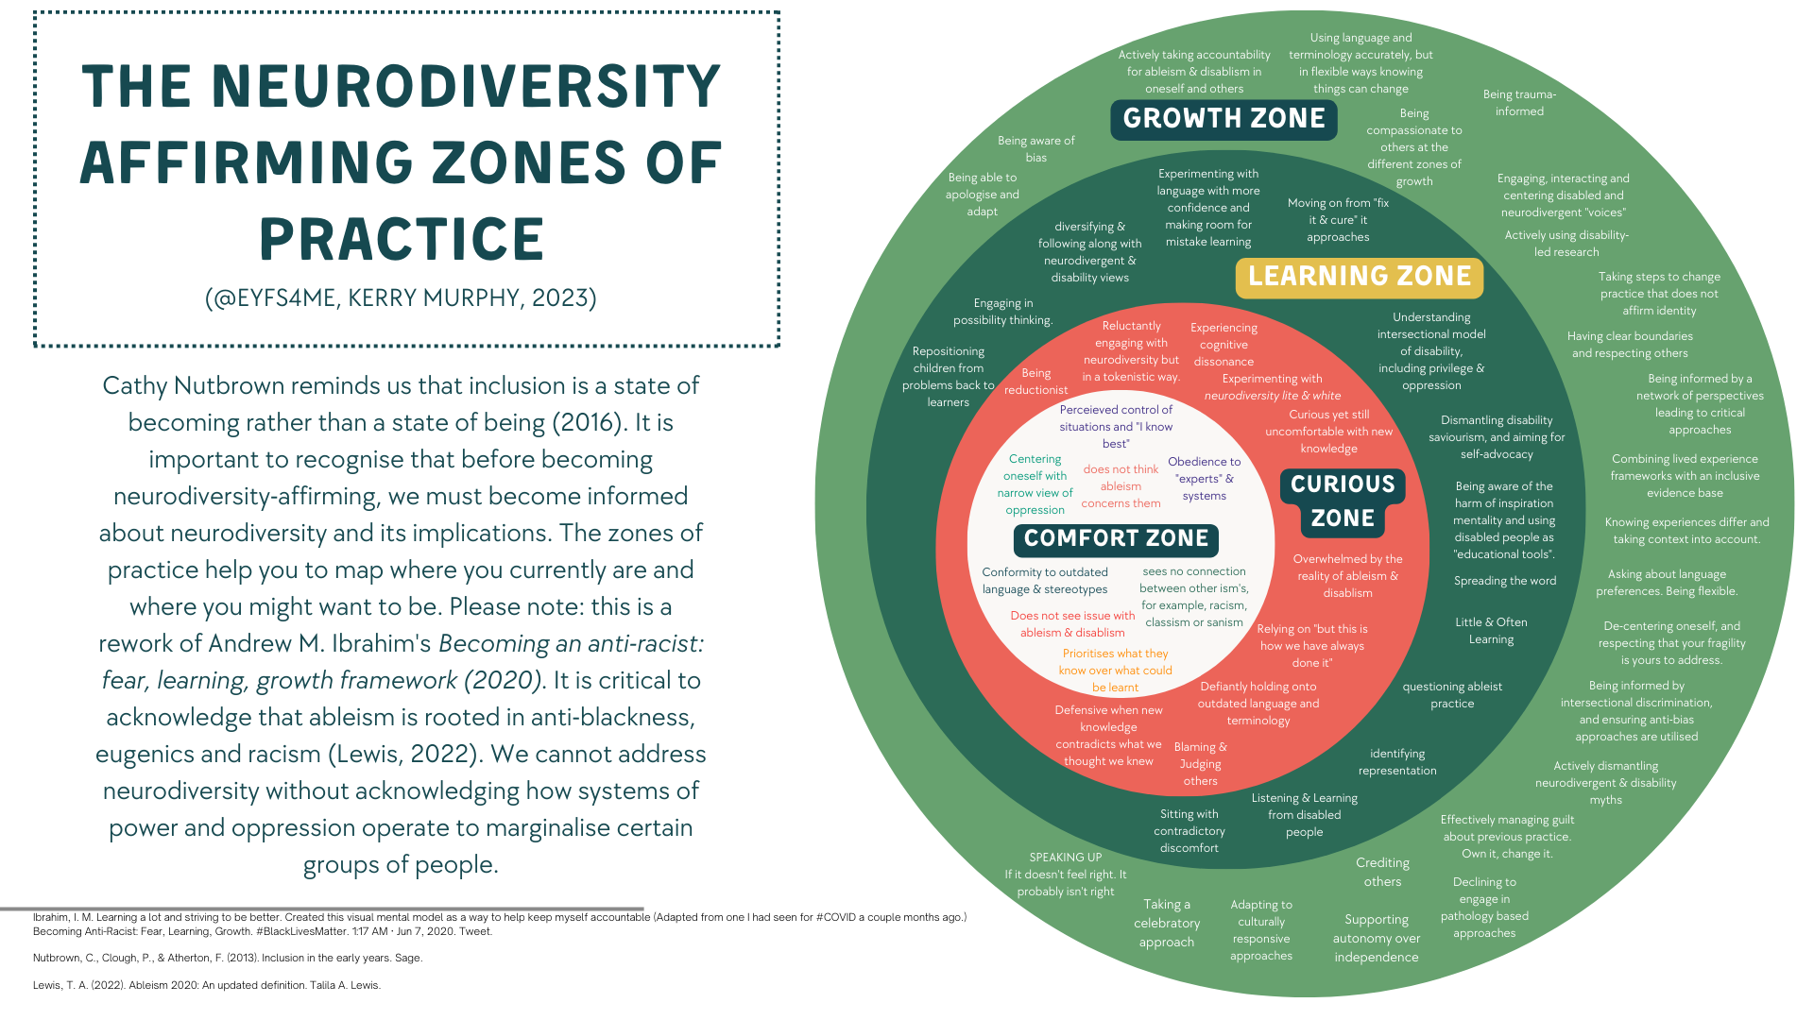
The Neurodiversity-affirming Zones of Practice
Notes:
Kerry Murphy (2023) has created a helpful visual about zones of practice. She makes reference to a growth, learning, curious and comfort zone

Slide 17

National Autism Implementation Team (NAIT) Practice Based Guidelines
Notes:
This is very important. There is also one for health professionals but the messages are applicable across other workplace settings.

Slide 18
Neuro-affirming approaches/ Embracing Neurodiversity
Employers should foster a culture of acceptance by modelling and promoting inclusivity and diversity, and providing resources for support and advocacy.
This means listening to and learning from neurodivergent people about how we can all improve employment experiences.
Actively create a workplace culture where everyone feels accepted and valued and different neurotypes are expected.
Language and mindsets matter.
Recognise discrimination and stigma and challenge it
Stay open to learning/reflecting how well you understand what ‘neuro-affirming’ workplaces look and feel like for neurodivergent people.
Notes:
Autistic people told us: “The hardest part is conversations with colleagues. Or working out should I have conversations with them? I understand what people mean but because that’s not my main challenge, I can ignore how difficult that is.” “I was off work for about 6 months. Burnout. Panic attacks and stuff like that. That was probably the motivation for leaving there.” “There’re at least two phases to being employed; you’re new; you’re established. All adaptations for autistic people in the workplace are for people who are new. There’s never a ‘What would you like and what can we do to support you at this point?’”

Slide 19
Provide and maintain reasonable adjustments and accommodations
Work with neurodivergent employees to offer, provide and maintain reasonable adjustments which help them to perform their job duties or role.
These accommodations may include modifications to the physical environment, the social environment, around social expectations, work routines, and communication.
These adjustments should be maintained and revisited regularly
Adjustments required can change over time.
Always try to be a flexible employer and to facilitate manageable workloads
Notes:
Research found that less than half of autistic employees who discussed reasonable adjustments had them implemented. A common theme in conversations with neurodivergent people is that they are implemented for a short time and then forgotten about. Maintaining them as long as needed is crucial. Employers should actively ensure that plans agreed are being implemented. Employers should be proactive, offering adjustments in advance including for recruitment processes (e.g., extra processing time for interview and questions provided in advance).

Slide 20
Provide safe and trusting environments for disclosure/sharing of diagnosis
When individuals choose to disclose/share, they should feel supported to be open about being autistic or neurodivergent. All staff should seek to create a safe and trusting environment for disclosure of diagnosis (formal diagnosis or self-identification). Disclosure is complicated and individuals have the right to choose whether or not they disclose/ share, to whom and when, e.g. at interview, in training or at a point when they feel reasonable adjustments are required.
Respect privacy and only share an individual’s diagnosis with clear permission.
Colleagues and employees may recognise differences and consider someone might be neurodivergent but it is important not to try to diagnose or label other people in the workplace.

Slide 21
Support self-advocacy and shared advocacy
Create a culture where people feel safe to speak up about their needs, whether or not they are formally diagnosed.
Employers should encourage neurodivergent individuals to self-advocate their needs and provide opportunities for them to express their concerns and suggestions for improving the workplace. This can help to create a more supportive and inclusive environment for all employees. Although self-advocacy is positive, we should also remember that for some people, sometimes having to always self-advocate is stressful and having others to advocate alongside you can be incredibly empowering.

Slide 22
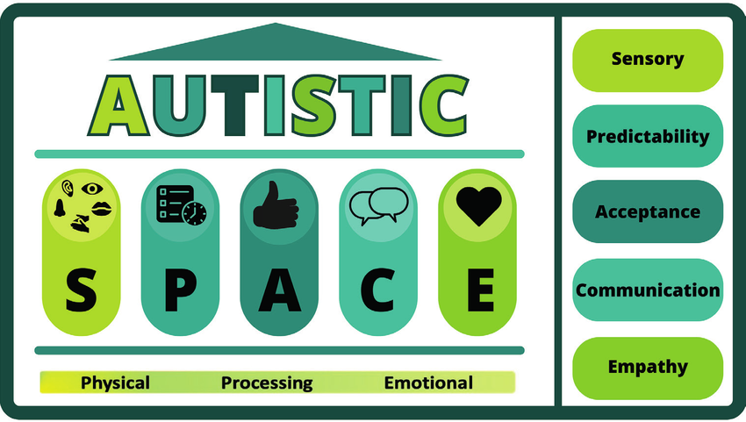
The Autistic SPACE Framework*
Notes:
This framework has been developed by Doherty et al. (2023) and they have given permission for us to share it. It is a helpful way to think about practical support, reasonable adjustments and accommodations

Slide 23
Sensory adjustments
Understand different sensory preferences and make adjustments to the physical environment. Consider lighting, noise, temperature, distractions or interruptions, smells, touch, social demands, movement and seating needs. Allow for breaks and ‘safe spaces’ where people can go if feeling overwhelmed or overstimulated. Consider break and eating/ drinking spaces as well as workspaces.

Slide 24
Predictability in the workplace
Provide structure and routine in a range of ways, e.g., clear deadlines, sending meeting invites, questions and agendas in advance; starting and finishing meetings on time, and following the expected agenda; making seating and spaces predictable.
Avoid disrupted expectations and when unavoidable changes happen, explain these clearly and try to create clear alternative plans.
Some individuals may need time and space to recover from unexpected things happening

Slide 25
Acceptance
Be an understanding colleague and accept that accommodations may be necessary.
Accept different thinking styles and sensory, social and communication preferences during work (including break times or during meetings) or for before and after work plans. For example, some neurodivergent people find that ‘stimming’ is a really effective way to feel calm but may mask or avoid stimming because they fear this might not be accepted in the workplace.
Notes:
stimming
: a self-stimulatory behaviour that is marked by a repetitive action or movement of the body (such as repeatedly tapping on objects or the ears, snapping the fingers, blinking the eyes, rocking from side to side, or grunting) and is typically associated with certain conditions (such as autism)

Slide 26
Communication considerations
Above all, be clear and direct in your communication.
Ask employees about preferences and adjustments they would find helpful, and wherever possible seek to put these in place. Review these adjustments regularly.
Agree preferred modes of communication e.g. written rather than verbal engagement where this better meets an individual’s communication style; provide visual/written information as well as verbal information; suggest email or online communication if phone calls or face-to-face conversations cause anxiety.
Time for processing and responding to information may be needed for some people, as opposed to expecting responses in the moment.

Slide 27
Empathy and shared responsibility
Recognise shared responsibility between neurodivergent and neurotypical colleagues/clients/customers for getting things right.
Neurotypical ways of communicating are not better, just different.
Make an extra effort to support positive relationships at work. One way of doing this is to ask individuals directly and to avoid assumptions about what has been understood or communicated

Slide 28
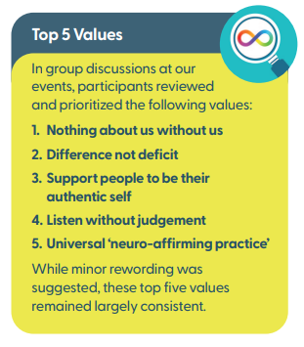
National Autism Implementation Team Core Values

Slide 29
Key Messages
Celebrate difference
Always be kind
Ask the individual what you can do to help
Don’t make asumptions or judge others
Try not to take things personally
Try to be neuro-affirming
Just be ‘good enough’ - you don’t need to be perfect!

Slide 30
Useful resources and links
Neurodivergent emabler, Workplace adjustments for executive dysfunction https://www.neurodivergentemabler.com/resources.php
AGCAS Reasonable Adjustments: Neurodiversity https://www.agcas.org.uk/write/MediaUploads/Resources/Disability%20TG/Reasonable_Adjustments_- _Neurodiversity.pdf
Autistica Employers Guide to Neurodiversity https://www.autistica.org.uk/get-involved/employers
Employers guide to ADHD in the workplace (ADHD coalition) https://www.scottishadhdcoalition.org/adhd-and-employment/ o Neurodiversity Hub resources for employers https://www.neurodiversityhub.org/resources-foremployers o
Neurodiversity at work, how Occupational Health can help https://www.staywelloh.co.uk/neurodiversity-at-work-how-occupational-health-can-help/

Slide 31
Single profession support groups
These are groups where neurodivergent peers can connect, be supported and advocate collectively. Here are some examples:
On being neurodivergent in the SLT Workforce: https://www.youtube.com/watch?v=tSIs-A1xQ4
Autistic Doctors International https://autisticdoctorsinternational.com/
British Psychological Society, Neurodiversity is not just for those we work with https://www.bps.org.uk/psychologist/neurodiversity-not-just-those-we-work
RCN Neurodiversity guidance https://www.rcn.org.uk/get-help/member-support-services/peer-support-services/neurodiversityguidance

Slide 32
Useful reading and references
Doherty, M., McCowan, S., & Shaw, S.C. K. (2023). Autistic SPACE: a novel framework for meeting the needs of autistic people in healthcare settings. British Journal of Hospital Medicine, 1-9. doi: 10.12968/hmed.2023.0006. Epub 2023 Apr 17. PMID: 37127416.
Wharmby, P. (2023) Untypical: How the World Isn’t Built for Autistic People and What We Should All Do About It HarperCollins Publishers
Lindsay, S., Osten, V., Rezai, M., & Bui, S. (2021). Disclosure and workplace accommodations for people with autism: A systematic review. Disability and rehabilitation, 43(5), 597-610
Huang, Y., Hwang, Y. I., Arnold, S. R., Lawson, L. P., Richdale, A. L., & Trollor, J. N. (2022). Autistic adults’ experiences of diagnosis disclosure. Journal of Autism and Developmental Disorders, 1-7.

