Slide 1
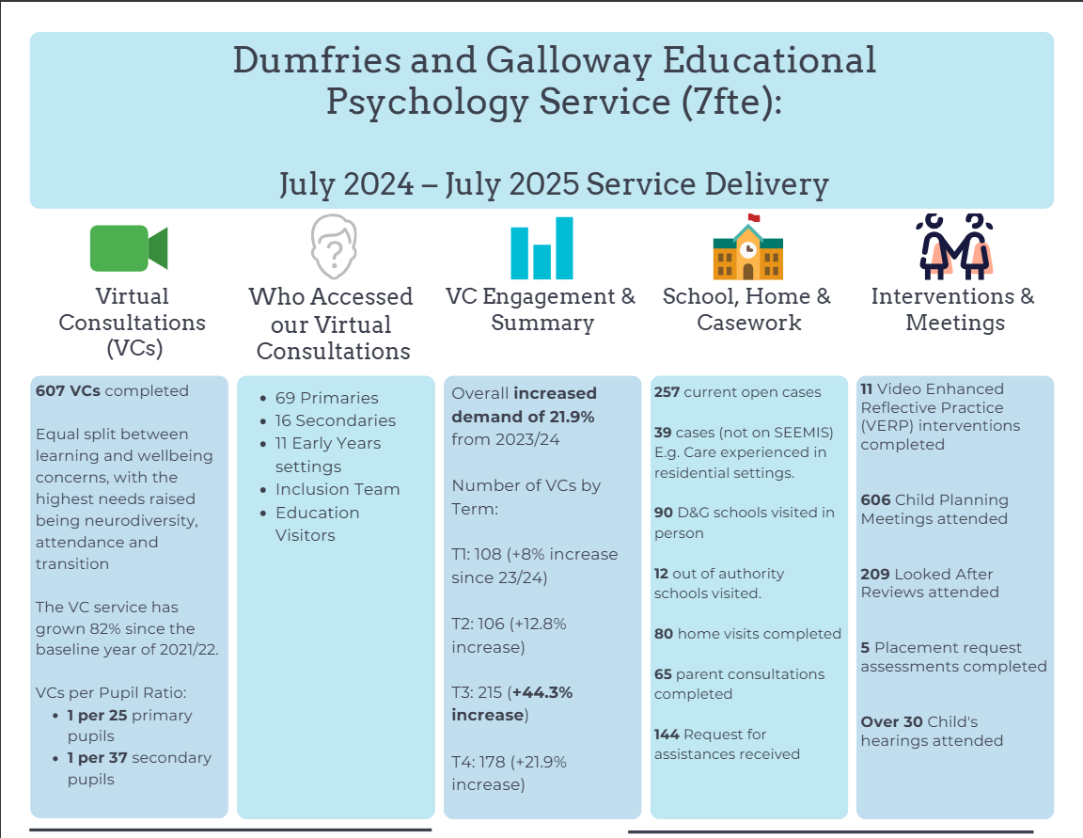


Slide 2
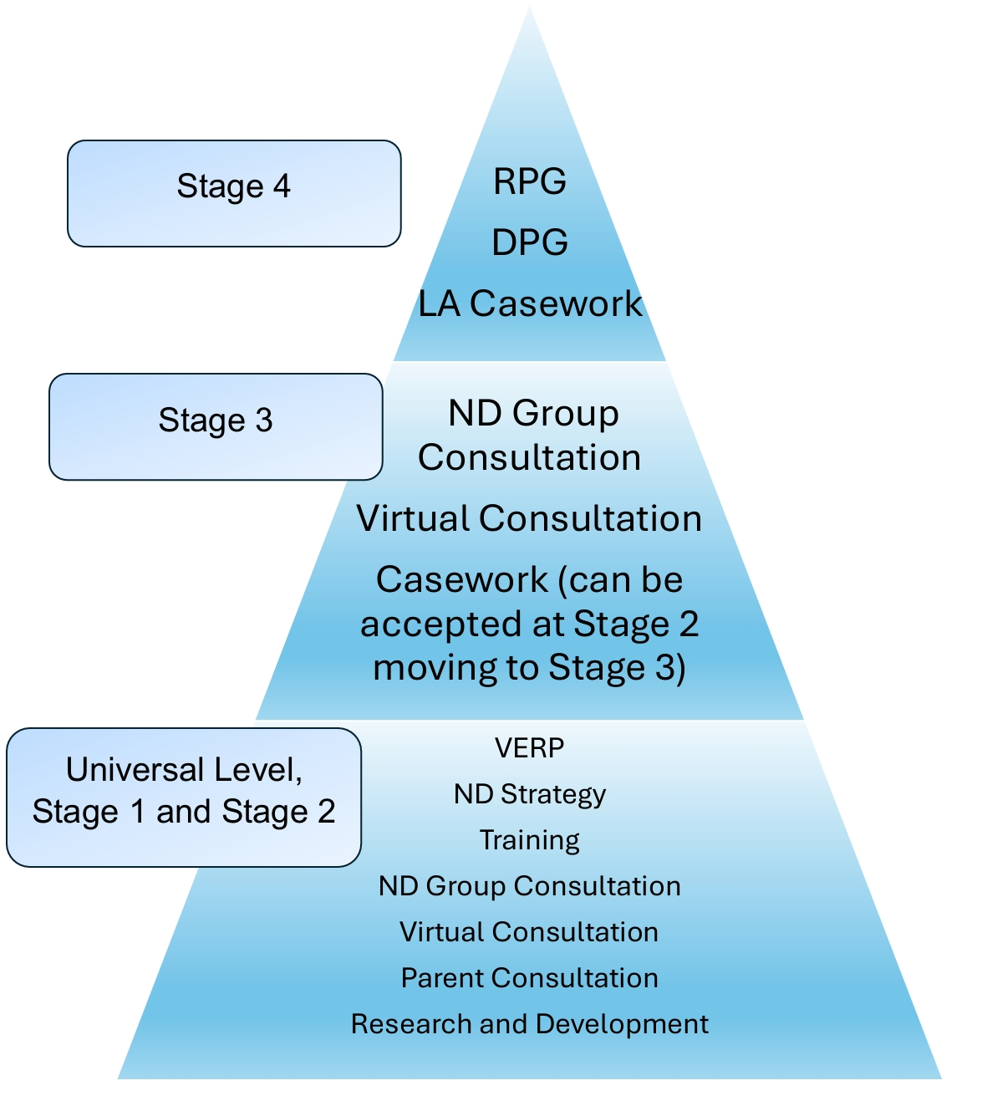
The Staged Intervention EPS Offer
School Offer
Whole school and group level work
Pilot ND Group Consultation
Virtual Consultation
Parental Consultation
Pilot Casework Blocks
  8-week Assessment
  12-week Intervention

Slide 3
Casework Key Points
Remember VC continues to be available for all education staff at all stages for children who do not have open EPS files.
RfA
Moderation
Assessment & Intervention Blocks with set times
Waiting Lists
Only Residential and Day Placement Group cases will remain open longer term

Slide 4
Criteria
There is an existing Single Agency or Multi‑Agency Plan and:
Needs are not yet well understood
Current interventions are not effective
Child is at Stage 3 or 4 of the Stages of Intervention
  (Those moving from Stage 2 → Stage 3 may also be considered)
There is a clear and distinct role for the Educational Psychologist
EP is the most suitable agency to support next steps
  Consider Dumfries & Galloway Children’s Service Information
There is an identified need for psychologically informed educational assessment and intervention

Slide 5
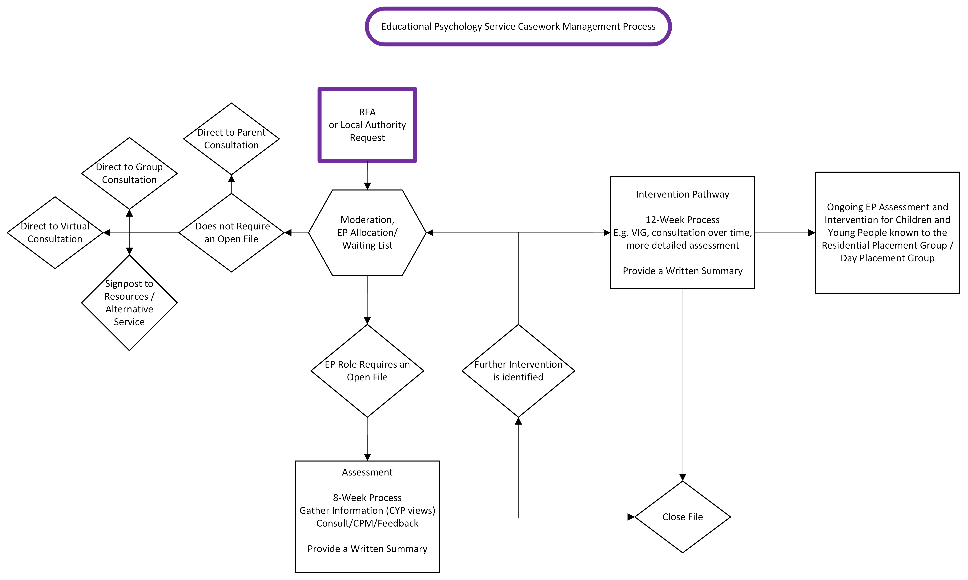

Slide 6
Intervention examples
Whole-School
  Supporting implementation of whole school nurture/positive mental health
  Research and evaluation of PEF projects
  Training followed by VERP to embed, e.g. executive function for numeracy/literacy
Class/group: WOWW, Circle of Friends, CBT approaches, Exam Stress, Person Centred Planning
Individual: Regular consultation, VIG, Solution focussed brief therapy, Personal Construct, Motivational Interviewing...

Slide 7

Review and Evaluation
Launching a new service delivery approach in June
Trial period with ongoing monitoring and review
Continuous feedback from schools and stakeholders
Engagement via HT cluster meetings
Impact measured through casework and evaluation
Findings captured in SQR reporting
Full review and next steps – Summer 2027

Slide 8

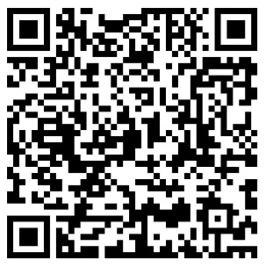
Thanks for listening!

Slide 9
References
Association of Principal Educational Psychologists. (2014). Position Paper: Educational Psychology Assessment in Scotland (2014).https://www.aspep.org.uk/wp-content/uploads/2014/02/Assessment-Position-Paper.pdf
Association of Principal Educational Psychologists. (2025, December). Improving Local Authority Educational Psychology Services in Scotland: A Self-Evaluation Framework. https://www.aspep.org.uk/wp-content/uploads/2025/12/EPS-Self-Evaluation-Framework-Dec-2025.pdf
Health and Care Professions Council. (2023, September 1). The standards of proficiency for practitioner psychologists. https://www.hcpc-uk.org/standards/standards-of-proficiency/practitioner-psychologists/

