Slide 1
Educational Psychology Service Moving Forward

Slide 2

Welcome and Thank You
Aim and Outline of Today’s Session:
The need for change
The Process we have Undertaken
Vision and Values/guiding principles
EPS Updated Offer

Slide 3
Context
Staffing: There has been a 10% reduction in our service. We have a service complement of 6.3 FTE EPs. We currently have 4.57 FTE.
Expectations of Educational Psychology Services:
  Consultation, Assessment, Training, Intervention, Research at Individual, School, and Local Authority level, for Children and Young People aged 0-24.
  At full capacity we will have 1 deployable EP per 5,238 young people under 18.
  At full capacity we will have 1 deployable EP per 1,700 school pupils with ASN.

Slide 4
The steps we have taken
Inward, Outward, Forward
Partner, Parent (Carer), young person, EP feedback
Data and themes from within the service
Improving Local Authority Educational Psychology Services in Scotland: A Self Evaluation Framework.
1.1 Self evaluation for self improvement and,
2.1 Consultation, Assessment and Intervention.

Slide 5
Planning parameters
To create a model which:
Ensures we can meet our statutory functions
Is transparent, accessible and equitable
Retains a focus on early intervention as well as high level need
Is consistent across the Authority
Meets HCPC professional standards
Is within budget

Slide 6
Statutory Role of the EPS
The Local Authority has a legal duty to provide a psychological service:
  Providing advice to the local authority on the provision for children with ASN
  Providing advice to parents/carers and teachers on appropriate educational methods
  Providing advice to Social Work and the Children’s Reporter
  Requests for assessments from various sources

Slide 7
Educational Psychologist Registration Standards
Health and Care Professions Council:
  Are qualified and trained to doctoral SCQF Level 12
  Must meet registration requirements of HCPC
  Standards of CPD
  Standards of Proficiency
  Standards of Conduct, Performance and Ethics

Slide 8
Our Vision for Dumfries and Galloway
"We envision a D&G where every child and young person's voice shapes the support they receive. Through evidence-based psychological practice, we work collaboratively with children, families and professional partners to create lasting change, not just for individuals, but across entire systems. By making psychology explicit and accessible, learning together, and embracing continuous improvement, we ensure everyone understands how we work, why we work this way and the unique difference educational psychology brings"

Slide 9
Our Values
The importance of relationships
Purposeful, inclusive education
Change is possible
Respectful collaboration
Child and young person centred
Psychological perspective
Evidence-based, least intrusive, most effective practice
Integrity and reliability

Slide 10
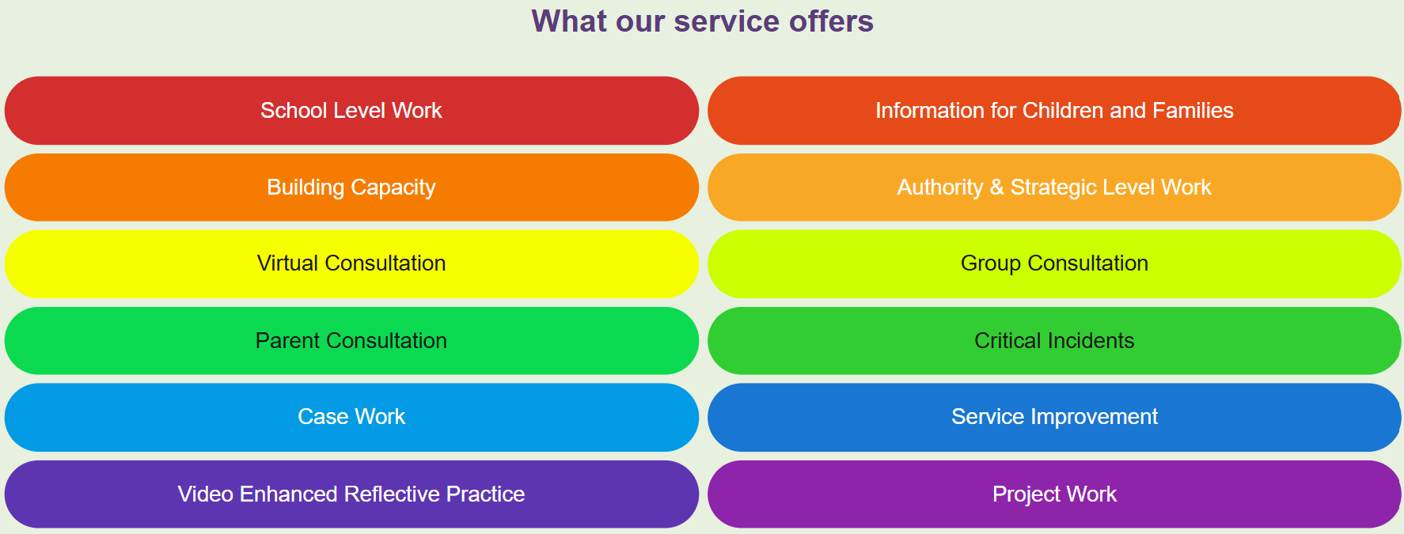
Our Glow Page

Slide 11



Slide 12

