Slide 1

CAERLAVEROCK & BROWNHALL PRIMARIES
PARTNERSHIP
​
STRATEGIC CHANGE INITIATIVE
By Gordon Tennant (Principal Teacher at Caerlaverock Primary)

Slide 2
Long Term Aim
To enhance learner’s digital skills to enable them to access the curriculum to improve their literacy skills, in particular – reading and writing.

Slide 3
Rationale
A number of our learners lacked adequate digital literacy skills.
After analysing our curriculum:
  Improvement in digital skills = Improve attainment in literacy?
Literacy & English is no longer just reading, writing, listening and talking – it included all aspects of digital literacy.
Digital literacy skills are fundamental to a learner’s progress in literacy.

Slide 4
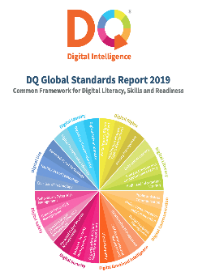
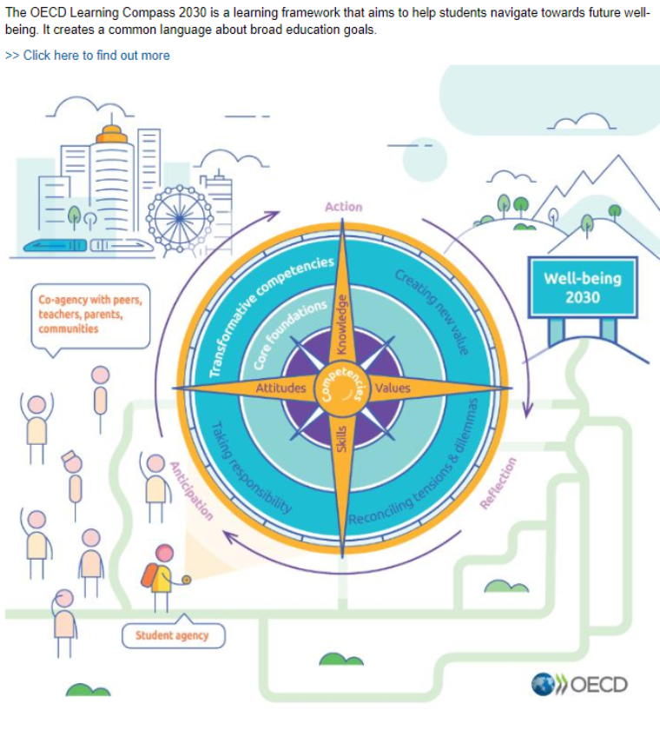


Research

Slide 5
Links to Policy Documents
https://www.dqinstitute.org/wp-content/uploads/2019/03/DQGlobalStandardsReport2019.pdf
https://www.oecd.org/education/2030-project/teaching-and-learning/learning/
https://www.weforum.org/reports/the-future-of-jobs-report-2020/
https://www.gov.scot/publications/enhancing-learning-teaching-through-use-digital-technology/

Slide 6
The Planning Stage
Internally:
  Head teacher and partner school PT
  Teaching staff
  Support Staff – Learning assistants and ASL teacher
  Parents from both schools
Externally:
  D&G STEM team
  Partnership Education Officer
  Development Officer for Education Scotland
  Speech and Language Therapy local co-ordinator

Slide 7
The Planning Stage
Questionnaires
  Staff
  Pupils
  Parents

Slide 8
Implementation
Partner school principal teacher and myself…
Teaching staff across the partnership…
Support staff…
Parents of both schools…
Pupils of both schools…
D&G STEM team…
Development Officer for Ed. Scotland…

Slide 9
Implementation
Functional Skills
Finding Information Skills
Critical Thinking Skills
Creativity & Collaboration Skills

Slide 10
Dictation & Immersive Reader
Functional Skill (second level)
  ‘I can select and use applications and software to capture, create and modify text, images, sound and video’
Creativity Skills
  ‘ I can select the direction to go in’
  ‘ I can give detailed ideas’
  ‘ I can elaborate on an idea’

Slide 11
Dictation & Immersive Reader Cont.
Recognition of some learners who struggle to use a pencil
Recognition of some learners who really do not like writing in a jotter
Recognition that some learners struggle to write what they want to say.
Recognition that some learners can explain verbally what they want to write, but struggle to put it down on paper.

Slide 12
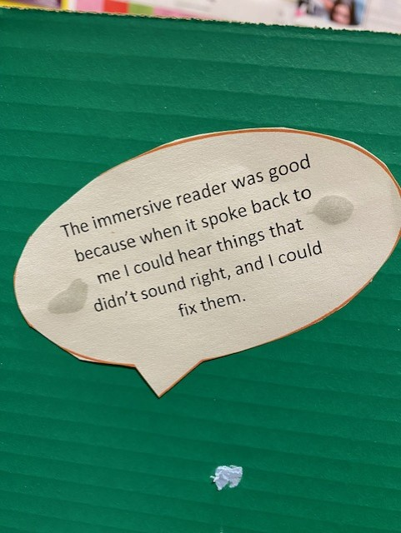
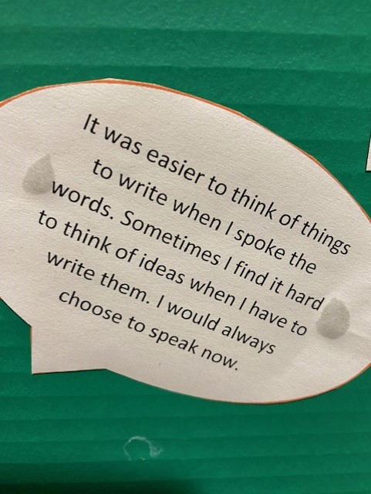
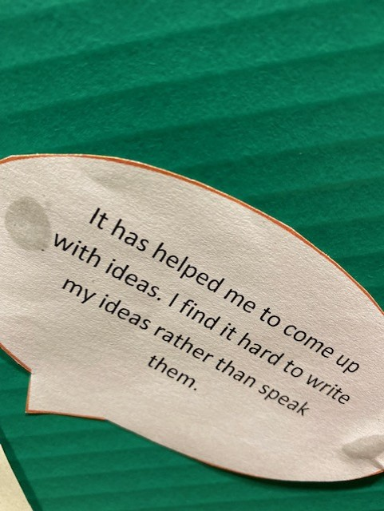
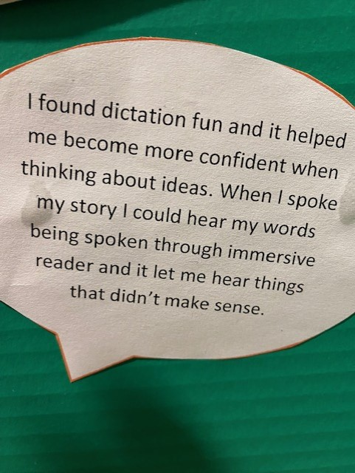
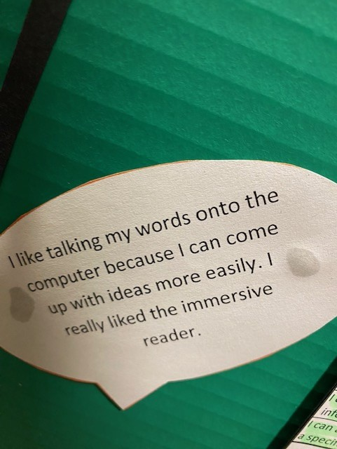
Learner’s Thoughts

Slide 13
Results so far
Increased motivation to create texts
Increased levels of attainment in reading and writing
A new skill that learners are using both at home and at school
Changing their opinion of ‘writing’ from being a chore, to being more enjoyable
Much improved use of descriptive vocabulary
A better ‘flow’ to their writing
An increased amount of text being produced
Increased use of checking and editing and improvement in correctly identifying errors.

Slide 14
Data – Stretch Aims
 | Reading | Writing
School 1
2020-21 | 52% | 43%
2021-22 | 66% | 63%
2022-23 | 70% | 70%
Improvement | +18% | +27%
School 2
2020-21 | 61% | 61%
2021-22 | 76% | 69%
2022-23 | 72% | 76%
Improvement | +11% | +15%

Slide 15
Thank you

