Slide 1
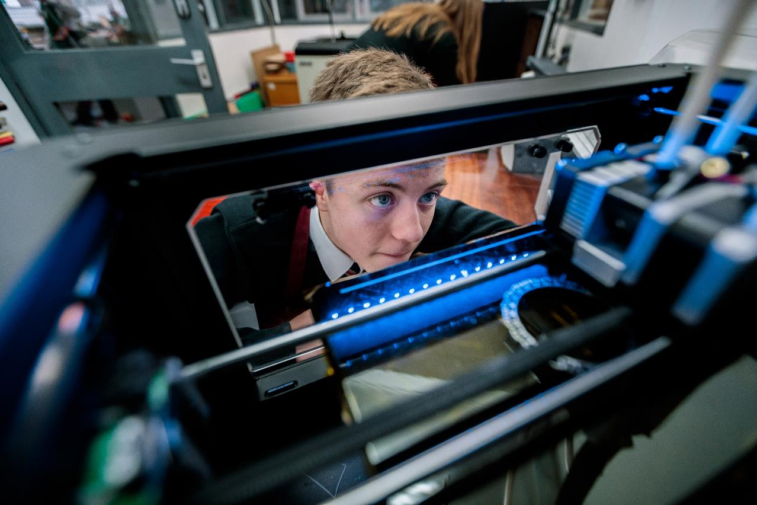

How do we collectively lead the change we want to see?
@olliebray
Ollie Bray - Strategic Director, Education Scotland
17th April 2024 – Dumfries & Galloway

Slide 2
Today?
Hello!
Where are we now?
A ‘confused’ policy landscape?
Our core business
The why, the what & the how?
Policy into practice & the wicked issues
Camels, snow and some holiday snaps!
Strong Settings & Schools
Thoughts, questions, challenge & discussion

Slide 3
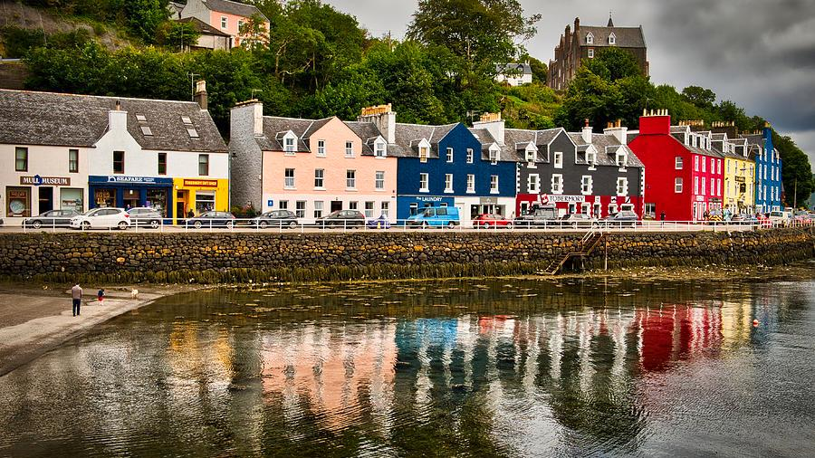
Reflections

Slide 4



Before
March
2020
Now and
into the
future

Slide 5






Before
March
2020
Now and
into the
future

Slide 6
Before
March
2020
Now and
into the
future
Innovation
Innovation
Innovation
Innovation

Slide 7
Innovation
Digital Learning

Slide 8
Innovation
Digital Learning
Collaboration
Community
Partnership
Pace of change
Agility
Joining up services

Slide 9
What was
working well
pre-COVID
What worked
well during
COVID
New models /
ways of
working
+
=

Slide 10


Slide 11


Slide 12


Slide 13
1. Who’s picture is the best?

Slide 14
1. Who’s picture is the best?
2. Who’s picture is the most creative?

Slide 15
1. Who’s picture is the best?
2. Who’s picture is the most creative?
3. Who hated the task the most?

Slide 16
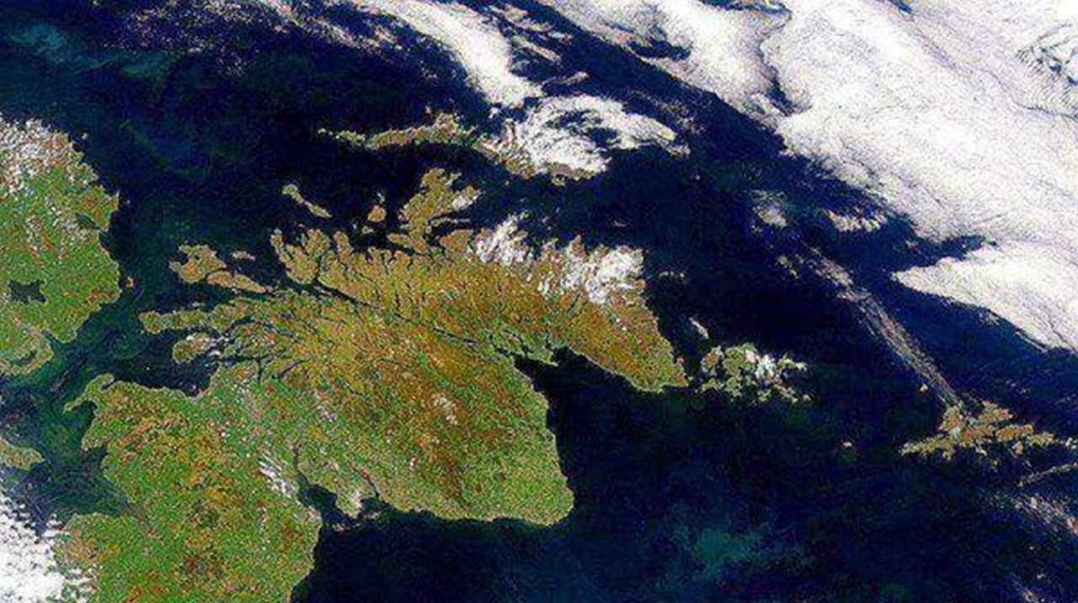
Education Reform in Scotland

Slide 17

In recent times…
June 2021

Slide 18

In recent times…
June 2021
Sept 2021

Slide 19

In recent times…
June 2021
Oct 2021
Sept 2021

Slide 20


In recent times…
March 2022
June 2021
Oct 2021
Sept 2021
May 2022
V2.0
Sept 2021

Slide 21

In recent times…
March 2022
June 2021
Oct 2021
Sept 2021
May 2022
V2.0
May 2023
National Discussion
Sept 2021

Slide 22

In recent times…
March 2022
June 2021
Oct 2021
Sept 2021
May 2022
V2.0
May 2023
National Discussion
Prof. Louise Hayward
[Assessment & Qualifications]
Sept 2021
June 2023

Slide 23
In recent times…
March 2022
June 2021
Oct 2021
Sept 2021
May 2022
V2.0
May 2023
National Discussion
Prof. Louise Hayward
[Assessment & Qualifications]
Sept 2021
June 2023

Slide 24
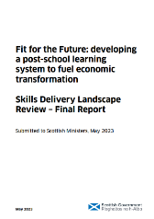
In recent times…
March 2022
June 2021
Oct 2021
Sept 2021
May 2022
V2.0
May 2023
National Discussion
May 2023
Prof. Louise Hayward
[Assessment & Qualifications]
Sept 2021
June 2023

Slide 25


In recent times…
March 2022
June 2021
Oct 2021
February 2023
Sept 2021
May 2022
V2.0
March 2023
National Discussion
Prof. Louise Hayward
[Assessment & Qualifications]
Sept 2021
May 2023

Slide 26

In recent times…
March 2022
June 2021
Oct 2021
February 2023
Sept 2021
May 2022
V2.0
March 2023
National Discussion
Prof. Louise Hayward
[Assessment & Qualifications]
Sept 2021
May 2023

Slide 27
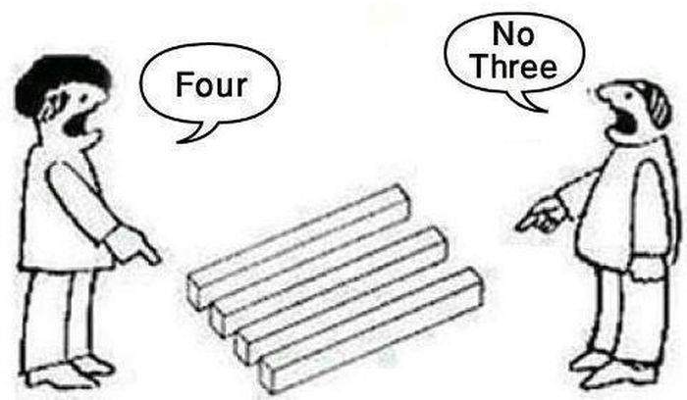
It is really confusing!

Slide 28




Slide 29

Key events since June 2021
OECD
Review
M | J | J | A | S | O | N | D | J | F | M | A | M | J | J | A | S | O | N | D | J | F | M | A
2021 |  |  |  |  |  |  |  | 2022 |  |  |  |  |  |  |  |  |  |  |  | 2023

Slide 30







Key events since June 2021
Stobart
Review
Consultation
Launch
National Discussion (ND)
Muir
Review
Implementation
Framework V2.0
Women in
Enterprise
Review
SLF
2022
1st year of
new Gov
New
School
Year
New Agency
High level
Blueprints
OECD
Review
Financial
Year
Implementation
Framework V1.0
M | J | J | A | S | O | N | D | J | F | M | A | M | J | J | A | S | O | N | D | J | F | M | A
2021 |  |  |  |  |  |  |  | 2022 |  |  |  |  |  |  |  |  |  |  |  | 2023

Slide 31





Equality,
Opportunity,
Community
Skills
Delivery
Review
Key events 2023 / 2024
New Education Agency?
New Inspection Agency?
New Qualifications Agency
New Teaching Centre of Excellence
SG OECD
Papers
Debate in Scottish Parliament
Prof
Hayward
Report
Women in
Enterprise
Review
August 2025?
SG Response?
Curriculum Review
Cycle Announced
National
Discussion
Report
LfS Strategy
End of 3rd
Term
Purposes &
Principles
J | F | M | A | M | J | J | A | S | O | N | D | J | F | M | A | M | J | J | A | S | O | N | D
School Year 22/23 |  |  |  |  |  |  | School Year 23/24 |  |  |  |  |  |  |  |  |  |  |  | School Year 24/25
2023 |  |  |  |  |  |  |  |  |  |  |  | 2024
Creation of long-term education reform strategic plan?

Slide 32


Slide 33

Women in Enterprise
(Stewart)

Slide 34
Women in Enterprise
(Stewart)
Key Messages
Focussing only on Proximate Causes instead of Root Causes.
Adding to broken systems instead of fixing them.
Favouring tokenism over scaled solutions.
To Scale-Up or to Scale-Deep?

Slide 35

It is important not to lose the focus that we are trying to develop people…

Slide 36
1.

Slide 37
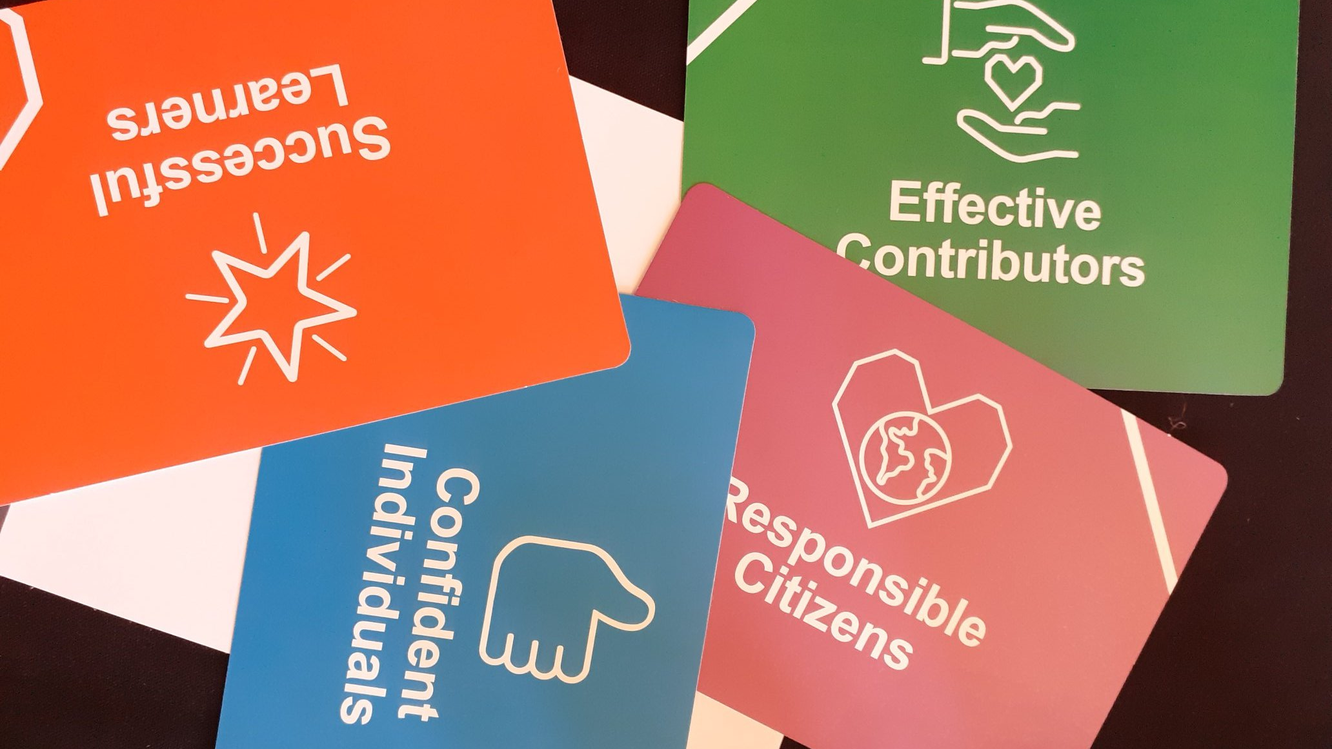

Slide 40
Inputs
Outputs

Slide 41
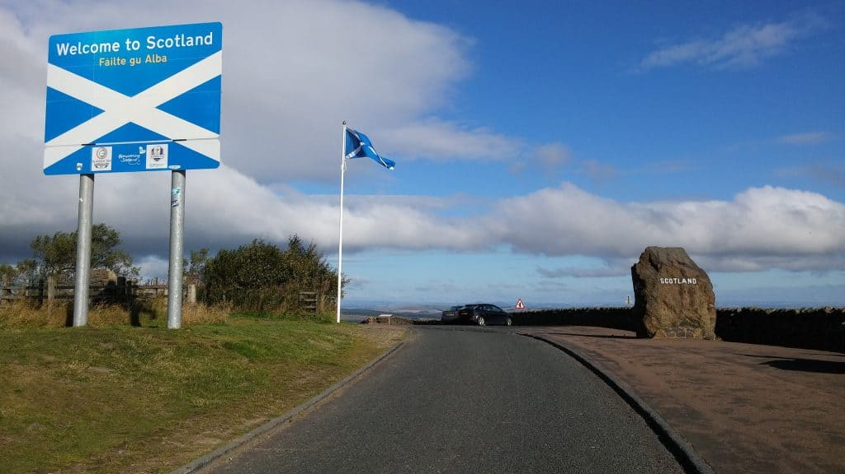
Curriculum for Excellence
Getting it Right for Every Child
Developing the Young Workforce

Slide 42


Slide 43
Curriculum entitlements
a curriculum which is coherent from 3 to 18
a broad general education, including well planned experiences and outcomes across all the curriculum areas from early years through to S3. This includes understanding the world, Scotland’s place in it and the environment, referred to as Learning for Sustainability
a senior phase after S3, which provides opportunities to attain and achieve, including to study for qualifications, awards and other planned activities to develop the four capacities
opportunities for developing skills for learning, skills for life and skills for work
opportunities to maximise their individual potential, benefitting from appropriate personal support and challenge
support to help them move into positive and sustained destinations beyond school

Slide 44

Scotland’s Curriculum
why | what | how
 | + entitlements
…
…
www.scotlandscurriculum.scot

Slide 45

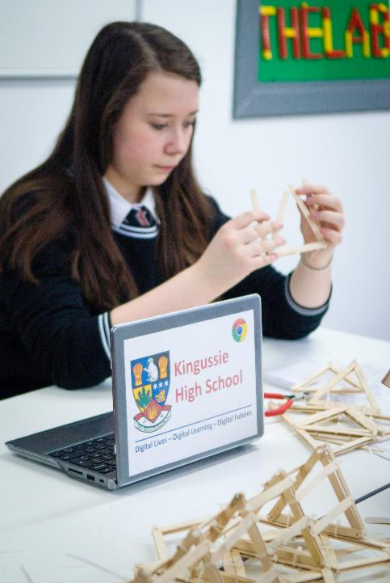
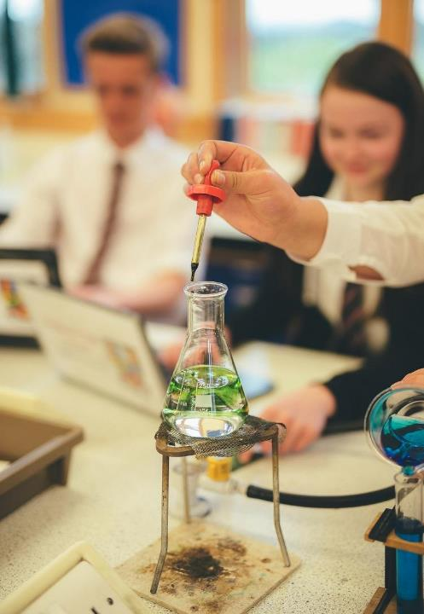
Curriculum
[increased]
Engagement
[improved]
Attainment
[More Positive]
Destinations

Slide 46
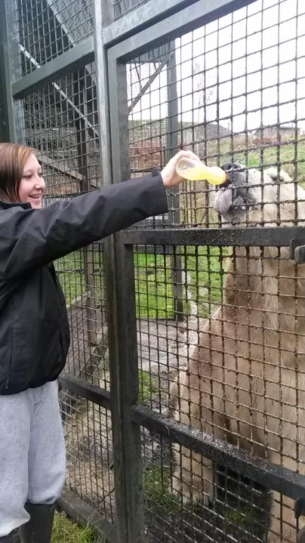
A framework
for permission

Slide 47
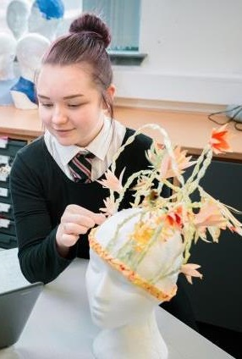
Your Curriculum Drives Attainment & Achievement

Slide 48
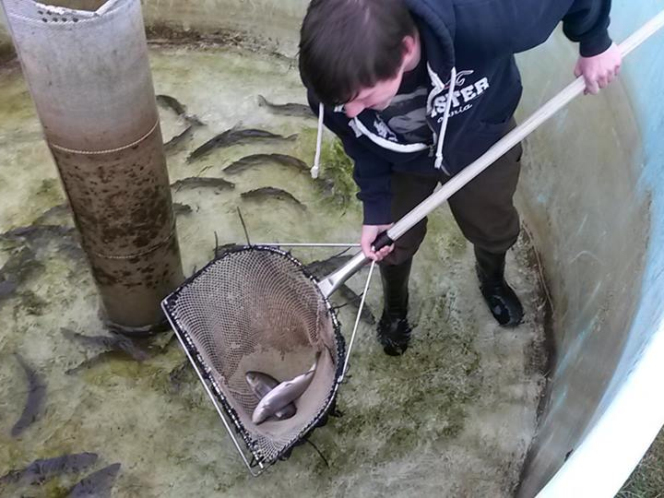

Slide 49

Policy into Practice / Wicked Issues

Slide 50



Catch-up?

Slide 51

A Crowded Curriculum?

Slide 52
A Crowded Curriculum?
Economy and Labour
Market Conundrum
Climate
Crisis
Equalities
Race – LGBTIQ+ - UNCRC
Empowered
Youth
Post-
COVID
Democratic
Deficit
Demographic
change

Slide 53

Policy Progression

Slide 54


Slide 55
Schools Subjects VS Employability?
Curriculum Areas
Expressive arts.
Health and wellbeing.
Languages (including English, Gaidhlig, Gaelic learners and modern languages)
Mathematics.
Religious and moral education.
Sciences.
Social studies.
Technologies.
Where the jobs are in Scotland...
Food & Drink (including agriculture & fisheries)
Creative Industries (including digital)
Sustainable Tourism.
Energy (including renewables)
Financial & Business Services.
Life Sciences.
[+ local employability options]
VS

Slide 56

Staying ahead of the [job / technology] ‘hype’ curve

Slide 57

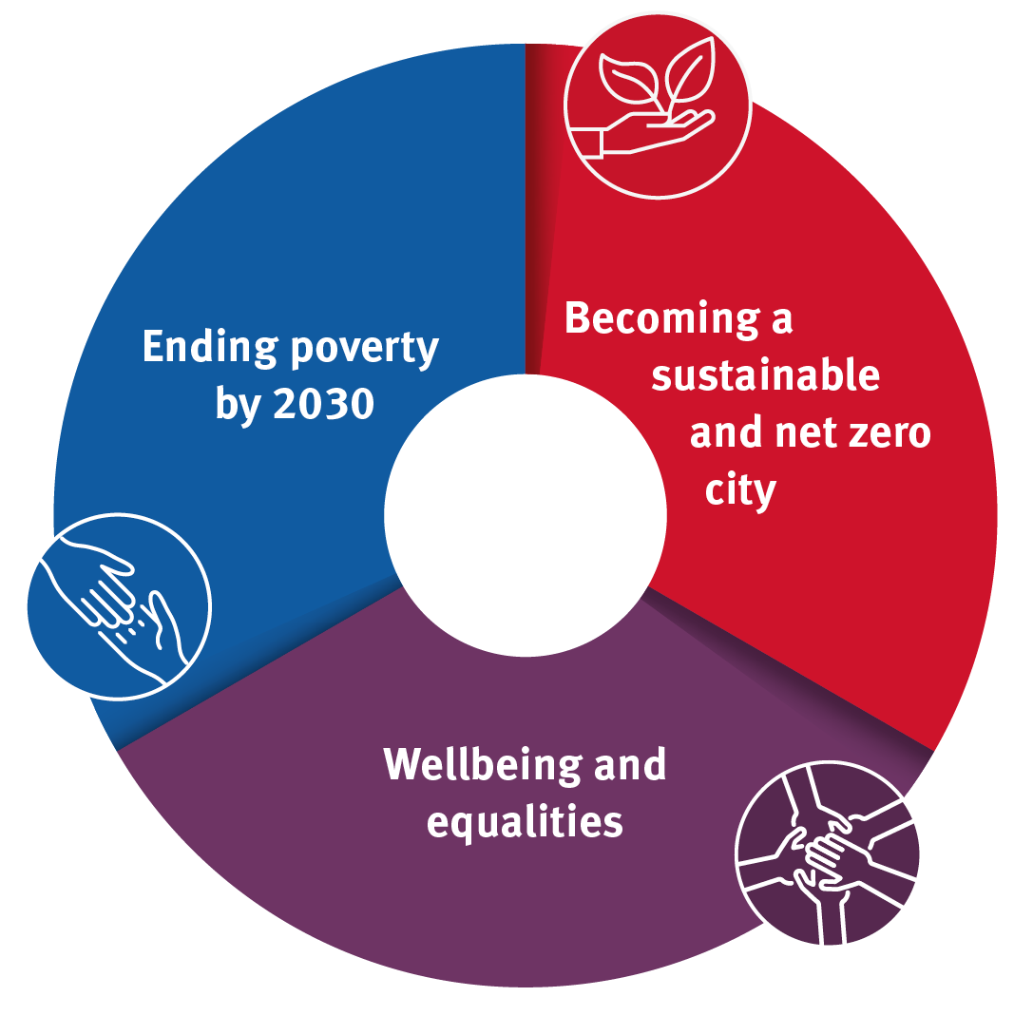
Aligning Priorities (in a sensible way)

Slide 58
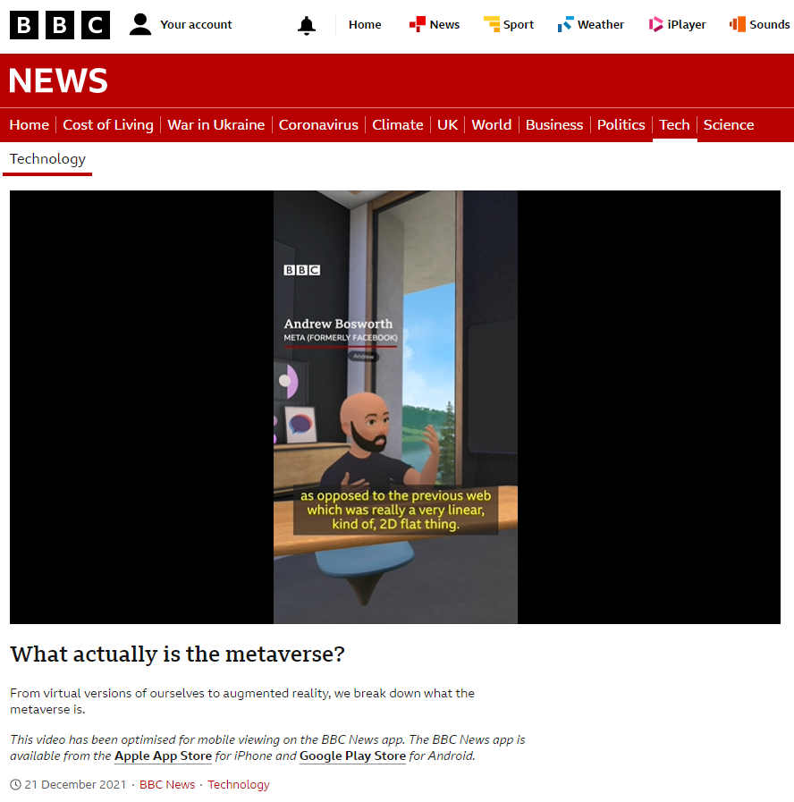
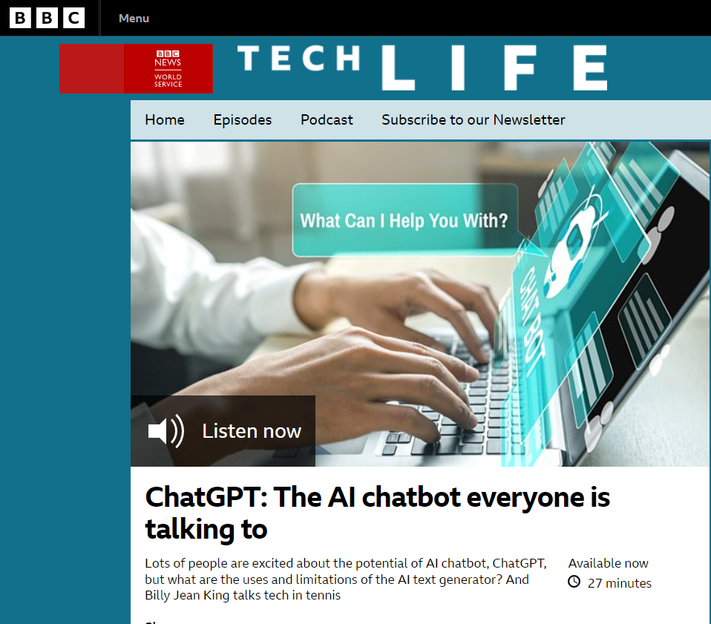
The role of technology?

Slide 59
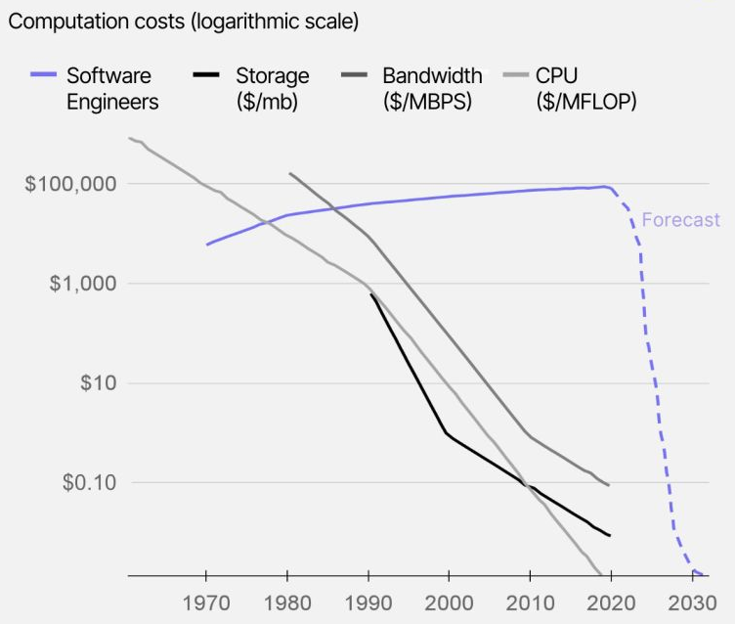
The next collapsing
technology industry
cost is software itself
Source: SK Ventures
Notes:
Ai to enrich existing education approaches.
Constrain learner agency, focus on closed ended problems, undervalue human connection and community.

Slide 60

Perverse incentives

Slide 61
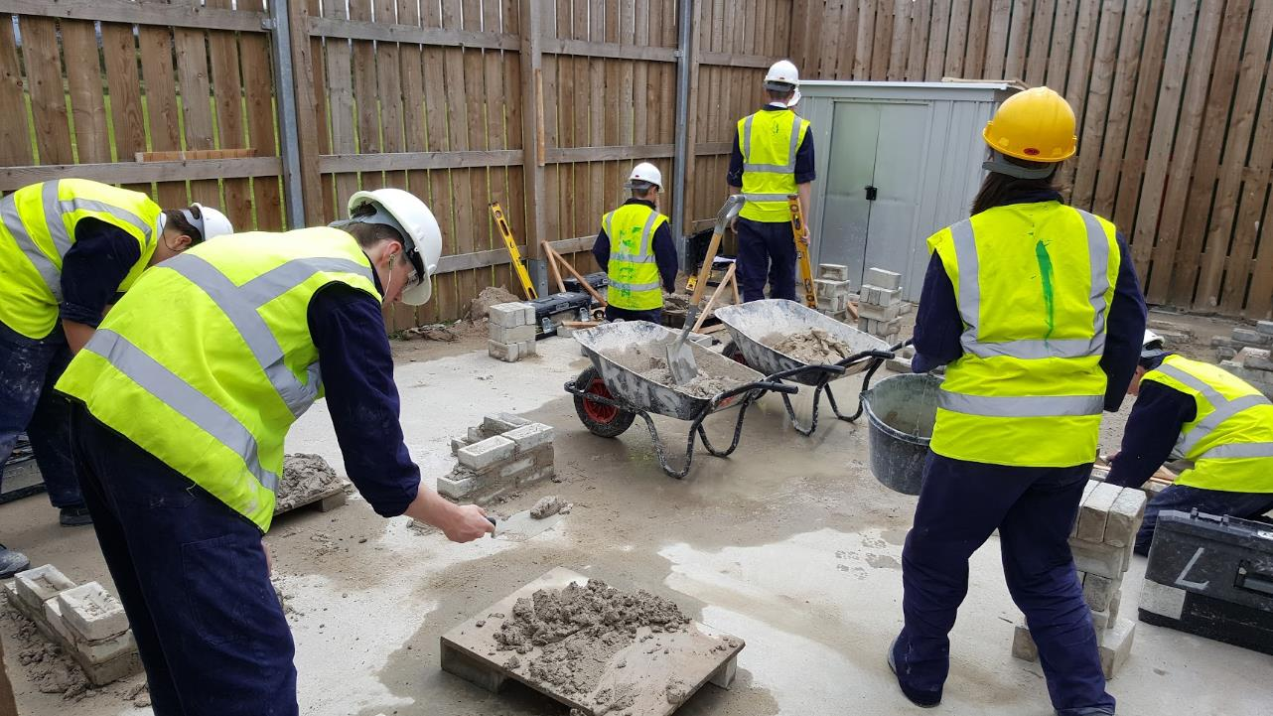

Slide 62
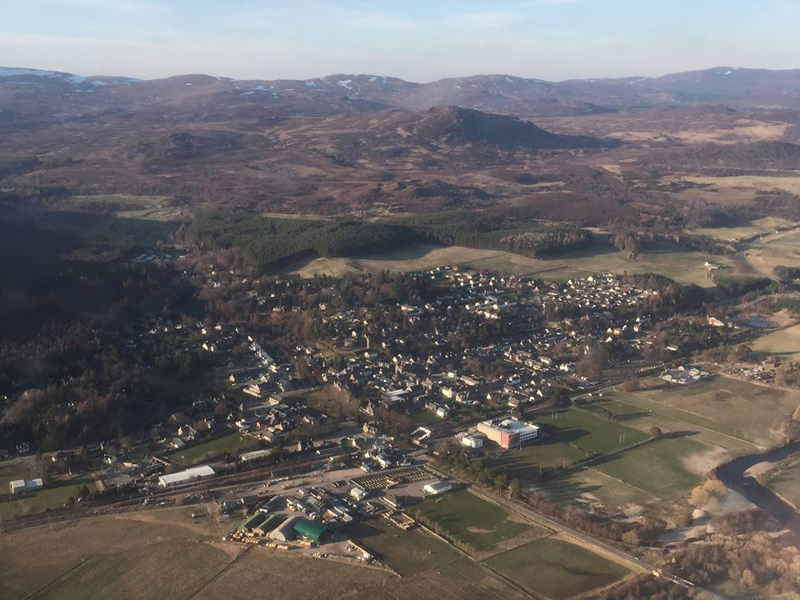
More ‘local’ than ever before?

Slide 63
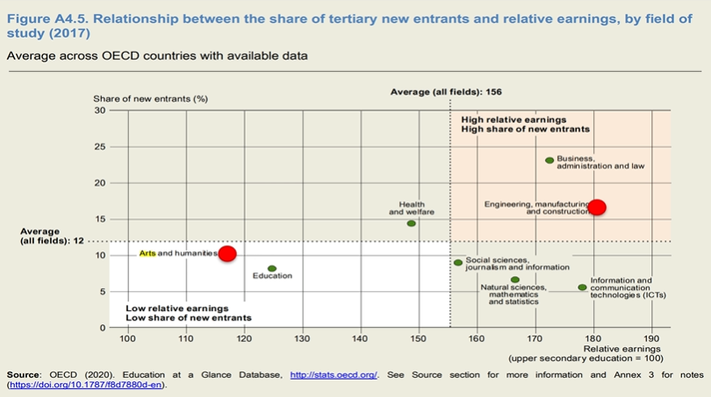
Curriculum Focus?

Slide 64
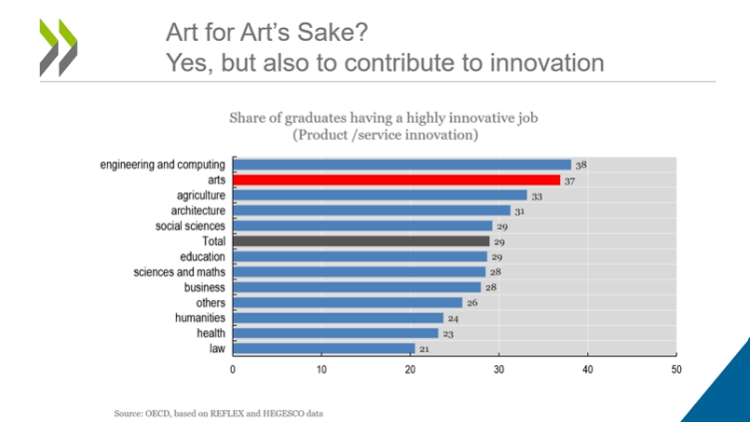

Slide 65

Simplified learning science

Slide 66

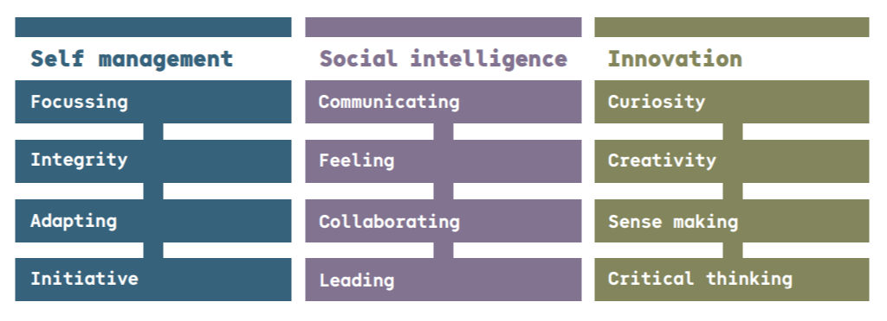
Skills 4.0
Skills progression
Backward Mapping

Slide 67
2.

Slide 68
LEg GOdt
meaning 'play well’.

Slide 70
Build a Duck
(in 40 seconds)

Slide 71
Assessment
A – E (F)
7 - 1
D - A

Slide 72
What just happened?

Slide 73
self-regulation
symbolic representations
executive functioning
spatial abilities

Slide 74
emotional regulation
self-efficacy
self-regulation
visual search
symbolic representations
long-term memory
attention
kinesthetic awareness
mental imagery
spatial visualization
systems thinking
sensory-motor skills
executive functioning
mental rotation
working memory
visual perception
spatial abilities
imitation
fine motor skills
adaptive social functioning
short-term memory
perspective-taking
cognitive flexibility
self-assessment

Slide 75



Slide 76

Curriculum
Assessment
Pedagogy

Slide 77
What combination of pedagogy is needed to teach a curriculum area and /or wider context for learning?
(with, without and supported by technology?)

Slide 78
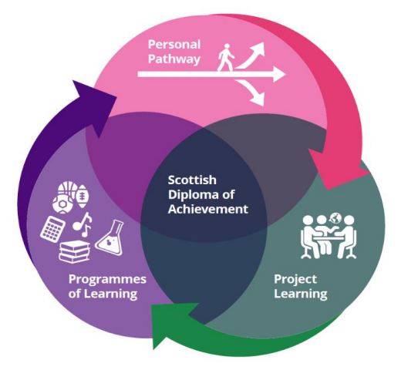


Slide 82


Slide 83
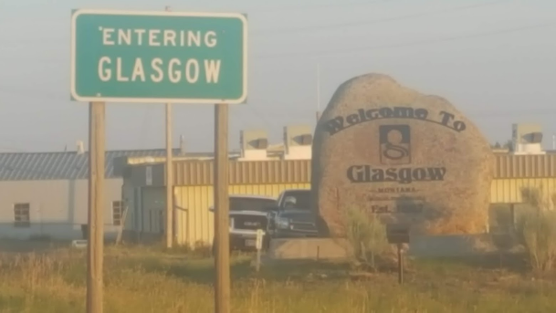
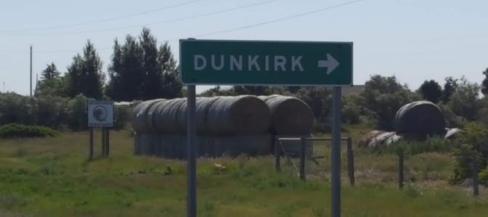
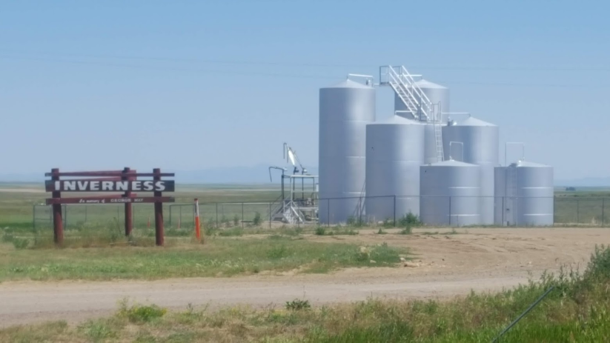
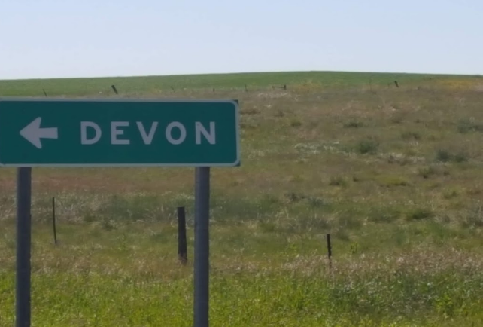
Notes:
Different words mean different things to different people.
Context is key.

Slide 84


Notes:
One of the more convincing studies showing an affect of language on cognition is a study focusing on colour perception. We all know what colours are: Red, Blue, Yellow etc. These are known as basic colour words, but did you know that different languages have different basic colours? For example, Russian has no single word encompassing what we would call blue. Instead, they have two separate words; goluboj means light blue, and siniy means dark blue.
Nuances are important – but how important and at what point to nuances contribute to bureaucracy?

Slide 85


Slide 86
Explore – Define – Exemplify – Empower

Slide 87
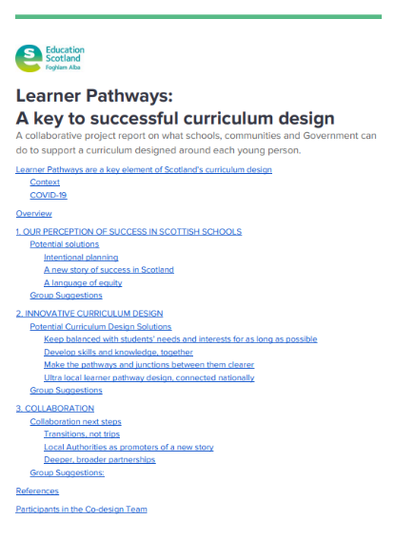
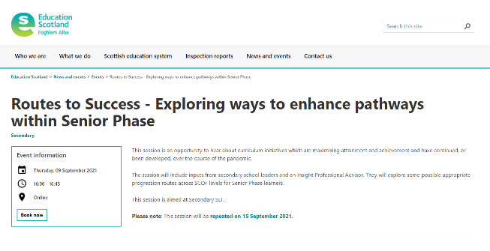

Slide 88
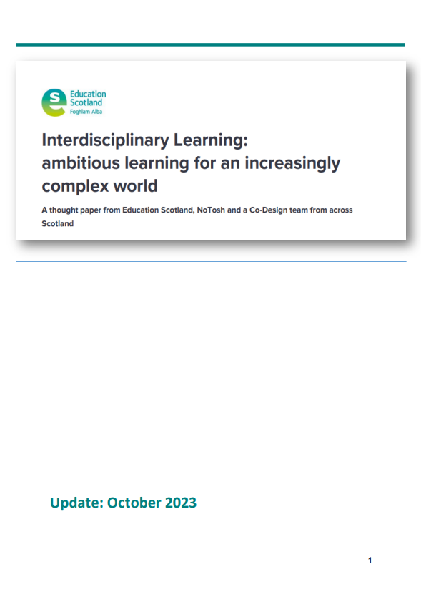
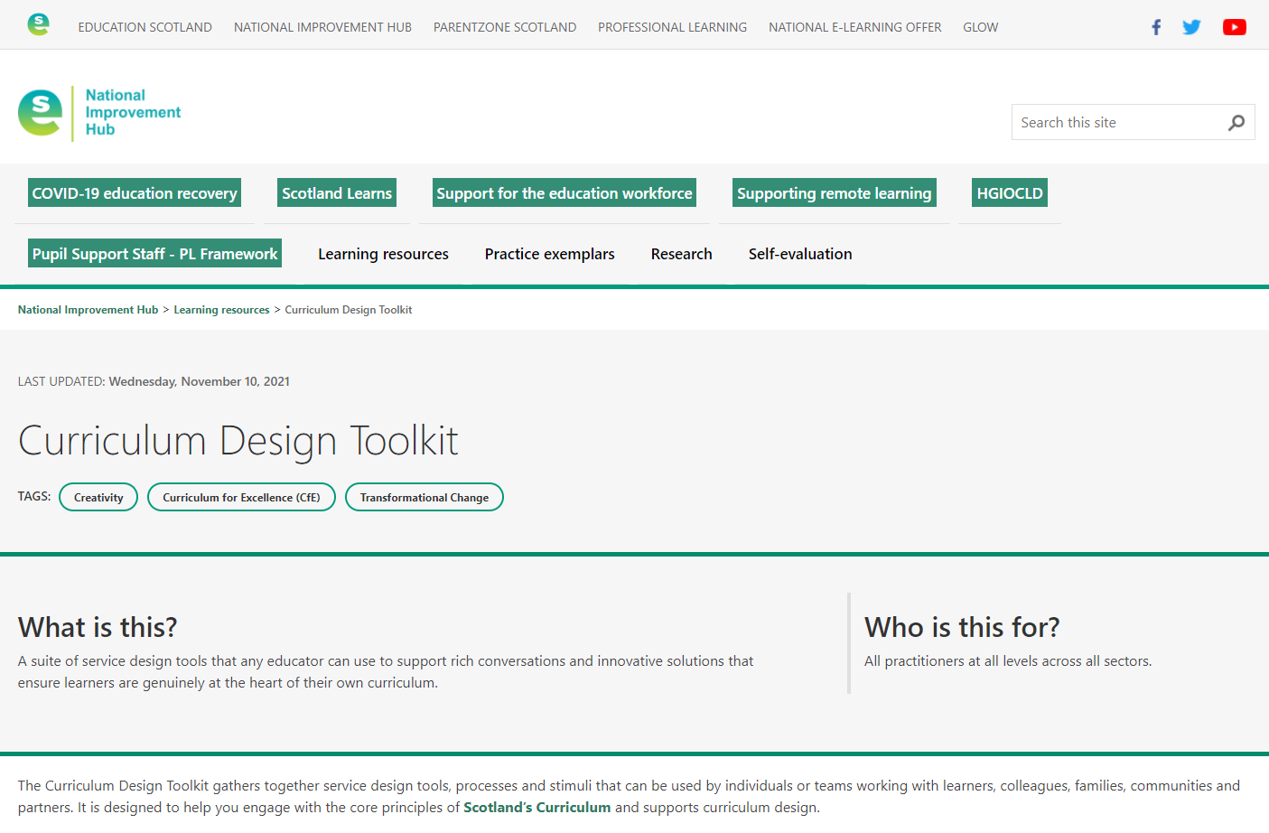

Slide 89
Key Messages
COVID has changed everything – but we need to progress not regress.
The ‘lost’ generation is actually the ‘golden’ generation – we have a lot of learn from them.
We are not short of ‘recommendations’ or ‘considerations’ for change – but we need to look for the common themes and think deeply about the order of implementation.
Education reform is around the corner – but we must be careful not to reform the wrong things.
We need to use the time before reform to strengthen our understanding of the foundations for reform – language, curriculum design & four capacities.
There are a number of key considerations / wicked issues that we could all consider now.
We need a national and local focus on pedagogy and curriculum from 3 – 18+
Skill development needs clear definitions and progression frameworks linked to knowledge acquisition and learning experiences.
Days like today including the discussions and time for reflection will provide very strong foundations to help move forwards
(Explore – Define – Exemplify – Empower)

Slide 90

Finally…

Slide 91
Focus
Wasting
Energy
Cannot Control
Can Control
Wasting
Opportunities
Paranoid
Ignore

Slide 92
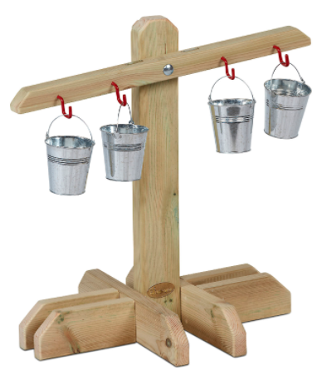
Everything is a balance
COVID, people, resources, energy, stress, etc…

Slide 93
Everything is a balance
COVID, people, resources, energy, stress, etc…
- but we are also all in it together.

Slide 94
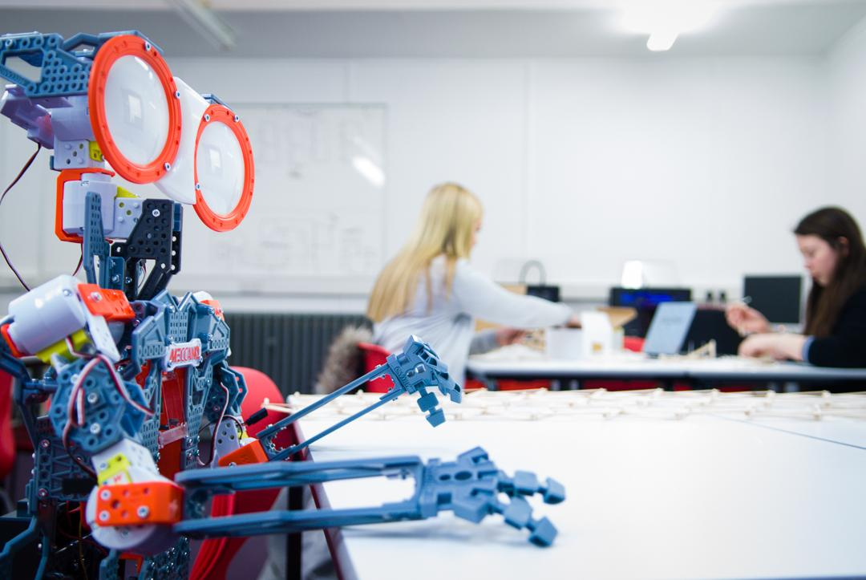
Questions, challenge, etc…
x: @olliebray
e: ollie.bray@educationscotland.gov.scot

Slide 95
What next?
Agree?
Disagree?
What will you do?

