Slide 1
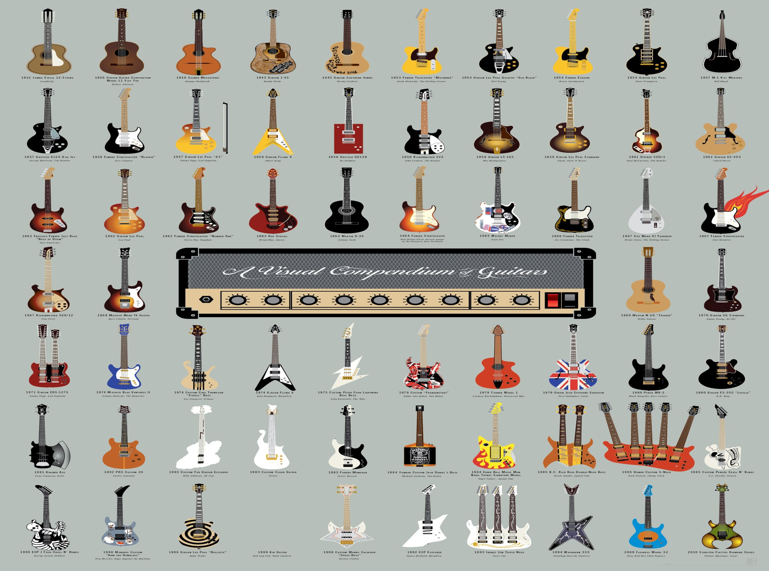
World music
Guitars of the world

Slide 2
contents
Guitars of the uk
China
USA

Slide 3
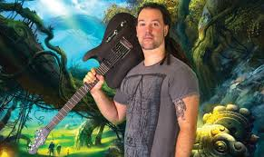
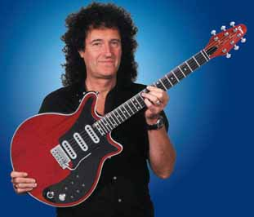
British guitars
Nowadays Britain has very little guitar company's there are mostly custom guitar shops the only two brands are brain may owned by the lead guitarist from queen and chapman guitars owned by rob chapman
Rob Chapman from chapman guitars
Brian may from Brian may guitars

Slide 4
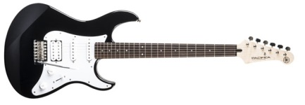
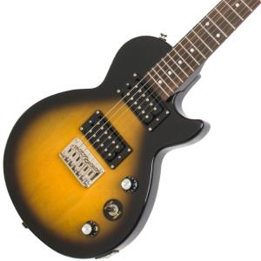
Guitars Of China
There aren't very many “quality” Chinese guitars But The main Brands are
Yamaha
Squire (By Fender)
Epiphone (partially)
These brands are all lower end but some are like with an Epiphone custom les Paul .
The majority of Chinese guitars are fakes.

Slide 5
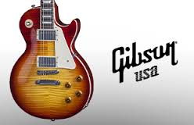
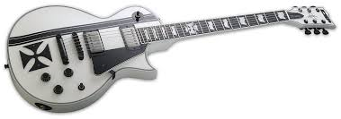
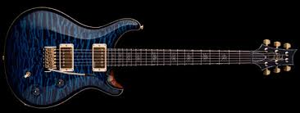
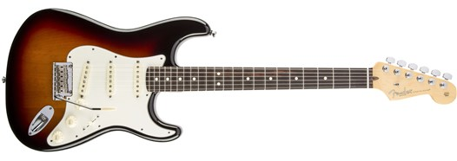
Guitars Of The USA
American Guitar companies are usually the best with brands like Fender Gibson ESP and PRS leading the market
Gibson
ESP
PRS
Fender

Slide 6
Spanish Guitars
Spanish guitars are played in the style of flamenco so the guitars have nylon strings witch are easier to play. There aren't very many particular brands.

Slide 7
Styles of Guitars and playing
Guitars all sound different and play different

