Slide 1
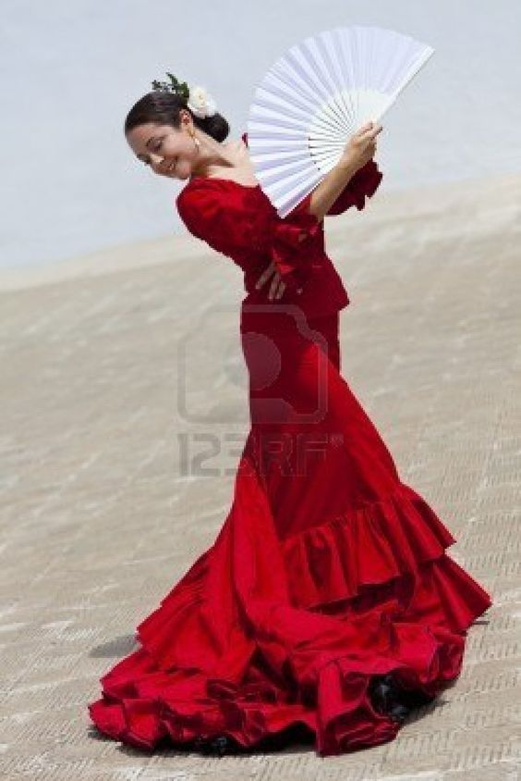
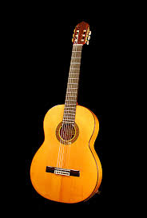
Spanish music

Slide 2
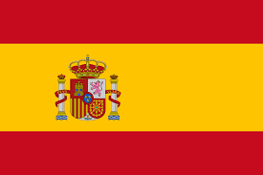
History of Spanish music
The music of Spain has a long history and has played an important role in the development of Western music and has greatly influenced Latin American music. Spanish music is often associated with traditional styles such as flamenco and classical guitar.

Slide 3
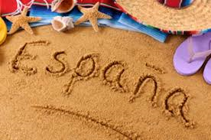
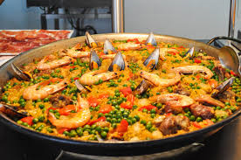
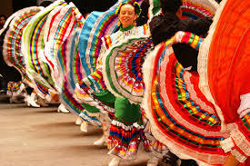
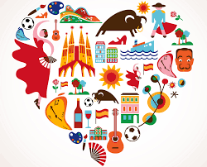

Slide 4
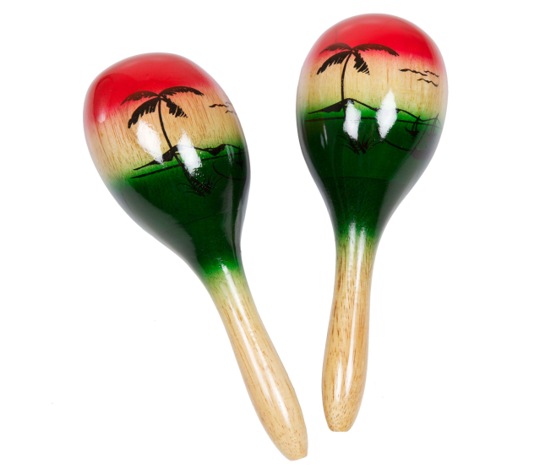
Spanish instruments
Castanets
Maracas
Spanish guitar

Slide 5
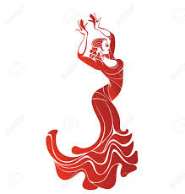
Flamenco
Flamenco dancing is really popular is Spain. They use castanets to dance with the rhythm.

