Slide 1
Spanish music
By Rachel McCreath

Slide 2
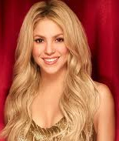
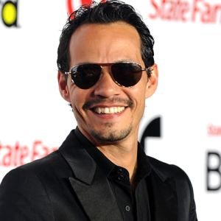
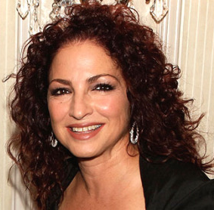
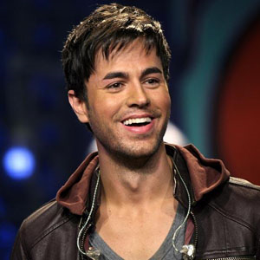
Spanish singers
Spain has a lot of famous singers some of them are:
Shakira
Ricky Martin
Thalía
Marc Anthony
Gloria Estefan
Enrique Iglesias

Slide 3
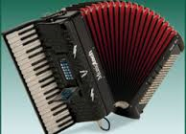
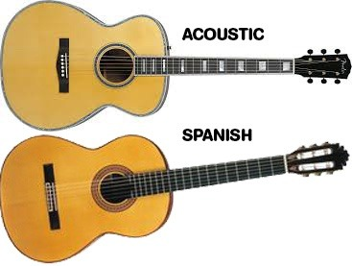
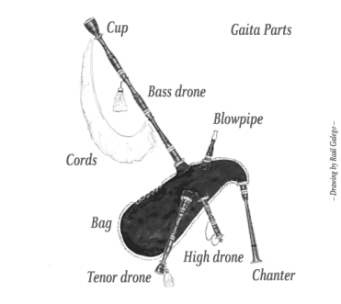
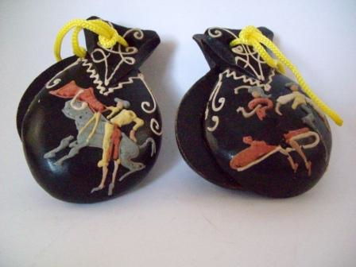
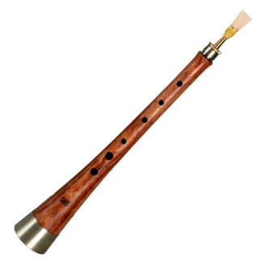
Traditional Spanish instruments
There are a few traditional Spanish instruments. These are a few.
Accordion
Guitar
Galician Gaita
Castanets
Flabiol i Tambori
Gralla

