Slide 1
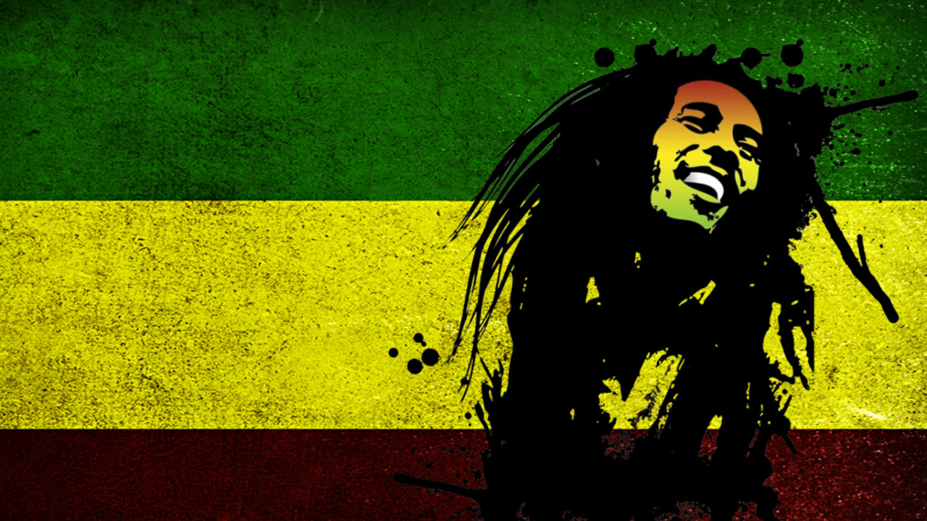
Reggae
By g

Slide 2
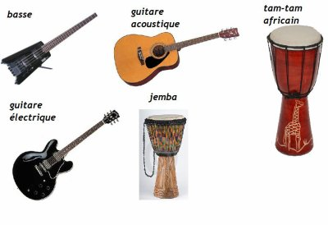
instruments

Slide 3
Reggae
Reggae is a music genre that originated in Jamaica in the late 1960s. Most music from Jamaica is the Reggae style. The music has regular chops on the back beat (off-beat). These are called “skank”, and are played by a rhythm guitarist. The bass drum hits on the second and fourth beat of each measure (each bar). These are called the “drop”. Reggae bands also use a bass, a keyboard or organ, and horns comes from the reggae style.

Slide 4
Famous Reggae bands
Reggae is a distinctive bouncing music that has a catchy beat with an emphasis on bass and percussion. It was formed out of ska, rocksteady and mento. Reggae has given rise to several sub-genres leaving an inedible mark on famous music. It is even credited for being the influence behind hip hop.
Bob Marley
Peter Tosh
Gregory isaacs
Jimmy cliff
Burning spear
Toots
Bunny waile
Black uhuru
Culture
Tanya stephens

