Slide 1
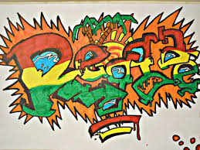
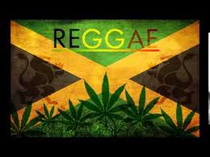
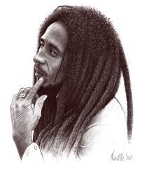
Reggie
BY ME!!!!!!!!!!!!

Slide 2
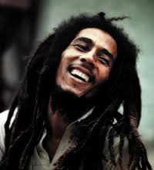
BOB MARLEY
Bob Marley is one of if not the most popular Reggie singer and songwriter
He was born on the 6th February 1945 and died on the 11th of May 1981

Slide 3
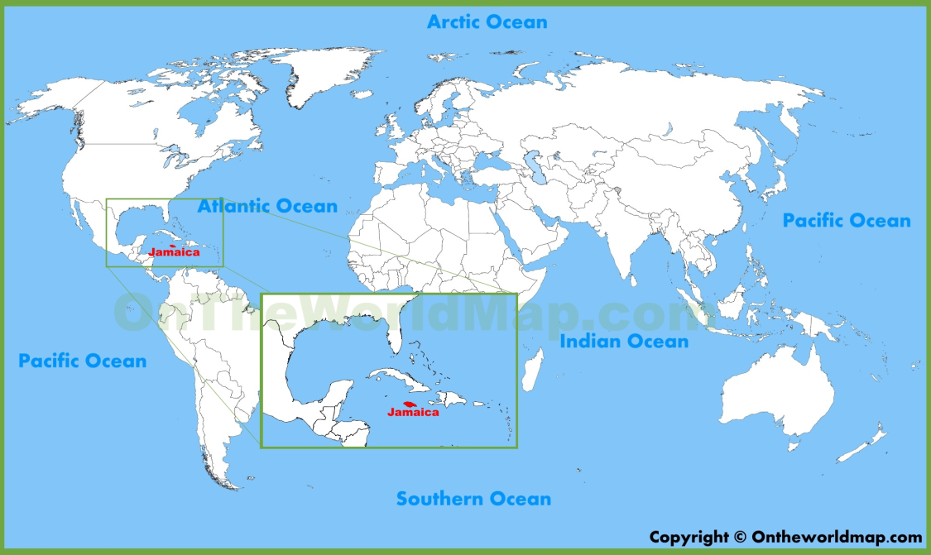
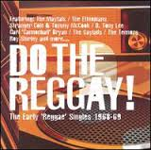
Where was the birthplace of reggae
The birth place of reggae is Jamaica in the late 1960s the first of the songs were “Do The Reggay” (that’s how it was spelt) which gave the genre its name
☺

Slide 4
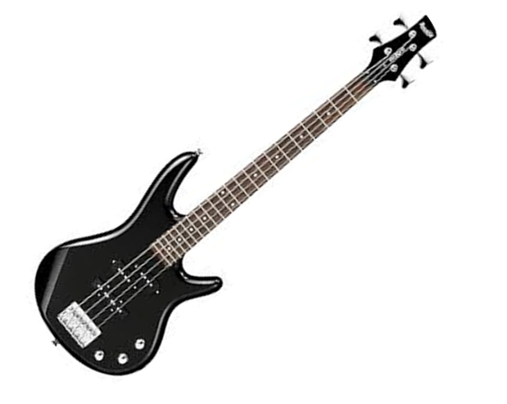
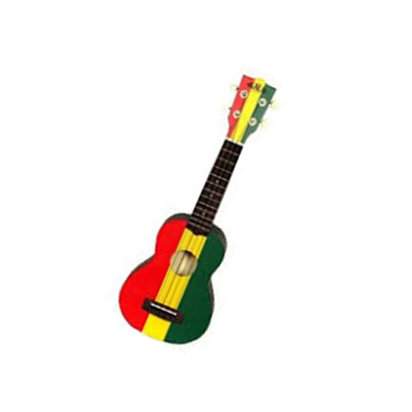
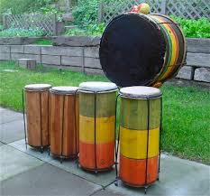
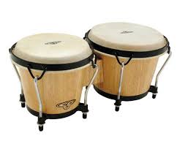
What Instruments Are Used
What many say is the guitar, bass guitar and the drums
But other ones like the organs, the Clavinet, the Keyboard and the Bongo

Slide 5
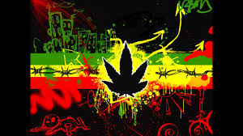
Weed
As unusual as it sounds weed is one of the reasons reggae is known because its also part of the culture.
The most famous person to publically put out that he smokes weed is no other but Bob Marley
Its used by Rastafarian people as a sort of a meditation device and as a religious use aswell

Slide 6
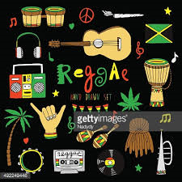
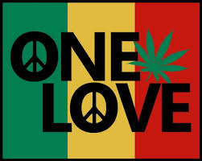
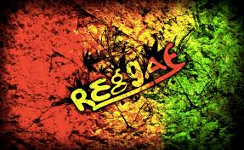
Thanks For Watching
( ͡° ͜ʖ ͡°)
\O/

