Slide 1
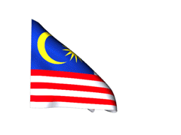
MUSIC IN MALAYSIA

Slide 2
MALAYSIAN MUSIC
Music of Malaysia means music that has been created in Malaysia. A huge variety of genres in Malaysian music show the different groups Malaysian society consisting of Malay, Chinese, Indian, Iban, Dayak, Kadazandusun, Eurasians and other groups. In general, music of Malaysia is categorised as classical, folk, syncretic (or acculturated music), popular and contemporary art music. Classical and folk music came during the pre-colonial period and exists in the form of vocal, dance and theatrical music such as Nobat, Mak Yong, Mak Inang, Dikir barat, Ulek mayang and Menora. The syncretic music developed during the post-Portuguese period (16th century) and has bits from both local music and foreign elements of Arabian, Persian, Indian, Chinese and Western musical and theatrical sources.

Slide 3
Among other types of this music are Zapin, Ghazal, Dondang Sayang, Mata-kantiga, Joget, Jikey, Boria, Keroncong and Bangsawan.
Malaysian popular music and contemporary art music are basically Western-based music combined with some local elements. In the 1950s, the musician P. Ramlee helped in creating Malaysian music that combined folks songs with Western dance rhythms and western Asian music.

Slide 4
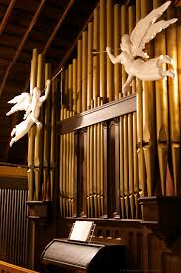
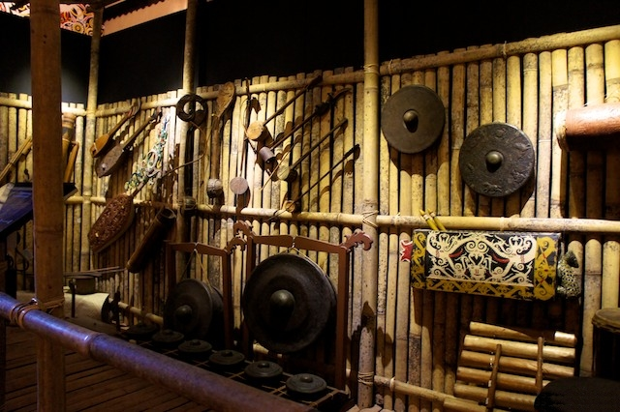
TRADITIONS
Expect Malay music, Chinese and Indian Malaysians have their own forms of music, and the indigenous tribes of Peninsula and East Malaysia have own unique traditional instruments.

Slide 5
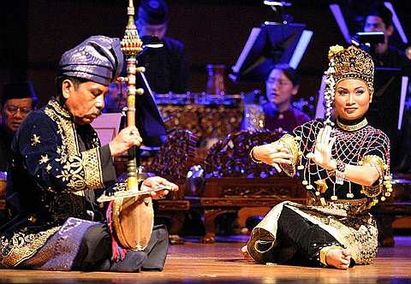
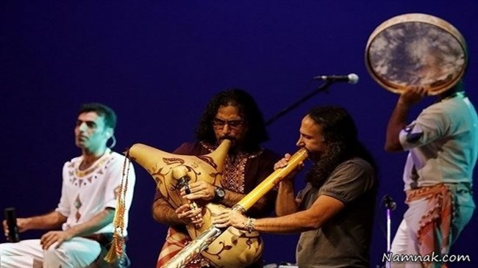
MALAYSIAN MUSIC
In East Malaysia, gong-based musical ensemble such as agung and kulintang are commonly used in ceremonies such as funerals and weddings. These ensembles are also common in neighbouring regions such as in the southern Philippines, Kalimantan in Indonesia and Brunei.

Slide 6
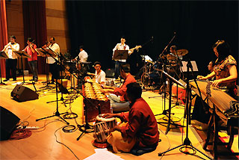
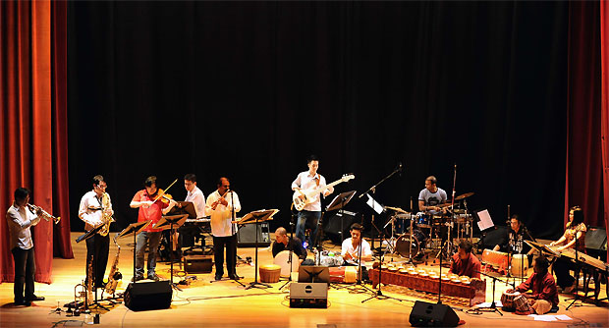
INDIGENOUS TRIBAL MUSIC
The Orang Asli groups of West Malaysia, Semang, Senoi, and Orang Melayu Asli, have their own musical traditions. The Semang people are use instruments that are disposable and created when needed, and instruments used include nose flute, Jew's harp and tube zither which are also used by the Senoi.

Slide 7
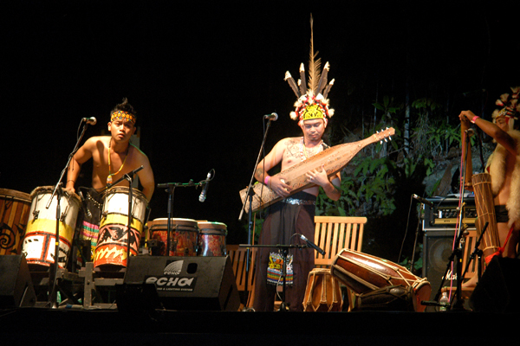
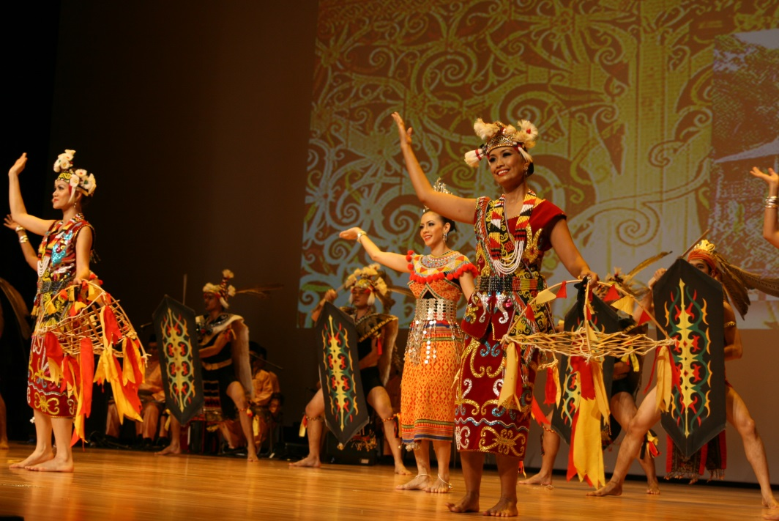
Instruments used by the Senoi are more long-Alasting and include kərəb. The Orang Melayu Asli however have closer contact with Malay and Chinese populations and used a wider range of musical instruments ranging from thigh xylophone to violin. The instruments may be used for purposes such as singing and trance-dancing ceremonies, and healing rituals.

Slide 8
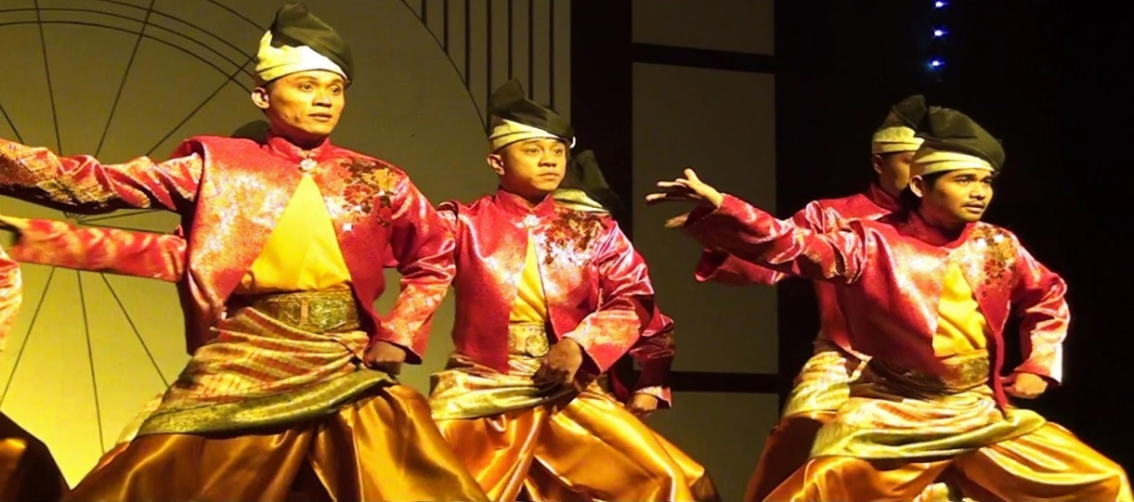
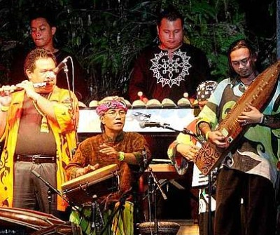
A number of groups such as the Dayak tribes, are found in Sabah and Sarawak. The music of these people include vocal music for narratives; songs for life-cycle events and rituals associated with religion, healing, growing rice, hunting game, and war; songs for dancing and community entertainment; as well as a wide variety of instrumental music. Instruments used include drums, gongs, flutes, zithers, xylophones, and Jew's harps, of which the bronze gongs are the most significant.

Slide 9
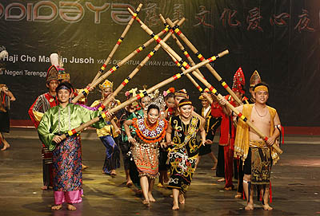
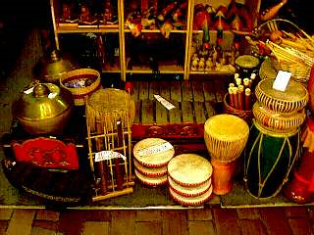
Ensembles of gongs of various sizes are played to welcome guests and in ceremonies and dances. A well-known instrument in Sarawak is the sapeh, a plucked lute of the Kayan and Kenyah people which is used for entertainment and dancing. Other instruments include the xylophone jatung utang, bamboo flutes and sets of bamboo tubes called togunggak which were formerly played in headhunting ceremonies of the Murut.

Slide 10
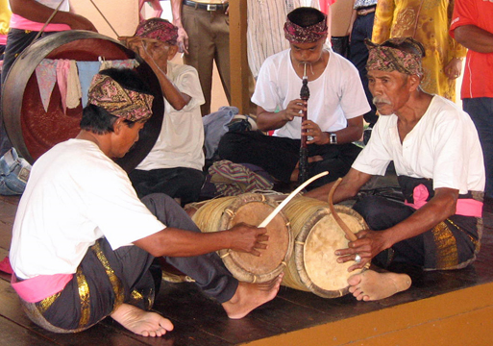
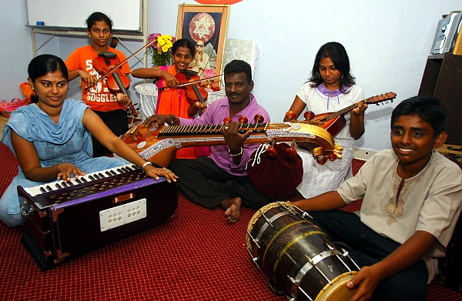
CLASSICAL MALAYSIAN MUSIC
Within Malaysia, the largest performing arts venue is the Petronas Philharmonic Hall. The resident orchestra is the Malaysian Philharmonic Orchestra. Malay popular music is a combination of the music from all around the country. The Malaysian government has taken steps in controlling what music is available in Malaysia; rap music has been criticised, heavy metal has been limited, and foreign bands must submit a copy of a recent concert before playing in Malaysia. It is believed that this music is a bad influence on youth.

Slide 11
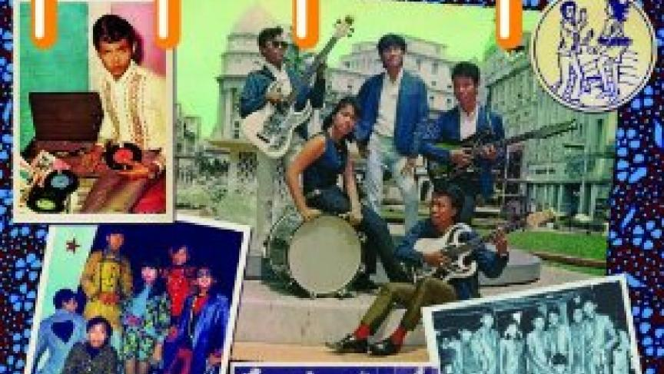
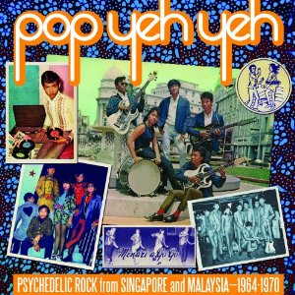
MALAYSIAN POP
Malaysia's pop music developed from traditional social dance and entertainment music such as asli, inang, joget, dondang sayang, zapin and masri, which were adapted to Anglo-American dance band arrangement by Bangsawan troupes in the 1920s and 1930s. The Bangsawan troupes are a type of Malaysian opera influenced by Indian opera at first known as Wayang Pasir which was started by rich Persians residing in India. They told stories from diverse groups such as Indian, Western, Islamic, Chinese, Indonesian and Malay. Music, dance and acting with costumes are used in performance depending on the stories told. The musicians were mostly local Malays, Filipinos and Guanis.

