Slide 1
Latin American Music
By Daniel

Slide 2
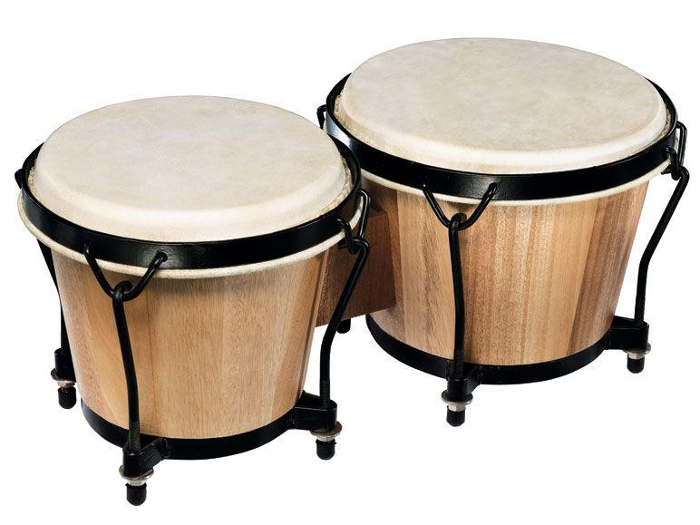
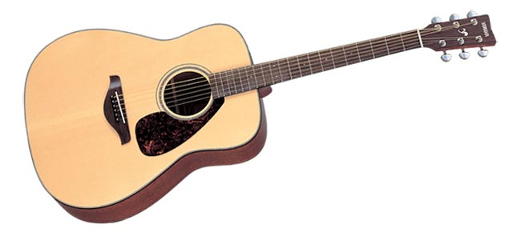
Instruments
Bongos are an Afro-Cuban percussion instrument consisting of a pair of small open bottomed drums of different sizes
Acoustic guitar- they use this to accompany the main vocalist. They use other stringed instruments as well

Slide 3
History
Latin American music has been around for a very long time. It first originated in the 16th century in south American countries.

Slide 4
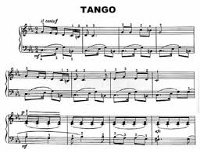
Latin American Piano Music
Notes:
Latin American music is very fast paced

Slide 5
Culture
Latin American music is used a lot, like in programs like Strictly Come Dancing. Latin American music is used at festivals, art shows and sometimes folk dances. Latin American music is very fast paced

Slide 6
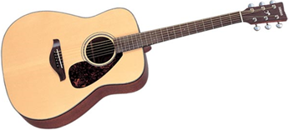
Different types of Latin American music
There are many different types of Latin American music. There is salsa, tango, cha-cha-cha, mambo, merengue, rumba, bomba and plena.

Slide 7
Samba music

Slide 8
Thanks for watching

