Slide 1
Japanese Music
By
Caitlin
Blackett

Slide 2
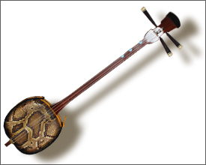
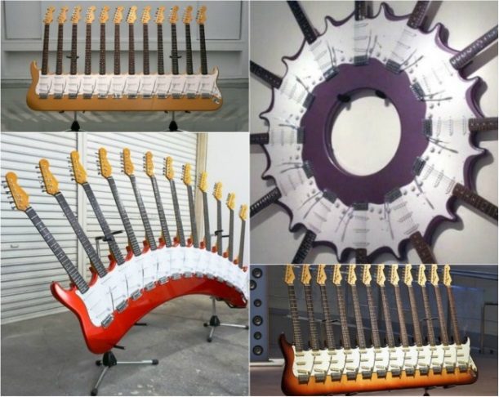
Japanese Instruments
Shamisen
Is made from
Cat, dog or snake skin.
Yoshihiko Satoh

Slide 3
Japanese Voices
There are at least 50 different best selling singles from Japan.
Artist | Sales
Hikaru Utada | 36.22 million
Namie Amuro | 35.52 million
SMAP | 35.18 million
Arashi | 33.37 million

Slide 4
Japanese Styles
Japanese people call pop music “Jpop”.

Slide 5
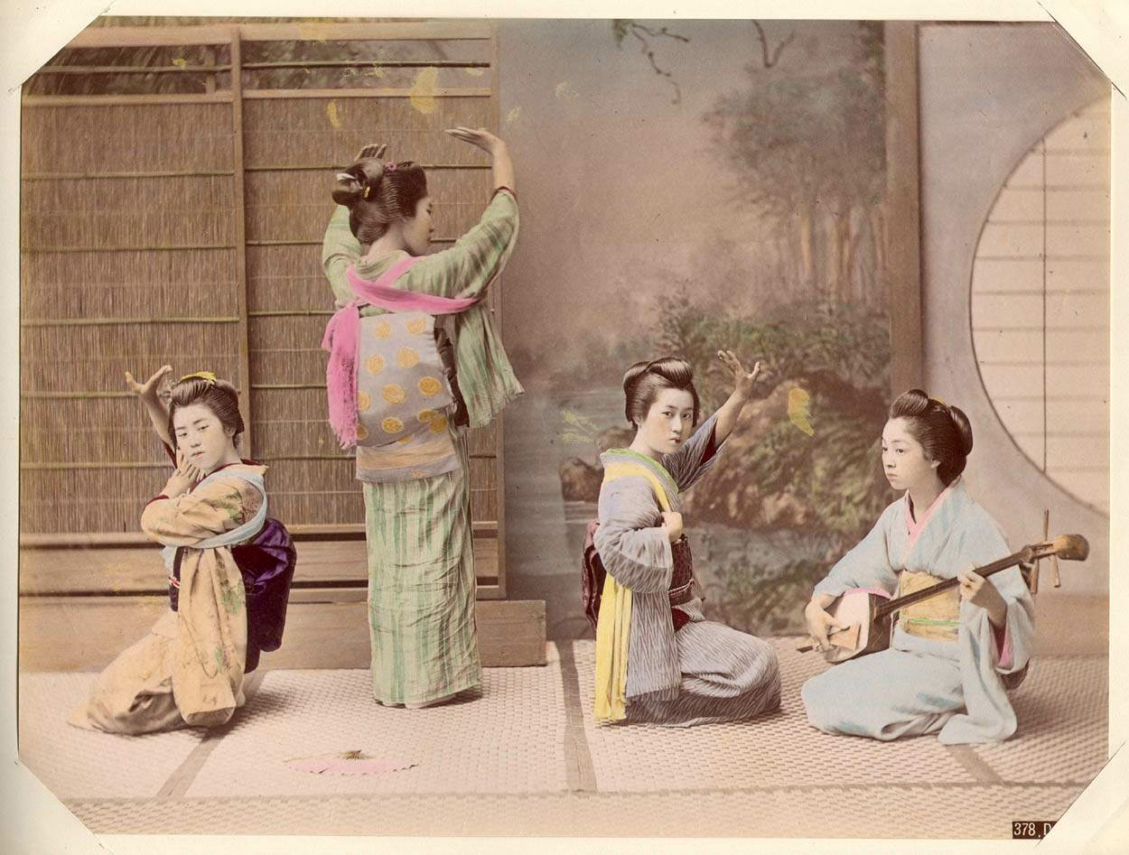
Japanese Culture
Japanese people like old folk music.

Slide 6
Japanese Rhythm

