Slide 1
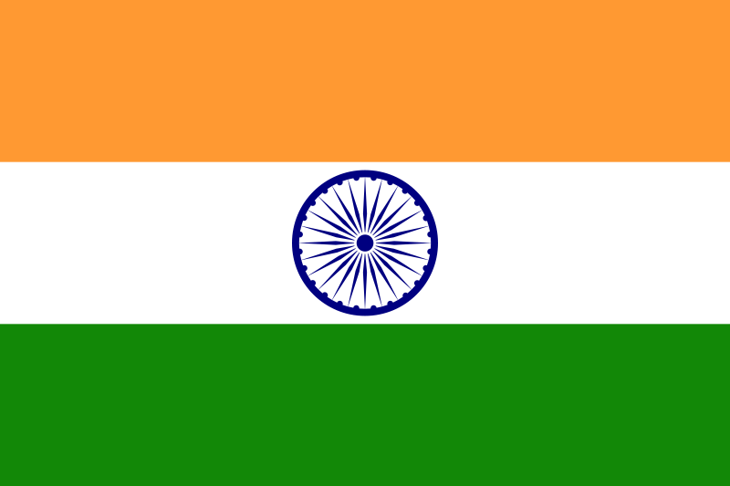
Indian Music
By florrie

Slide 2
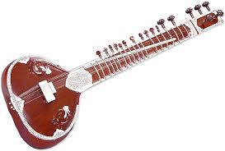
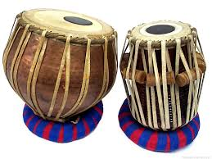
Indian Instruments
The Sitar = The Sitar is an instrument that comes from India but it looks like an oversized guitar. It is regarded as an instrument that came in from Central Asia.
The Tabla = The Tabla is a percussion instrument most commonly used in north Indian classical music. This instrument is made up of two drums that look a bit like bongo drums.

Slide 3
Indian Styles of Music
Here are a couple of styles of music in India:
► Indian classical music‎
► Indian country music‎
► Indian folk music‎
Here is some Indian folk music ;

Slide 4
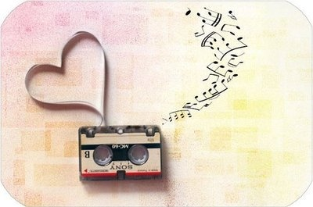
Indian Rhythms
Taala or Taal is the term used in Indian classical music for the rhythmic pattern. A tala does not have a fixed tempo and can be played at different speeds.

Slide 5
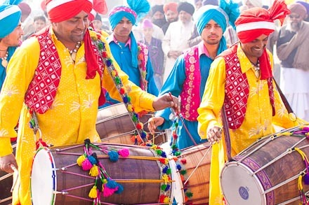
Indian Music Linked with Culture
In India people usually like to listen to Bhangra music and dance the Bhangra to the traditional music.
Bhangra originated in the Punjab region of India. Traditionally a good harvest was celebrated by dancing and singing songs to the sound of the dhol drum.

