Slide 1
African Masks
Week 10 with Mrs Shenton-Ross

Slide 2
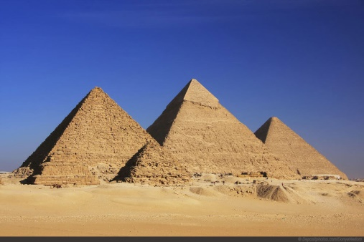
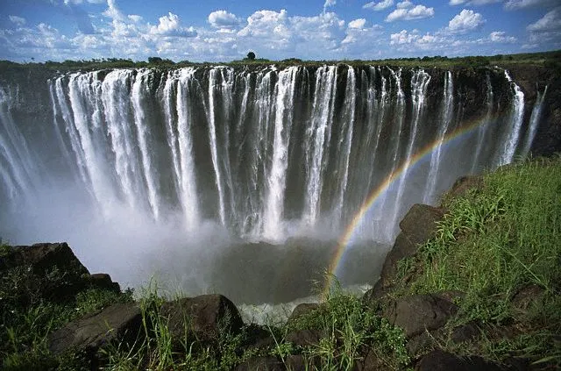
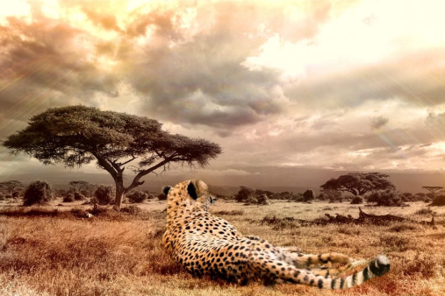
When we go on holiday we see how different people live and experience some of their culture.
Africa is a BIG continent and there are lots of different people and lots of different beliefs.
Some people in Africa believe in religions like Christianity or Islam.

Slide 3
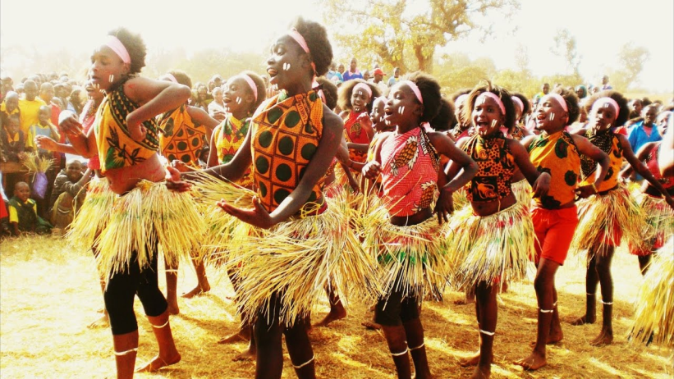
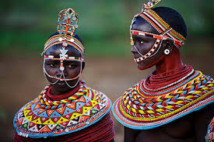
Africa and African Tribes have lots of traditional beliefs too!
Each country in Africa has different tribes with different names.
Each tribe has special songs, special clothing and special beliefs.

Slide 4
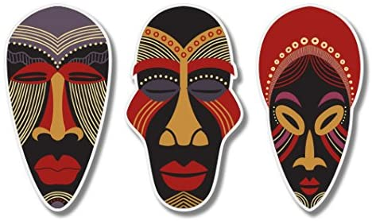
One thing that lots of tribes have are tribal masks.
African masks are used at special times and can be lots of different shapes and sizes. Usually they are made of natural materials and have holes for the eyes.
Nowadays if you go to different parts of Africa people make mini masks out of wood and you can buy them and take them home.

Slide 5
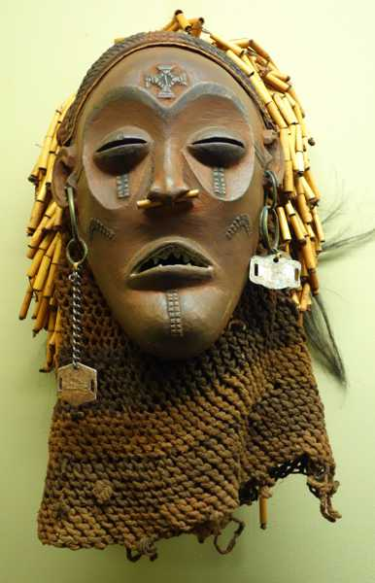
Why Wear Masks?
Tribal masks are worn at special times.
Sometimes it is thought the person who wears the mask is connected to good spirits or bad spirits.
Sometimes masks represent that the tribe thinks nature is important.
Sometimes the people in the tribe believe that the mask links them to people who have lived and died.

Slide 6
Pick one of the following tasks
Don’t forget to share what you do!

Slide 7
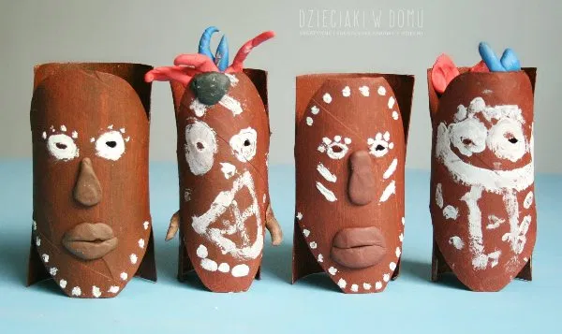
Task One
Make your own mini mask.
Use an old toilet roll middle and white paint/ crayon to design your own mask.
For more inspiration, follow the link below and look at the pictures of different styles of masks.
https://www.artyfactory.com/africanmasks/information/african-mask-functions.htm

Slide 8
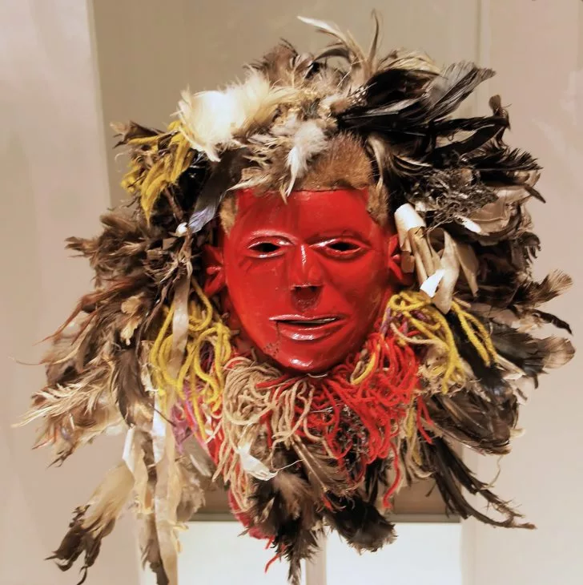
Task Two
Make your own mask from natural materials.
Some masks cover your whole head. These are called headdresses.
Can you use grasses, branches or other materials outdoors to create your own headdress?

