Slide 1
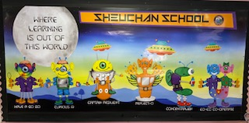

Sheuchan Primary School
Primary One
Parents Information Meeting

Slide 2
Many Expectations of Parents
That From the First Day!!!
They will get a reading book with lots of words in them
Learn to write and spell words
Learn to count and add and do sums

Slide 3

In the school day we …….
Self Registration
Morning Boxes – working on developing skills, e.g. fine motor skills like cutting, threading, drawing, etc.
Learning through play – literacy focus – teacher led activities/ child led activities
Learning through play – numeracy focus –
teacher led activities/ child led activities
Topic work – science, history, geography
Art / Technology – all carried out in play situations – child led with teacher support
PE / Music / PSD / French – all specifically taught

Slide 4
We are developing many of the early year skills
Pre reading skills – book handling, environmental print, interpreting pictures to tell a story, sequencing
Phonological skills – hearing individual sounds, rhyming, syllables in words
Pre writing – drawing pictures with detail, pencil control, pattern making
Listening and Talking – following instructions, taking part in discussions, listening to stories and answering questions, allowing others to speak without interrupting
Learning how numbers work – not simply counting , we need to do lots of pre number skills

Slide 5



P1 Literacy
Sounds – Phonological / Jolly Phonics
Reading – PM Benchmarks – Yellow level by end of P1
Books- developing reading skills, interpreting texts
Writing – pictures / writing

Slide 6


Pencil Hold
We have been using ‘Crocodile Snap’ to learn about the correct pencil hold.
https://youtu.be/1j0rPflY8-k

Slide 7
Letter formation

Slide 8
End of P1

Slide 9

P1 Numeracy
Sorting and sharing
Read, write and count to 20
Add and subtract to 10
Money – recognise 1p,2p,5p,10p,20p,£1 – make amounts up using coins
Time – o’clock, days of week, seasons
Weight / Volume / Length
Shape/ Patterns / Symmetry
Big Maths – Learn Its

Slide 10
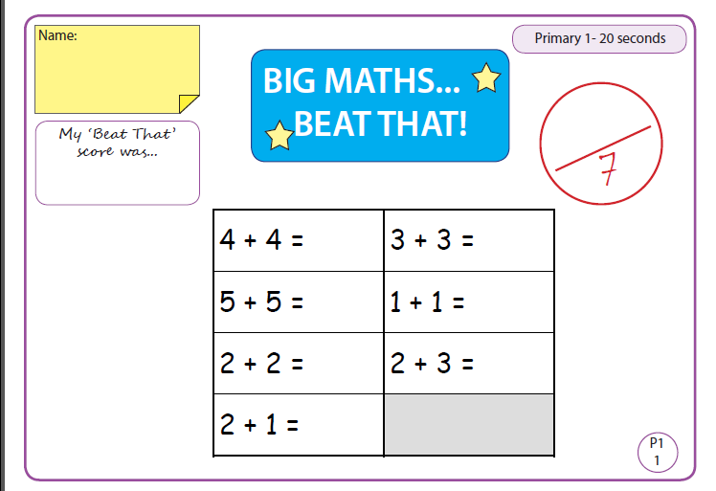

Slide 11











Number Formation
We use Number Zoo to teach number formation.
Each number 0–10 has a number zoo character.

Slide 12
Learning Characters – Meet Our Aliens
We use these to help children develop important learning skills.
Coco Co-operate
Curious Q
Captain Resilience
Reflect-O
Have a Go Go
Concentralien

Slide 13

Learning through play – Why?
Social skills – sharing, talking, working co-operatively
Physical health and mental wellbeing
Life skills – problem solving, asking questions
Concentration
Transfer knowledge into the wider curriculum
All play is observed and tracked to ensure that progress is being made.

Slide 14
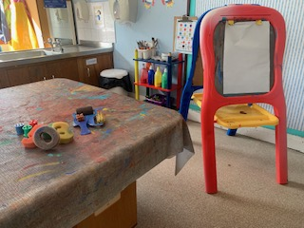
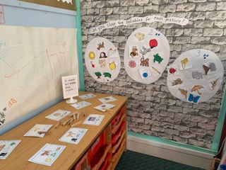
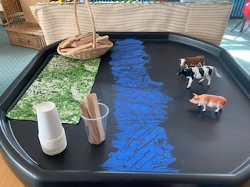
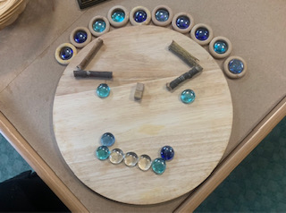
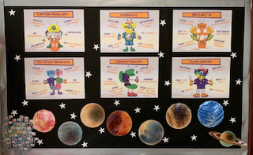
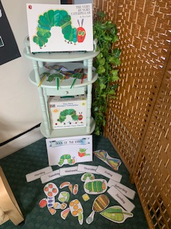
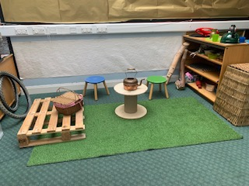
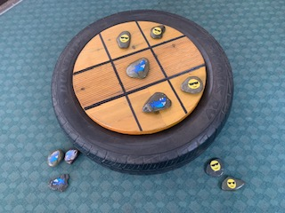
STEM – Science, Technology,
Engineering & Maths
Art & Crafts
Literacy
Learning Journey Wall
Loose Parts
Book Corner
Games & Puzzles
Role-play

Slide 15
Storybooks – ask open ended questions
Why did the animals decide to take revenge on the lazy farmer?
What do you think will happen now that the farmer has run away? Why?
How would you feel if this happened to you?
How can you tell what kind of person Farmer Duck was?

Slide 16
Play Games – develop important skills
I-spy
Noughts and crosses
Hangman
Roll a dice
Pairs
Memory games
Who am I?
Rhyming games

Slide 17

Homework
Will be issued on a Monday to be completed by the Friday.
There will normally be 4 tasks set per week.
Mixture of Literacy & Numeracy
Will be a mix of written and practical activities as well as reinforcement/revision using I.C.T. games.
All log in details can be found in the inside cover of the homework jotter.
Please return the Homework Bags & content every day (we may need to update information/provide new reading books or update keywords)
Library Books will be issued to take home and should be returned the following week. (day to be confirmed)

Slide 18
What Can You Do to Help?
Set aside time for homework, make it a positive experience. 10 minutes is plenty.
Read stories help your child to develop great language skills through talking about the stories you are reading.
Sing rhymes, play rhyming games.
Talk about the world around them. Make connections with their learning.
Encourage them to ask questions and help them answer them.
Point out literacy and numeracy in the world around them.
Use your home as a learning opportunity.

Slide 19

School Policy
Only plain water in their bottles
1 play piece is plenty – 15 mins for break
Change of shoes for P.E. which can be left in school
No jewellery due to Health & Safety guidance
School is a Nut Free Zone - due to a child with a severe nut allergy – birthday cakes????
8.55am start – 2.55pm finish

Slide 20

School Lunches
Lunches can be ordered online using the iPayimpact link.
Toast is available for anyone who wishes some in the mornings between 8.45 - 8.55am.

Slide 21





School Communication
Sharing Information
Our Class Facebook page
The School App
School Newsletter
School Blog
By Email
Mrs M. Fraser (Monday)
gw08frasermildred@glow.sch.uk
Mrs G. Ferguson (Tuesday - Friday)
gw09fergusongillian3@glow.sch.uk
Mrs M. McClymont
gw08mcclymontmaura@glow.sch.uk
The School Office
gw08officesheuchan@glow.sch.uk

