Slide 1
HOW TO BE An Eco EXPERT
BY OLIVIA

Slide 2
In this presentation, I will be giving 7 reason why being ecofriendly is important.

Slide 3
1. Electricity
Electricity is wasted every day from leaving lights on, to running the dishwasher half full. I understand electricity is essential for living comfortably, but they are simple ways you can reduce your energy use. You can switch off lights when you're not in a room, fill the dishwasher full when you put it on and washing your clothes, towels and sheets in cold water will use a lot less energy and will be better for the enviroment.

Slide 4
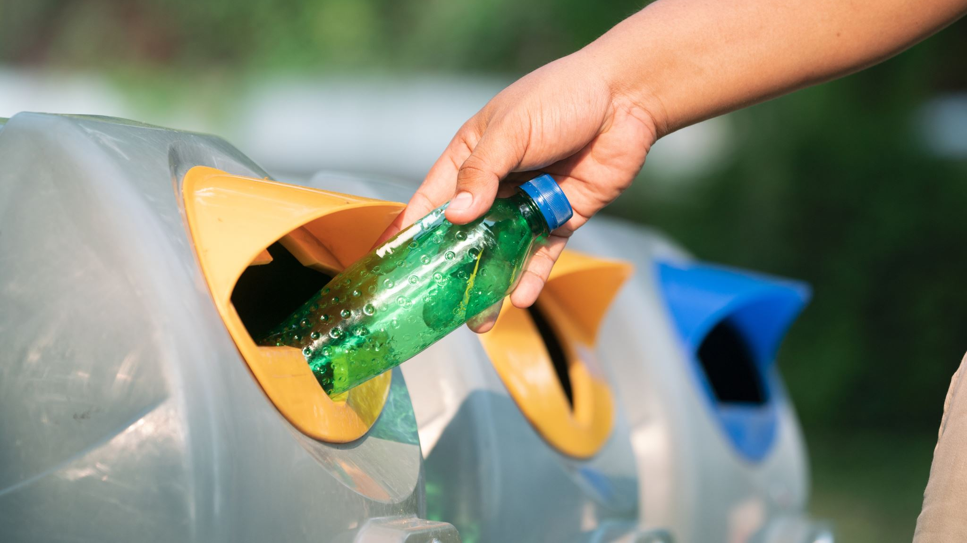
2. litter
Litter is anything from a crisp packet or cigarette butt to a bag of rubbish. It has always been a problem and probably will still be a problem in the future. Unless of course, you decide to help...
Firstly, you could bring a healthier snack to school, like an apple or banana which doesn't come in any packaging or plastic and will disintegrate if you drop it and will make you have a healthier lifestyle.
Secondly, bring a reusable water bottle to school, you can refill it at the water fountain and wash it every night when you get home from school.
Finally, take part in any beach or community litter picks. Remember even the tiniest bit of litter could end up in the ocean or a land fill and destroy the wildlife around it.

Slide 5
3. water
Water is essential in everyday life, but do you need to have the taps running while you're brushing your teeth or fill the bath all the way to the top and just be in it for 5 minutes?
think about the people who travel up to 10 miles every day to get water for their families, and the water they are getting isnt always clean either.
You can help by:
Turning off the taps while brushing your teeth.
Having a 5-minute shower.
Collecting water in a water butt and only watering your plants in the morning before it gets warmer, and the water starts to evaporate.

Slide 6
4. biodiversity
Over 1 million seabirds and 100,000 marine mammals are killed by ocean plastic every year. 700 species of marine animals are in danger of extinction due to plastic. An animal welfare charity received 5000 calls last year about animals who were hurt by rubbish. It's not the animals fault it gets caught in plastic. You can help by:
You could adopt an animal.
You could volunteer at a local wildlife center and help there.
You could hang up a bird feeder or make a hedgehog house, this a great way for animals to make it through the winter months.

Slide 7
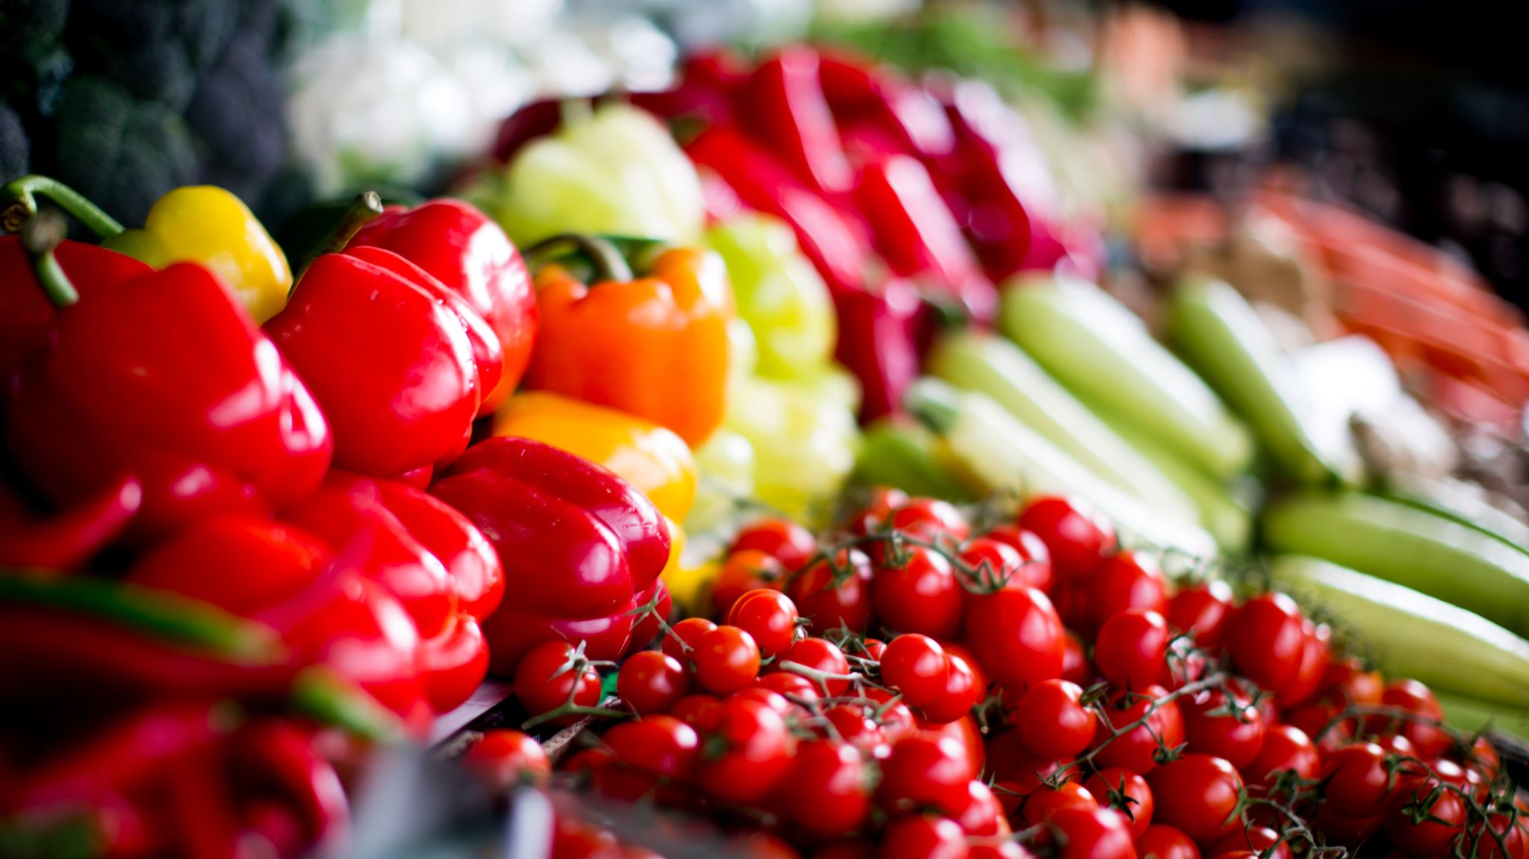
5. food waste
1.3 billion tonnes of food is wasted each year. That is the equivelent of 216,666,666 elephants! For some people, school lunch could be their only meal of the day so think about how lucky you are.
You can prevent food waste by:
Eating up your dinner
Any uneaten foods could be donated to charity or food banks
If you have a compost bin or heap, put your food waste in there because the worms and insects can break it down to make compost.

Slide 8
6. Food Miles
AROUND 20,948,398 TONNES of the UK'S FOOD IS IMPORTED EACH YEAR. THIS MEANS that more aeroplanes and boats must make long journeys to cross the sea or sky to get to the uk.
About 15 to 35 kilometres above the earth's surface a gas called ozone surrounds the planet. The ozone layer acts as a barrier between the sun and the earth. However, due to pollution from transport the ozone layer has started to get thiner which is causing global warming.
How you can help:
Look for the red tractor lable on food packets (this means the food is british)
BUY LOCALLY TO SUPPORT LOCAL BUISNESSES
Try and grow your own fruit, vegetables and herbs

Slide 9
7. plants
Plants are very important to the ecosystem. They improve air quality and take in carbon dioxide. They provide oxygen and provide a habitat for animals. Sadly, due to deforestation, many habitats have been destroyed.
Here are some ways you can help:
Planting anything from trees to flowers, hedges and shrubs.
Try not to buy foods that have palm oil in them as forests are destroyed to be replaced with palm oil trees.
Try and not waste paper.

Slide 10
Thanks for watching!
Any Questions?
Notes:
1. talk about Christmas Jumpers
2. Rap the Mummy

