Slide 1
Balmurrie Fell Wind Farm

Slide 2
Gael Force Team

Slide 3
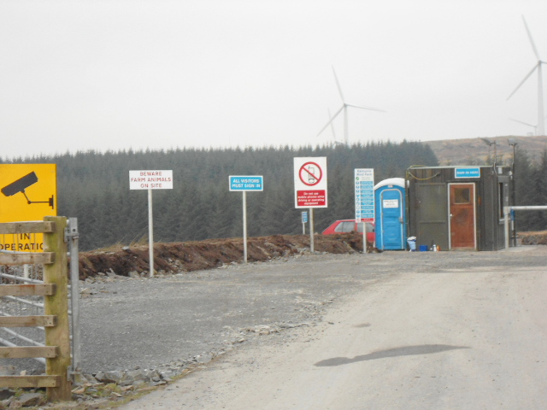
PROJECT DETAIL
Project Name: Balmurrie Fell Wind Farm
Description of Project: Construction of turbine bases & access roads for 7 no 1.3MW Siemens wind turbines.
Start Date: November 2011
Completion Date: September 2012

Slide 4
Site Location

Slide 5
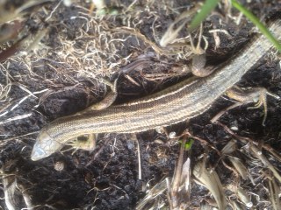
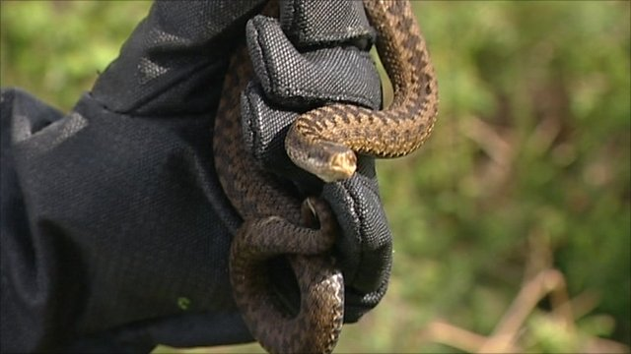
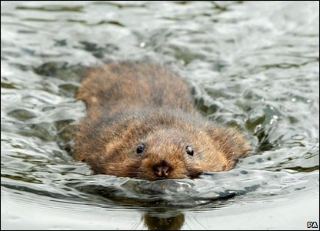
Biodiversity on Site
Variety of life i.e. plants and animals

Slide 6
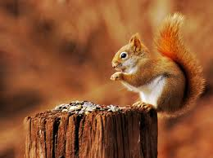
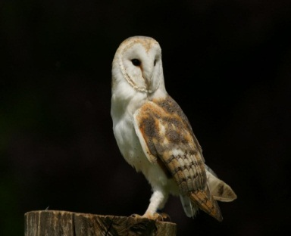
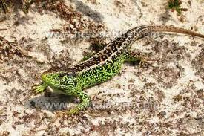
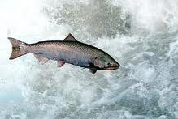
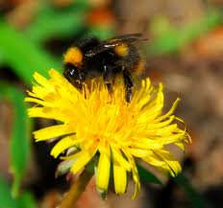
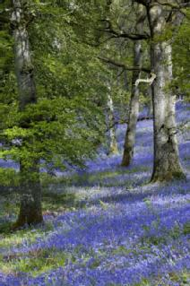
Species | Description | Photo
Mammals | Warm blooded, give birth to live young and feed them on milk
Birds | Warm blooded have feathers, lay eggs, most can fly
Reptiles | Cold blooded, lay eggs on land often have scaly skin
Amphibians | Cold blooded, lay eggs in water but the adults can live on the land soft skin
Fish | Cold blooded, have scales, breathe in water using gills
Invertebrates | Small creatures with no backbone
Plant | Have green leaves and use energy from sunlight to make food

Slide 7
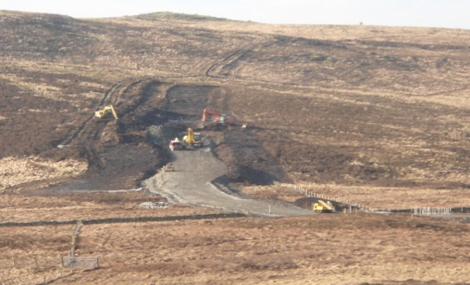
Protection of Biodiversity
do not disturb animals
conserve resources
conserve habitat
do not litter –
reduce, reuse & recycle
do not start fires

Slide 8
Eco Map

Slide 9
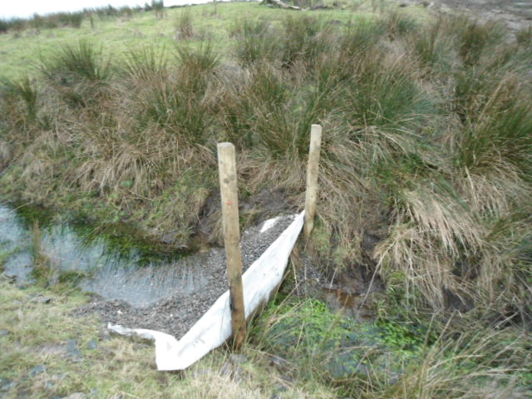
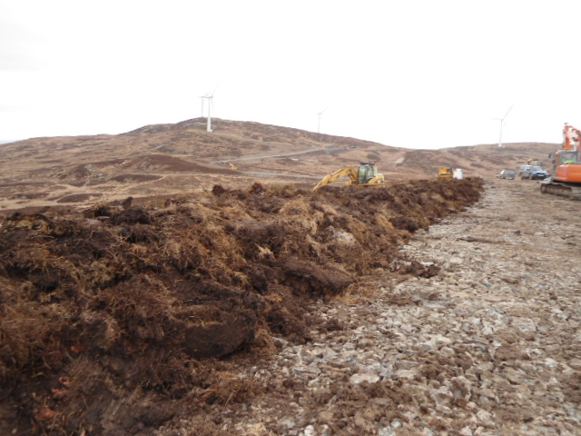
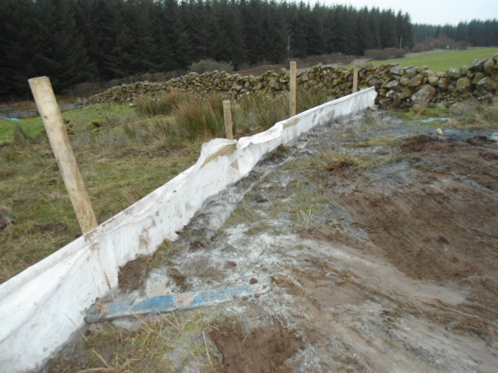
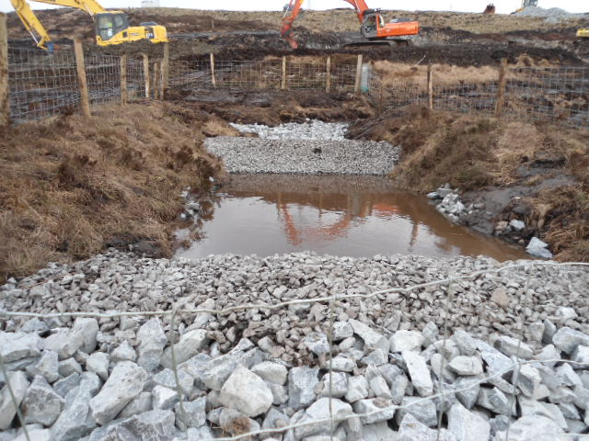
Pollution Prevention
Measures

Slide 10
Scottish Species - Water Vole
Live along banksides
Glossy black fur (rodents)
Size of large hamster
2 year life span
Eat stems, leaves, roots, fruit
Lot of predators – owls, rats, stoats, herons, mink, cats, eagles

Slide 11
Declining numbers of water vole
Why do you think water vole numbers are decreasing?
Mink are good at hunting?
Water pollution
River bank plants lost to planting conifer trees
River bank plants grazed by farm animals
Earthy riverbanks built over with stones and concrete
How would you protect water vole?

Slide 12
Competition
Can you help us name the Turbines?
We need you to name the 22 turbines they must be based on Scottish endangered or a declining species
The competition ends on the 22nd of June.
The chosen names will displayed on placard at the control building

