Slide 1

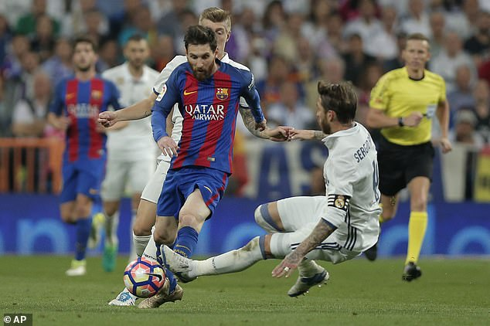

Football maze

Slide 2


settings
Brightness
Sound
difficulty

Slide 3

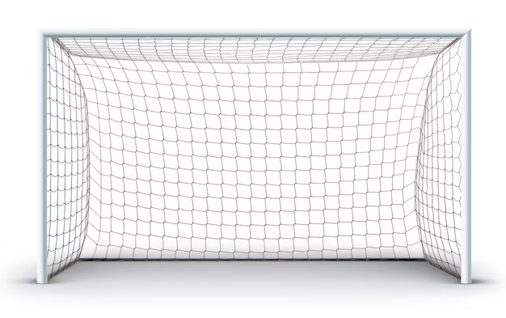
Level 1

Slide 4
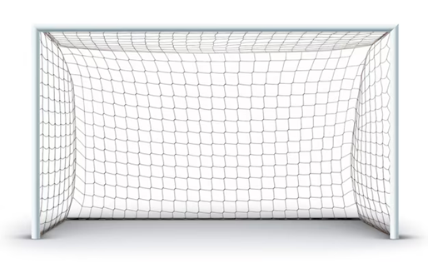
Level 2

Slide 5
You failed l

Slide 6
Level 3

