Slide 1
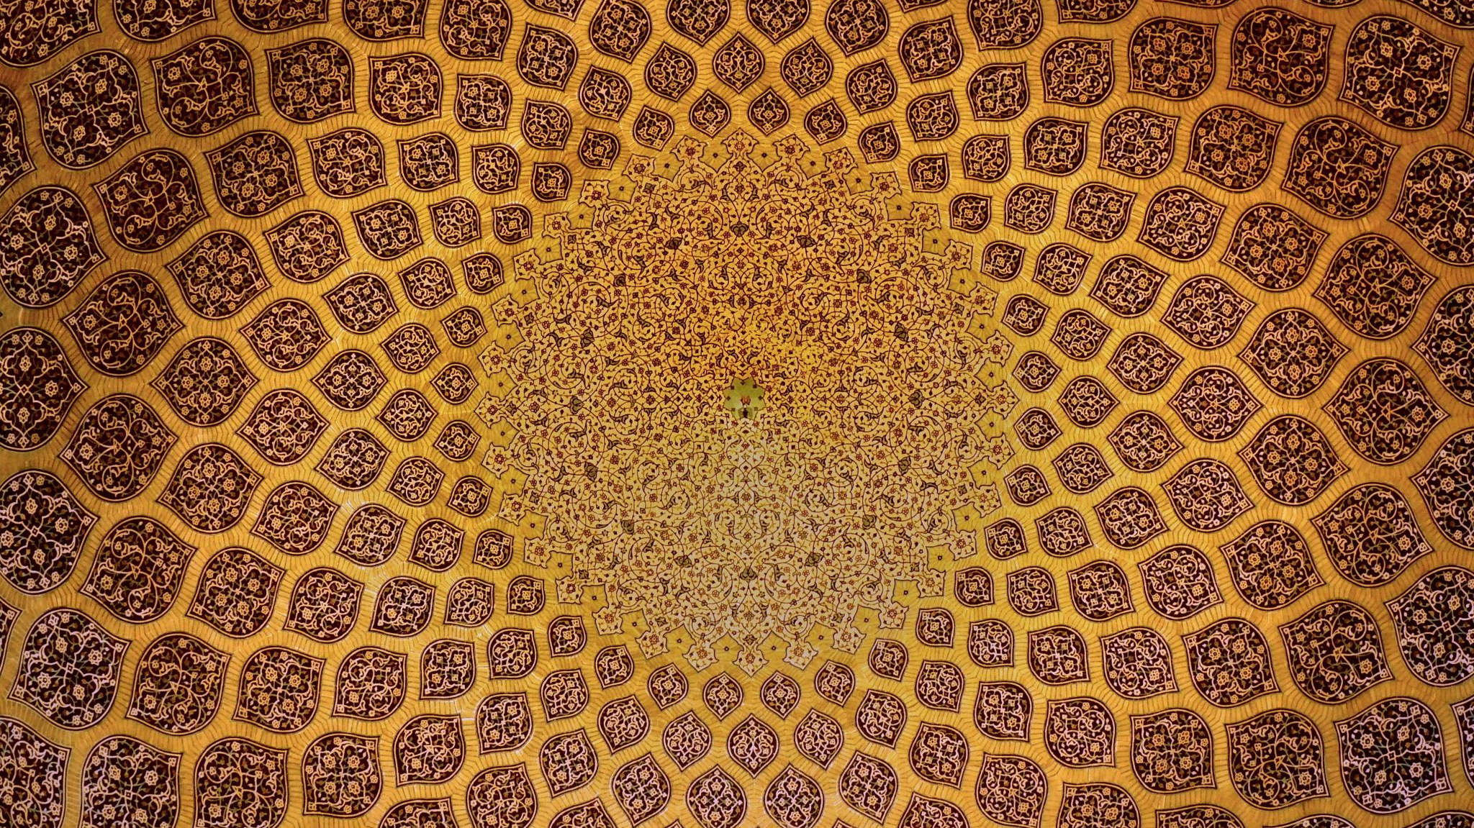
Sikhism
By Owen, Harry, Grace, Amber and Asil

Slide 2
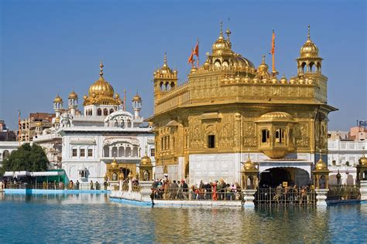
The believers of Sikhism are called Sikhs.

Slide 3
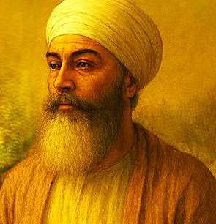
Sikh Leaders
There are no priests in Sikhism but there is a person that is responsible for leading services. The person responsible is the Guru Granth Sahib and they are also responsible for reading the holy book and looking after it, you must be qualified to become a Guru Granth Sahib.
This Photo by Unknown Author is licensed under CC BY-NC

Slide 4
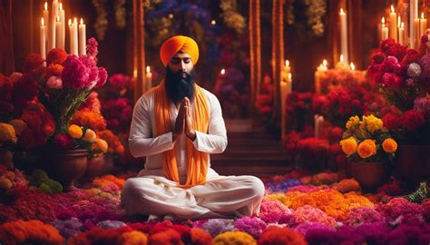
Sikh prayers
Sikhs pray any time any where but generally once in the morning and once at night. In the morning Sikhs wake before dawn to pray and in the evening before bed.

Slide 5
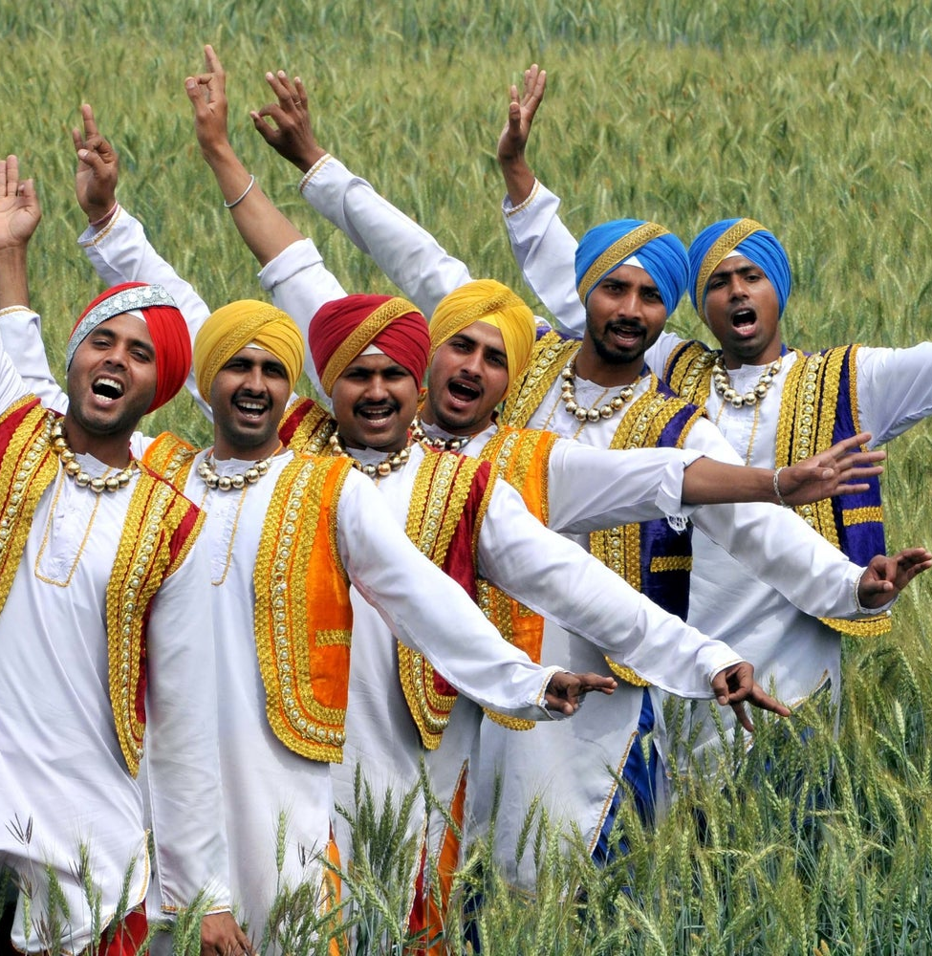
Sikh Festivals
There are 2 types of festivals in Sikhism. There are special holy days where they celebrate about the lives of gurus, these are known as Gurpurbs, other celebrations which are on the same days as some Hindu festivals get called melas.

Slide 6
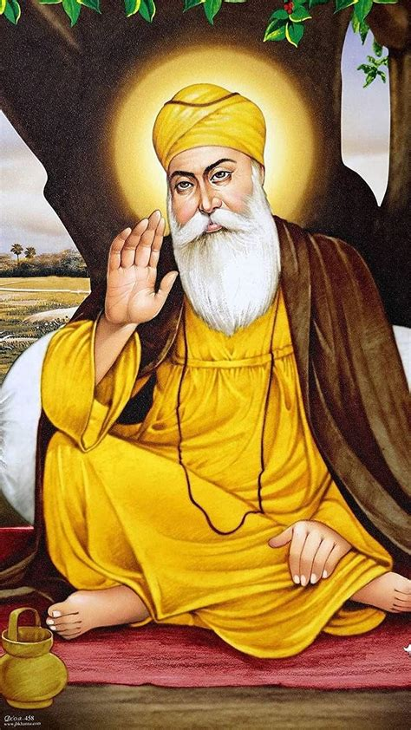
Beliefs about God
The most important belief in Sikhism is that there is only one god called Waheguru.

Slide 7
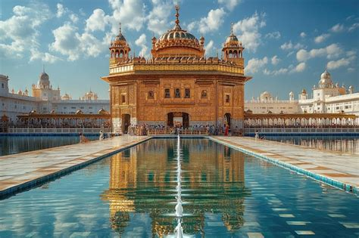
Sacred space
Sikhs often choose to visit Amritsar at least once in their lifetime.

Slide 8
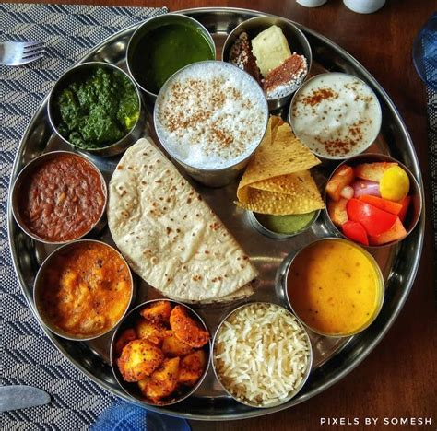
Food
Sikhs commonly eat roti with vegetables.
Roti is made from whole meat or brown wheat flour and is very easy to make.

