Slide 1
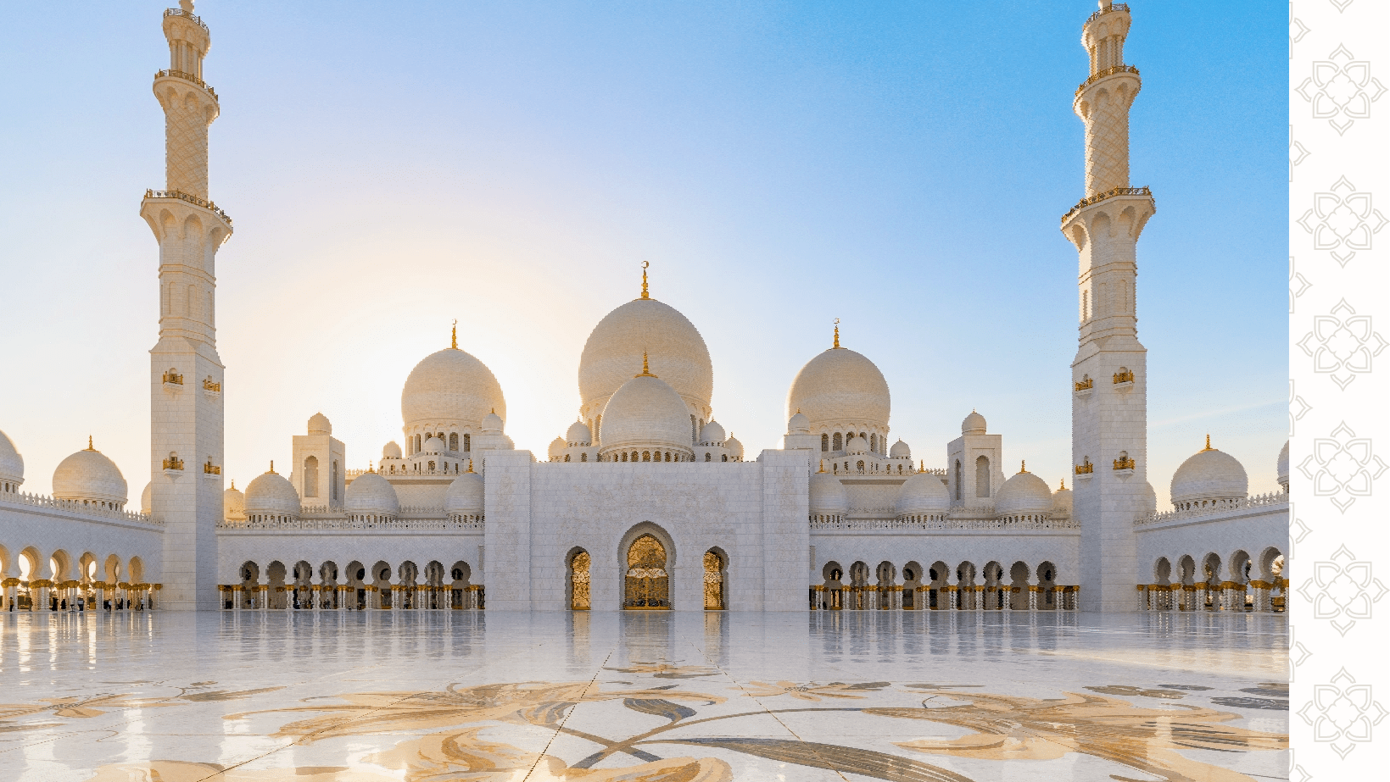
Islam

Slide 2
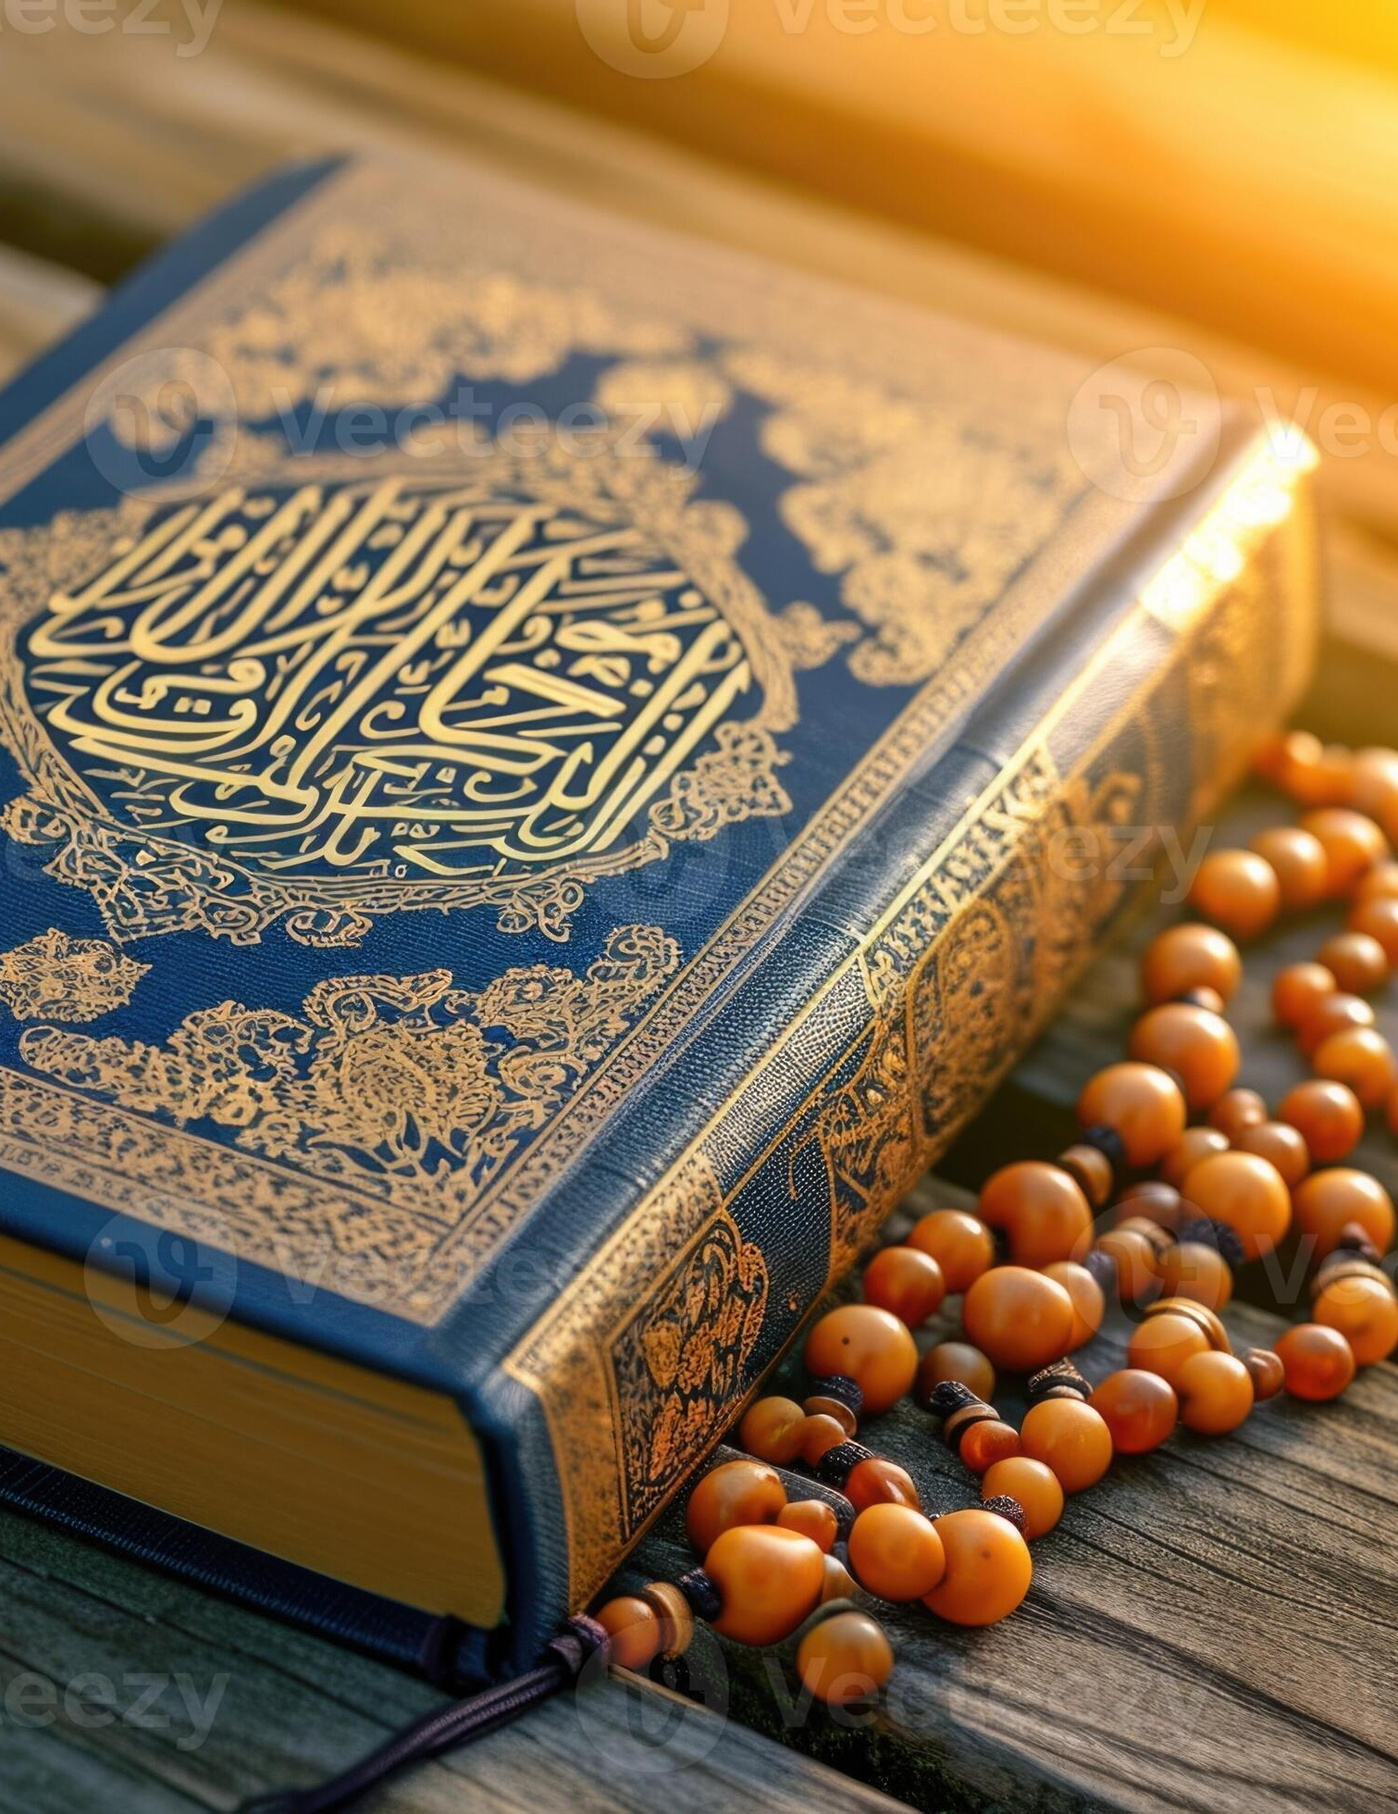
The Quran
The Quran is the holy book of Islam. Muslims believe it contains words from god. It teaches everything to now about Islam.
القرآن
This is the Quran written in Arabic

Slide 3
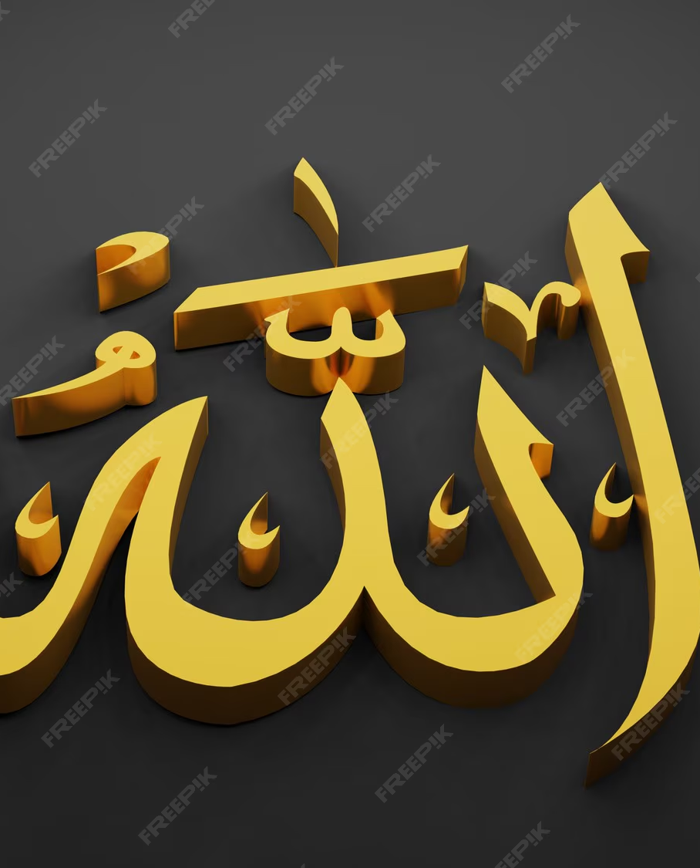
Beliefs
Muslims believe that there is only one god and that Mohhamed is a messenger.

Slide 4
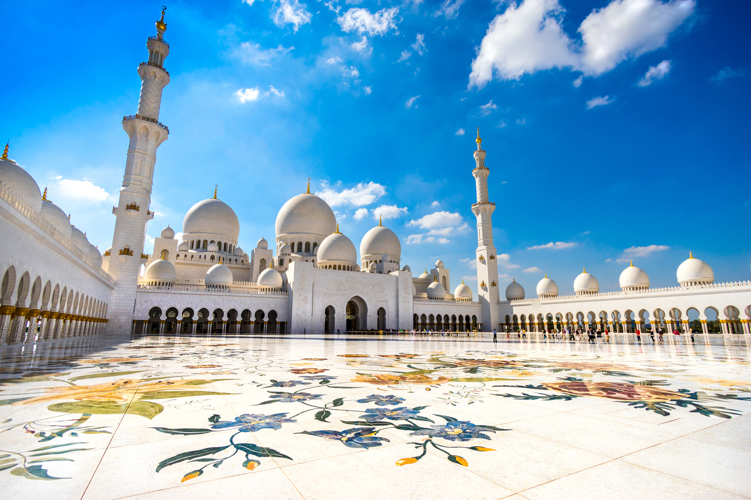
Sacred places
The main sacred place of Islam is the mosque. Muslims go to mosques to pray and worship Allah. Mosques don’t have any paintings or statues because Mohamed believed that they may start worshiping them instead of Allah.

Slide 5
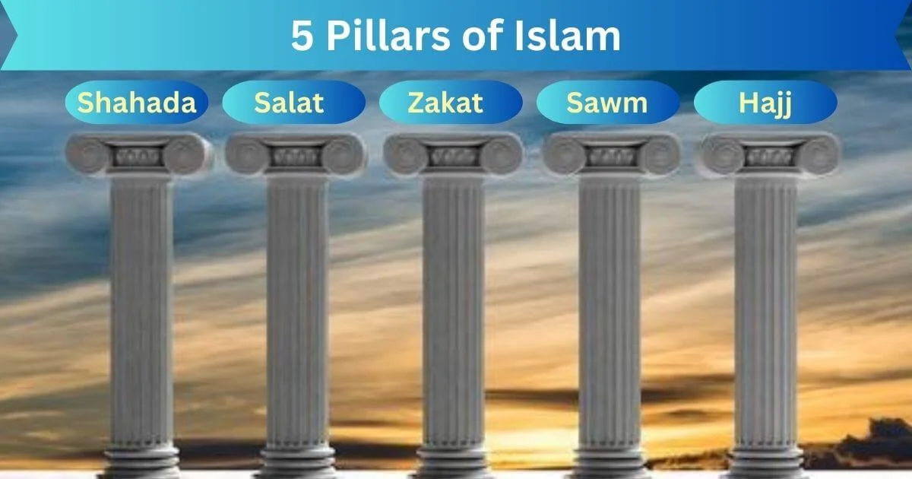
5 Pillers
The 5 pillars of Islam are shahada declaring faith. Salat prayer. Zakat giving. Sawm fasting. Hajj pilgrimage

Slide 6
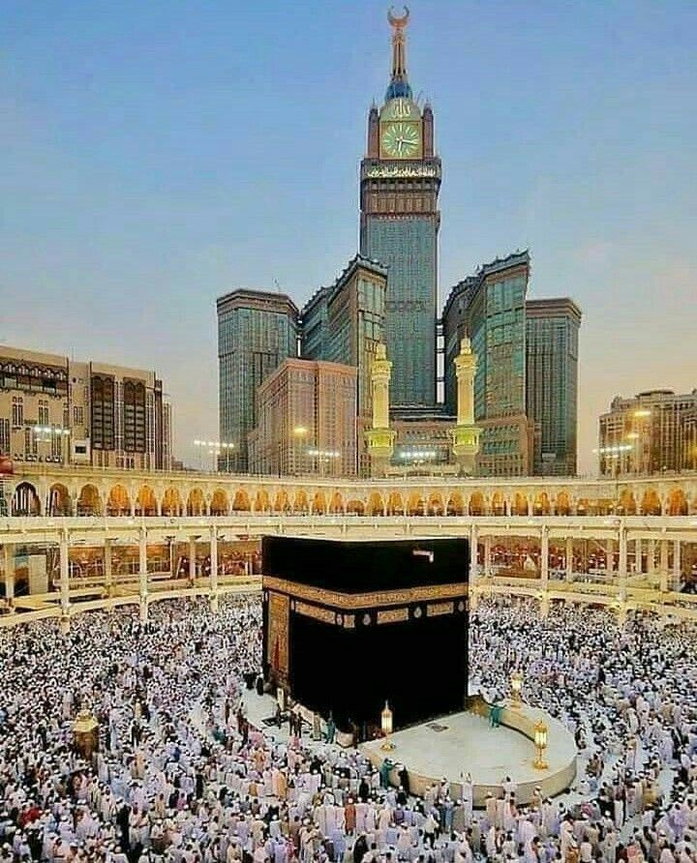
mecha
Muslims pray facing mecha. It is the holy city of Islam. Muslims must visit Mecha at least once in their lifetime.

Slide 7
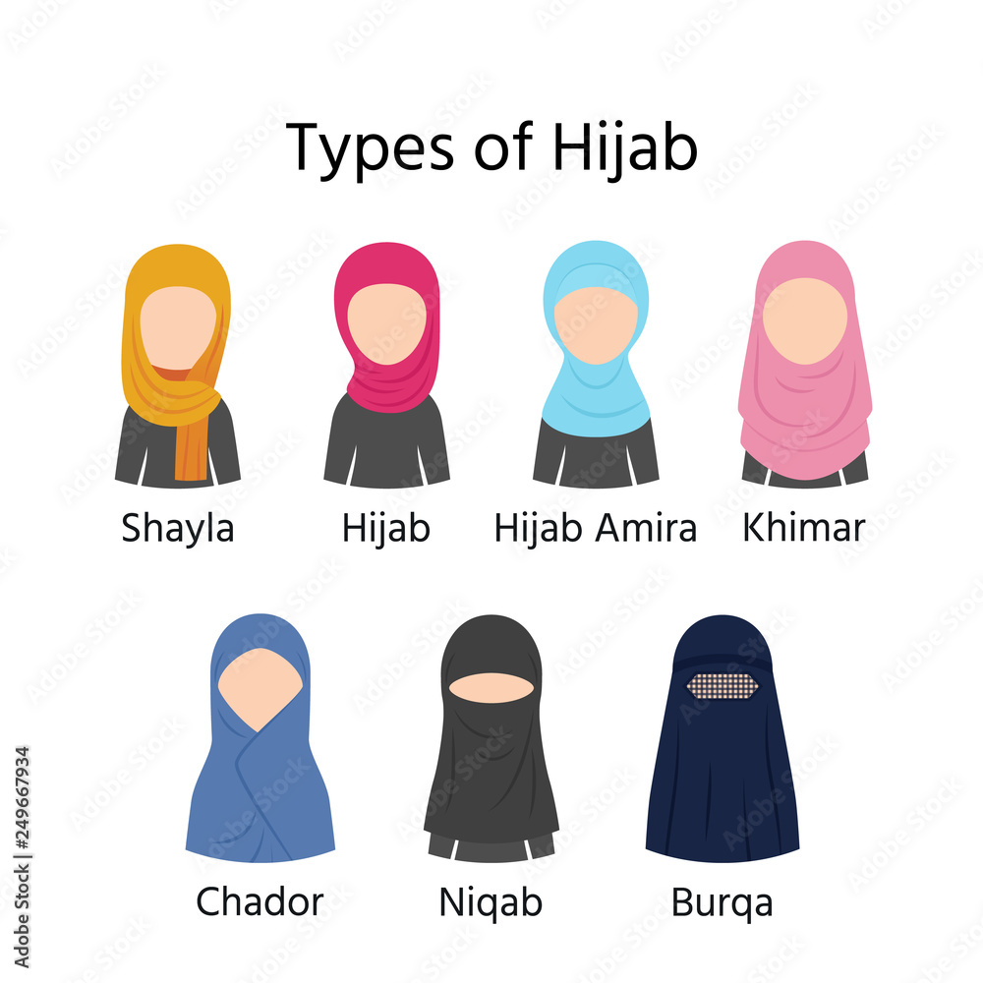
Women wear a hijab to cover their hair and neck they believe that the hijab is a sight of respect.

Slide 8
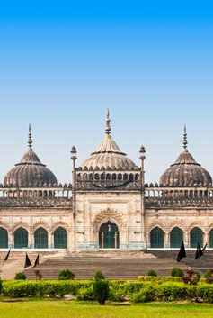
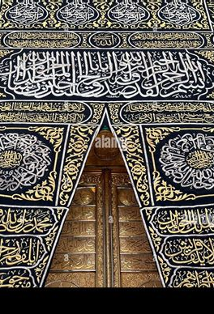
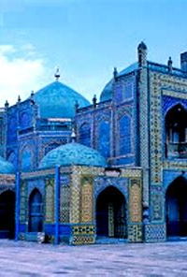
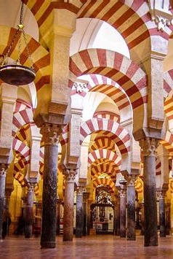
This is a mosque

Slide 9
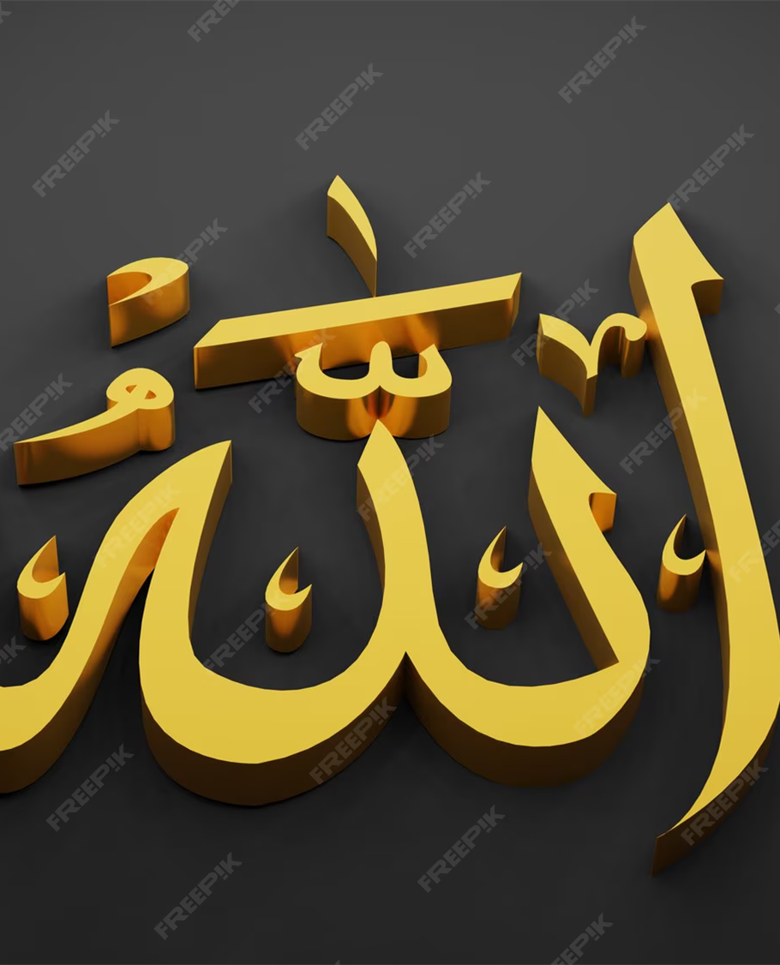
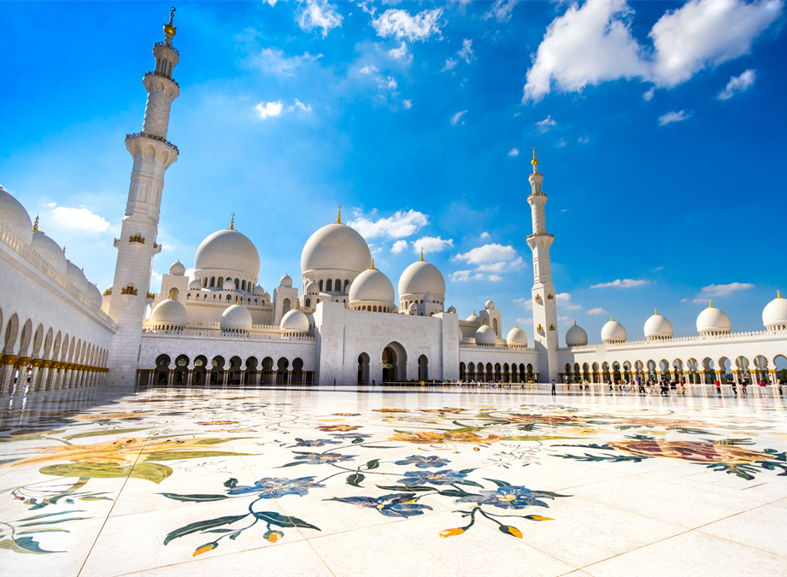
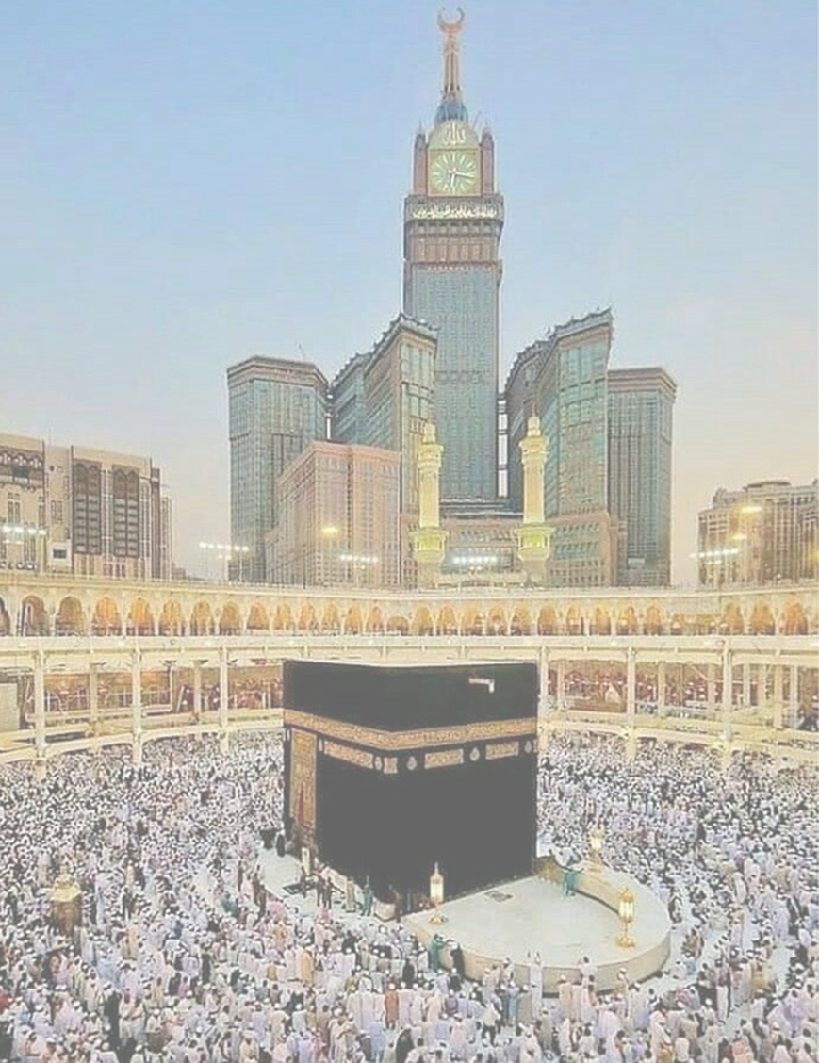
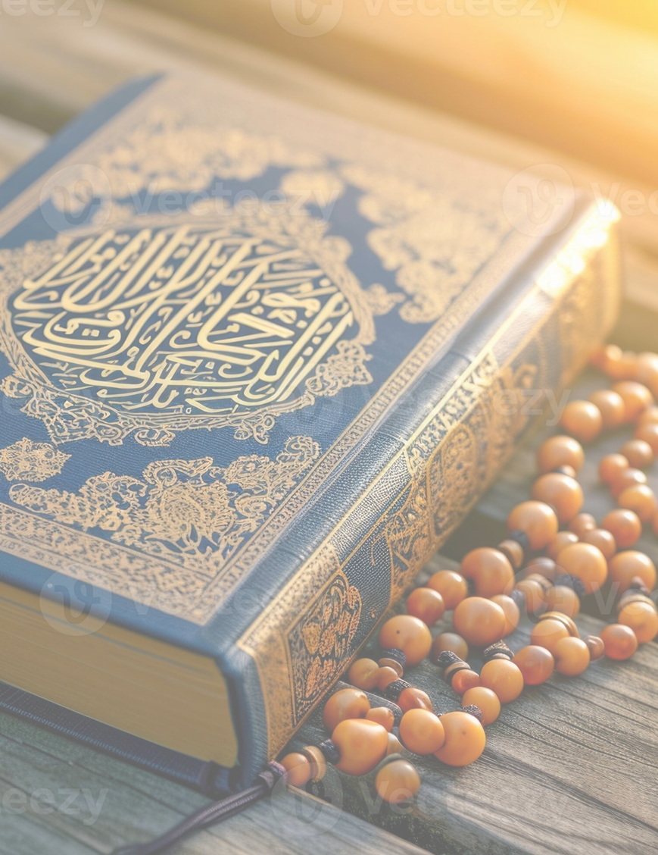
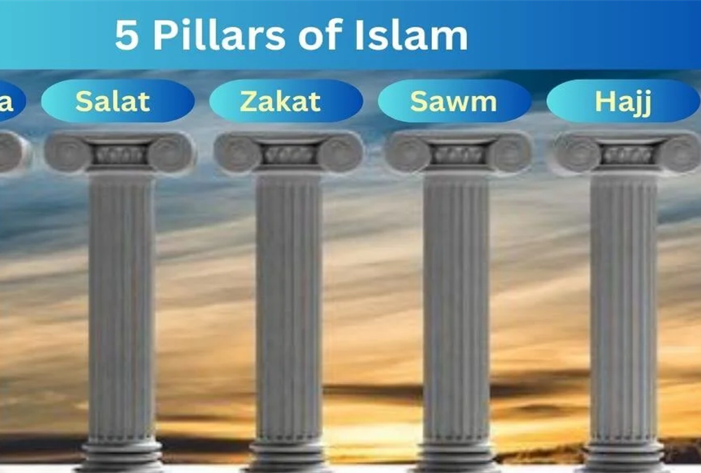
This is what we talked about

