Slide 1
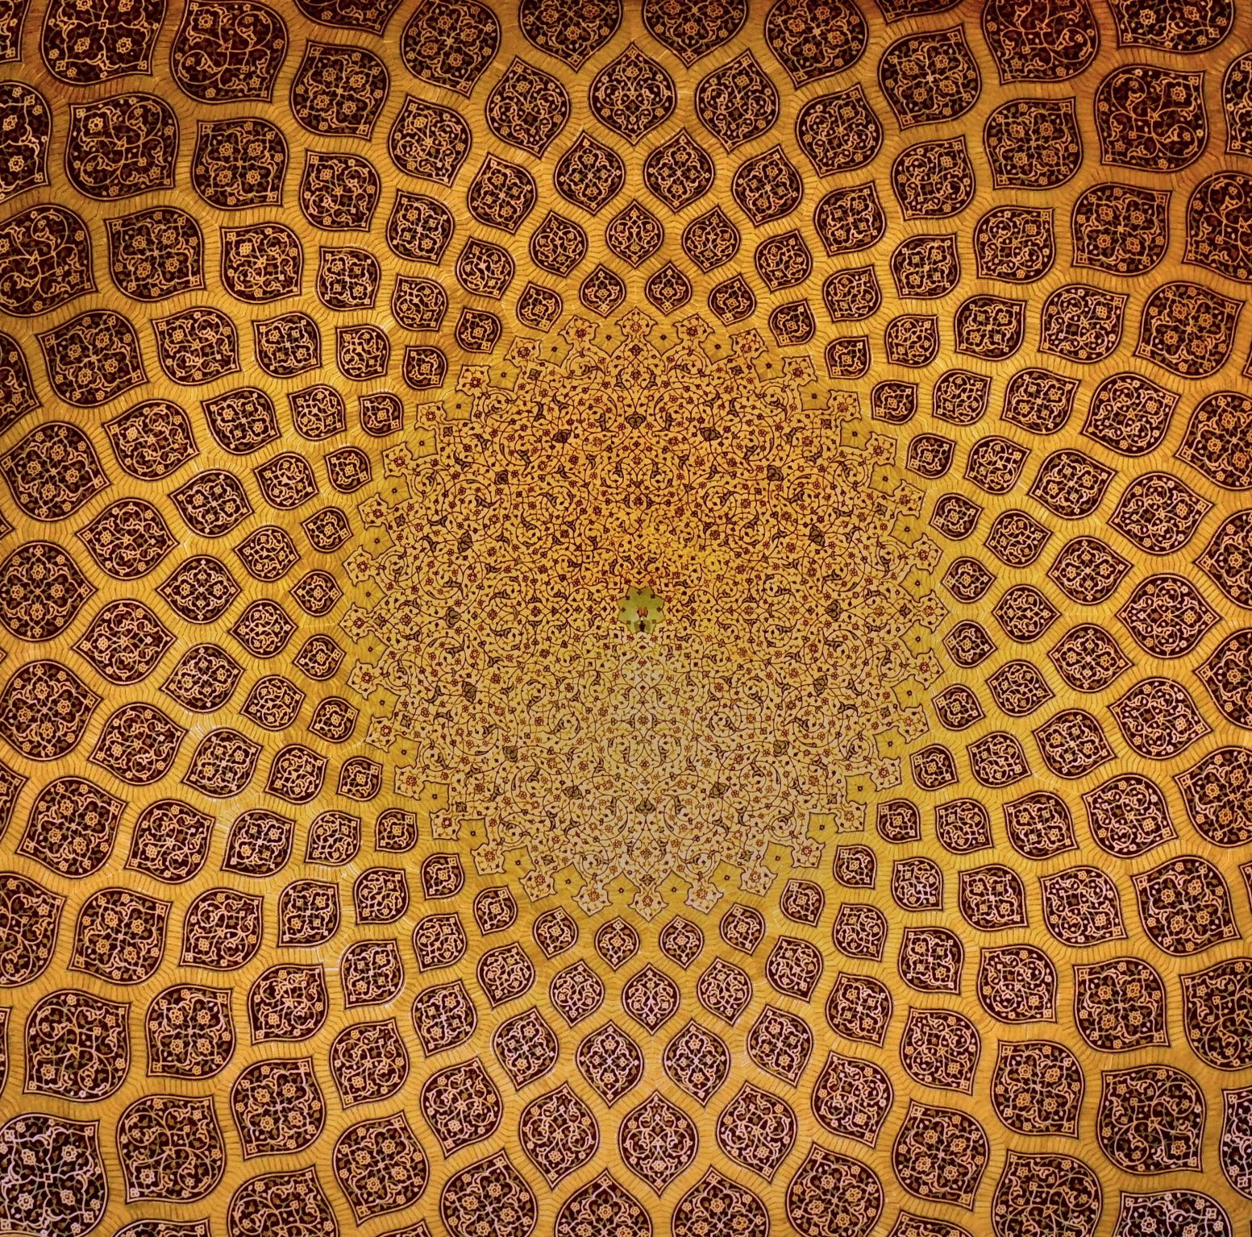
Judaism
People who believe in Judaism are called jews.

Slide 2
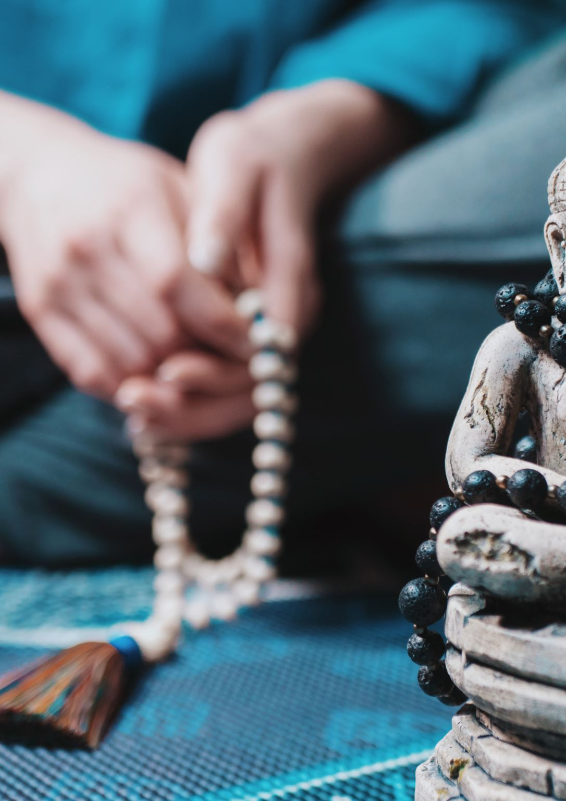
contents
Name of the people
Beliefs
Sacred places

Slide 3
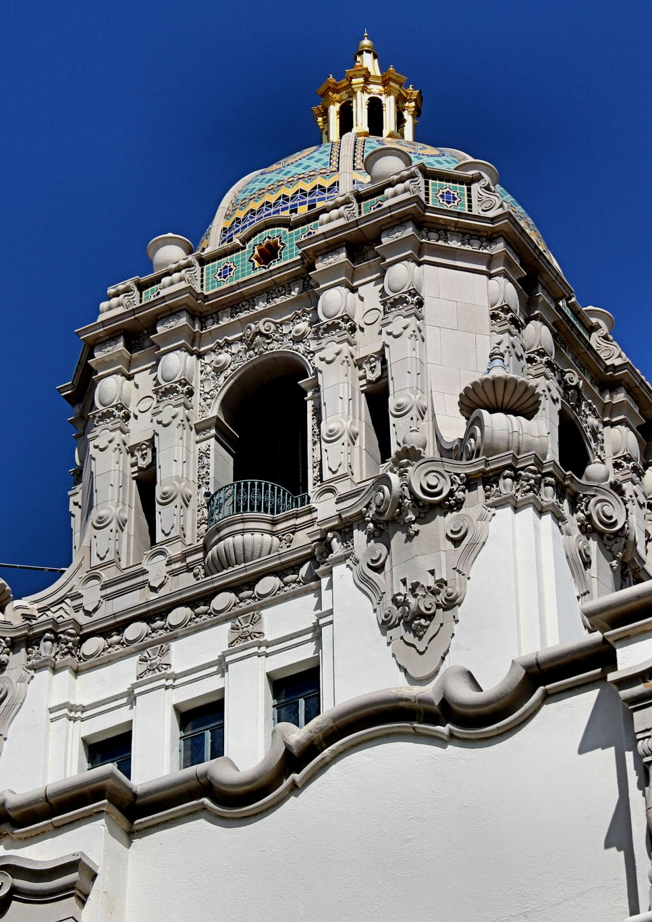
Sacred places
The synagogue : A house of prayer
The western wall a symbol of resilience
home a domestic sanctuary
Holy grave sites that evokes a feeling of scaredness

Slide 4
Beliefs
In Judaism, God values justice and mercy, and cares about all humanity. Jews recognise that Christians and Muslims are also monotheistic witch means they believes in one god although their beives are different.
The Torah refers to the first 5 books of the bible and is the most important book in Judaism

Slide 5
festivals
Passover
Hanukkah
Purin
Tisha
Yom,tov
Chanukah
The three weeks

Slide 6
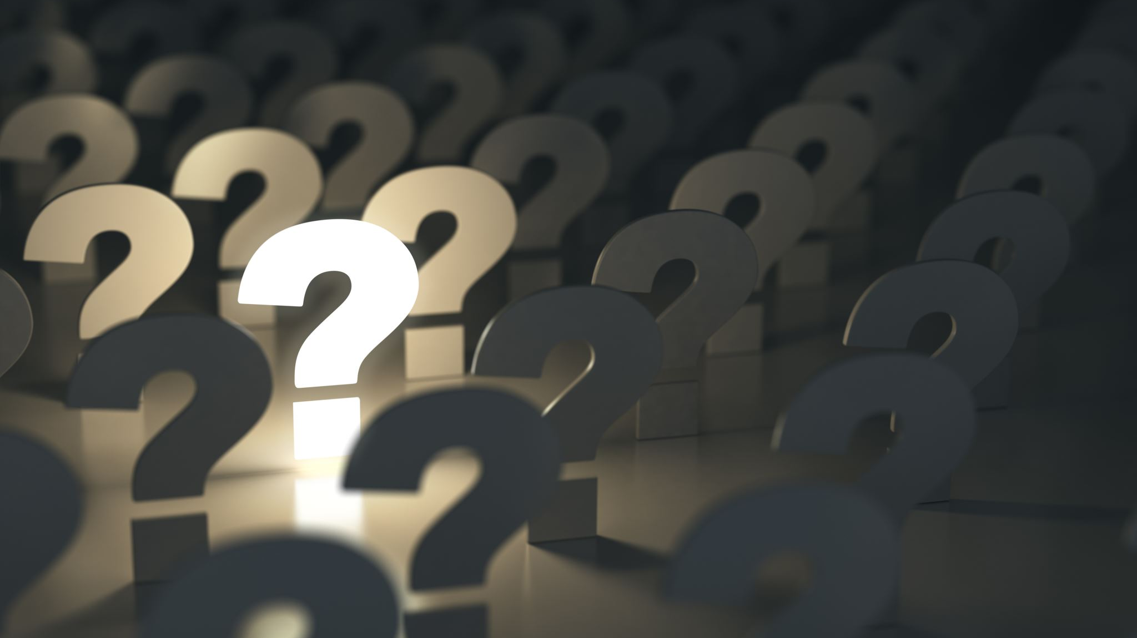
Any questions / the end

