Slide 1
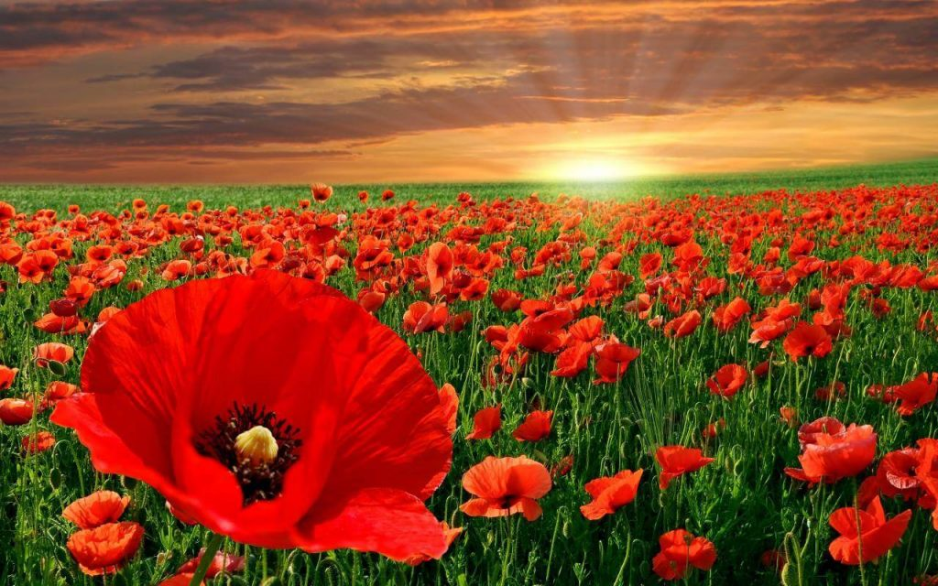
Remembrance Day
BY EVENTS GROUP

Slide 2
CONTENTS WHY WE DO REMEMBRANCE POEMS QUESTIONS

Slide 3
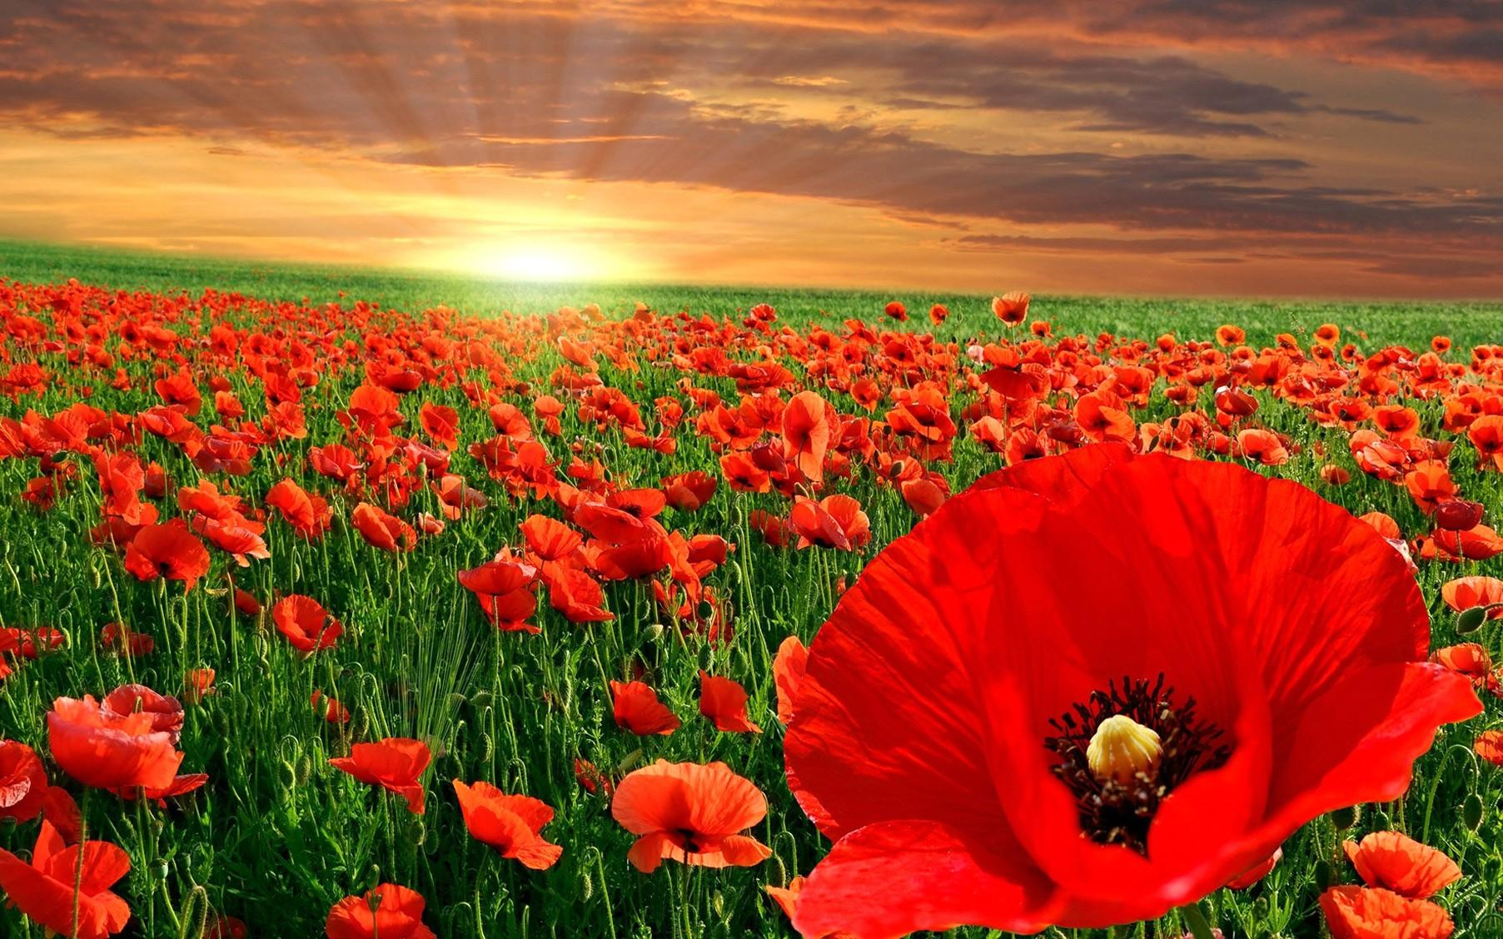
WHY WE DO REMEBERANCE DAY
We do Remembrance day to remember our loved ones who fought for our country and sadly passed.
https://www.youtube.com/watch?v=q97bEp8Q0Mg

Slide 4
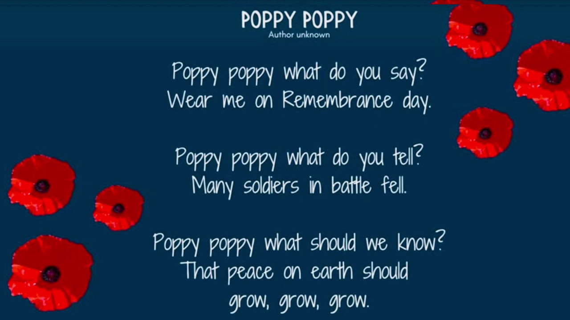
Poems

Slide 5
Any Questions

