Slide 1
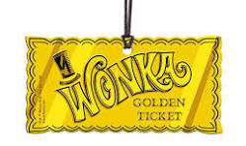
I never thought my life could be anything but catastrophe But suddenly I begin to see a bit of good luck for me Cause I've got a golden ticket I've got a golden twinkle in my eye I never had a chance to shine never a happy song to sing, But suddenly half the world is mine what an amazing thing Cause I've got a golden ticket. I've got a golden sun up in the sky. I never thought I'd see the day when I would face the world and say, "Good morning. Look at the sun." I never thought that I would be slap in the lap of luxury Cause I have said it couldn't be done But it can be done. Yes, it can be done! We never ever dared to think that there would be a golden time When, bang in a glorious golden blink, our lives would become sublime! Cause I've got a golden ticket - I've got a golden ticket I've got a golden chance to make my way
And with the golden ticket it's a golden day!
Voice & piano
Voice only
accomp

