Slide 1
Staying safe online

Slide 2
Common Passwords
Some passwords are very common and are easy to remember if your password is here then change it NOW
123456
123456789
qwerty
password
12345
qwerty123
1q2w3e
12345678
111111
1234567890
Guest
1234
(your name)
barbie
How to make a safe password
Use a special character
Use capital letters
Make it not make sense
4. Use more than 9 characters

Slide 3
Site ratings
Some sites are not for children
I found out the age rating for sites that children in the school use
Roblox (lots of age ratings but mostly all ages)
SnapChat 13+
Youtube 13+ but youtube kids is all ages
Whatsapp 16+
TikTok 13+
Scratch 7+
Scratch Jr 4+

Slide 4
Fake Profiles
Fake profiles are profiles that steal all of your posts or try to get your friends to follow that account
If you see any fake profiles block and/or report them
If the fake profile has less friends or a different name or a typo it could be fake

Slide 5
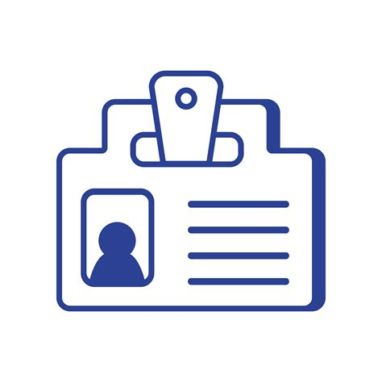
Don’t share your personal information
Think before you post a image of yourself
Do not wear school clothes or clothes with local company logos
Do NOT share your name address or age

Slide 6
Challenge Posts
Challenge posts are posts that try to get you to do a
Task like liking or following
They make them scary by putting something like
A SPIDER WILL COME INTO YOUR BED IF YO DON’T DO IT! Here Is a example of a challenge post
LIKE AND FOLLOW OR THIS FACE WITH RED EYES WILL SLEEP WITH YOU TONIGHT

Slide 7
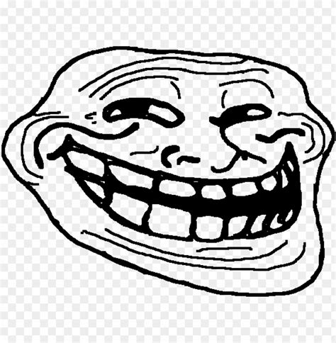
DONT SPREAD THE TROLLING
TROLLING IS A BAD THING AND IF IT HAPPENS TO YOU REPORT IT AND DON’T SPREAD IT

Slide 8
Scamming
A scam is like go to this website for robux or vbux
So usually if it seems to good to be true it’s probably not
FREE ROBUX AND FREE V-BUCKS

Slide 9
AI
AI is bad because it tries to take your money by making an ai video of a family member you have
Ask the family member if you don’t think it real
ai is a new dangerous thing on the internet it is everywhere try to avoid it

Slide 10
THE END!!
By Sam and Sevi

