Slide 1
By Rory and Lewis
Internet safety

Slide 2
Contents
What is internet safety.
Examples of scams.
How to know about hackers.
Not to click on random things unless its definitely real.
Know who you are talking to.

Slide 3
What is internet safety
Internet safety is all about staying safe online like not speaking to strangers.
If you see this hi

Slide 4
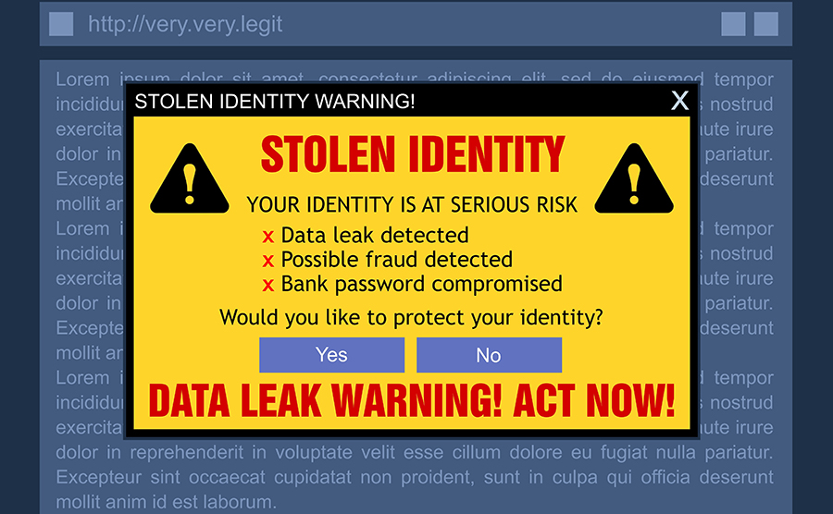
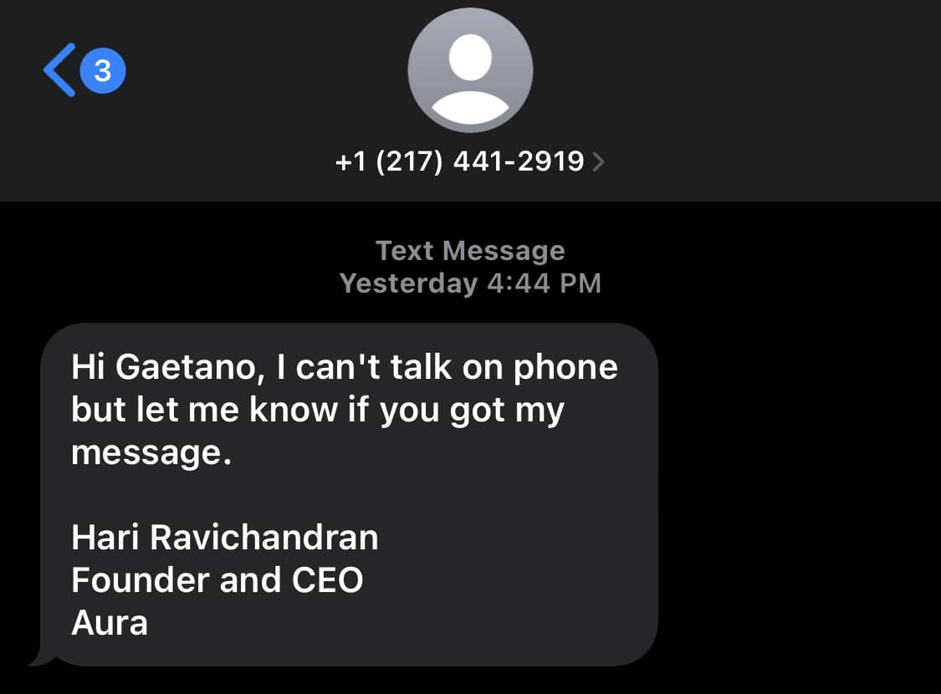
scams
examples
Scams are when someone's lying about something. For example if someone asks for your pass word for *free* money.
Do NOT trust this.
Do NOT trust this either.

Slide 5
How to stay safe from hackers .
examples
Top tip to not get hacked keep your stuff private to friends and family
Hackers are someone you don’t know about. They steal stuff that is yours and ask for a lot of money for it back and probably wont even give you it back. So if someone steal yours just ignore it or call the police .

Slide 6
Do not click on random websites
Now you don’t want to click on websites that ask you for you password and say that all your internet stuff will be safe. BUT IT WILL NOT BE SAFE BECAUSE THAY ARE FAKE .

Slide 7
Know who your are talking to
Fake callers. Now fake callers are annoying because they pretend that they are your work or your family and ask for money because they might say I am in jail can you pay 1000 pounds to get me out but when you get the 1000 pounds they will steal it .
And also they can spam message you like help in 2000 pounds please send to this website.

Slide 8
Sharing personnel stuff
Now you should not share any thing online with you friend's because they can steal your money .

Slide 9
Bye every one that is seeing this
Hope you all stay safe online

