Slide 1
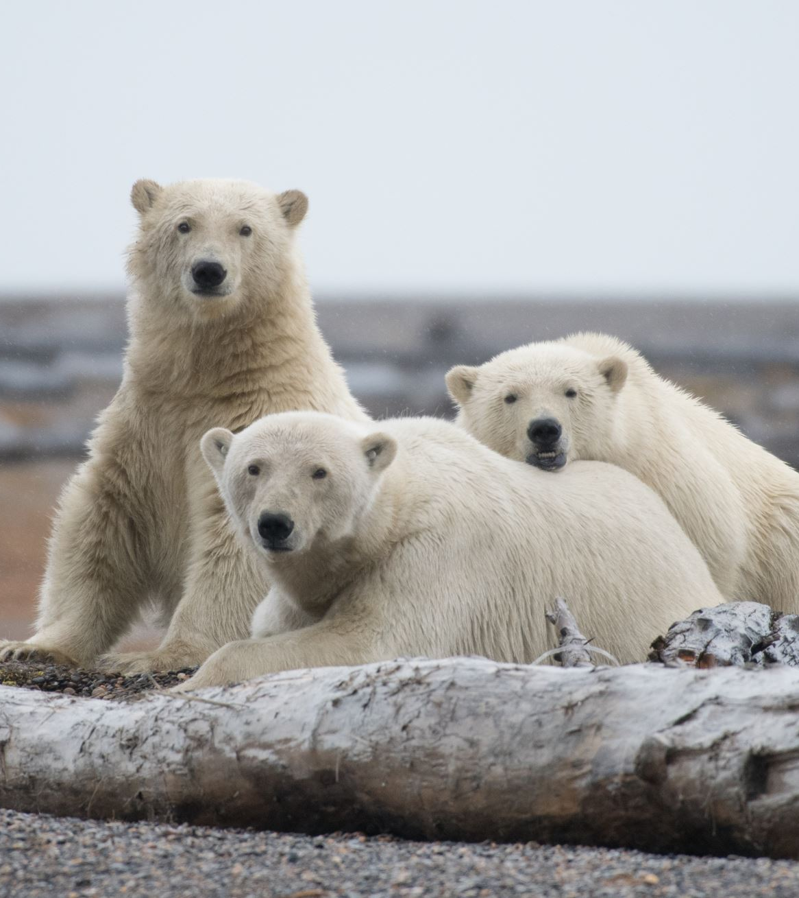
Polar Bears In Extinction
By Caspian Merriman-Bonde, who loves all animals.

Slide 2
Polar Bears: How They Are Becoming Extinct
Polar bears are precious animals, and all these tours through the Arctic that are heating up, melting, and smashing the ice, are destroying polar bear homes. Instead, we need to make an eco-tour that does not melt or break the ice, but does show people the wonders of the Arctic without destroying it.

Slide 3
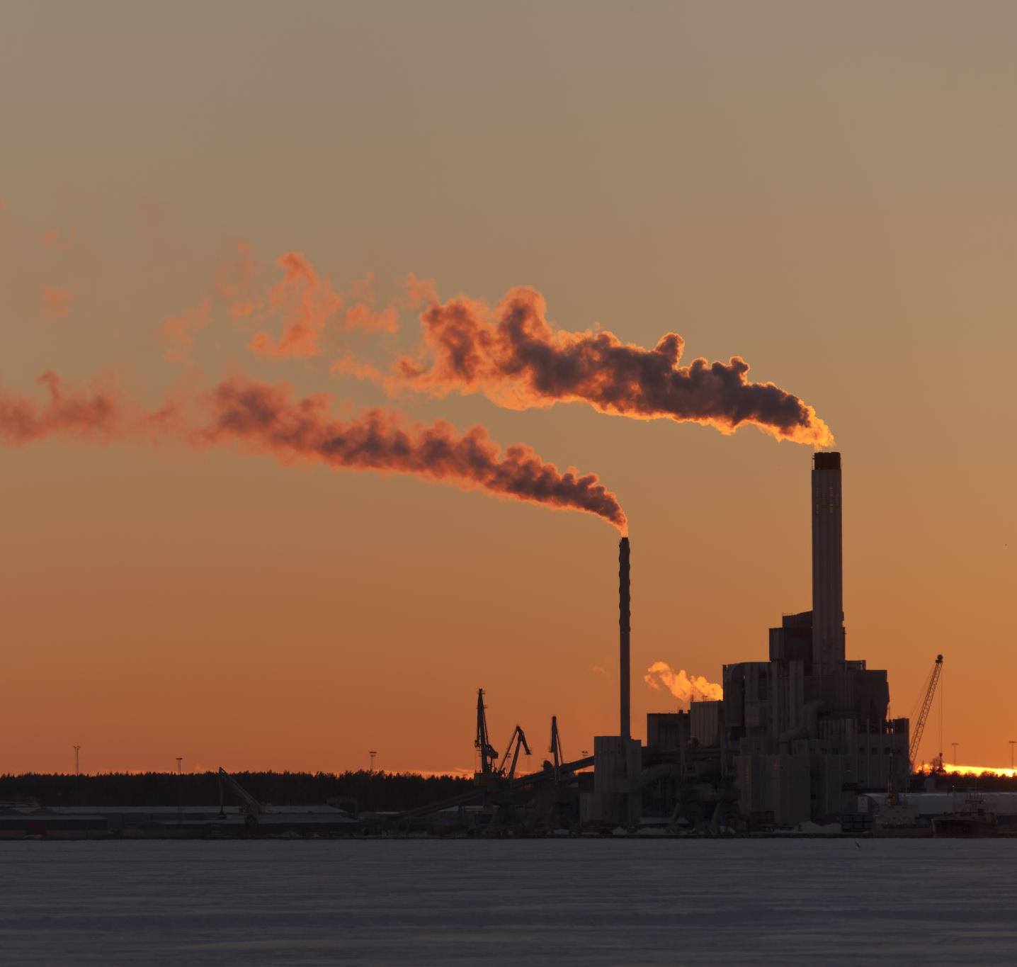
How We Can Save Polar Bears
To save the bears, we must stop greenhouse gasses. To do that, we must stop using fuel, and use electricity. We must stop landfill and stop releasing fumes into the air. Can YOU do that?

Slide 4
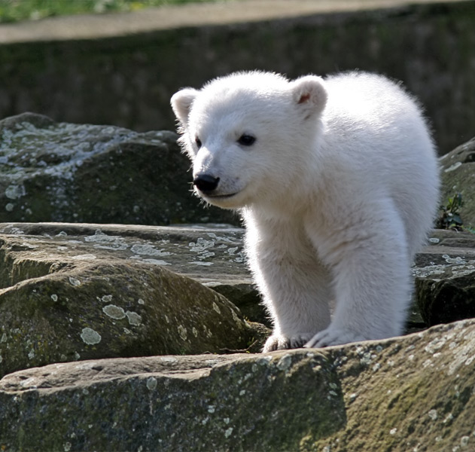
Life Cycle Of A Polar Bear
The polar bear starts when it gets fertilized by the male in the female's womb. Then, after 2-3 months, the cub gets born. It stays with its mother for 3 years while being taught to hunt, swim, and dig dens. After those 3 years they are off to fend for themselves.
This Photo by Unknown author is licensed under CC BY-SA.

Slide 5
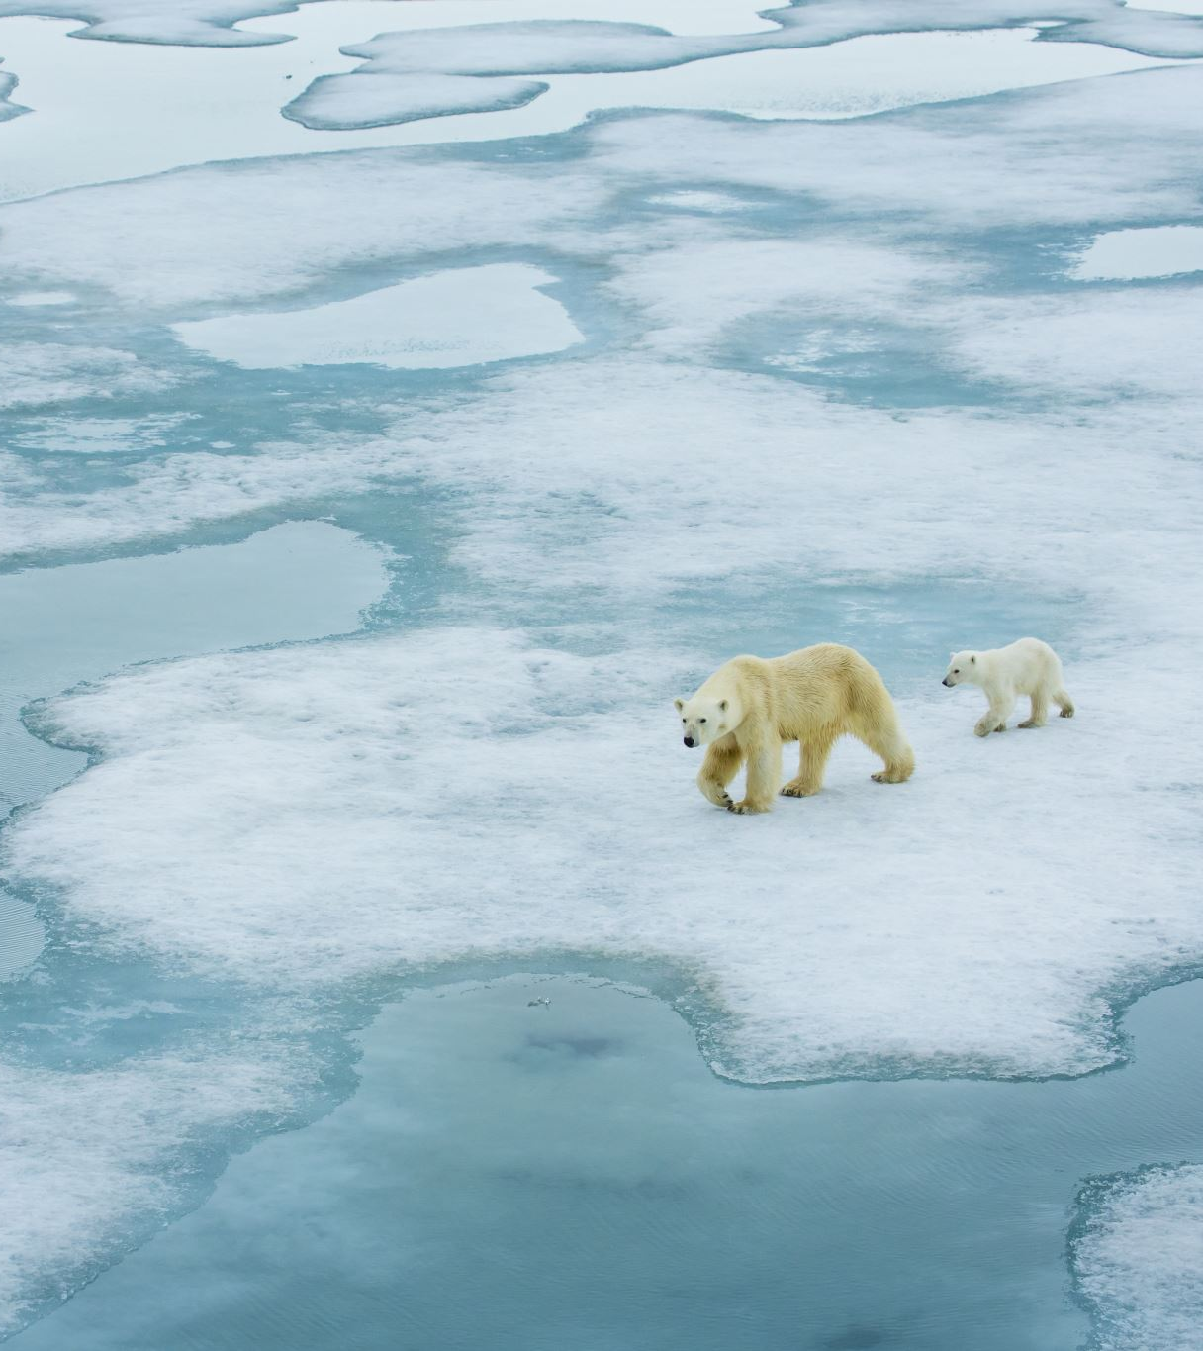
Zoos & Aquariums
Most zoos and aquariums have polar bears in captivity. Some have decided to make a better enclosure for them by adding in objects alike their natural habitat. For example, there was room for the bears to dig, there was a waterfall, a shallow stream, and trees to sit with. Other zoos have got polar bears, but just give them a concrete cage with strong glass.

Slide 6
The End (With bonus polar bear picture)
This Photo by Unknown author is licensed under CC BY.

