Slide 1
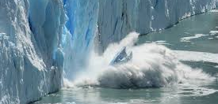
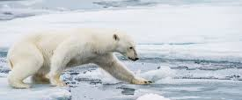
Climate change in the Arctic
Arctic Matters

Slide 2
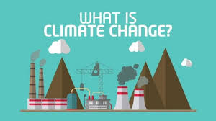
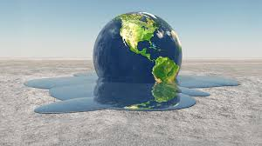
What is climate change?
Climate change is happening. Increased Greenhouse gasses and pollution are causing poor air quality, temperatures to rise resulting in ice caps melting in the Arctic.

Slide 3
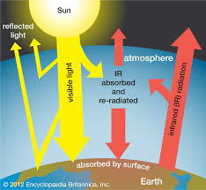
Green House Effect
The green house effect is caused by trapped particles in the atmosphere such as methane cabon dioxide and nitrous oxide these are from cutting down trees and fossil fuels.
The greenhouse effect is a warming system for the earth. When the suns energy reaches the earth some of it is reflected to space and the rest is absorbed. The absorbed energy warms up the earths surface.

Slide 4
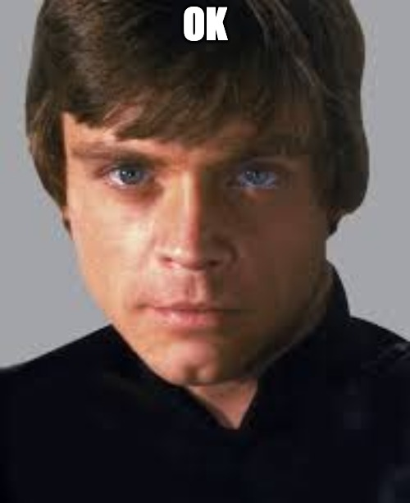
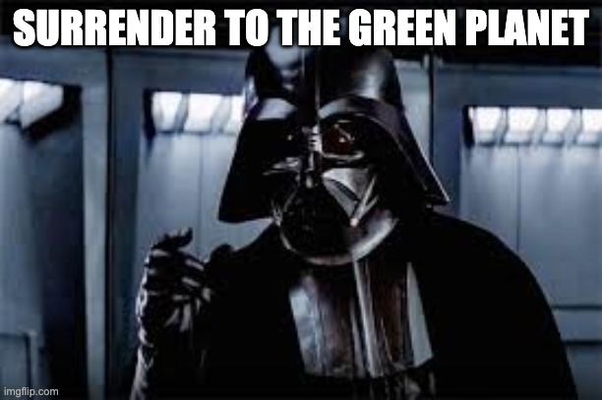
How can we stop global warming
One of the best ways to cut down global warming is to recycle and use electric cars and power things through solar panels and renewable energy.
Plant trees, and switch to renewable energy

