Slide 1
Apostrophe revision
Challenge: to recap on your previous knowledge of apostrophes.
(‘)

Slide 2
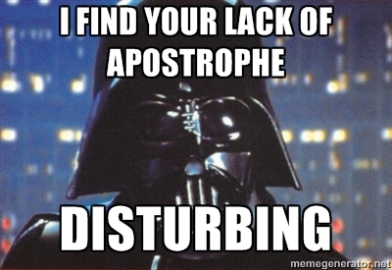
Darth Vader hates it when you do not use apostrophes.
Come to the dark side and use apostrophes correctly.

Slide 3
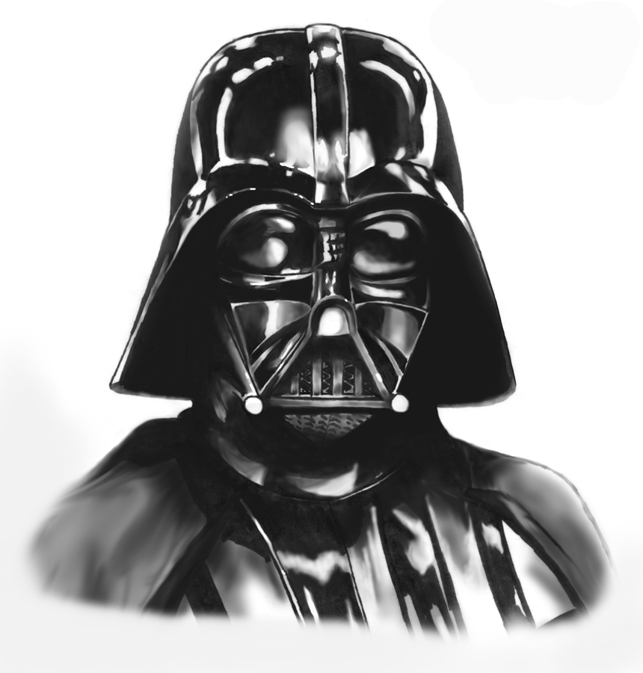
“You underestimate the power of the apostrophe.”
Use the force that you have acquired in previous lessons and tell me what you need apostrophes for:
1)
2)

Slide 4
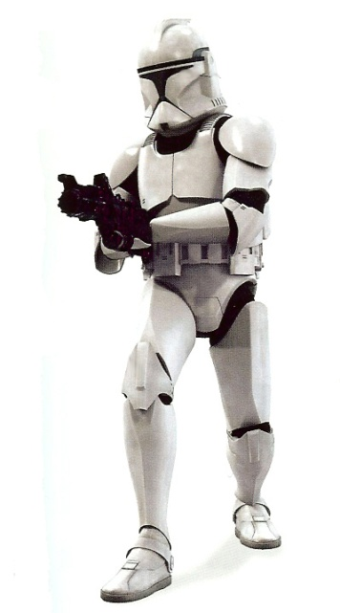
1. Possession
The gun belongs to the clone trooper.
It is the clone trooper’s gun.
Remember the apostrophe comes before the s. Only one clone trooper.
These guns belong to the clone troopers.
These are the clone troopers’ guns.
Remember the apostrophe comes after the s. More than one clone trooper.

Slide 5
2. Omission
I do not like the clone trooper.
I ___don’t______ like the clone trooper.
Remember the apostrophe replaces the missing letter(s).

Slide 6
“The ability to destroy a planet is insignificant next to the power of the apostrophe.”
Re-write the following sentences using apostrophes for omission or possession.
1) Darth Vader is Lukes father.
2) Darth Vader can not take off his mask as he needs it to live.
3) Luke did not know that Darth Vader was his father.
4) If you have not seen any of the Star Wars films then I will be rather shocked.
5) Darth Vaders lightsaber is red.
6) The Jedi will not defeat me. They are too weak.
7) The Death Star is the Galactic Empires ultimate weapon.

Slide 7
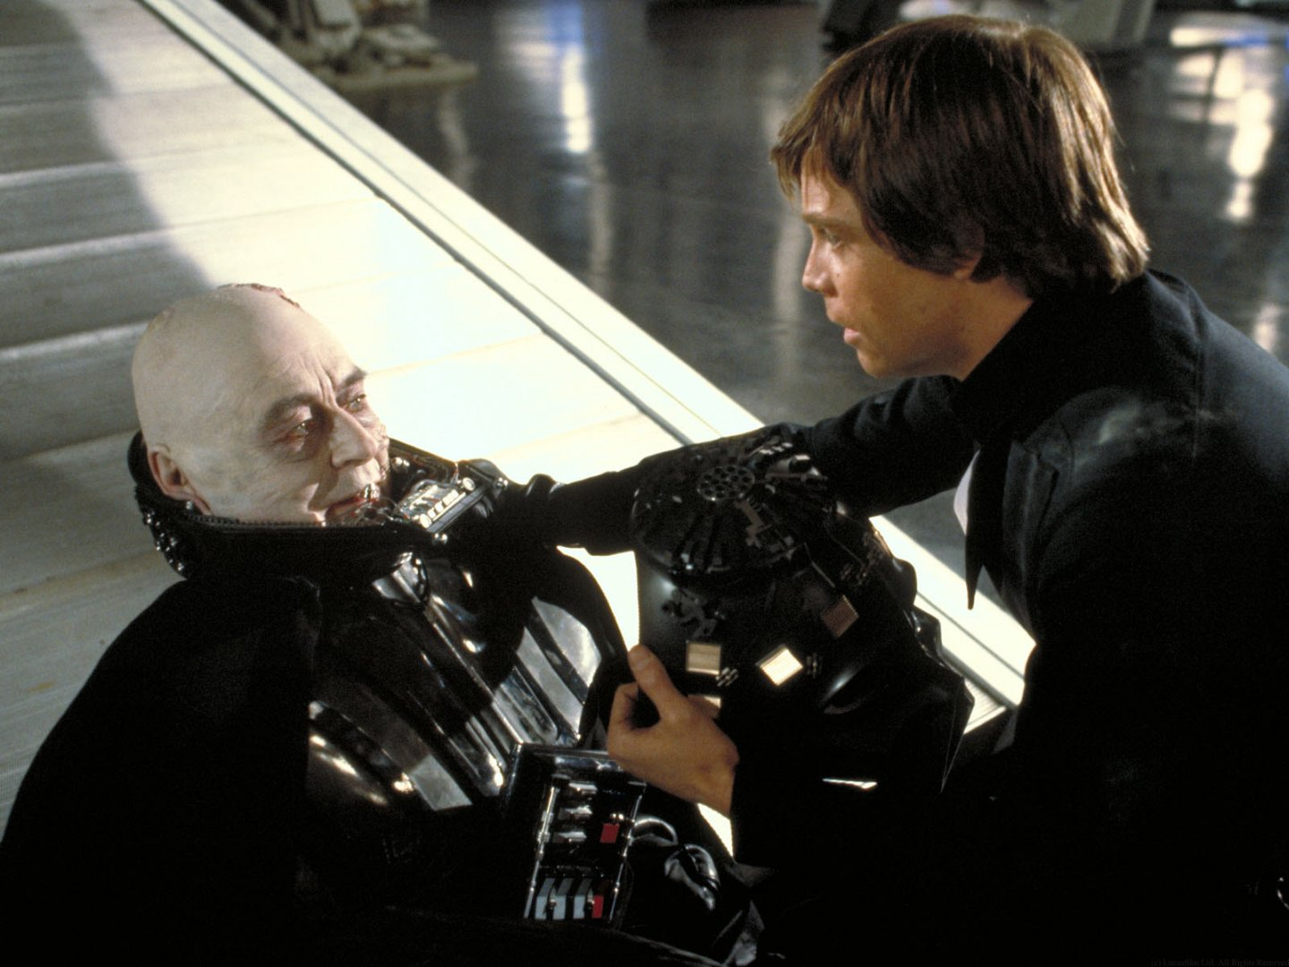
Put the apostrophes for omission and possession in this script from Star Wars.
There are 5 apostrophes for omission and 1 possessive apostrophe.
Darth Vader: Luke... help me take this mask off.
Luke: But you will die.
Darth Vader: Nothing... can stop that now. Just for once... let me... look on you with my *own* eyes.
[Luke takes off Darth Vaders mask one piece at a time.]
Anakin: Now... go, my son. Leave me.
Luke: No. You are coming with me. I will not leave you here, I have got to save you.
Anakin: You already... have, Luke. You were right. You were right about me.
[Anakin slumps down in death]
Luke: Father... I will not leave you.

Slide 8
Extra Task:
Write a paragraph about your favourite film or a film you have recently watched using apostrophes for omission and possession.
Try and use some of the following words BUT using omission:
It is you have did not I am I have you will they are you are
e.g. My favourite film is Ironman. It’s absolutely amazing; you’ll love it! I’ve watched it so many times but I’ll probably watch it again on the weekend. Tony Stark’s iron suits help him to save the whole world. One day I’m going to be as cool as Ironman!

