Slide 1
Learning to Double Numbers

Slide 2
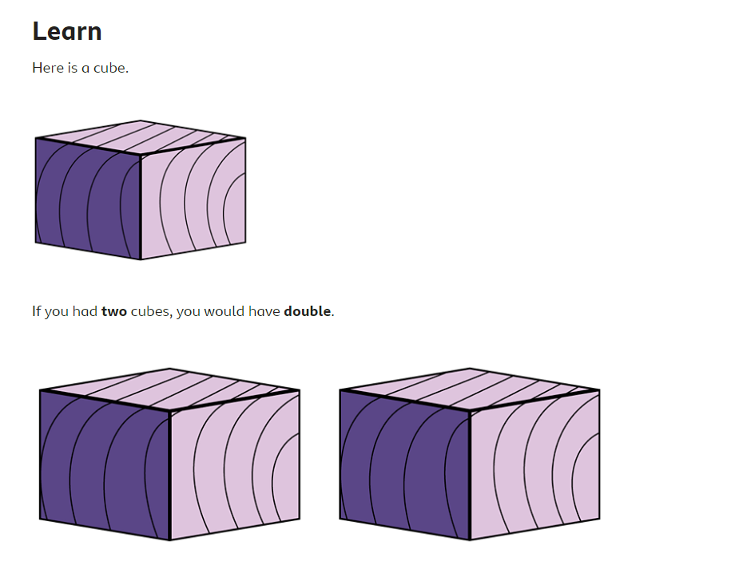

Slide 7
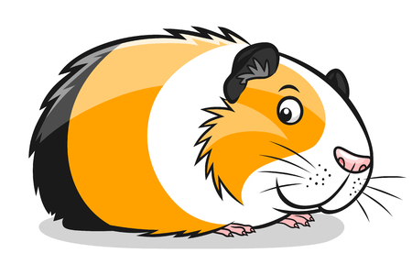
Claudia has 4 guinea pigs.
How many will she have if she has double?

Slide 8
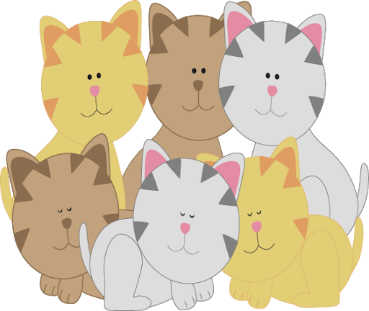
Daniel has 6 kittens.
How many will he have if we double them?

Slide 9
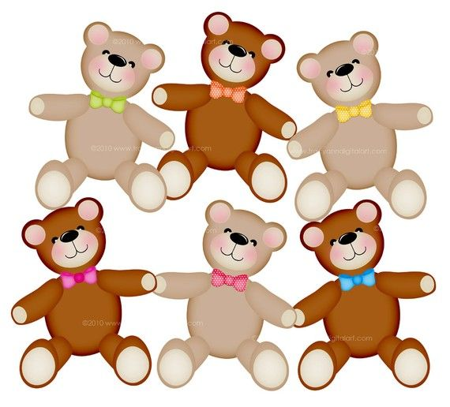
Carlay has 6 teddies.
How many will she have if we double them?

Slide 10
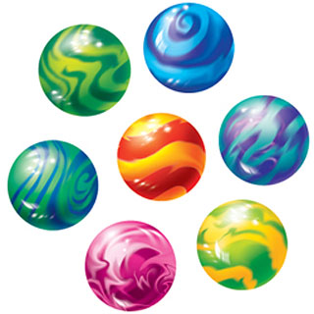
Miller has 7 marbles.
How many will he have if we double them?

Slide 11
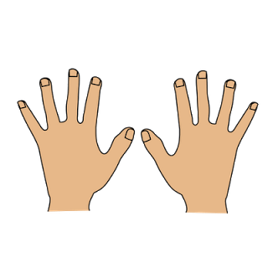
Keep Practising your doubles to 10 until they pop into your head…
Double 1 is 2
Double 2 is …
Double 3 is …
Double 4 is …
Double 5 is 10
Your hands are perfect for helping you double to 10.
Use them until you don’t need them!

Slide 12
Try playing the BRONZE rounds on Karate Cats.
Search for:
bbc karate cats

