Slide 1
Substitution
(Yes, more algebra!)

Slide 2
What is substitution in algebra?
In algebra, “substitution” means putting numbers where the letters are.

Slide 3
For example…
If we had the expression x-2
And we knew that x=6…
…then we could substitute x for 6:
6-2=4

Slide 4
Order of Operations
Something that is also important to know for this area, is the order of operations
Operations means things like add (+) take away (-) multiply (x) divide (÷)
If there is more than one of them in a calculation… like 5 + 2 x 6… there is a special order we have to do them in
The rule is - multiply or divide before you add or subtract
(there is an extra bit of the rule for brackets or powers/roots but we don’t need to worry about those just yet)
So 5 + 2 x 6… we have to do 2x6 first which is 12, then +5 so its 17

Slide 5
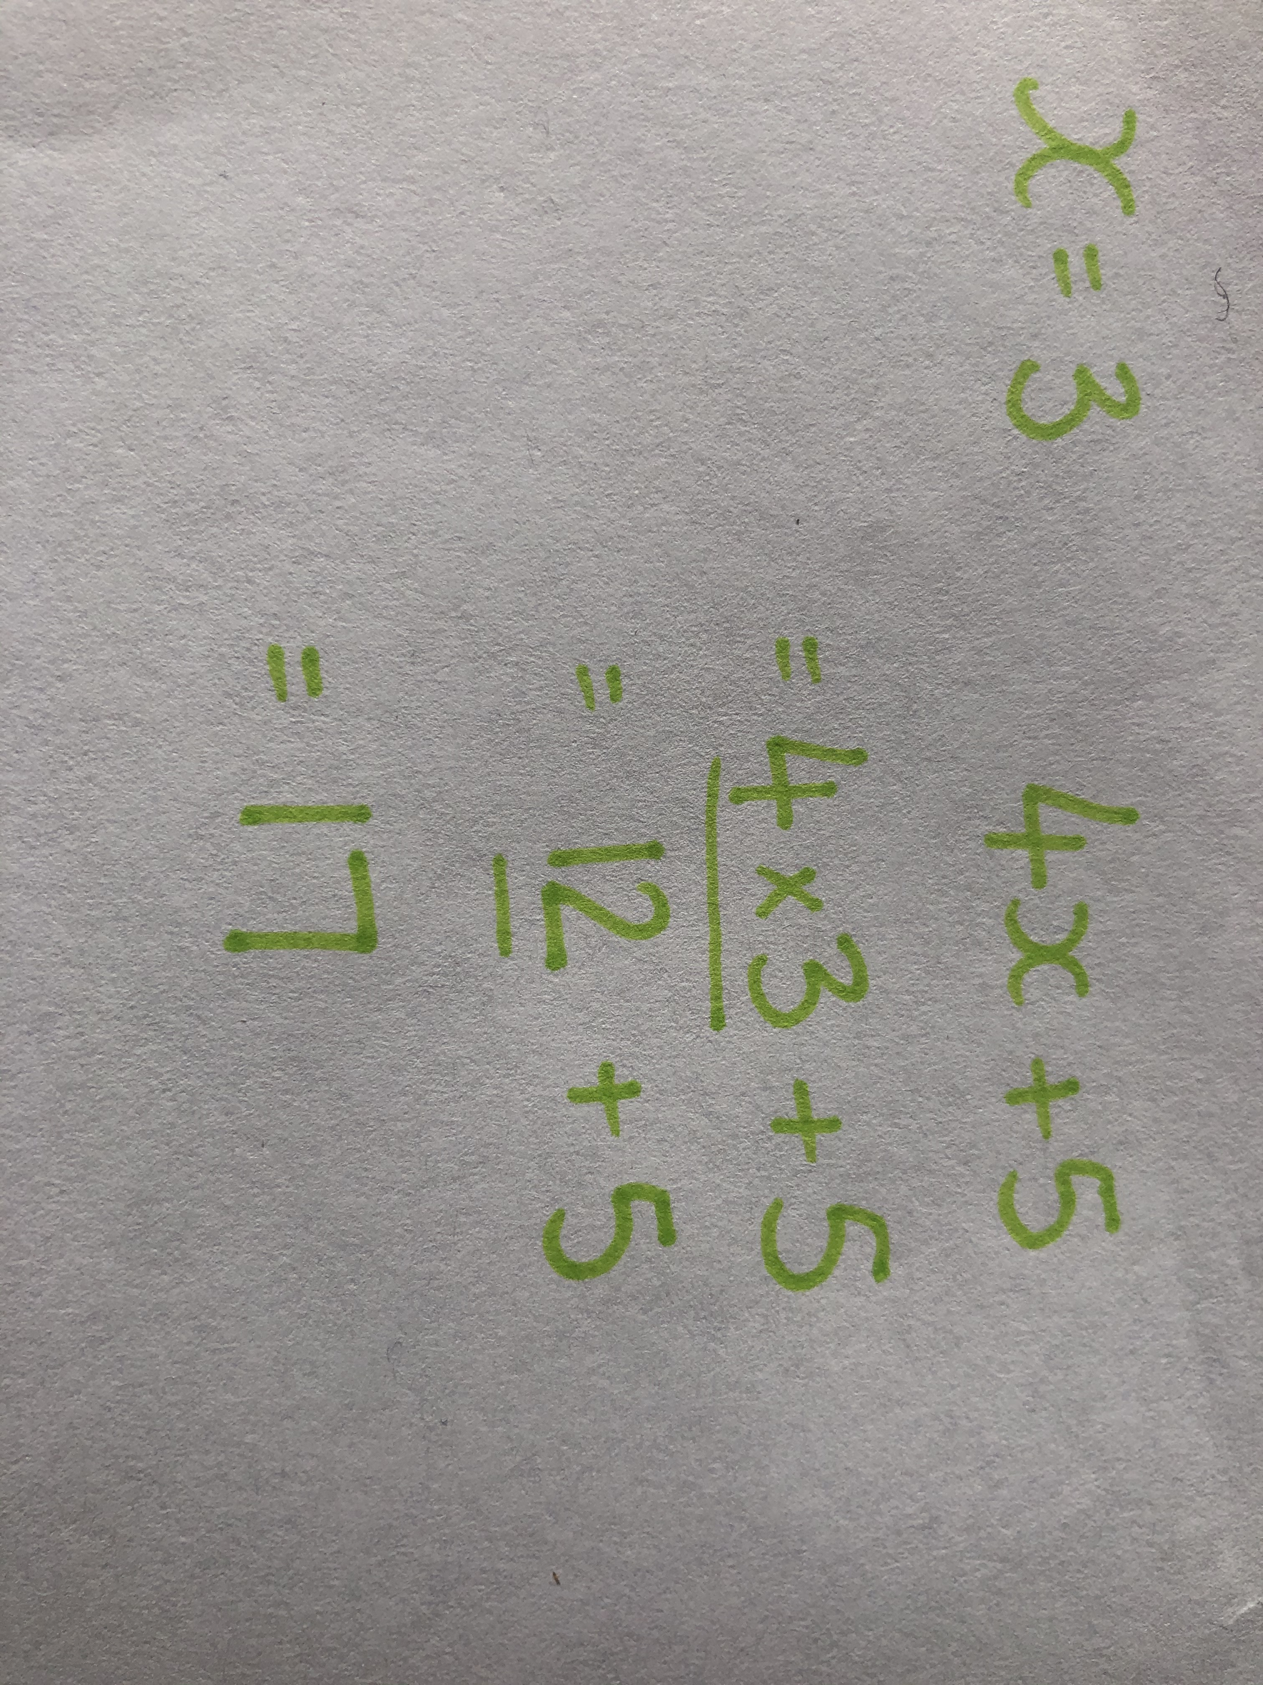
Example
When x=3, what is 4x + 5 ?
Put 3 where the x is.
4 x 3 + 5 (did you remember 4x meant 4 times x?)
=17
we did the multiply first…4x3=12…then we added 5

Slide 6
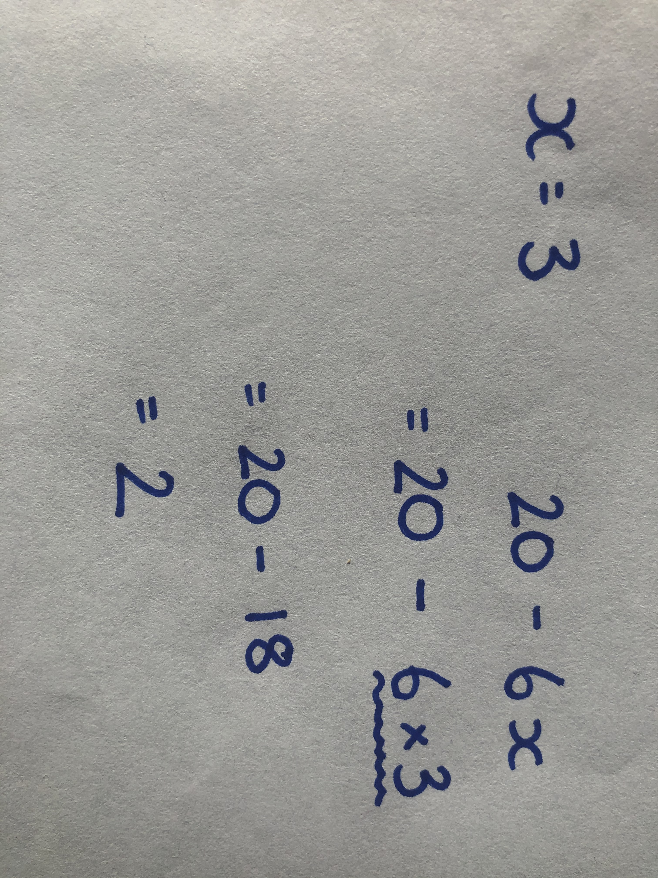
Example 2
If x=3, what is 20- 6x?
Put 3 where the x is.
20 – 6 x 3
(remember x or ÷ before + or -)
6x3=18… 20-18=2
The answer here is 2

Slide 7
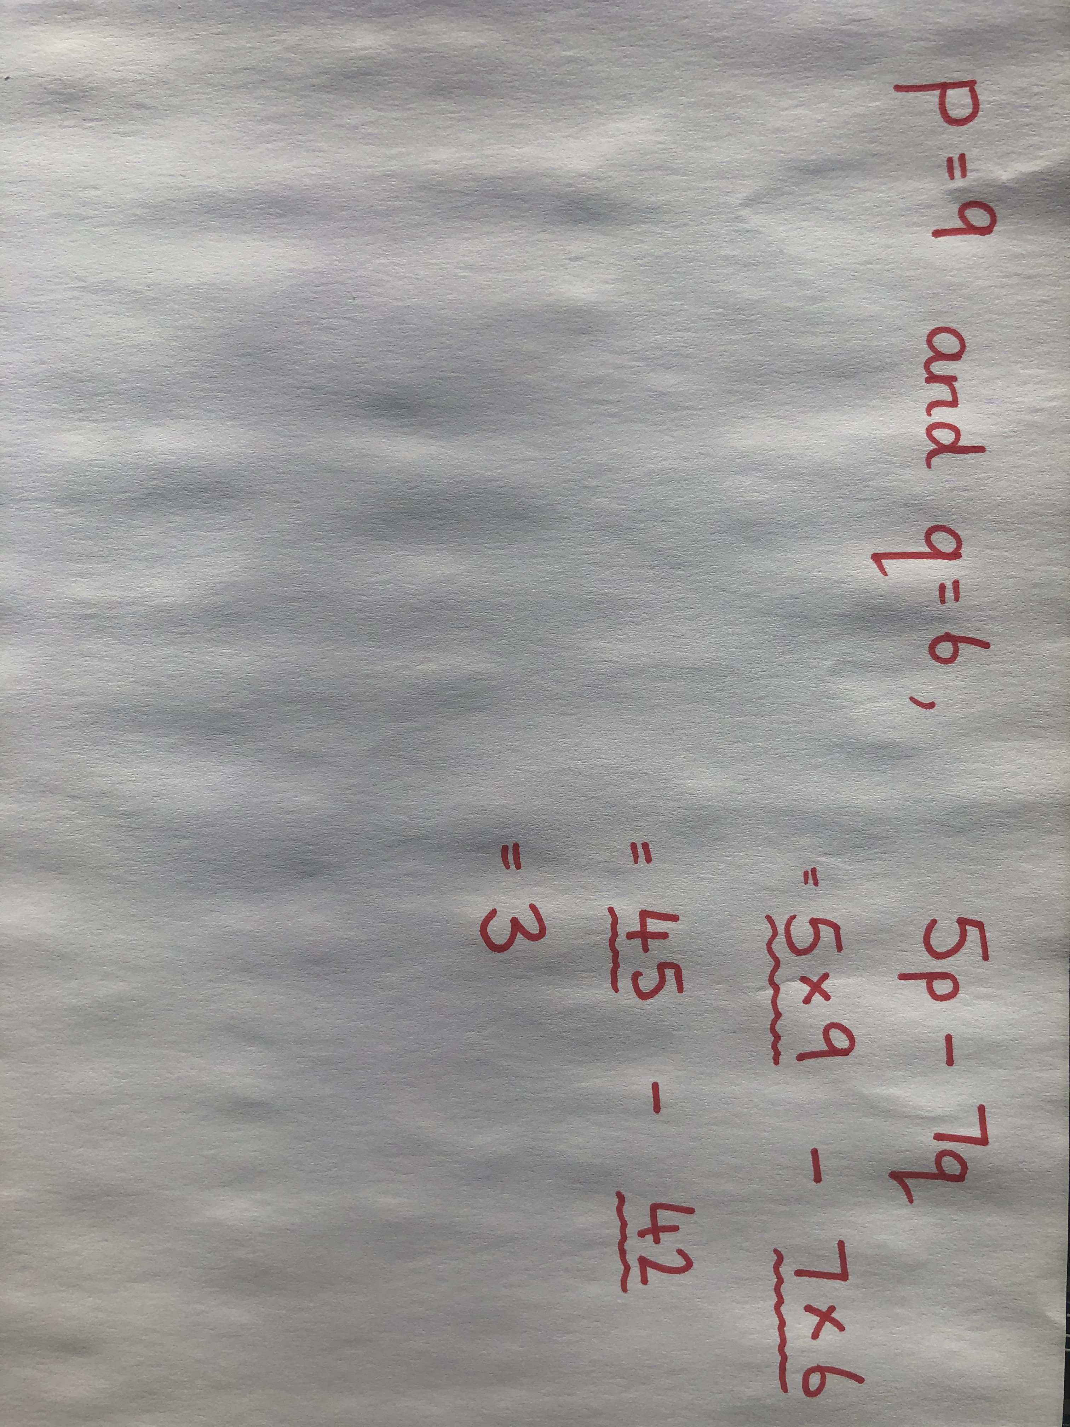
Example 3
If p=9 and q=6, what is 5p – 7q
Put 9 where p is, and 6 where q is…
5 x 9 – 7 x 6
(remember to multiply first!)
45 – 42
=3

Slide 8
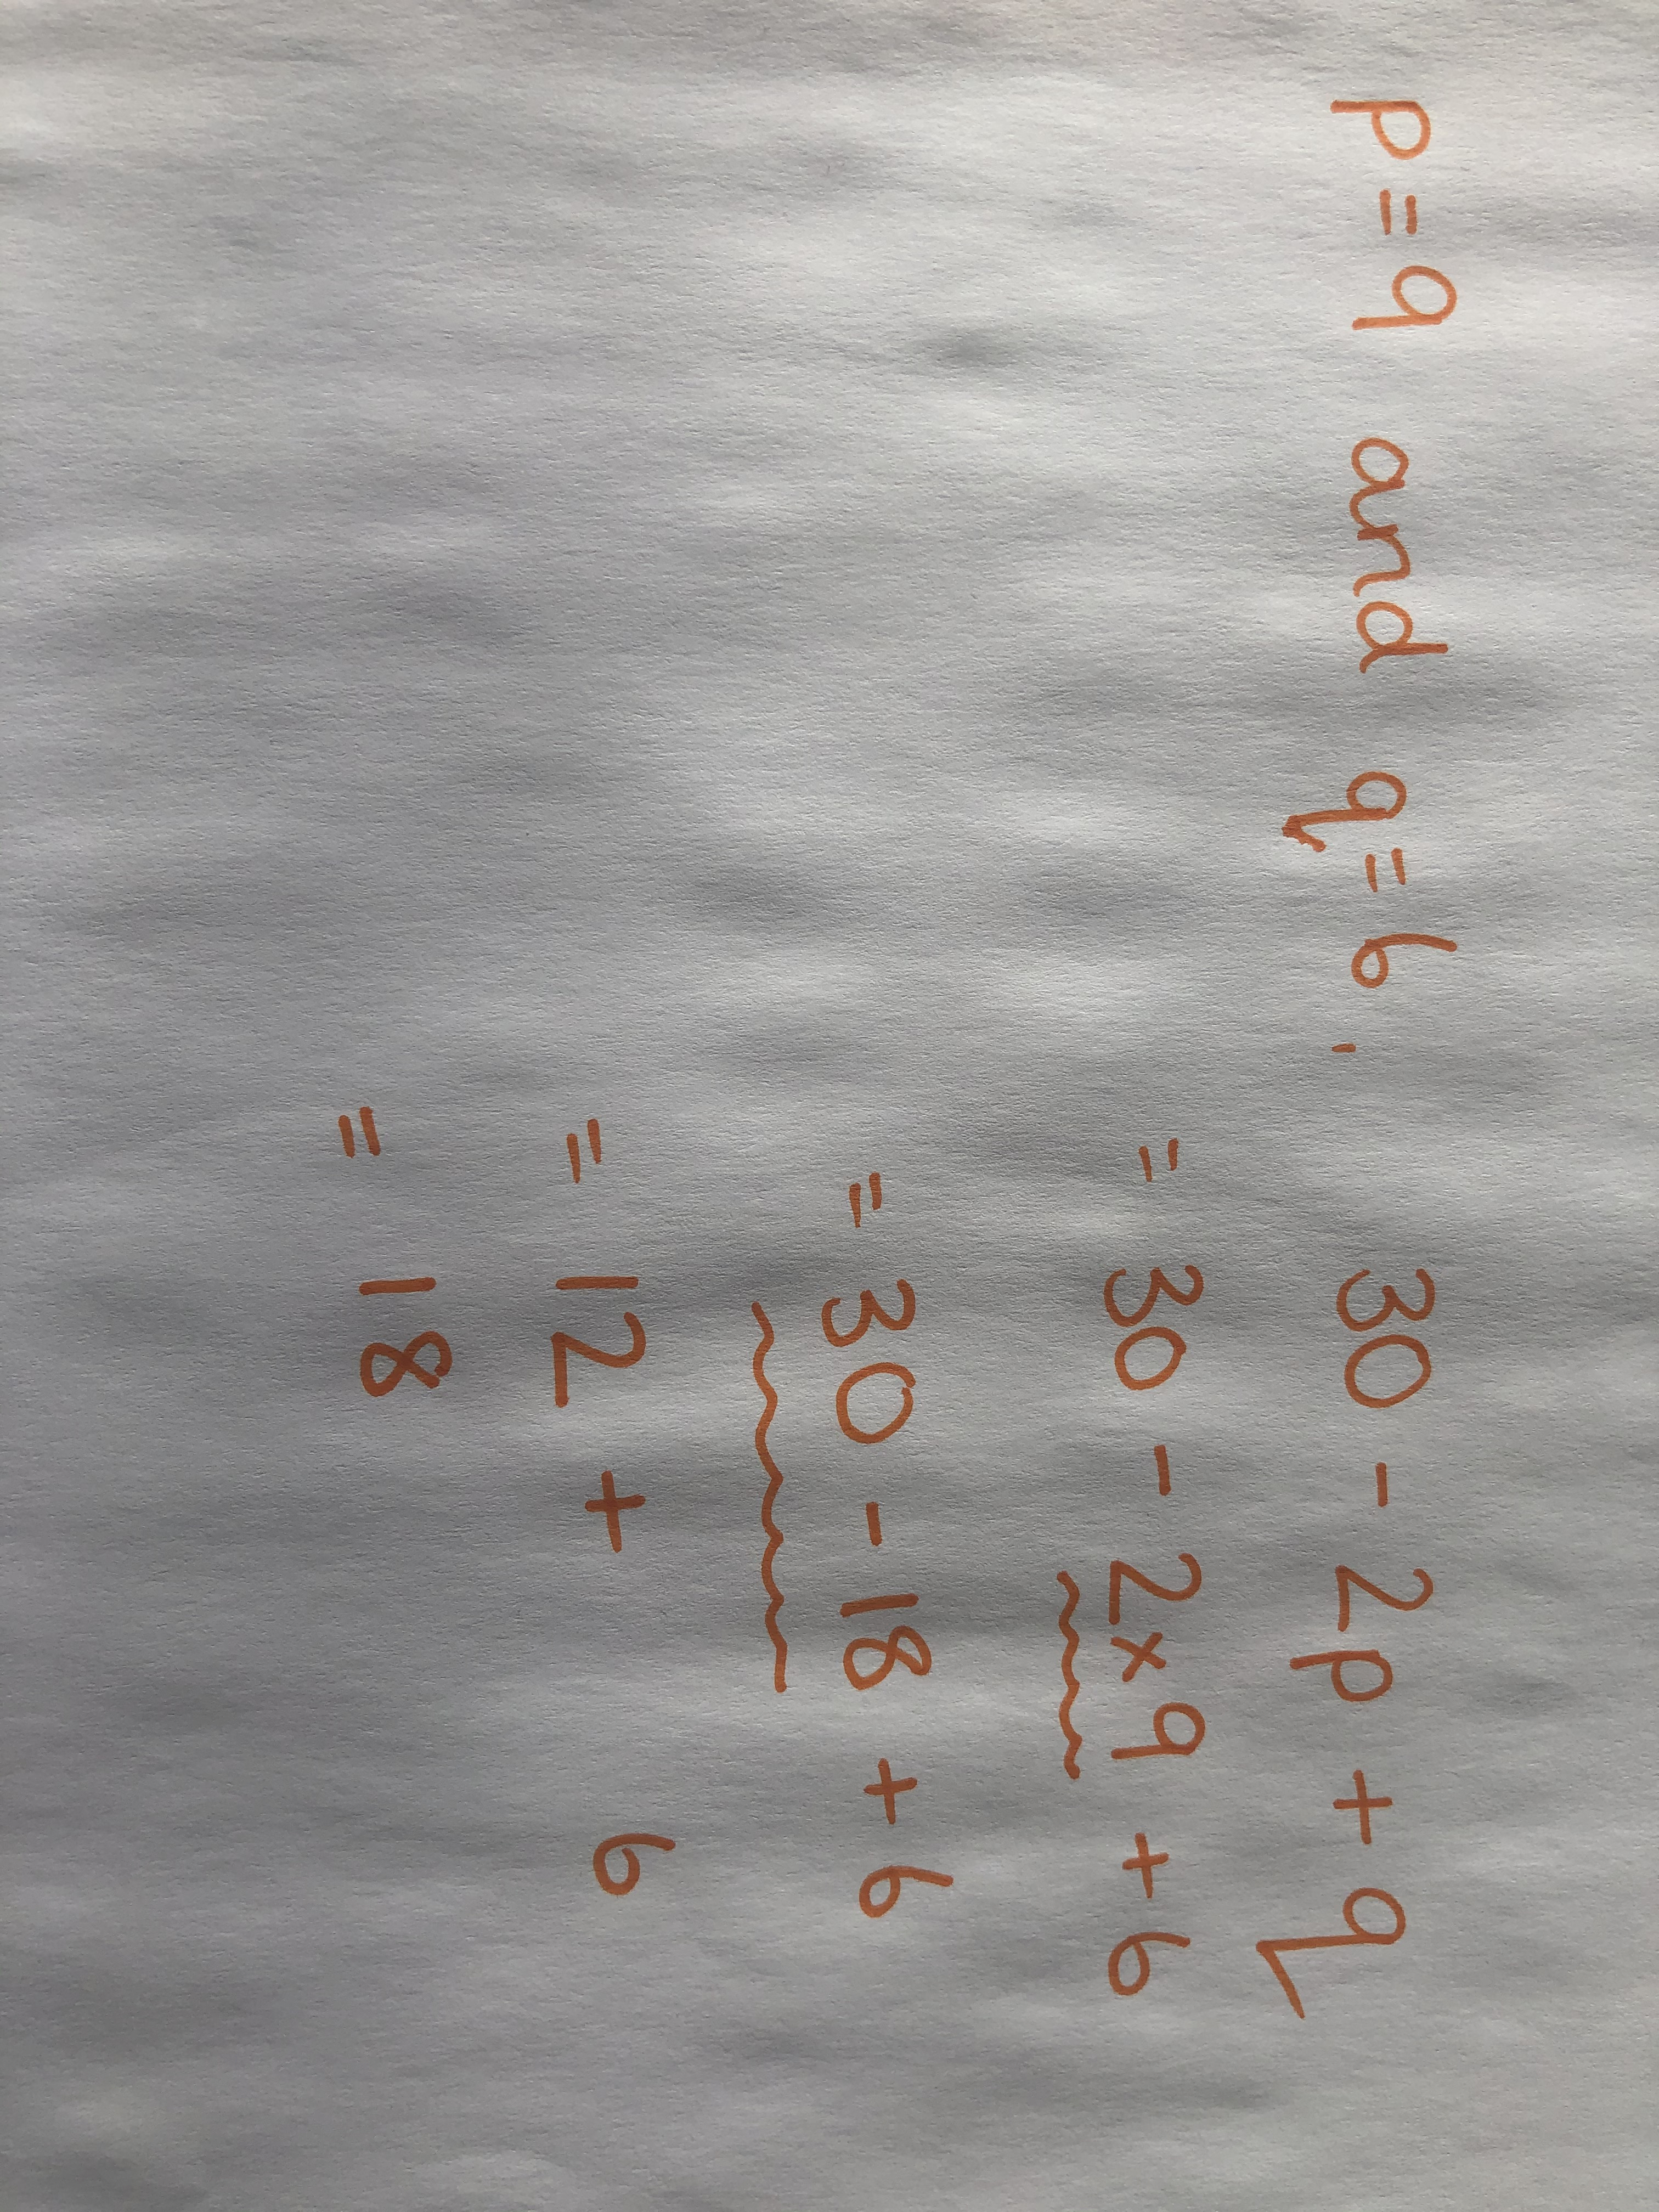
Example 4
If p = 9 and q = 6, what is 30 – 2p + q
Put 9 where p is, and 6 where q is.
30 – 2 x 9 + 6
Do the multiplication first…
30 – 18 + 6
Then do the rest in the order you read it…
30-18=12 12+6=18
The answer is 18

Slide 9
Questions
Answer these questions, and I will put the answers on the last slide so that you can check
1) If x = 4 and y = 3, find the value of
a) x + y b)x – y c) xy d) 5x
e) 2yx f) 7x ÷ 2 g) 10y h) xy ÷ 10

Slide 10
2) If p = 6 and q = 8, find the value of:
a) 2p + 1 b) 3q – 4 c) 20 – 3p d) 10 + 5q
e) ½ p + 7 f)1/4 q – 1 g) p² h)q²
3) If a = 5, b =1 and c = 10, calculate
a) a + b + c b) 2c – a c) a – b + c d) c + 2a – b
e) 10 – bc f) abc g) 9c – 16a h) 1/5 a + 9

Slide 11
Answers

Slide 12
Answers

Slide 13
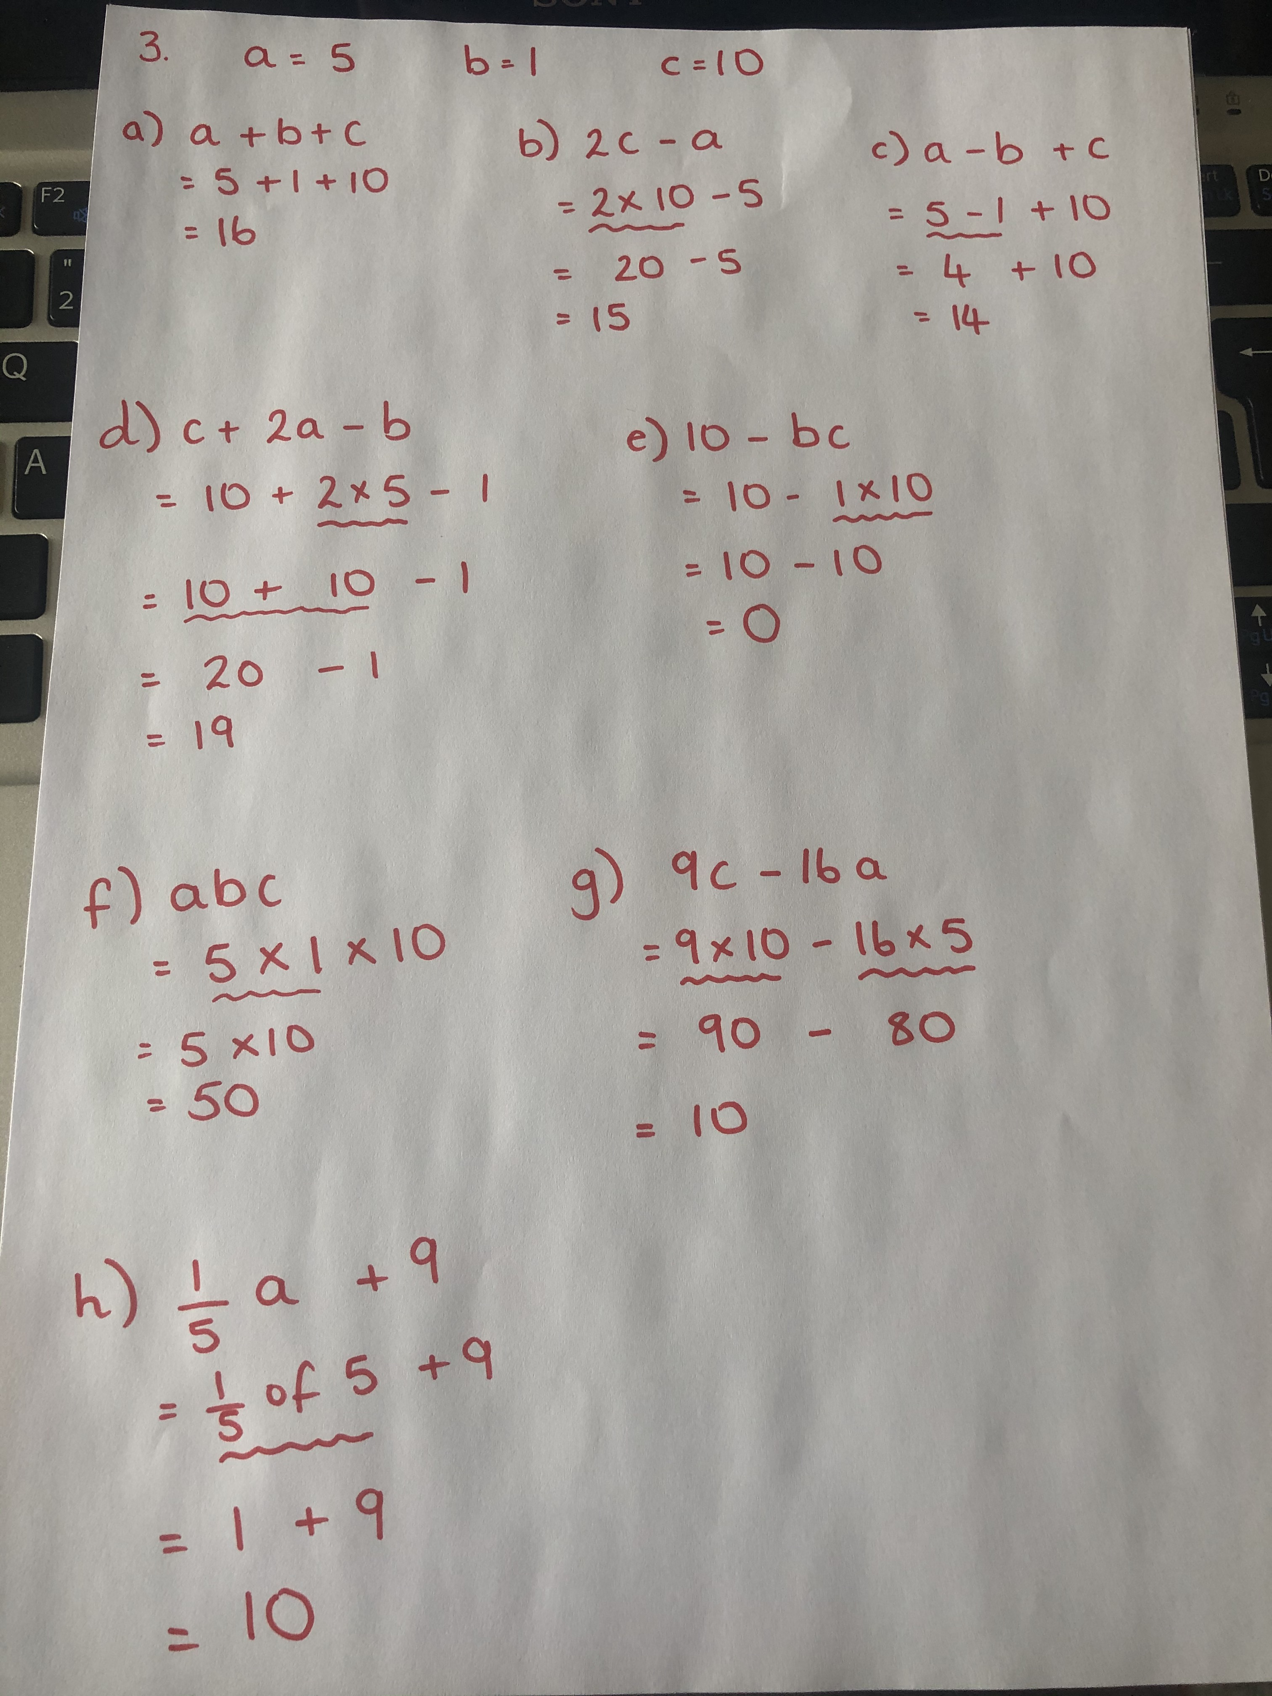
Answers

