Slide 1
Guess the Book - Lower Primary
www.readingchallenge.scot

Slide 2
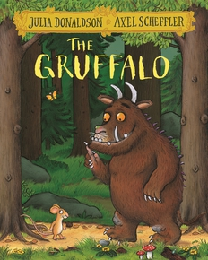
Guess the book…
The story is set in a wood…
The story is told by a mouse…
He has terrible tusks, and terrible claws, and terrible teeth in his terrible jaws…
Click on one square at a time to reveal the book cover…

Slide 3
Guess the book…
This story is about a family of four…
They go on a walk which turns into an adventure…
We’re going on a _ _ _ _ hunt!
Click on one square at a time to reveal the book cover…

Slide 4
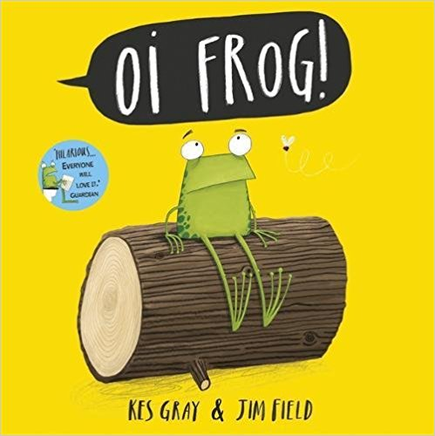
Guess the book…
The main character in the story rhymes with ‘log’…
This is a story about where animals sit…
Cats sit on mats, hares sit on chairs, mules sit on stools but Frog does not want to sit on a log!
Click on one square at a time to reveal the book cover…

Slide 5
Guess the book…
The main character in the story is a rabbit…
This rabbit loves books…
Ralfy wants to read books ALL the time and this gets him into trouble…
Click on one square at a time to reveal the book cover…

Slide 6
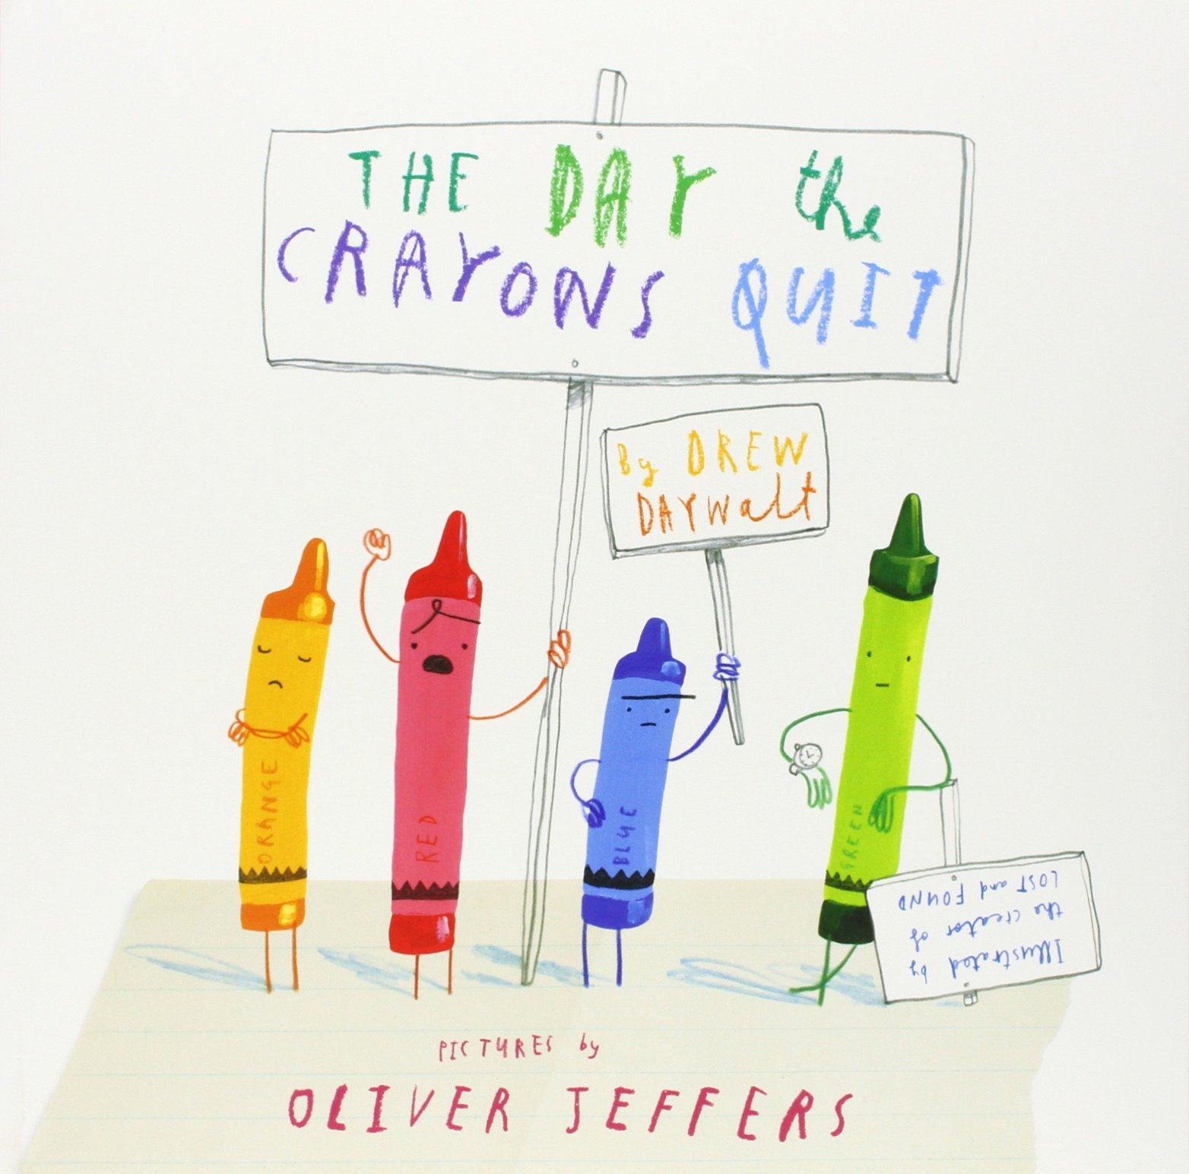
Guess the book…
Life is just not fair…
This story starts with a pile of letters…
Duncan, you really need to listen to your crayons!
Click on one square at a time to reveal the book cover…

Slide 7
Guess the book…
The main character in this book is a tiger…
He is a very proper tiger but he doesn’t feel like himself…
All he wants is to be WILD!
Click on one square at a time to reveal the book cover…

Slide 8
Guess the book…
This story is about a very unusual bear…
This bear’s favourite food is marmalade sandwiches…
He is found by the Browns at Paddington station…
Click on one square at a time to reveal the book cover…

Slide 9
Guess the book…
The main character in this book is always getting into trouble…
His younger brother is called Perfect Peter…
_ _ _ _ _ _ Henry
Click on one square at a time to reveal the book cover…

Slide 10
Guess the book…
There are three farmers in this book…
“Boggis, Bunce and Bean, one short, one fat, one lean. Those horrible crooks, so different in looks are nonetheless equally mean.”
_ _ _ _ _ _ Mr Fox
Click on one square at a time to reveal the book cover…

Slide 11
Thank You
www.readingchallenge.scot
/scottishbktrust @FMReadChallenge

