Slide 1
Rhythm patterns
Music 14.5.2020

Slide 2
We are learning to read and play a series of rhythmic patterns
Drumming lesson number 4!
Like last week, I will keep using the shapes to help those of you who still need it – but I’ll put a page with the proper musical notation just after if you’re at the stage where you can read it.
If you want some body percussion warm ups, visit Mrs Picken’s Youtube page
https://www.youtube.com/watch?v=jQxYOLOJUbg
https://www.youtube.com/watch?v=lZQEUrMXoR4

Slide 3
Notation we have looked at…
Crotchet It’s worth 1 beat, or say square in your head as you drum it.
2 Quavers 2 quavers is 2 half beats – say circle as you drum
Crotchet rest – be quiet for 1 beat
Repeat signs - repeat whatever is in between them.

Slide 4
New for this week...
Repeat signs!
They mean you repeat whatever is in between them.

Slide 5
Rhythm 4
Here is the first line of your rhythm today
Remember that repeat sign means you play it twice.
On the next page is just the notes – no shape.

Slide 6
Notes only

Slide 7
Ready for line 2?
Play it twice as well.

Slide 9
Line 3…
Play it through twice!

Slide 10
Notes only again

Slide 11
And the last line

Slide 12
Just the notation

Slide 13
Like normal, you can stop there if working on one line at a time is enough of a challenge at the moment – great work.
If you want all 4 lines to play, the next 2 slides have them.
One Republic – Counting Stars is today’s backing music of choice.
Look out for my video demo on the blog.

Slide 14
Youtube -https://www.youtube.com/watch?v=5igCxd0wZ4Y

Slide 15
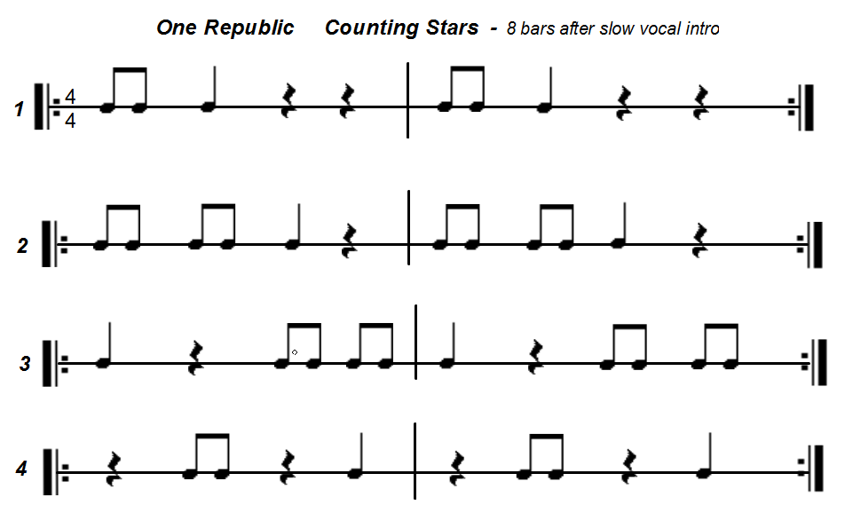

Slide 16
Well done!

