Slide 1
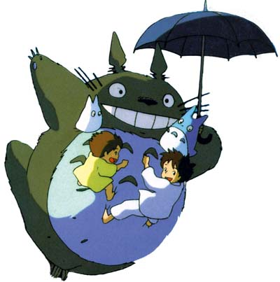
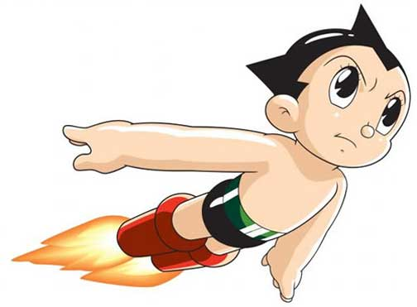
アニメ
anime
animation
まんが
manga
comics

Slide 2
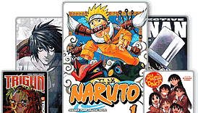
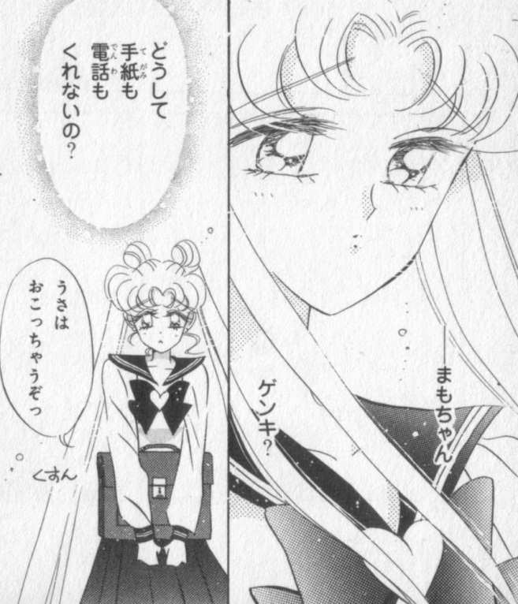
漫画 まんが manga comics
Japanese comic books or まんが are incredibly popular. Over one
billion comic books are published every year. Everyone in Japan
loves comics – not only children but adults too. Japanese people have
been enjoying stories and pictures presented in comic style for
almost 100 years.

Slide 3
What is manga?
manga 漫画 is a Japanese word.
- man 漫 = fanciful; with strange ideas
- ga 画 = pictures; sketches
manga are like comics that tell stories in pictures and words.
In manga anything can happen.
There are manga for children and manga for adults.
Characters are normal people who end up in unusual situations or have a ‘secret other life’.

Slide 4
manga shop
http://www.guardian.co.uk/commentisfree/belief/2010/dec/22/jesus-buddha-japan-manga-novel

Slide 5
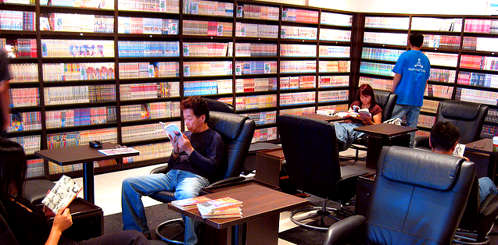
manga cafe
http://keikakudoori.wordpress.com/2011/07/24/manga-and-exposure-to-the-medium/

Slide 6
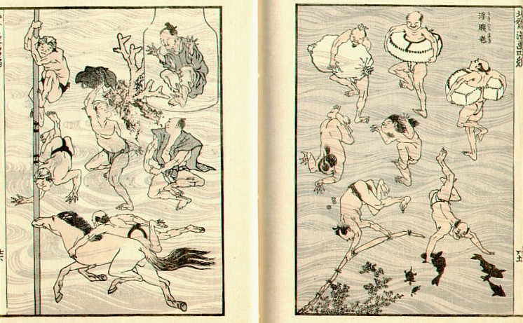
Earliest form of まんが:
Image of bathers from the Hokusai manga:
(before 1820)

Slide 7
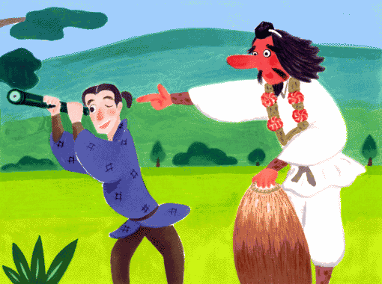
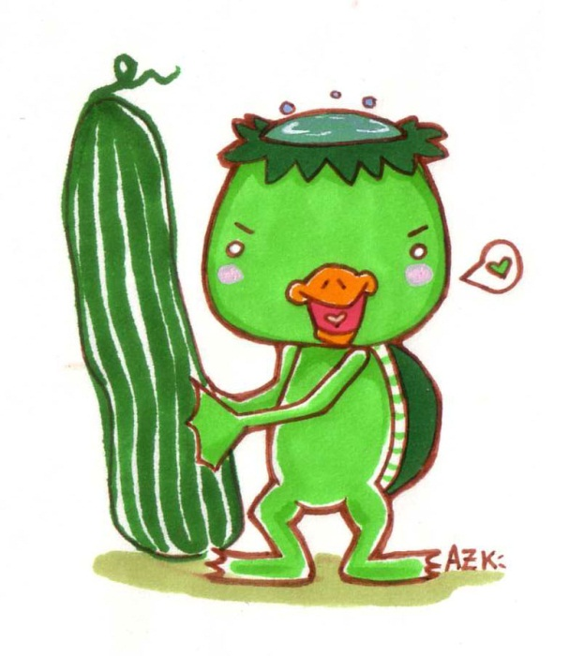
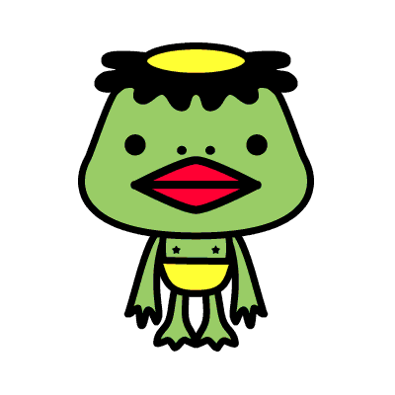
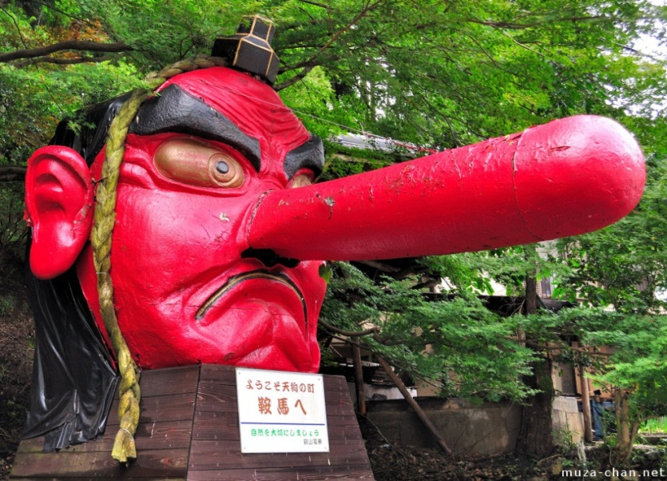
Traditional Characters used in manga
kappa
tengu
Located a little north of Kyoto, Mount Kurama is one of the mythical places inhabited by tengu.
http://muza-chan.net/japan/index.php/blog/japanese-stories-tengu-mount-kurama
http://web-japan.org/kidsweb/folk/tengu/tengu01.html http://azukiblog.wordpress.com/tag/kappa http://tokyo5.wordpress.com/tag/kappa/

Slide 8
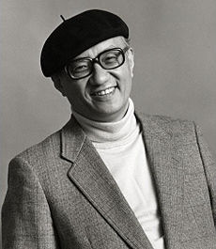
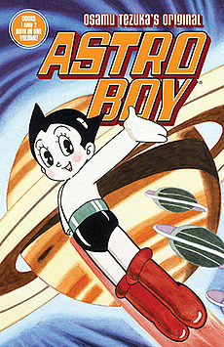
TEZUKA Osamu 手塚治虫:
Japan’s most famous manga artist.
His manga include:
Tetsuwan Atomu 鉄腕アトム(Astro Boy, 1961)
Janguru Taitei ジャングル大帝
(Jungle Emperor or Kimba the White Lion)

Slide 9
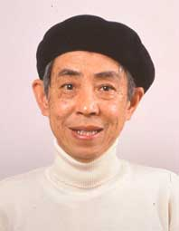
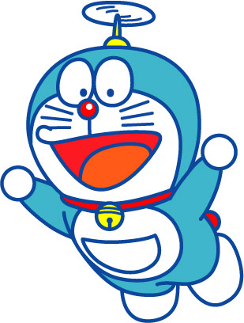
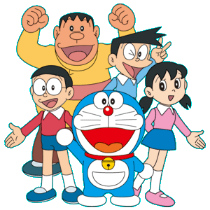
Doraemon
ドラエもん
Hiroshi Fujimoto and his childhood friend Motoo Abiko
co-authored cartoons under the pen name Fujiko Fujio from 1952–1987. In the 1980’s, a doraemon boom swept through parts of Asia.
ドラエもん is a 22nd century robotic stray cat.
He has a magic 4D pocket from which he pulls
anything he wants.

Slide 10
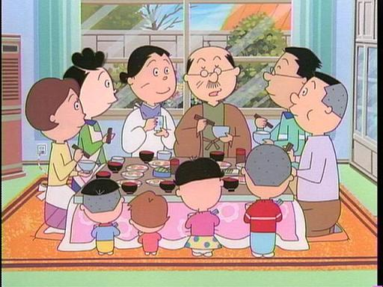
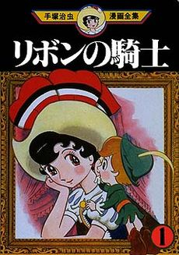
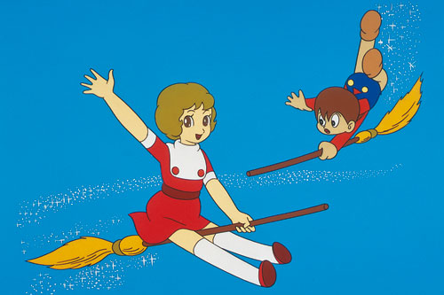
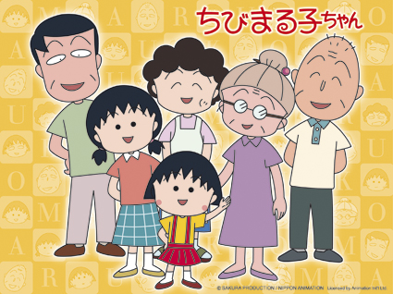
Sazaesan
by Machiko Hasegawa (1946)
Ribon no kishi:
Princess Knight (1953-56)
Mahootsukai Sarii:
Little Witch Sally (1966)
Chibi Marukochan
by Momoko Sakura (1986)

Slide 11
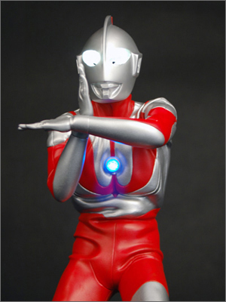
ウルトラマン
urutoraman
Ultra Man
TV Series (1966)
He has come from outer space to fight against evil. Ultra Man can stay on earth for only three minutes at a time. The light on his chest stays on while he is on earth. If the light goes off, he must return quickly to space.
Niko Niko National Curriculum Corporation

Slide 12
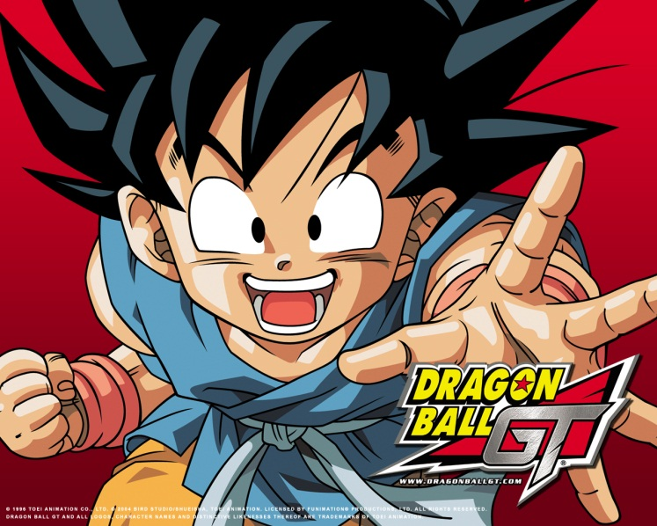
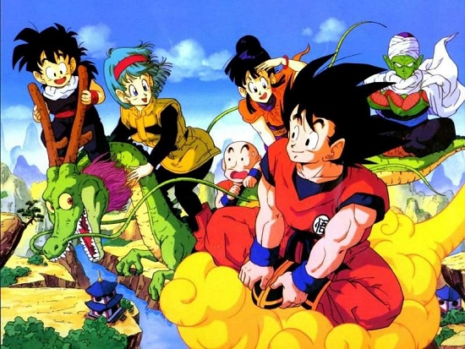
ドラゴンボール Dragon Ball by TORIYAMA Akira 鳥山明 (1984)
Doragon booru (Dragon Ball) was inspired by the classical Chinese novel Journey to the West. The series follows the adventures of Gohu from his childhood through adulthood as he trains in martial arts and explores the world in search of the seven mystical orbs known as the Dragon Balls, which can summon a wish-granting dragon.

Slide 13
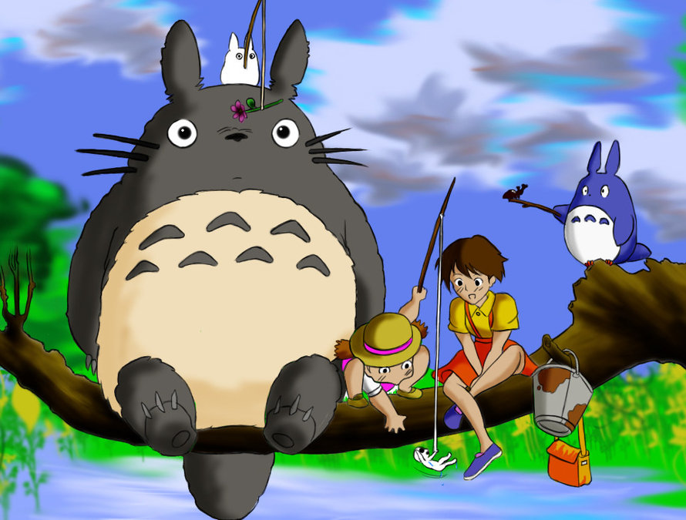
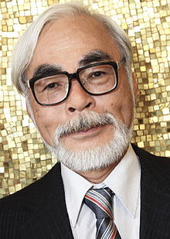
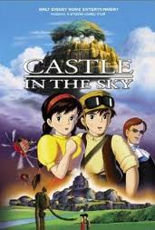
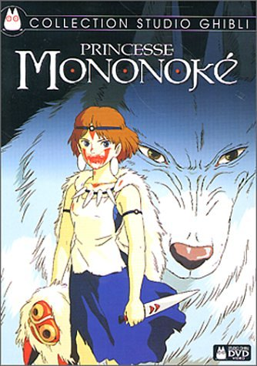
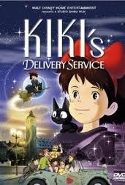
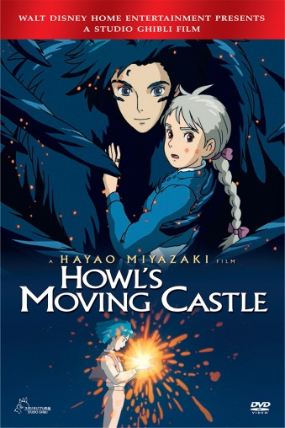
Tonari noTotoro
となりのトトロ
My Neighbour Totoro
by Hayao Miyazaki (1988)

Slide 14
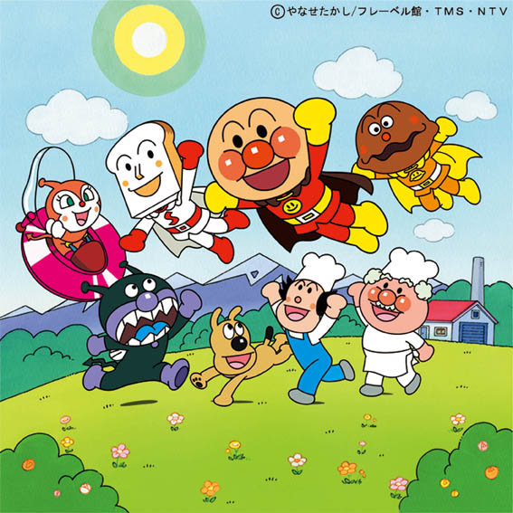
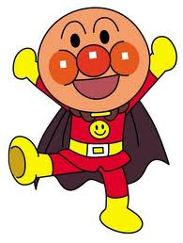
Anpanman by Takashi Yanase
アンパンマン
Anpanman began as a Children’s book
Series in 1973 and became a successful
animation series in 1988.
Anpanman is made from bun dough filled with sweet red-bean paste.

Slide 15
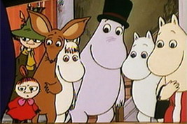
ムーミン Muumin (1990)
TV series adaptation loosely based on the books by the
Finnish illustrator and writer Tove Jansson.

Slide 16
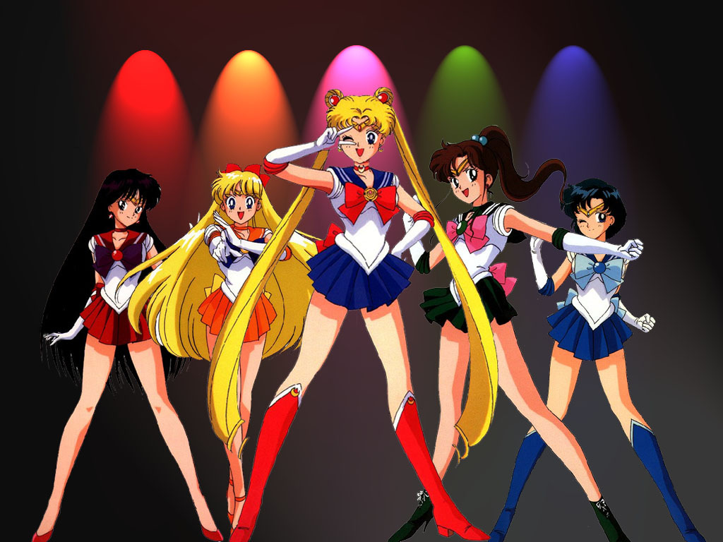
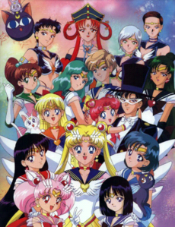
Sailor Moon 美少女戦士セーラームーン
(Bishoojo senshi Seeraamuun)
by TAKEUCHI Naoko 武内直子 (1991; anime 1992)

Slide 17
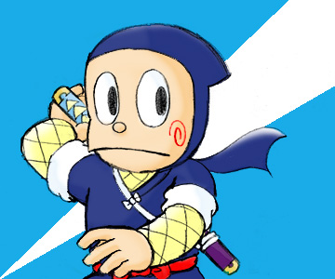
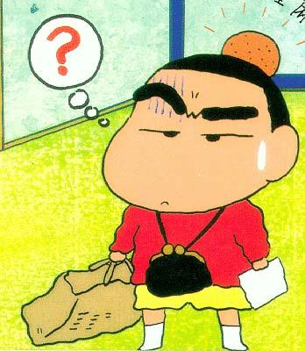
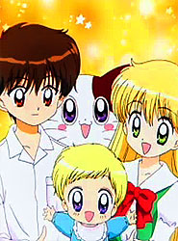
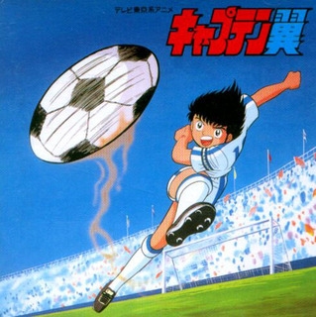
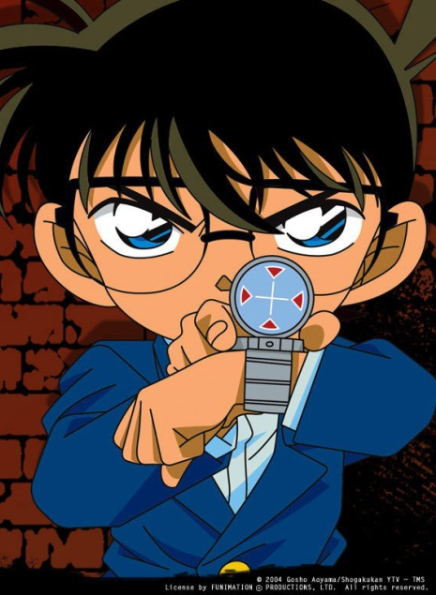
Do you know any of these characters?
Kureyon Shinchan
Ninja Hattori-kun
Da! Da! Da!
Meitantei Conan
Kyaputen Tsubasa

Slide 18
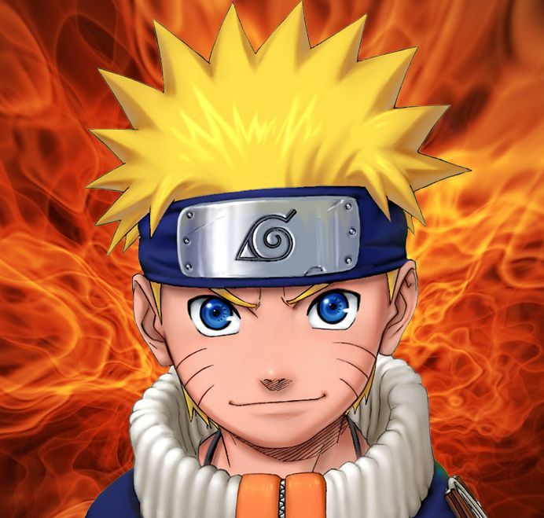
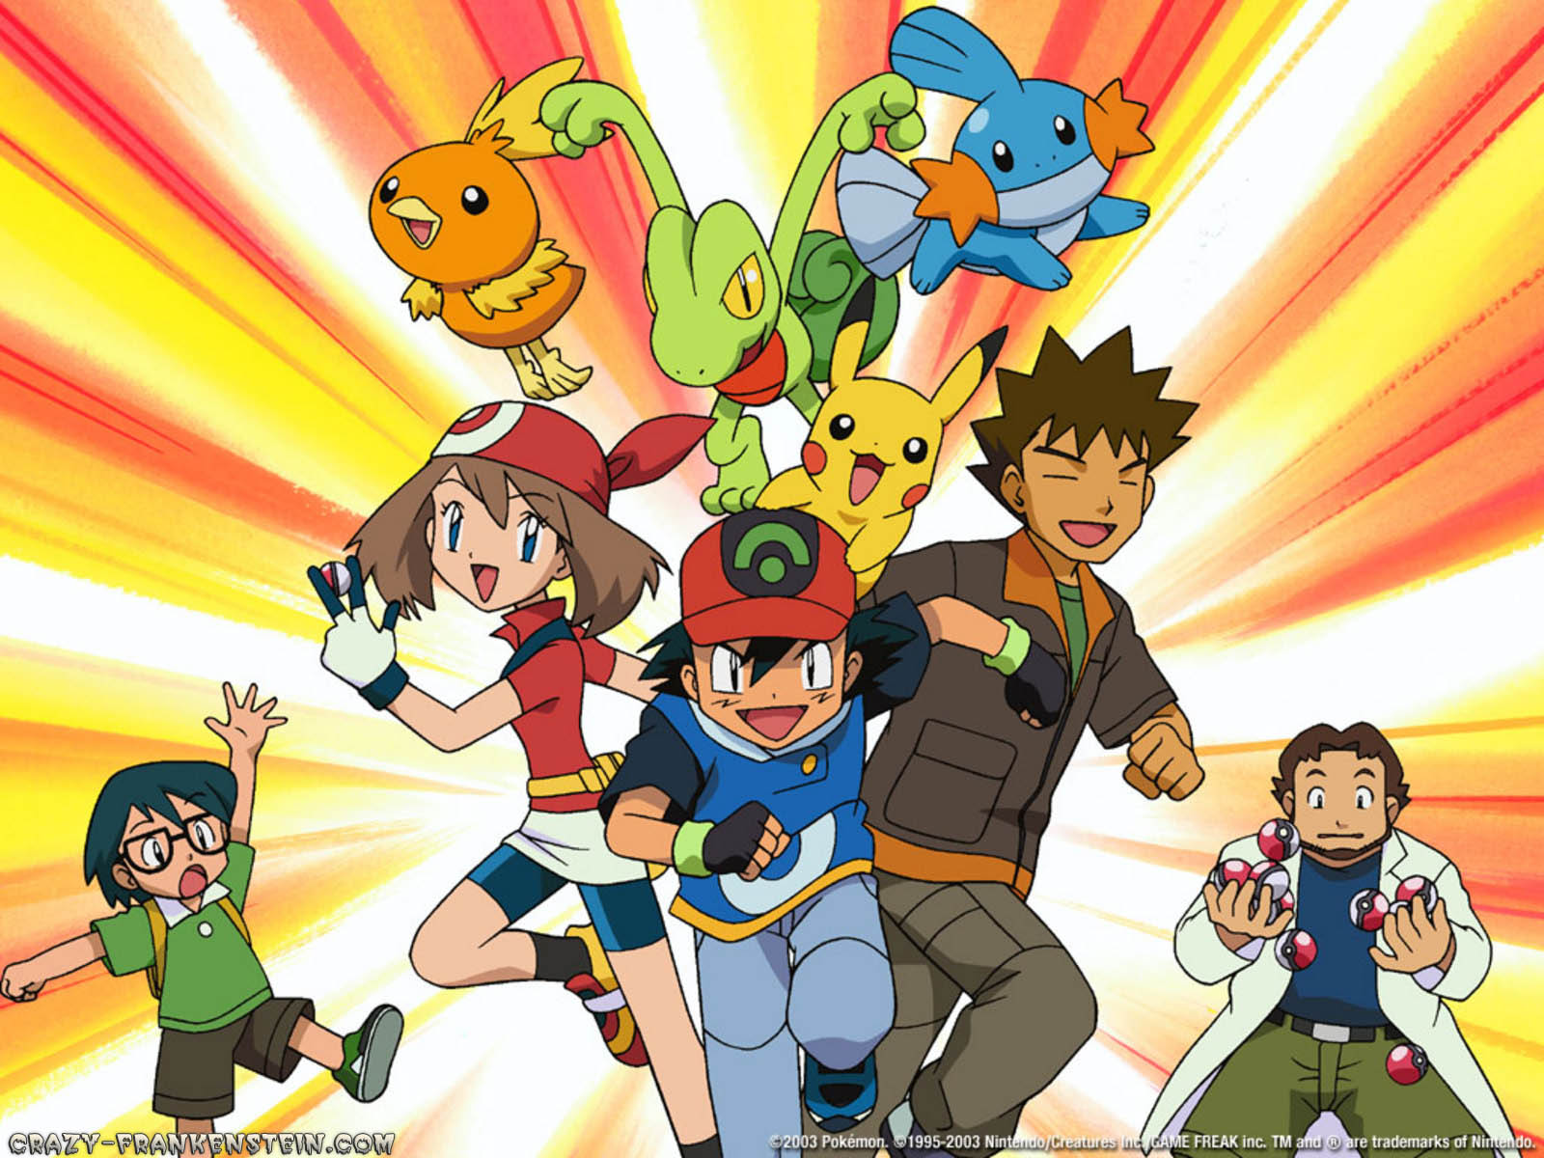
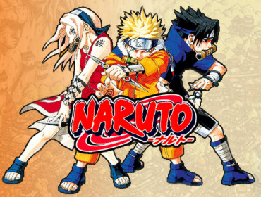
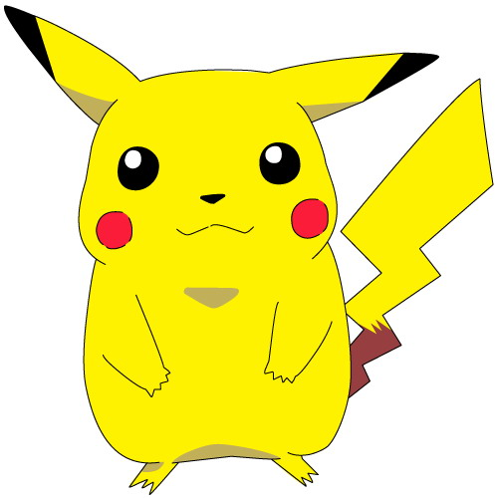
Or these?
Pokemon

