Slide 1
Survival club
By Paul

Slide 2
Rules and safety
Listen to the instructions. Your safety could depend on it!
Never hurt any living thing ( animals or humans)

Slide 3
What we will be doing
We will light fires
Building dens
Learn About B.O.B –Bug Out Bag
Cooking
Climbing

Slide 4
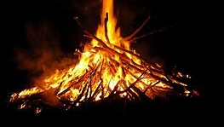
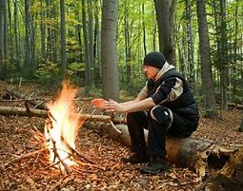
Lighting fires
We will be using a flint and steel to light the fires. You will need to gather tinder, twigs, small sticks and medium sticks.

Slide 5
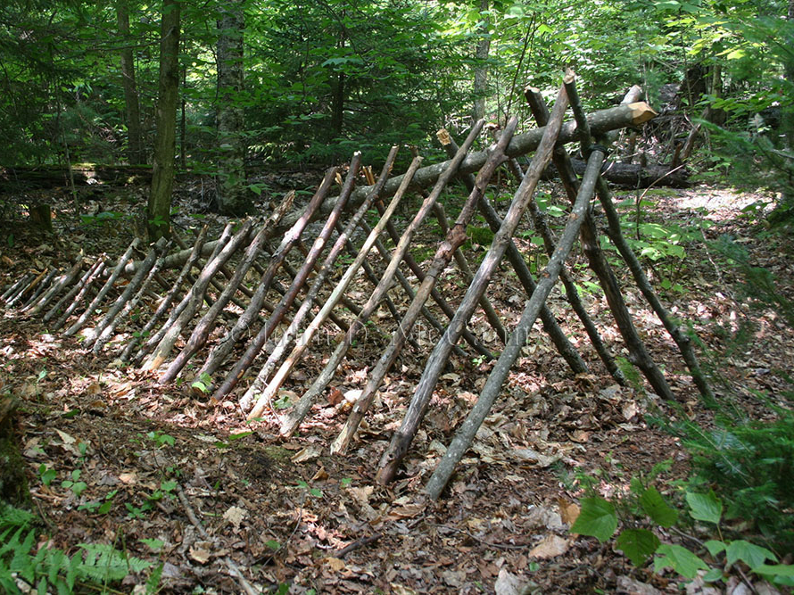
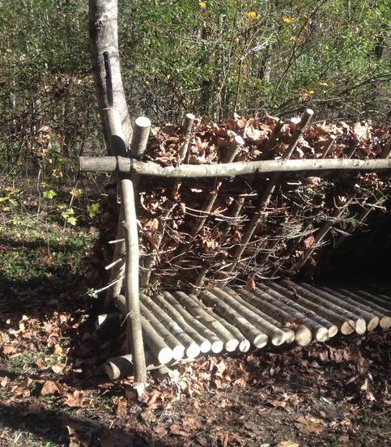
Building dens
You can build a A-frame or a lean-to shelter/den

Slide 6
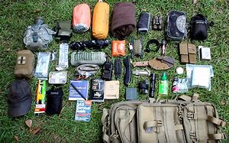
Learning about B.O.B –Bug Out Bag
B.O.B stands for bug out bag. It is a bag you can grab that has the essentials to survive 72 hours so 3 days one per person.
The essentials are
3 gallons of water
Food like beans, pasta and rice.
Clothing
Shelter like a tarp or a water proof sheet
A first aid kit
Water proof matches and a flint and steal
Flashlights
A pot and a canteen

Slide 7
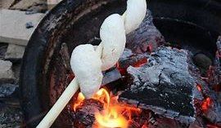
We will be making things like
Smoars
Nettle soup
hot chocolate
bread and jam
Cooking

Slide 8
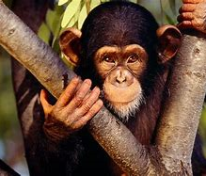
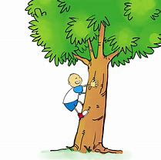
Climbing
We will be climbing on trees. We will be climbing two different ways on the branches and climbing with a rope having the rope around the tree and your waist like in some movies.

Slide 9
