Slide 1
Our New Greenhouse

Slide 2
Our New Greenhouse

Slide 3
Our New Greenhouse

Slide 4
Our New Greenhouse

Slide 5
Our New Greenhouse

Slide 6
Our New Greenhouse

Slide 7
Our New Greenhouse

Slide 8
Our New Greenhouse

Slide 9
Our New Greenhouse

Slide 10
Our New Greenhouse

Slide 11
Our New Greenhouse

Slide 12
Our New Greenhouse

Slide 13
Our New Greenhouse

Slide 14
Our New Greenhouse

Slide 15
Our New Greenhouse

Slide 16
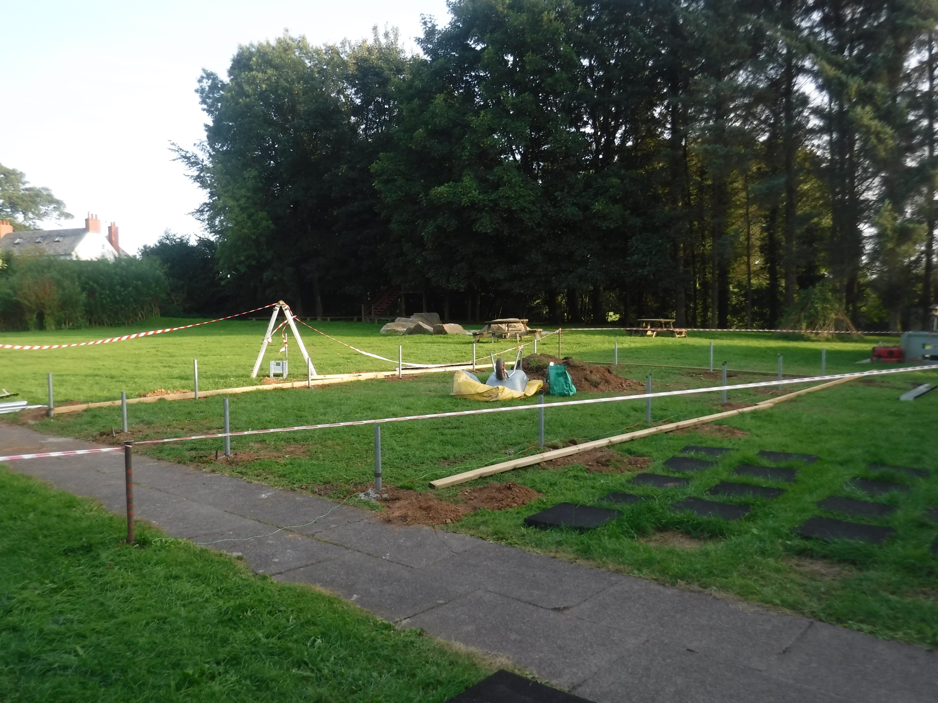

Slide 24
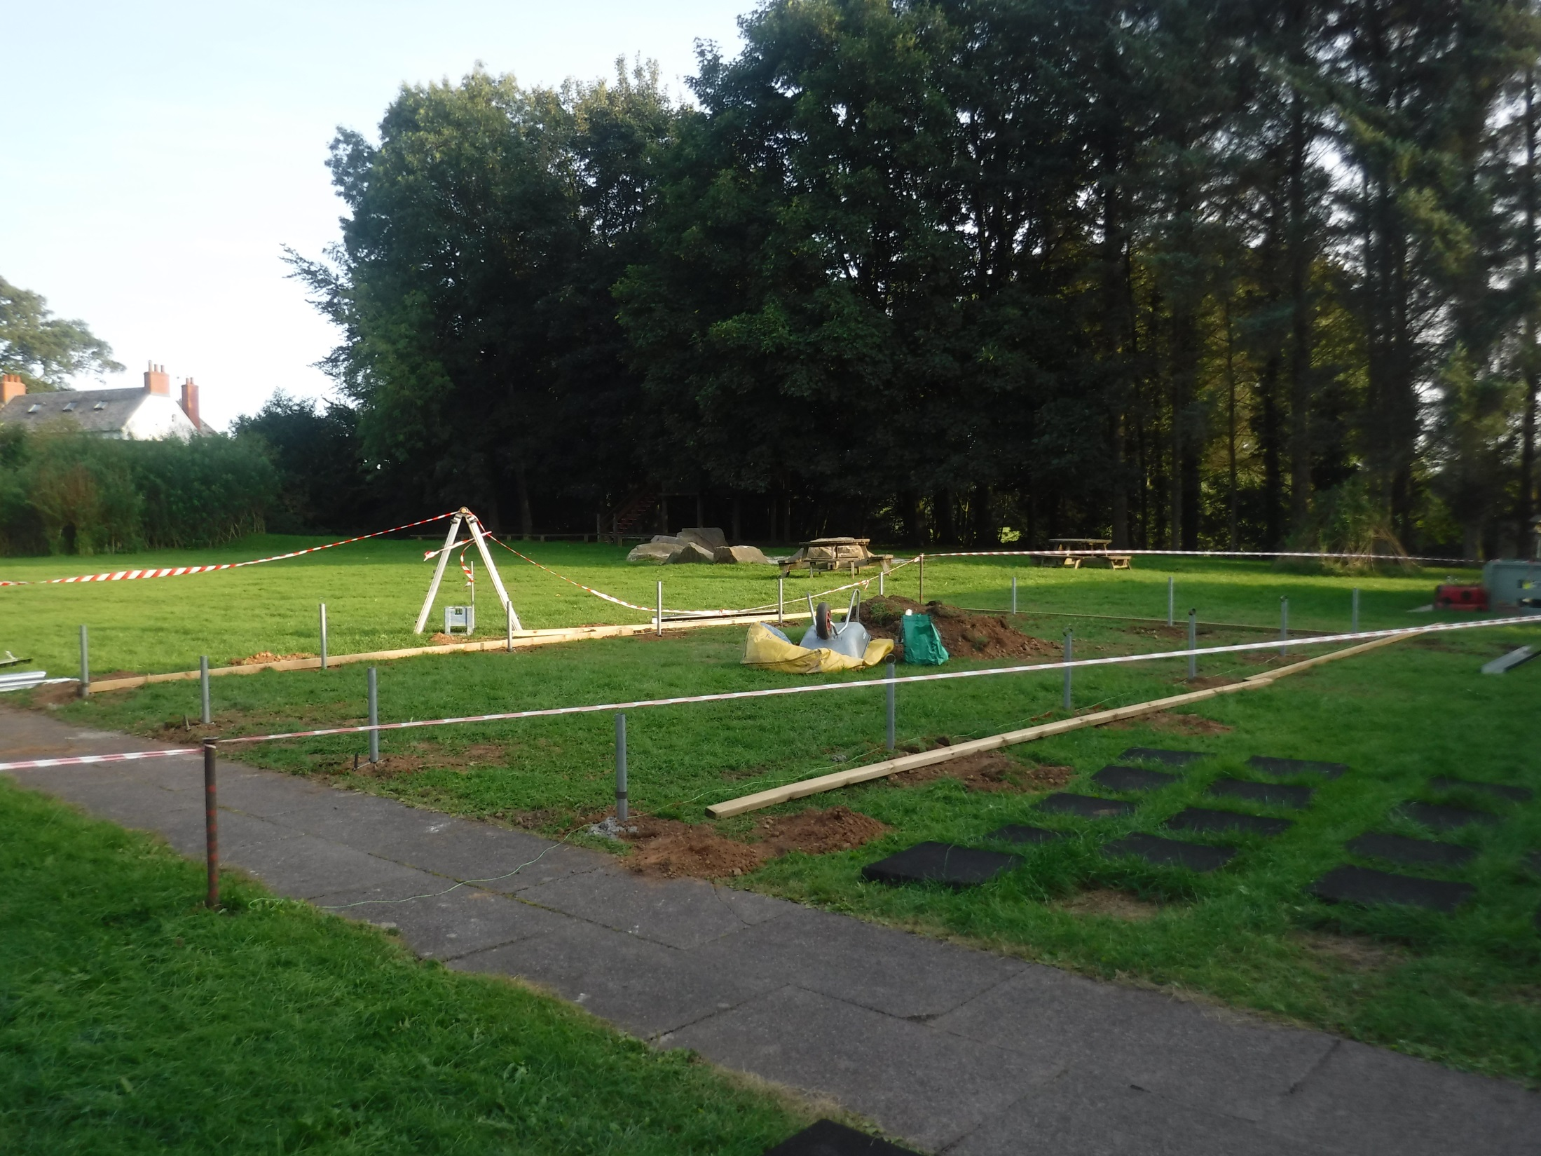

Slide 25
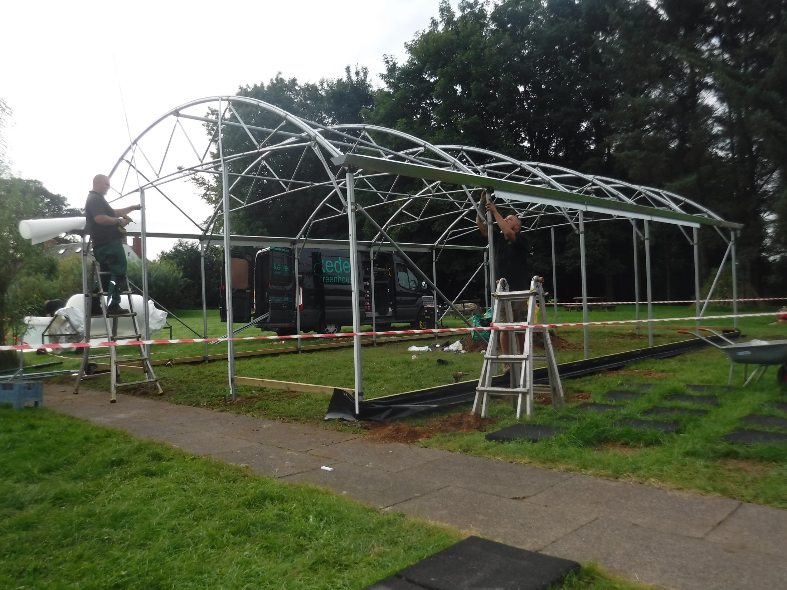

Slide 37
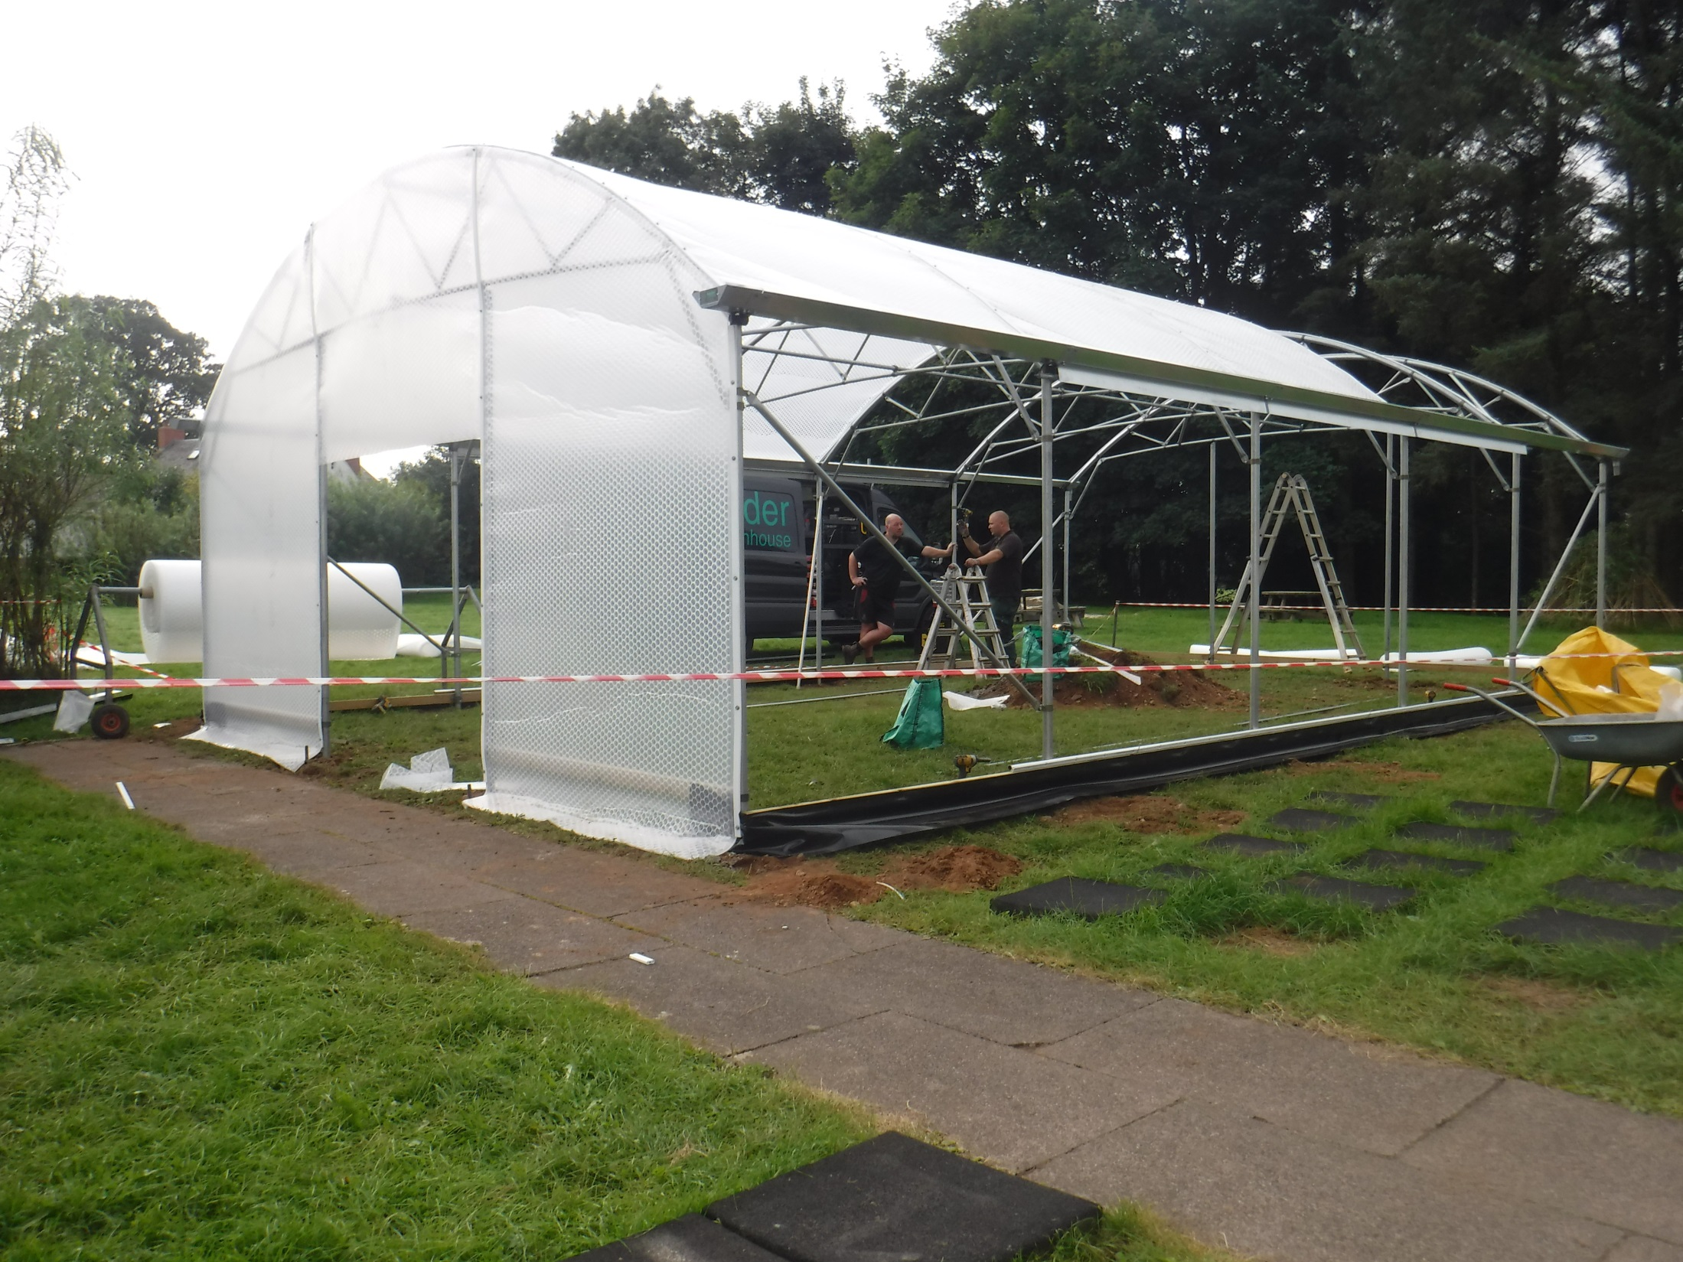

Slide 47
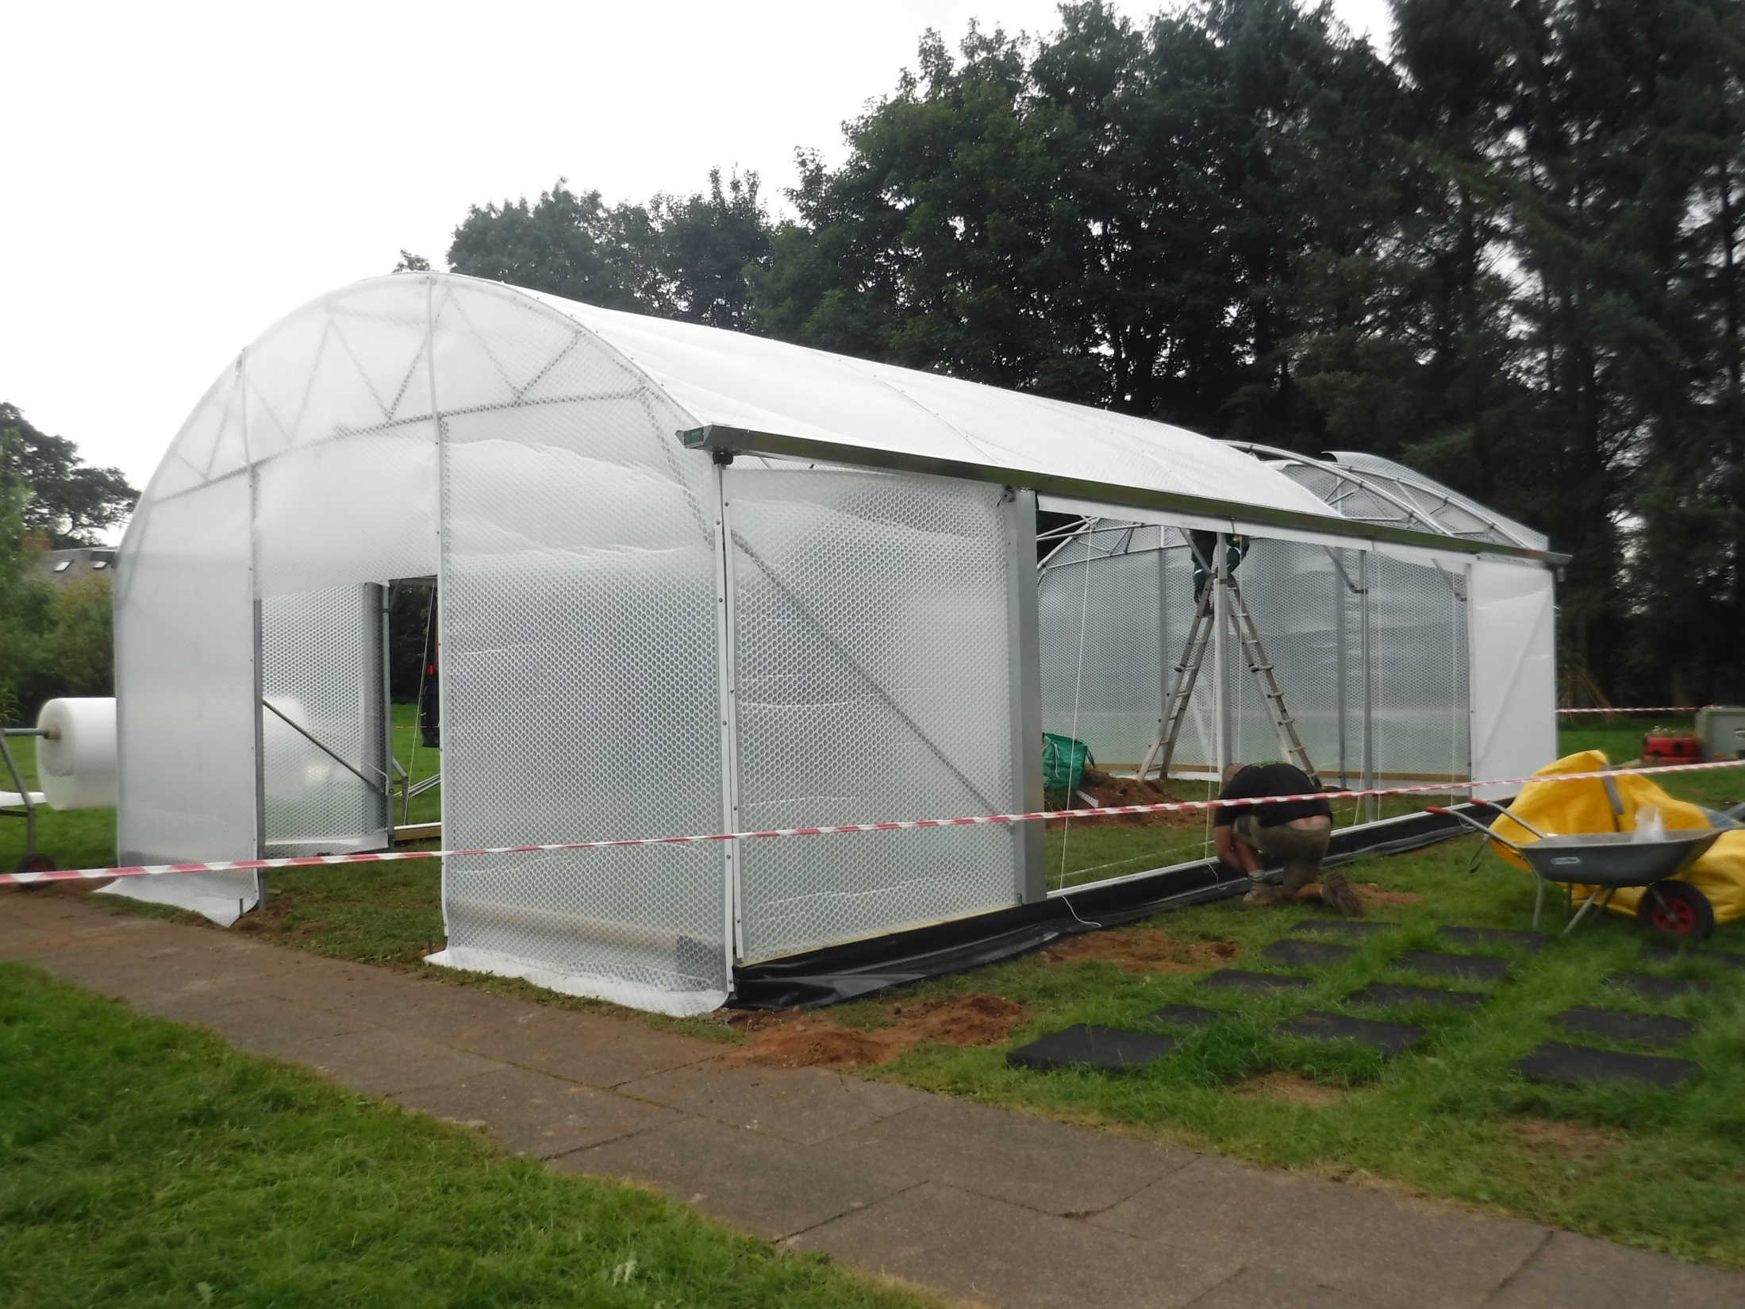

Slide 57
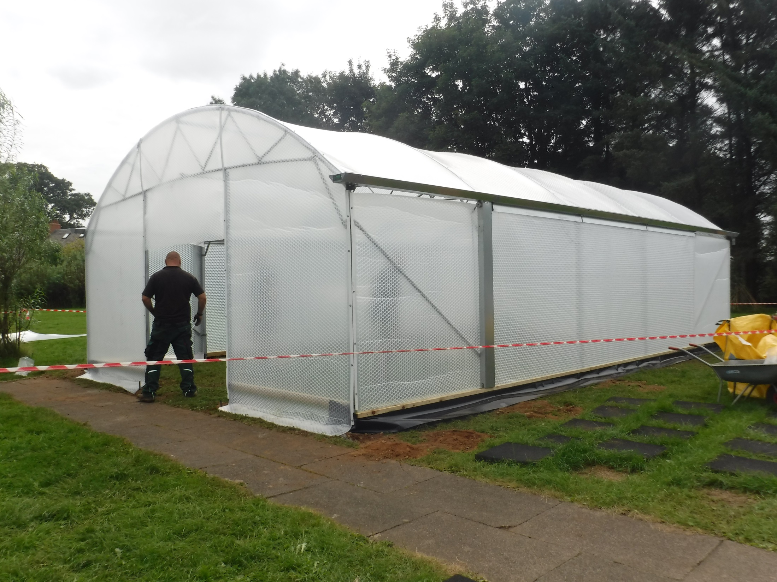

Slide 63
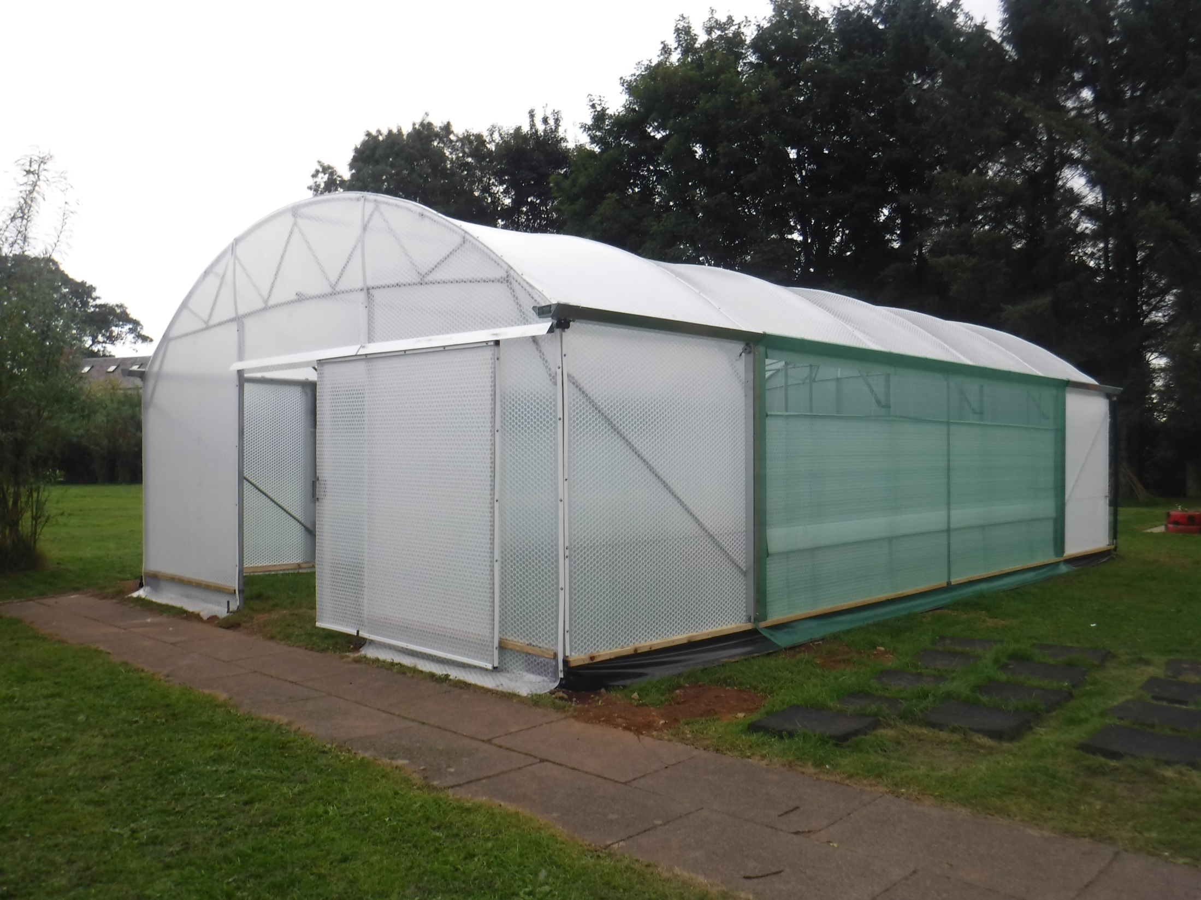

Slide 70
