Slide 1
flood
By bailey olivia molly james

Slide 2
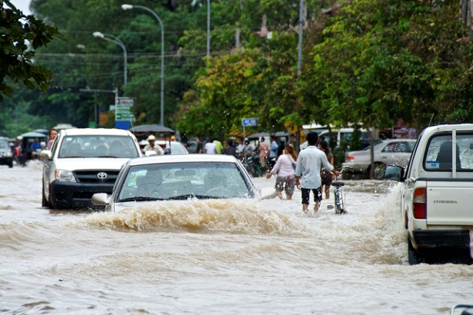
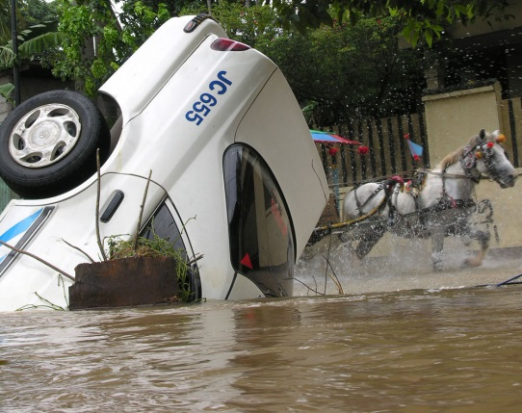
What is it.
When river get high and coved the land.

Slide 3
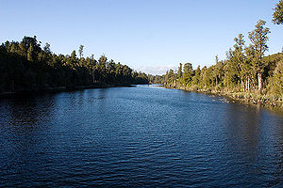
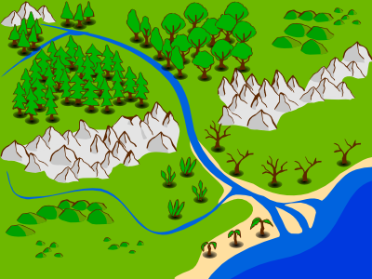
What made it?
A flood is when a lot of hevy rain fils up the river high .

Slide 4
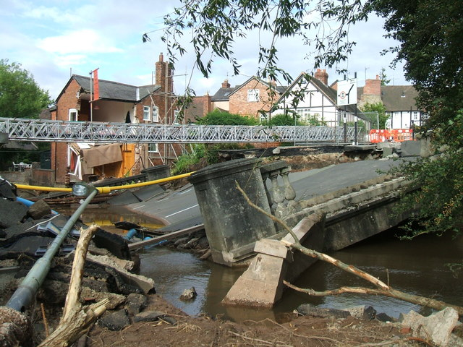
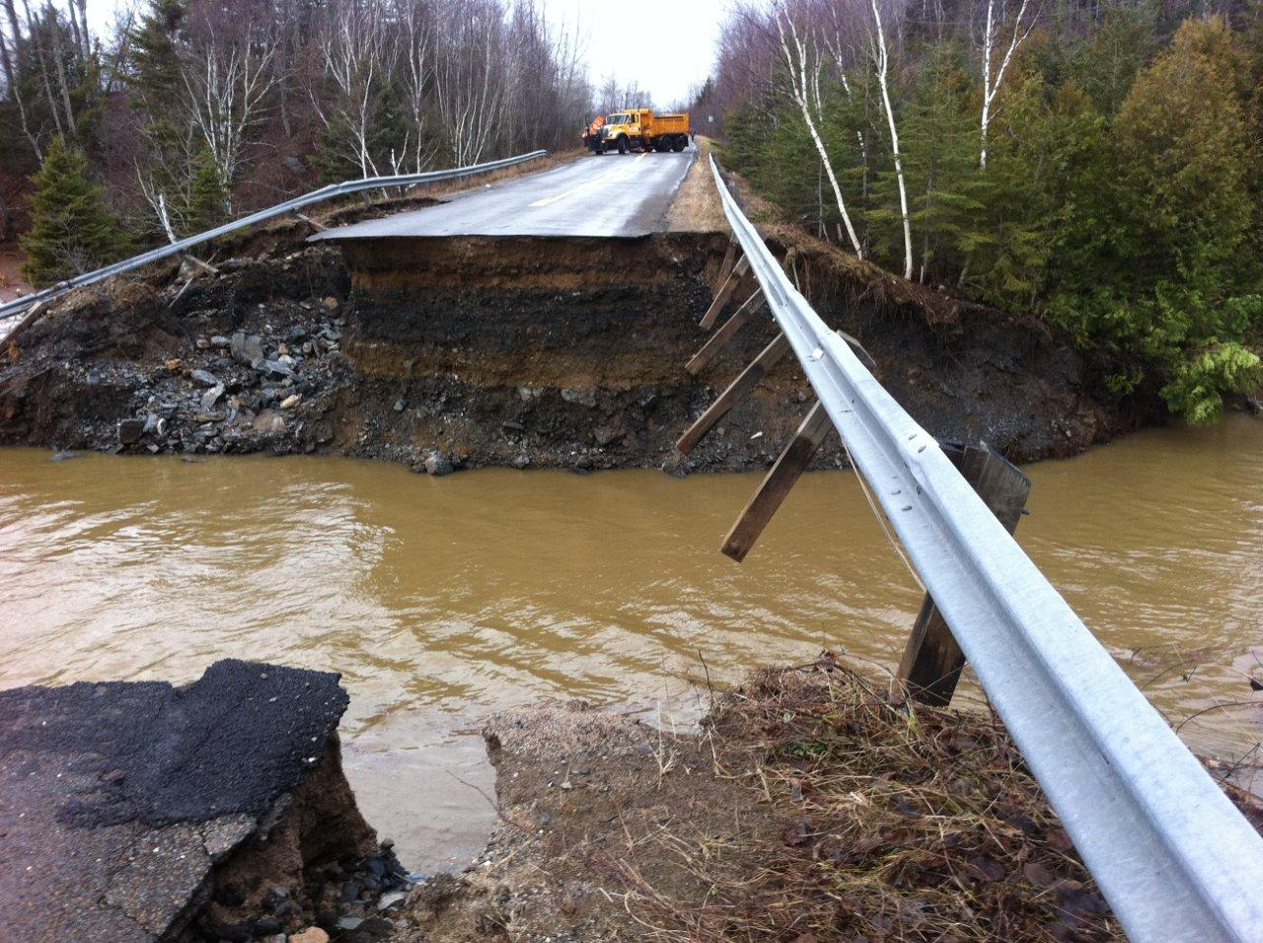
What damage can it do?
It can rip your roof of.
It can brake aleltrcs.

Slide 5
WHAT CAN WE DO?
Evacuate.
Move furniture upstairs.
Build a dam.
Block your door with sand bags.

